Slide 1

Measuring Inter-Brain Synchrony:
Methods and Pitfalls
Marten de Vries
Supervisors:
Dr. Marieke van Vugt
Lionel Newman MSc
Notes:
https://thenounproject.com
Include burgess ref

Slide 2
Today
?
What is inter-brain synchrony?
How do we record it?
How do we quantify it?
How can we use it in studies?

Slide 3
What is inter-brain synchrony?

Slide 4
Inter-Brain Synchrony (IBS)
Found during social interaction
(Konvalinka & Roepstorff, 2012)
Influenced by
  Gender (male IBS > female IBS; Cheng et al., 2015)
  Relationship duration (Dikker et al., 2021; Pan et al., 2017)
  Autism spectrum disorder (Salmi et al., 2013; Valencia & Froese, 2020)
Notes:
Add effect direction to make it less abstract (example!)

Slide 5
How do we record inter-brain synchrony?

Slide 6
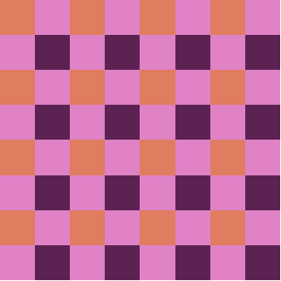
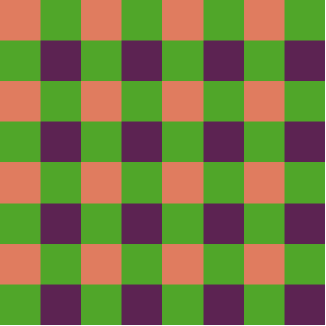
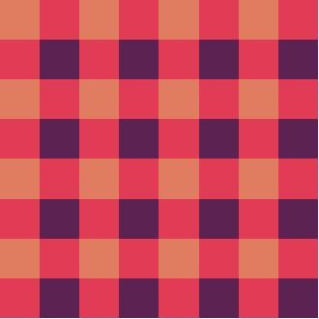
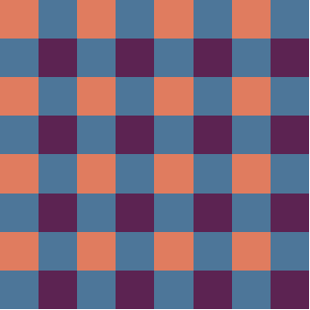
A Tacit Coordination Task
(Newman et al., 2021)
Notes:
Also add the second example

Slide 7
A Tacit Coordination Task
Incorrect
(Newman et al., 2021)
Notes:
Also add the second example

Slide 8
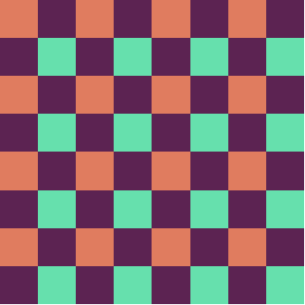
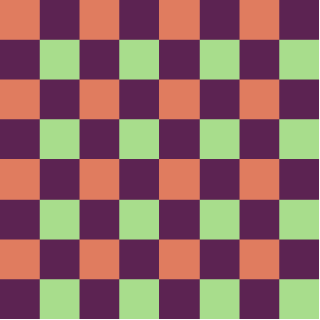
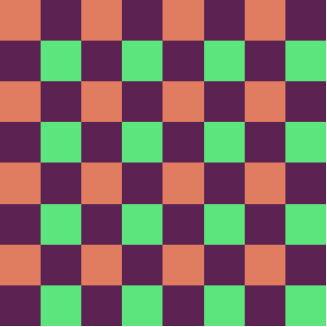
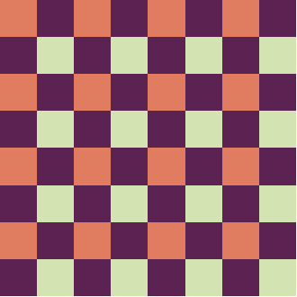
A Tacit Coordination Task
(Newman et al., 2021)
Notes:
Also add the second example

Slide 9
A Tacit Coordination Task
Correct
(Newman et al., 2021)
Notes:
Also add the second example

Slide 10

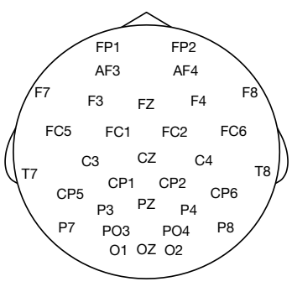
Hyperscanning

Slide 11
How do we quantify inter-brain synchrony?

Slide 12
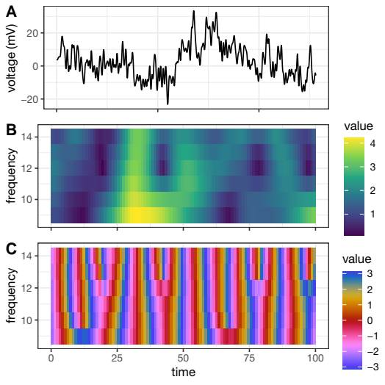
Time-Frequency analysis
Two signals for each:
Electrode
Trial
Frequency band (here: alpha)
focus
Notes:
Wrong arrow

Slide 13
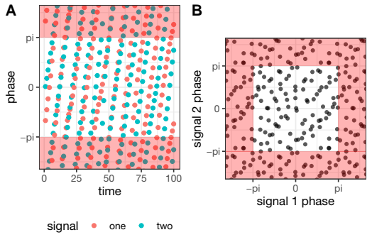
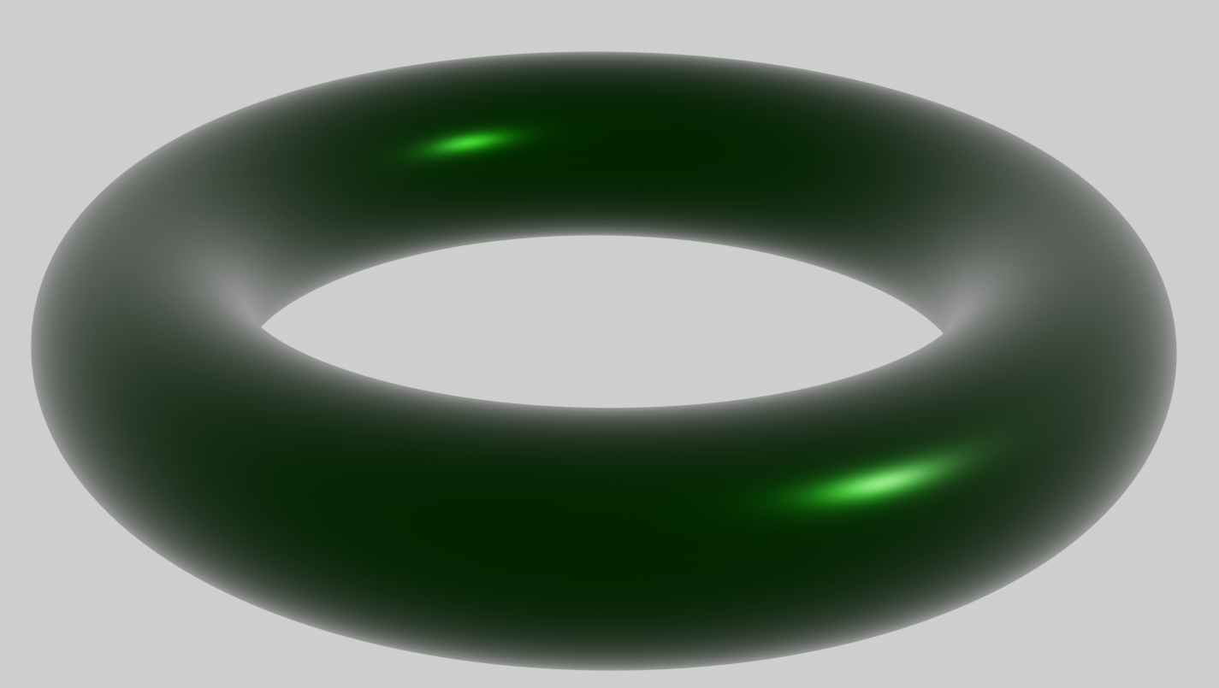
Inter-Brain Synchrony
Notes:
Show one at a time

Slide 14
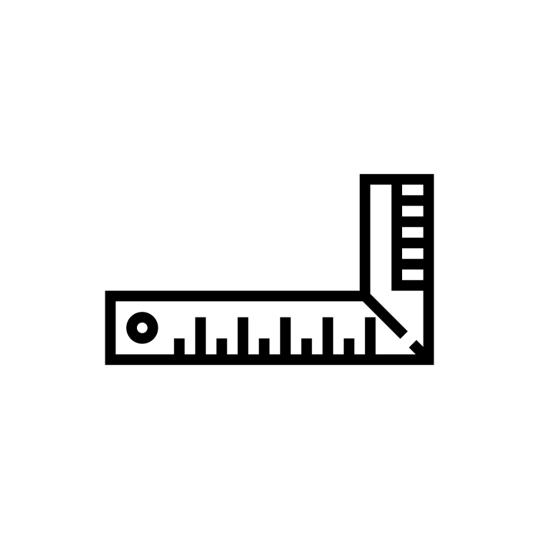
Inter-brain synchrony measures (1)
Circular correlation (Burgess, 2013)
Phase Locking Value (Lachaux et al., 1999)
Imaginary part of coherency (Nolte et al., 2004)

Slide 15
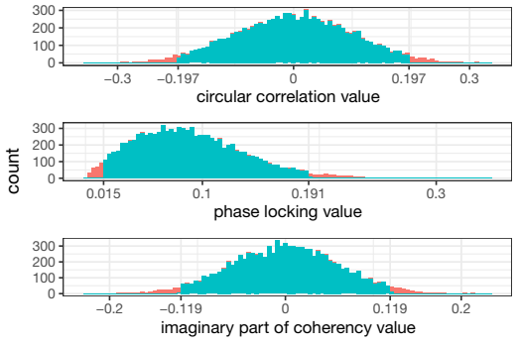
Measure values distributions for simulated (random) signals

Slide 16
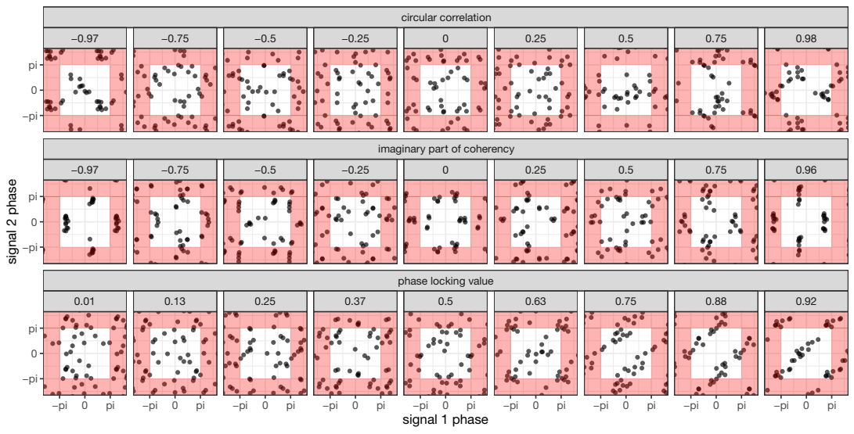
Inter-brain synchrony measures (2)
Notes:
Show one measure at a time
add much synch/no synch labels

Slide 17
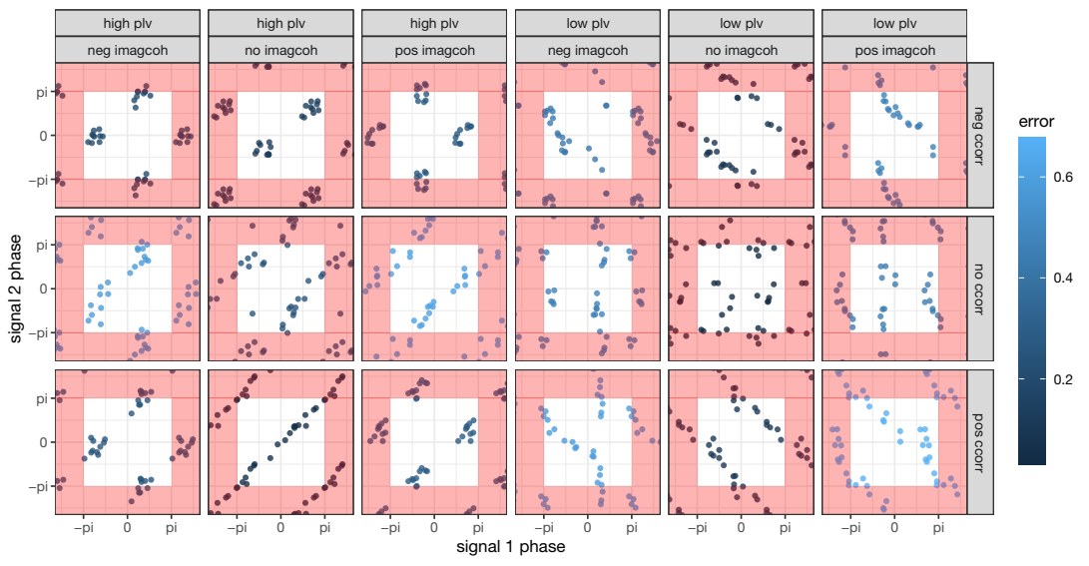
Inter-brain synchrony measures (3)
Notes:
Reveal in parts (low/high PLV?)
Maybe completely remove color. It’s a technicality, and the examples are good regardless.

Slide 18
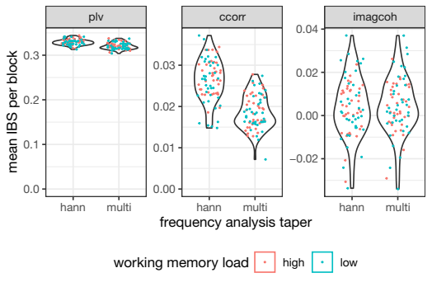
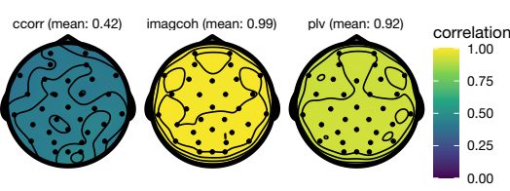

Slide 19
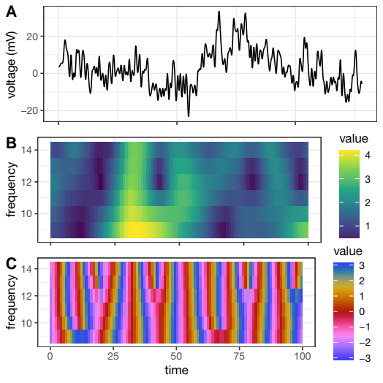
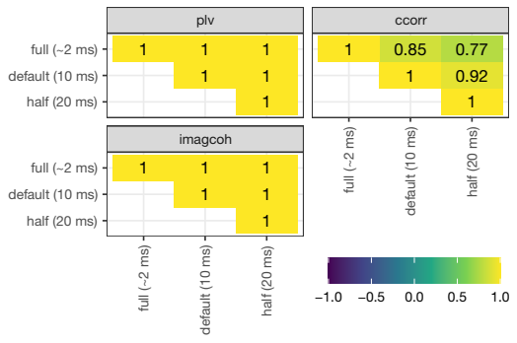
Frequency analysis resolution effect
512, 100, 50

Slide 20
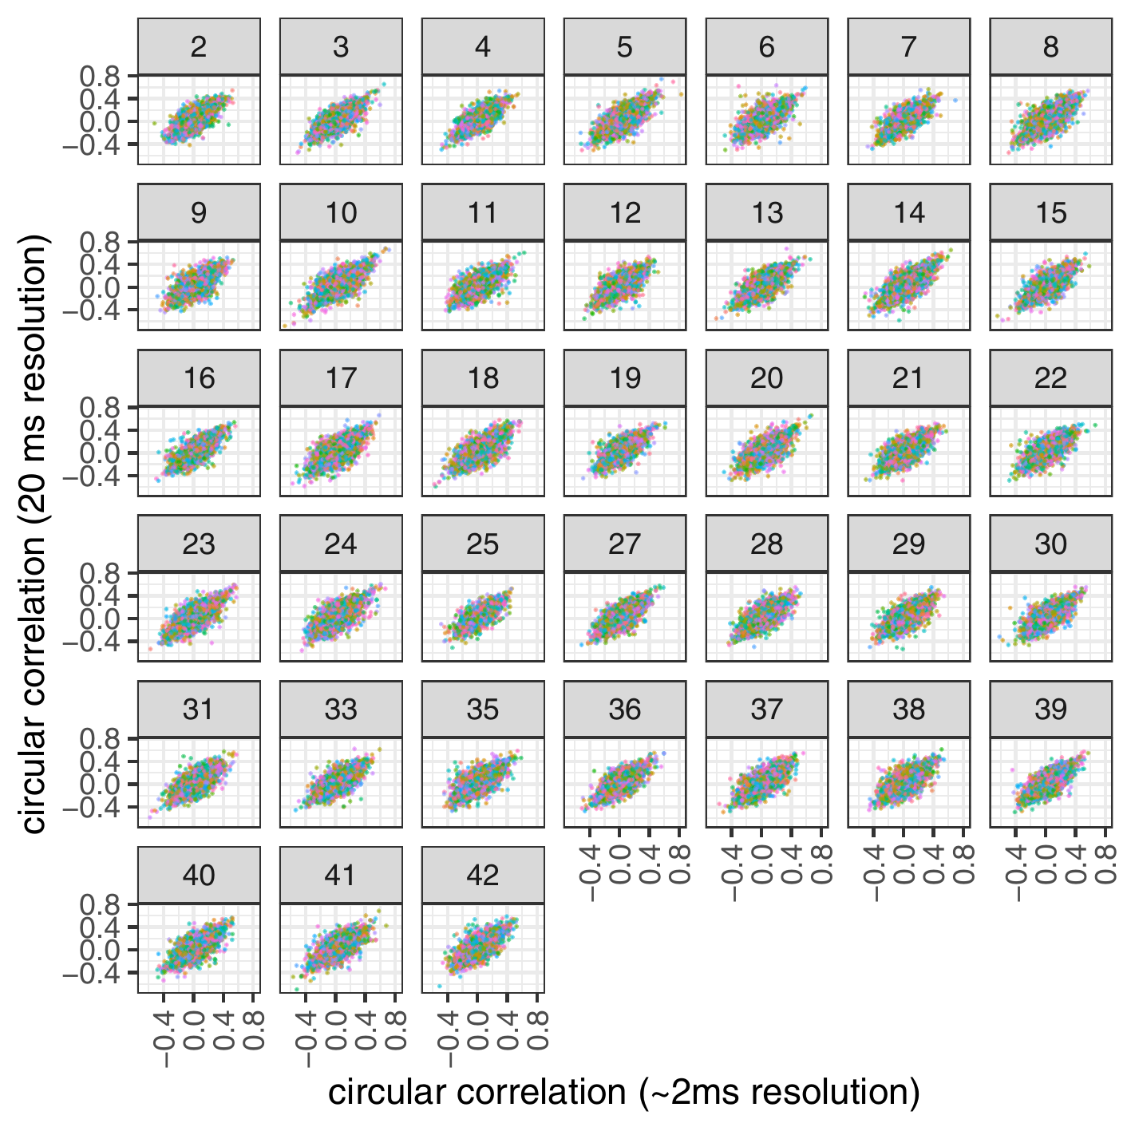
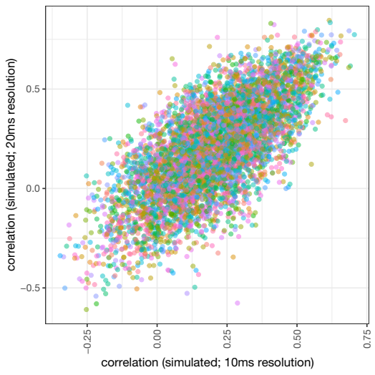
Frequency analysis: effect of resolution

Slide 21
How do we use inter-brain
synchrony in studies?

Slide 22
Is the inter-brain synchrony significant?
No.

Slide 23
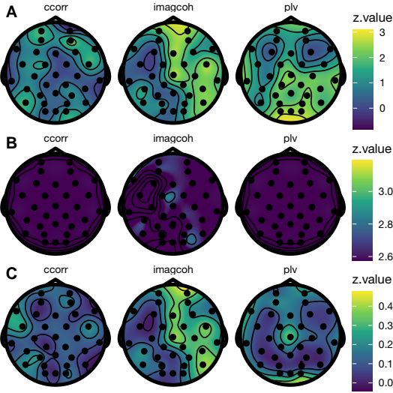
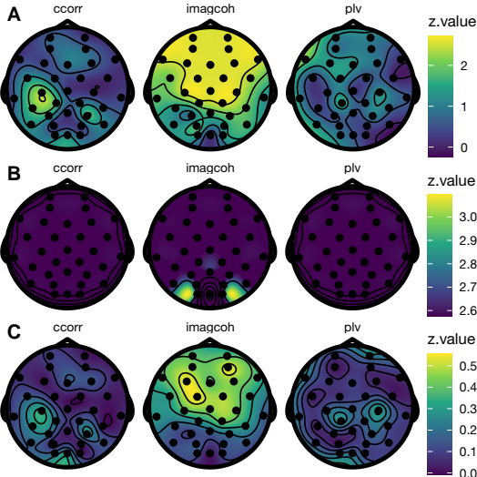
Alpha band
Theta band
Time shuffled
Groups shuffled
Notes:
Remove middle plot altogether, reveal in parts.

Slide 24
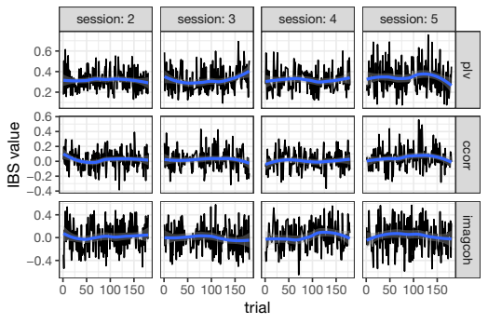
No effect of time*

Slide 25
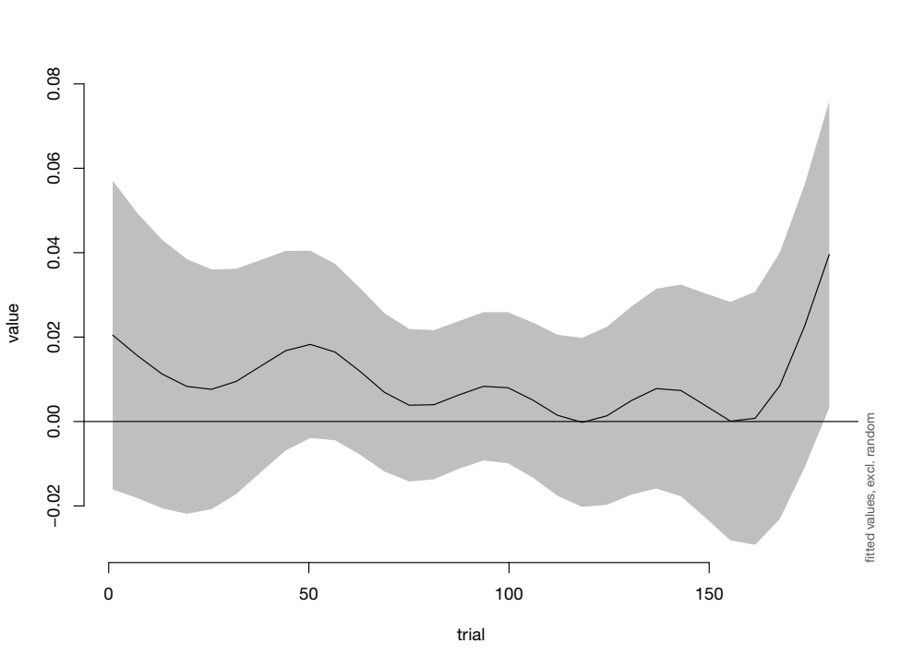
*Except maybe for ImagCoh

Slide 26
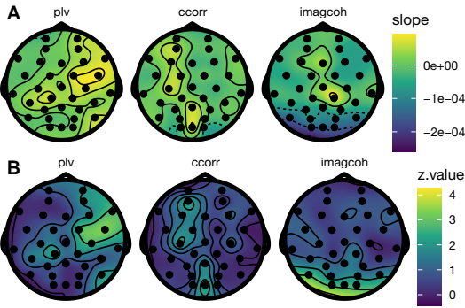
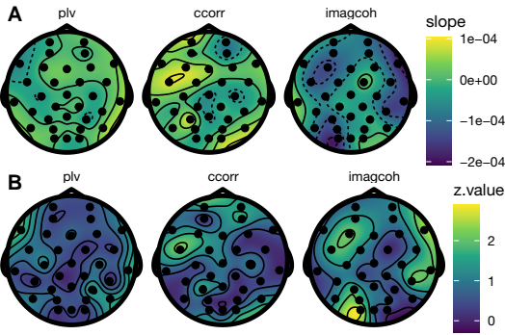
Slopes
alpha
theta

Slide 27
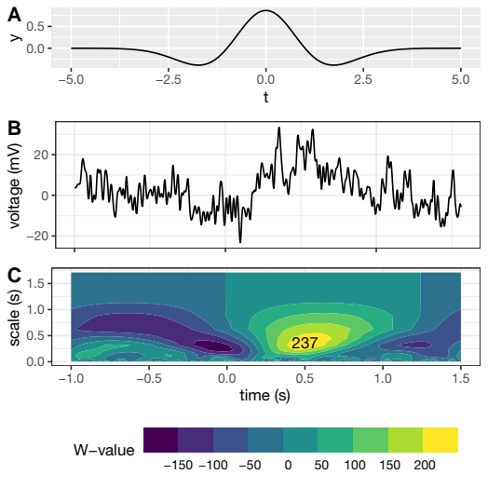
Prediction
P3 ERP component
Single-trial ERP

Slide 28
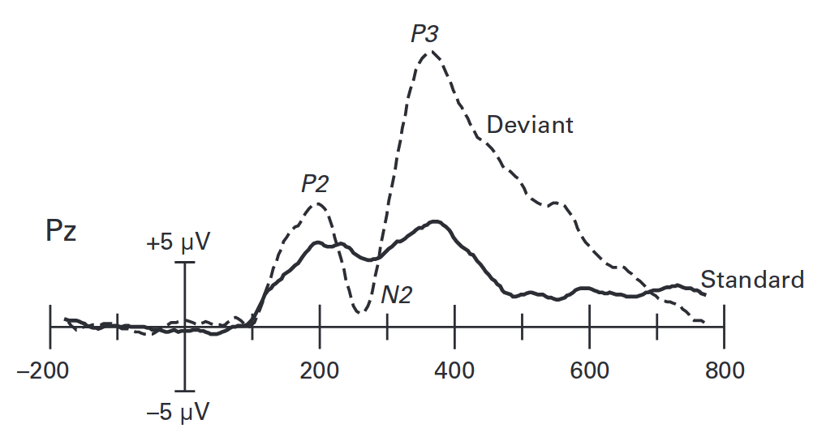
Prediction (1)
P3 Event-Related Potential
Source: Luck, 2014, p.79

Slide 29
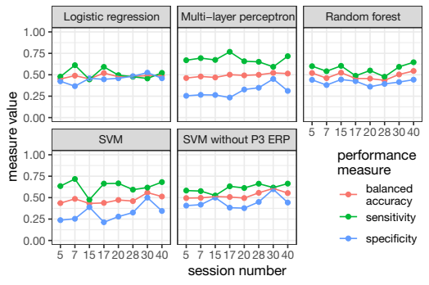
Prediction (2)
Look at
the red
line!
Notes:
Remove sensitivity/specificity

Slide 30
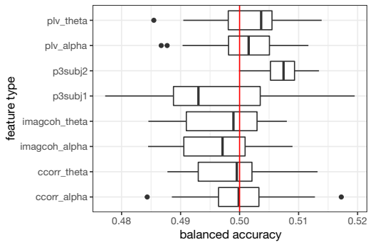
Most influential features

Slide 31
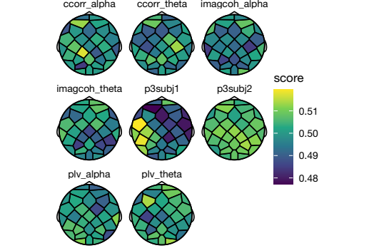
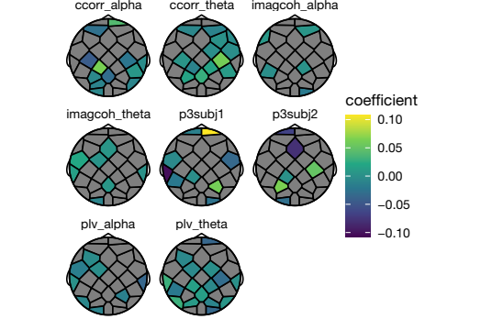
L1 logistic
Indiv. svms

Slide 32
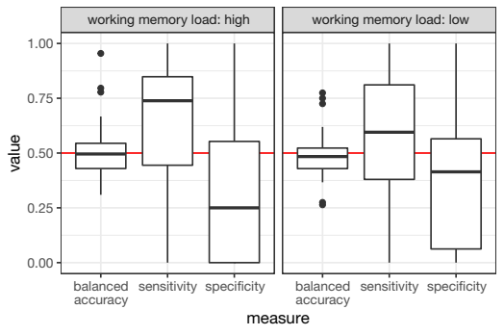
Prediction within sessions

Slide 33
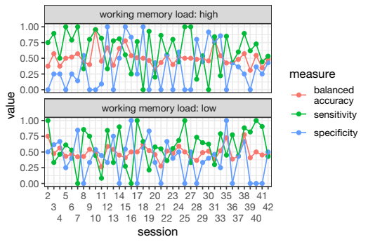

Slide 34
Discussion (1)
Recommended measures:
Circular correlation
  Performs well in simulations (Burgess, 2013)
  But: requires careful interpretation
Phase locking value
  Popular
  Mostly works
Notes:
Split up slide, add the ‘why’ for recommended measures

Slide 35
Discussion (2)
No IBS found
Interpreting Inter-Brain Synchrony values in isolation is risky
Causal mechanism behind prediction
Notes:
Split up slide, add the ‘why’ for recommended measures

Slide 36
Future Research
Amplitude-based measures
  Projected power correlation (Hipp et al., 2012)
Information-based measures
  Kraskov mutual information (Kraskov, 2004)
Standardization of IBS experiments
(Burgess, 2013; Ayrolles et al., 2021)
Notes:
Practise this slide.

Slide 37
References
Ayrolles, A., Brun, F., Chen, P., Djalovski, A., Beauxis, Y., Delorme, R., Bourgeron, T., Dikker, S., & Dumas, G. (2021). HyPyP: A Hyperscanning Python Pipeline for inter-brain connectivity analysis. Social Cognitive and Affective Neuroscience, 16(1–2), 72–83.
Burgess, A. P. (2013). On the interpretation of synchronization in EEG hyperscanning studies: A cautionary note. Frontiers in Human Neuroscience, 7.
Cheng, X., Li, X., & Hu, Y. (2015). Synchronous brain activity during cooperative exchange depends on gender of partner: A fNIRS-based hyperscanning study: Synchronous Brain Activities. Human Brain Mapping, 36(6), 2039–2048.
Dikker, S., Michalareas, G., Oostrik, M., Serafimaki, A., Kahraman, H. M., Struiksma, M. E., & Poeppel, D. (2021). Crowdsourcing neuroscience: Inter-brain coupling during face-to-face interactions outside the laboratory. NeuroImage, 227, 117436.
Hipp, J. F., Hawellek, D. J., Corbetta, M., Siegel, M., & Engel, A. K. (2012). Large-scale cortical correlation structure of spontaneous oscillatory activity. Nature Neuroscience, 15(6), 884–890.
Konvalinka, I., & Roepstorff, A. (2012). The two-brain approach: How can mutually interacting brains teach us something about social interaction? Frontiers in Human Neuroscience, 6.
Kraskov, A., Stögbauer, H., & Grassberger, P. (2004). Estimating mutual information. Physical Review E, 69(6), 066138.
Lachaux, J.-P., Rodriguez, E., Martinerie, J., & Varela, F. J. (1999). Measuring phase synchrony in brain signals. Human Brain Mapping, 8(4), 194–208.
Luck, S. J. (2014). An introduction to the event-related potential technique (Second edition). The MIT Press.
Newman, L. A., Cao, M., Täuber, S., & van Vugt, M. (2021, januari). Effects of working memory load on tacit coordination [Poster].
Nolte, G., Bai, O., Wheaton, L., Mari, Z., Vorbach, S., & Hallett, M. (2004). Identifying true brain interaction from EEG data using the imaginary part of coherency. Clinical Neurophysiology, 115(10), 2292–2307.
Pan, Y., Cheng, X., Zhang, Z., Li, X., & Hu, Y. (2017). Cooperation in lovers: An fNIRS-based hyperscanning study: Cooperation in Lovers. Human Brain Mapping, 38(2), 831–841.
Salmi, J., Roine, U., Glerean, E., Lahnakoski, J., Nieminen-von Wendt, T., Tani, P., Leppämäki, S., Nummenmaa, L., Jääskeläinen, I. P., Carlson, S., Rintahaka, P., & Sams, M. (2013). The brains of high functioning autistic individuals do not synchronize with those of others. NeuroImage: Clinical, 3, 489–497.
Valencia, A. L., & Froese, T. (2020). What binds us? Inter-brain neural synchronization and its implications for theories of human consciousness. Neuroscience of Consciousness, 2020(1), niaa010.

Slide 38
Image sources
https://thenounproject.com/icon/brain-206190/
https://thenounproject.com/icon/keyboard-3204178/
https://thenounproject.com/icon/measure-2279416/

Slide 39
Thank you for your attention!

Slide 40
?
Questions?

