Slide 1
Prototype
Session 2
Compute PLV & Ccorr between Participants for A1 electrodes (Fp1)
Using Fourier output directly

Slide 2
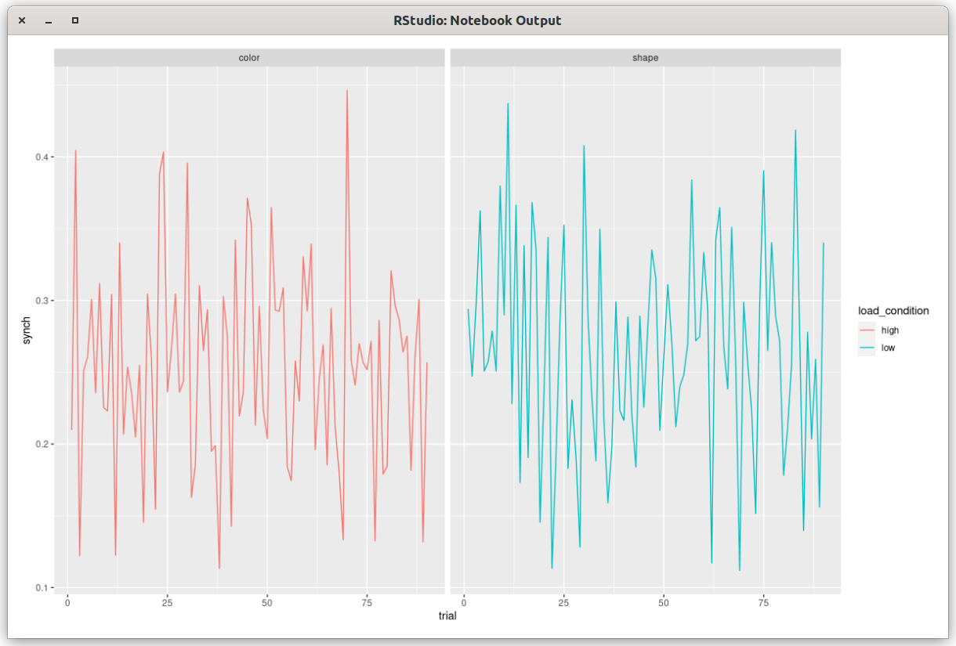
Lionel’s PLV

Slide 3
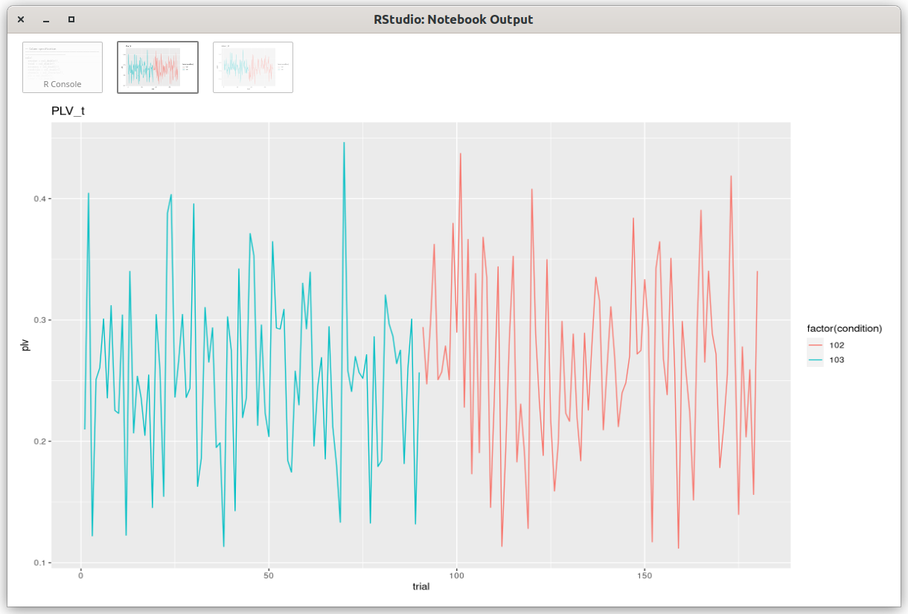

Slide 4
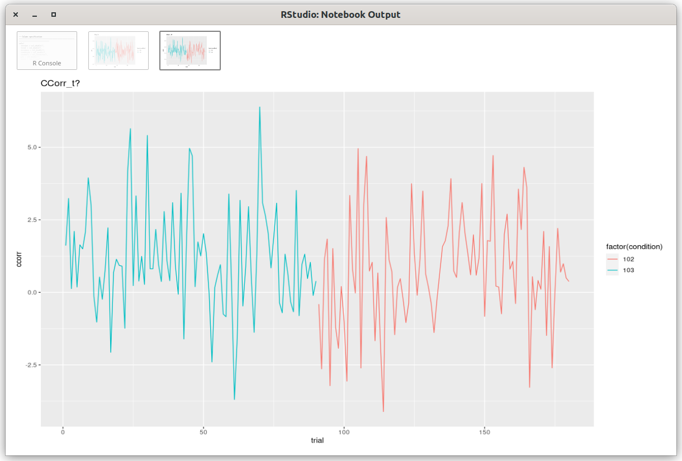

Slide 5
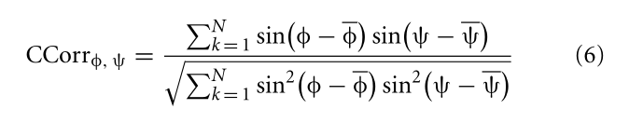
Problems:
Average over frequency?
Scale of circular correlation: between 0 and 1?

