Slide 1
Circular correlation
Plan: try robust circular correlation (Mahmood, 2022)
Uses trimmed circular mean internally
Combats outliers (in Mahmood’s simulations)

Slide 2
Kraskov mutual information
Implementation found
Chebyshev distance vs. Angular distance(?)
Validation?

Slide 3
Prediction: goal
Goal: predict correctness (= y) of a trial
  Data: IBS values (PLV, ccorr, imagcoh, KMI?)
    Extension: with P300 values (for all electrodes? Or only posterior? Use mean value for a range?)
  Classifiers are session-specific
    Also color/shape-specific?
    Average classification performance over sessions?

Slide 4
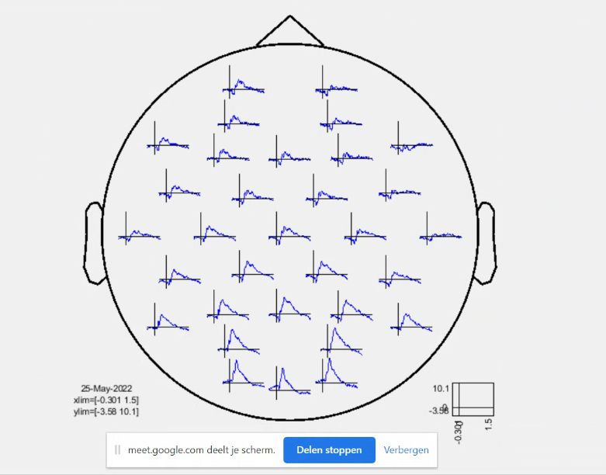
Reminder: ERPs

Slide 5
Prediction: validity
Assuming 90 data points:
  Keep 20% (18) for final validation (‘lock box’)
  80% (72) for cross-validation & final models training
    Train/test split during cross validation ~80%/20% = 58/14
  How to split?
    Randomly (problem: likely correlation over time)
    Fixed blocks (problem: begin & end of a session are not equal)

Slide 6
Classifiers
Baseline: (regularized) logistic regression
SVM (regularizing (C)? kernel? How creative?)
Random forest (max features parameter)
Tools: currently planning to use Python/scikit-learn

