Slide 1
Prediction
e.g. plv_alpha & plv_theta, avg over channels
P3 single trial: max(Pz data between 0.25-0.6s)
  If time: Cross-variance w/ mexican hat
Random oversampling
Group k-fold cross validation (grid search)

Slide 2
Prediction (2)
Logistic regression preliminary results: chance level
SVM also implemented but currently too slow

Slide 3
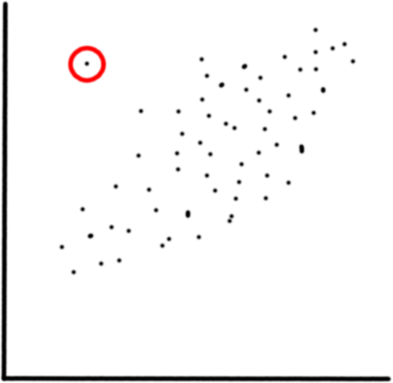
Circular correlation (again)
Mahmood (2022)’s robust trimmed CCorr definition
Univariate outlier detection
described
Implementation doable using
Pewsey et al. (2013)
But: bivariate required
(Shevlyakov & Smirnov, 2010;
Maronna, 2019)

Slide 4
Kraskov mutual information
Only use in EEG next to Burgess (2013):
Quiroga, Kraskov, Kreuz & Grassberger (2002) (and differently?)
So hard to verify implementation.
Still worth trying?
Some other mutual information definitions are in use
(Cha & Lee, 2019; Chen, 2019 (master thesis))

