Slide 1
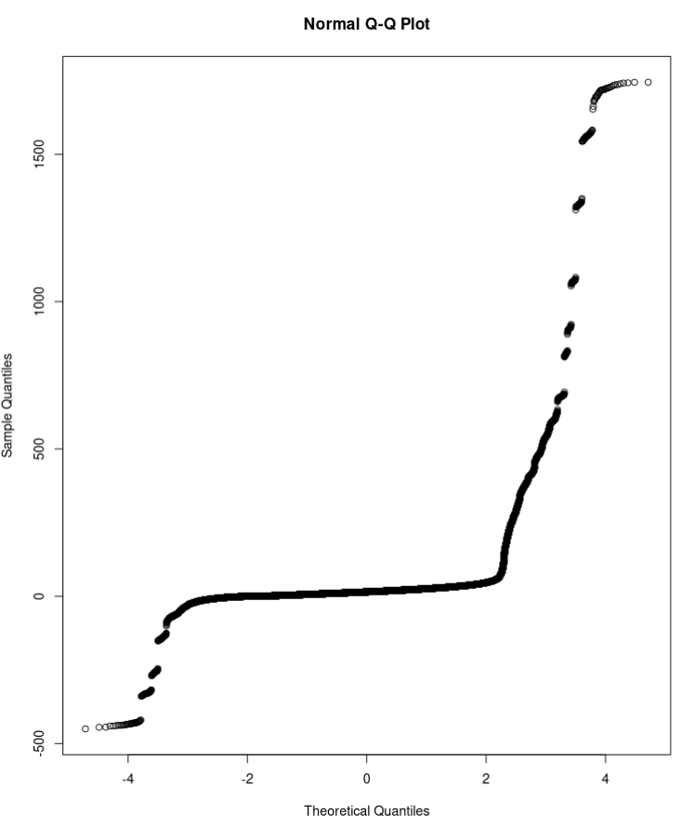
Features (1)
192 features
(32 electrodes x
3 measures x
2 bands)
Fisher transform/qnorm + scale
Currently, no single-trial ERP-like feature
  Because distribution ->

Slide 2
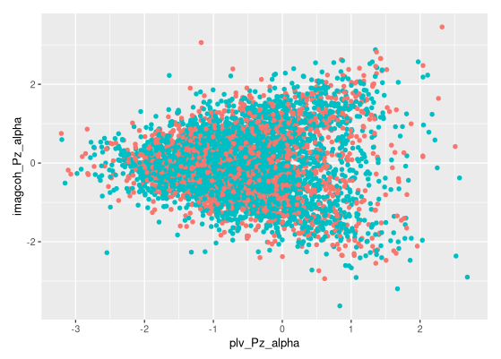
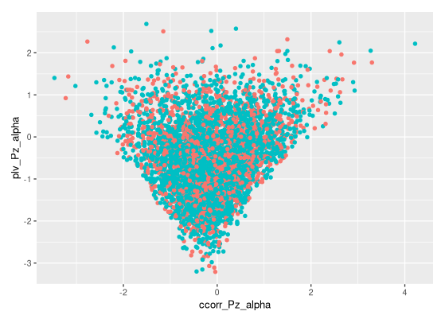
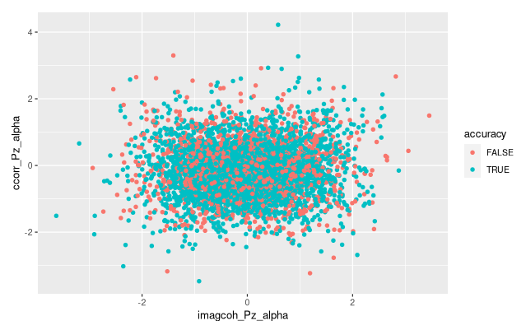
Features (2)
Correlation between
features

Slide 3
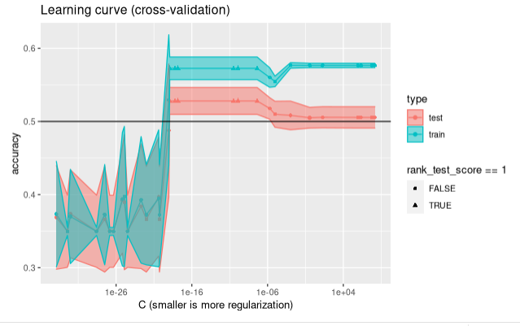
Logistic regression (max: 53%)

Slide 4
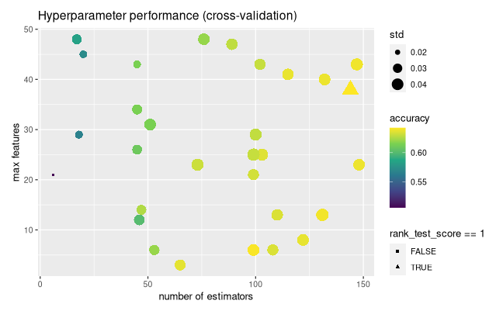
Random forest (max: 64%)

Slide 5
Conclusion
Better performance than expected (?!)
Next: reducing features
SVM convergence

Slide 6
Robust CCorr
WIP, small implementation issue (resolvable)

Slide 7
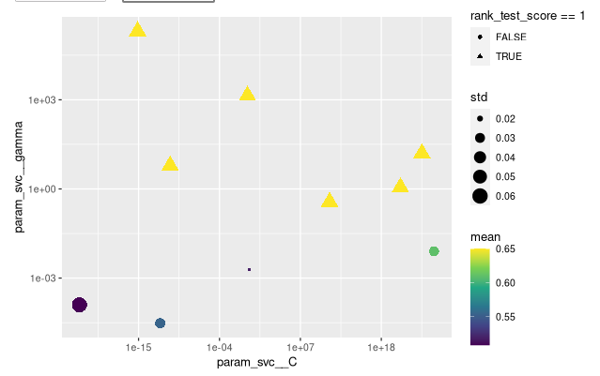
SVM (max: 65%)

