Slide 1
Wrapping up circular correlation

Slide 2
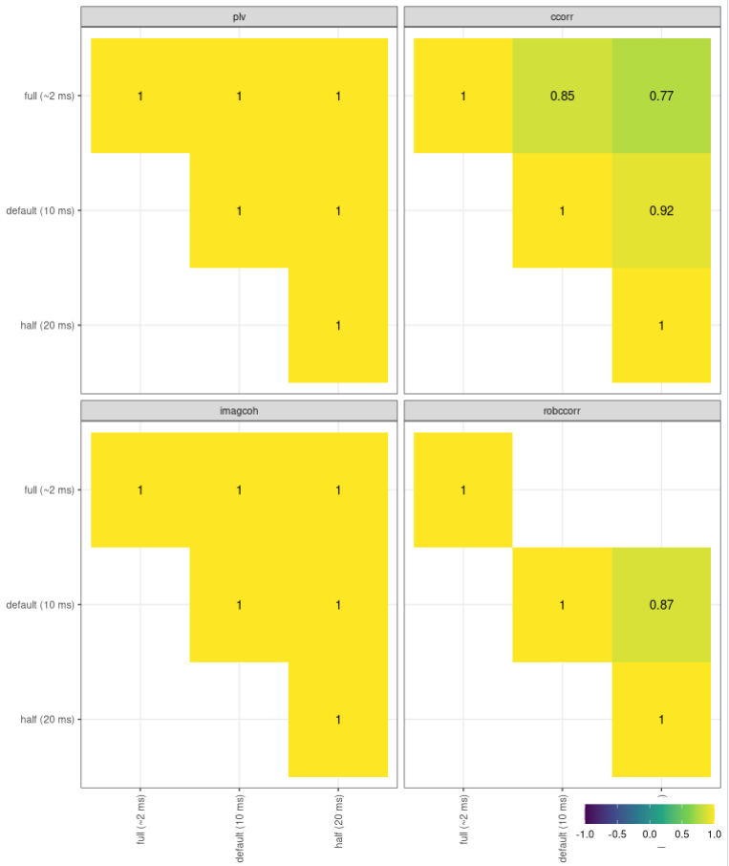
Robust circular correlation does not help

Slide 3
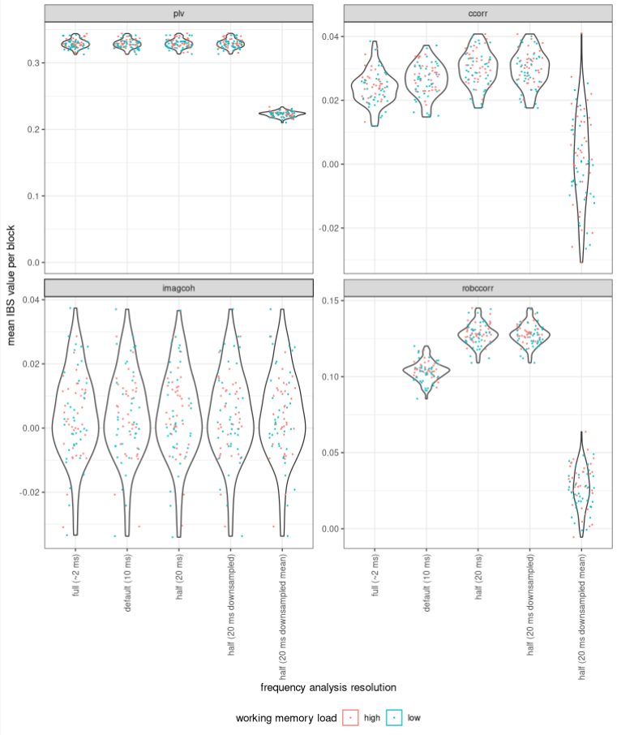
Other methods of downsampling?
Worse or the same

Slide 4
But: normal correlation has the same issue
(plot showing that on simulated
data to be re-created)
Conclusion regarding: circular correlation:
Careful interpretation, but OK to use.

Slide 5
Wrapping up prediction:
Last call before final evaluation

Slide 6
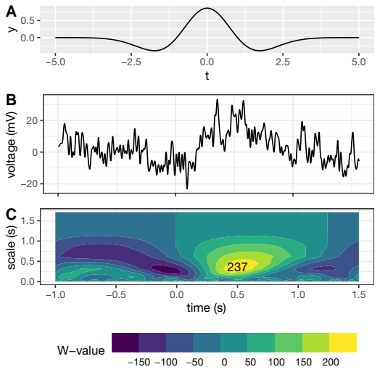
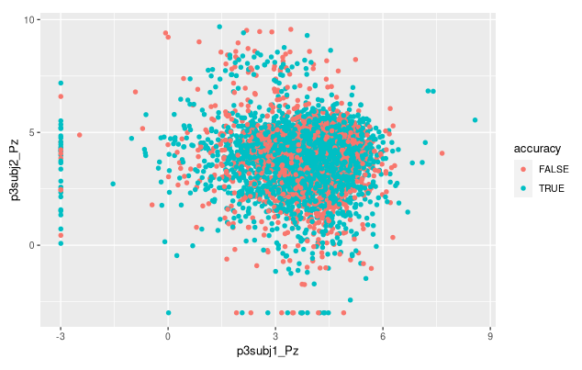
Single-trial ERP:
Continous wavelet
transform
Force value > 0.05
Logarithm

Slide 7
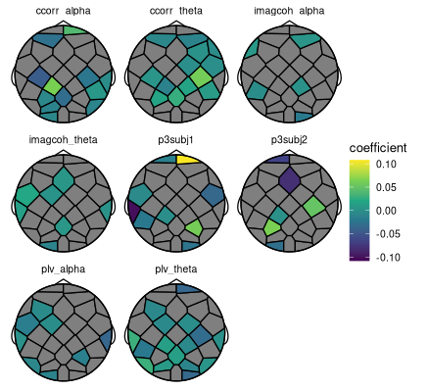
Logistic regression L1 norm
Side project (low accuracy)

Slide 8
SVM (1)
Same parameters used throughout (local maximum in parameter space/accuracy plot for all features)
Accuracy (cross validation): 65% w/ all 256 features

Slide 9
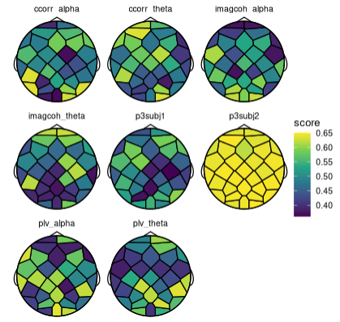
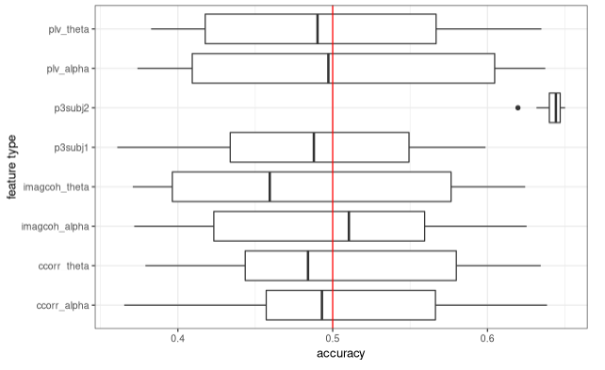
SVM (2): single feature classifiers
P3subj2 difference from P3subj1?

Slide 10
Other classifiers (cross-validation)
L1 Logistic regression
Full-blown SVM
Individual feature SVMs
SVM without P3: 64% accuracy (= -1 %)
Random forest: also ~65% accuracy
Multi-layer perceptron: ~56% accuracy
Which model for
final evaluation?

Slide 11
Next up
Writing
Model evaluation
Wrapping up other still-open questions

