Slide 1
Mistake

Slide 2
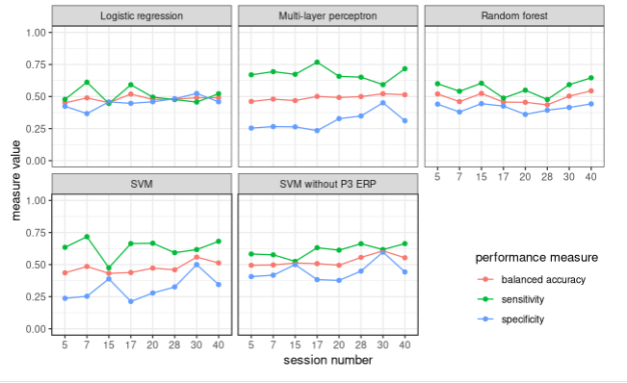

Slide 3
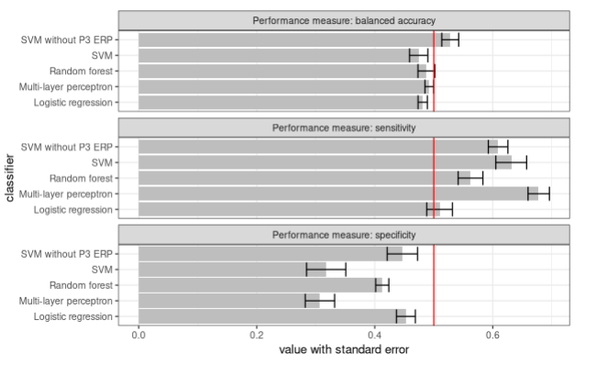

Slide 4
Within-session classification
Train on first 75%, predict last 25%.
PCA & SVM

Slide 5
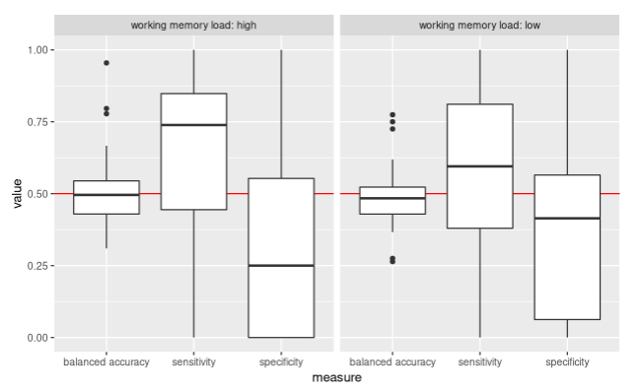

Slide 6
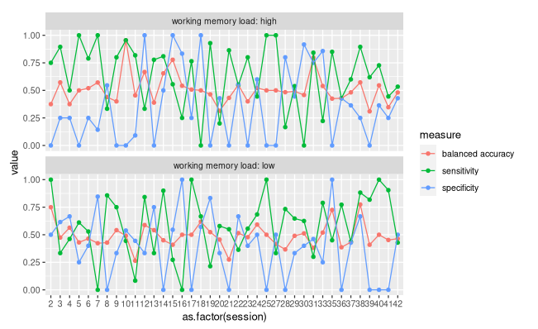

Slide 7
Work in progress:
Power Envelope Correlation (Orthogonalized)
Writing up circular correlation, prediction

Slide 8
Structure
Introduction
General methods
Varying frequency analysis methods
  Methods
  Results
  Discussion (ccorr!)
IBS time course inspection
  Methods
  Results
  Discussion
Permutation test analysis
  Methods
  Results
  Discussion
Prediction
  Methods
  Results
  Discussion
Simulation study?
  Methods
  Results
  Discussion
General discussion

