Slide 1
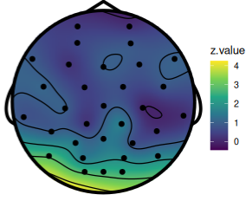
Significant slope?
Is this a misleading plot?
Prefer voronoi?

Slide 2
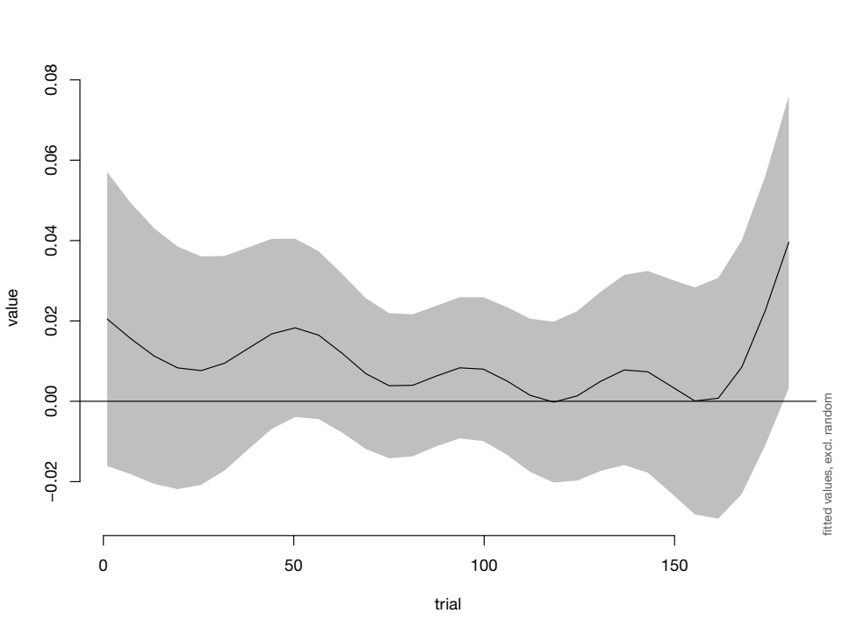
IBS over time
GAMM suggests
ImagCoh theta
band end
= significantly
different
Convincing?
χ²(2) = 5.805, p = 0.003

Slide 3
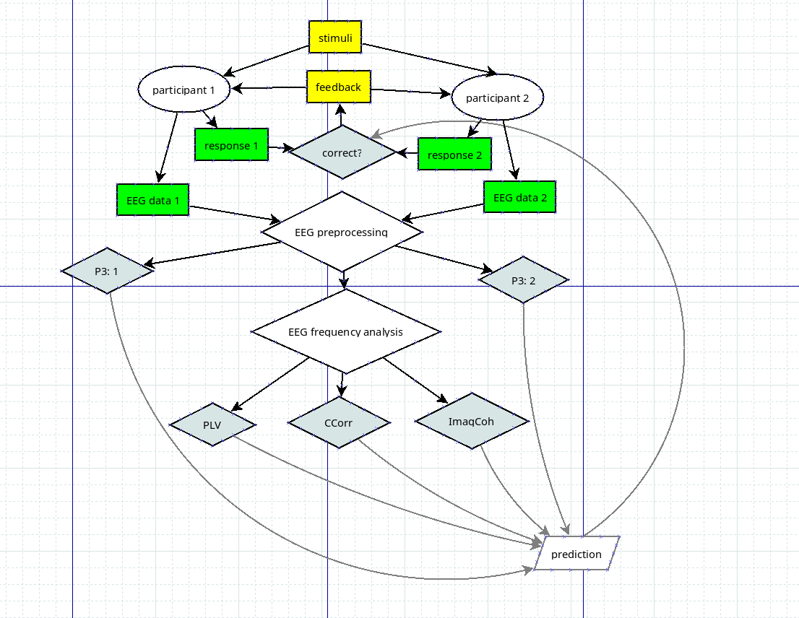
Mechanisms
for prediction
- P3: concept of
correctness (?)
- IBS: concept of
similar patterns

Slide 4
Planning
Feedback
  All at once, or
  Submit self-contained parts as ready?
    IBS time course
    Frequency analysis variation
    Prediction
    (Simulation? Permutation test?)

