Slide 1
Research proposal v2

Slide 2
EEG window of interest
Fixation: 1-3.5s
Stimulus presentation (1s, no response)
Response (duration up to participants)
Feedback: 3s
Currently: stimulus start – 1sec afterwards. 1Second (=0.5 sec margin)

Slide 3
Warning: output time-bins are different from input time-bins

Slide 4
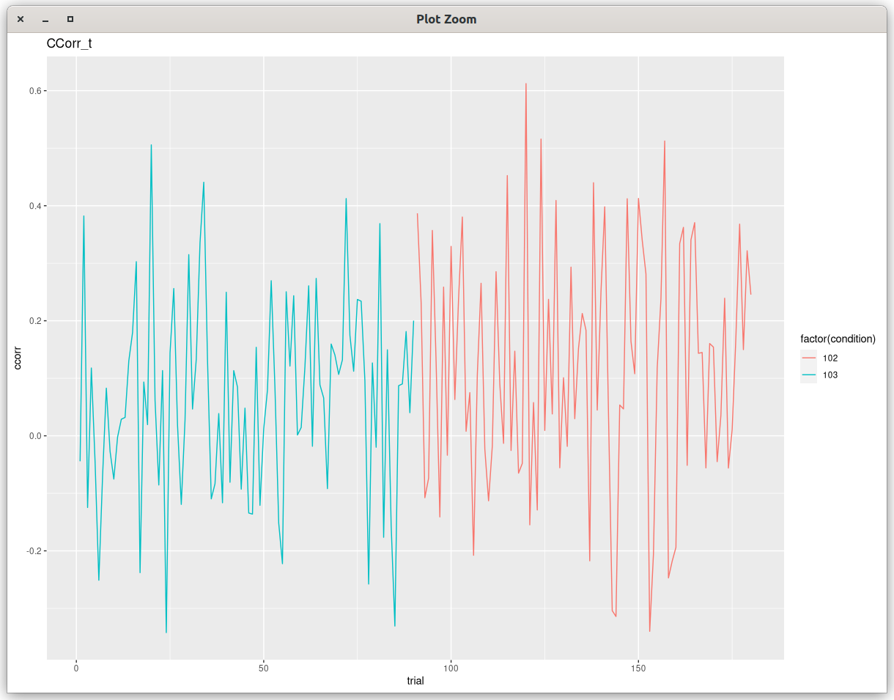
fixed circular correlation

Slide 5
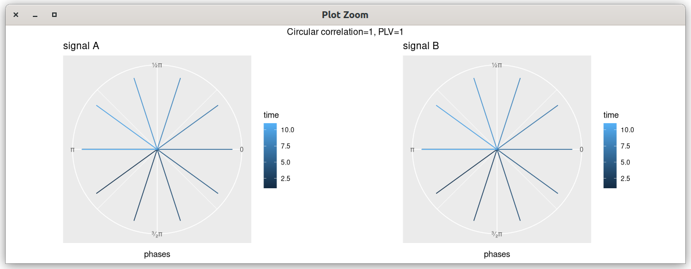
polar plot experiments (1)
A = B

Slide 6
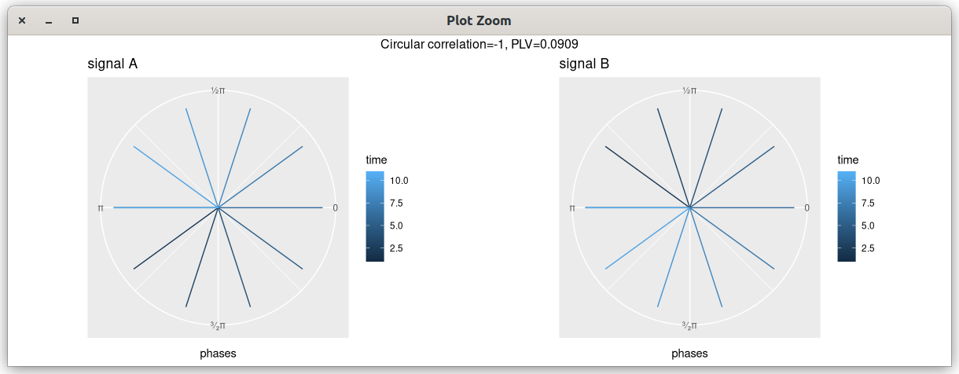
polar plot experiments (2)
A = -B

