Slide 1
Introduction: outline
Q: Put behavioural results under ‘Theoretical background’ or ‘Results’?

Slide 2
Session 43
EEG data was never pre-processed
… but appears to have been recorded.

Slide 3
IBS measure calculation (alpha): sources of variation (1)
A larger window size (up to 1.5sec instead of 1sec) decreases PLV values across all electrodes
Incorrect averaging (when there’s NaNs) further decreases PLV values
Same window size; no NaNs → identical results

Slide 4
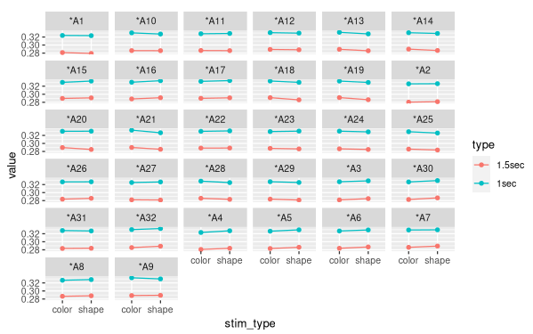
Effect of window size

Slide 5
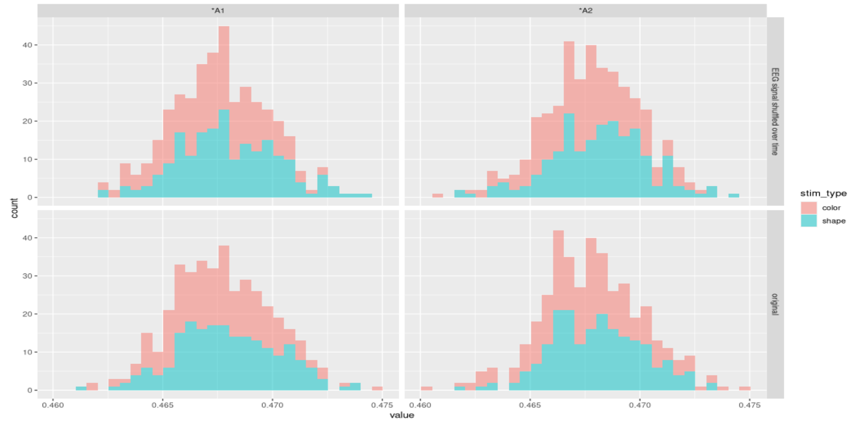
No NaNs? Then identical results.

Slide 6
Emperical statistic
Q: Mean PLV over last 30 trials?
  Effect on null distribution?

Slide 7
Time shuffling null distribution
Different calculation strategies
  Shuffle time or
  Shuffle spectrum over time
Different results

Slide 8
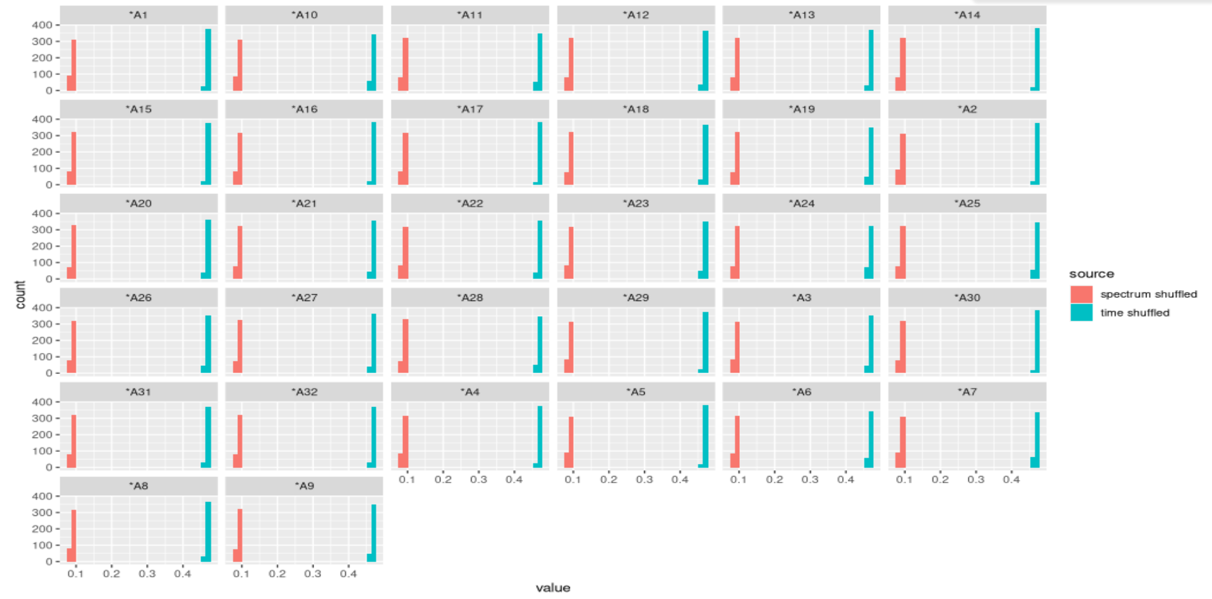
Results depend on shuffle method

Slide 9
Results: alpha
Spectrum-shuffle over time permutation test
  Everything significant
Time-shuffle permutation test
  Null distribution values are higher; only some significant
Shuffled dyads: nothing significant

Slide 10
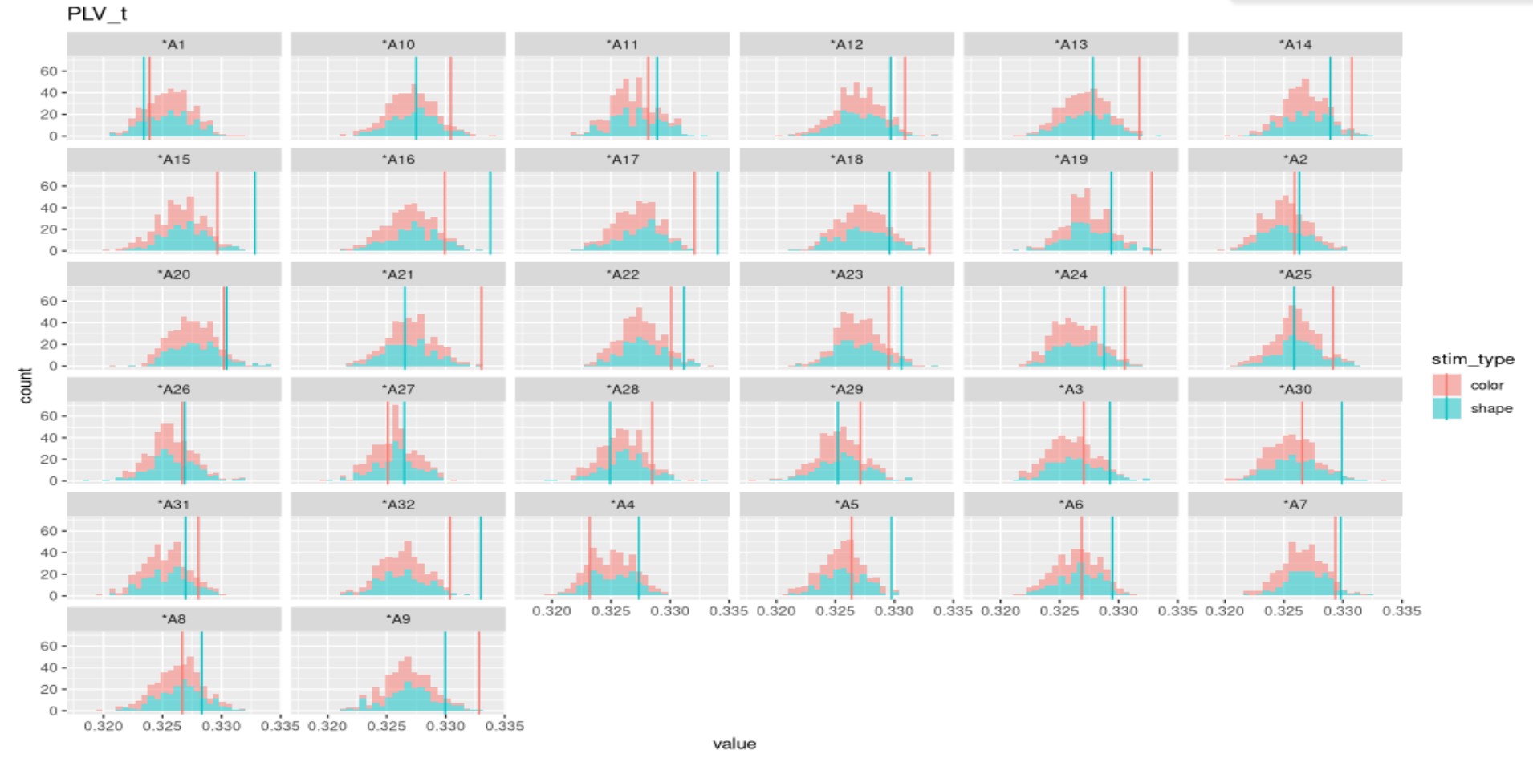

Slide 11
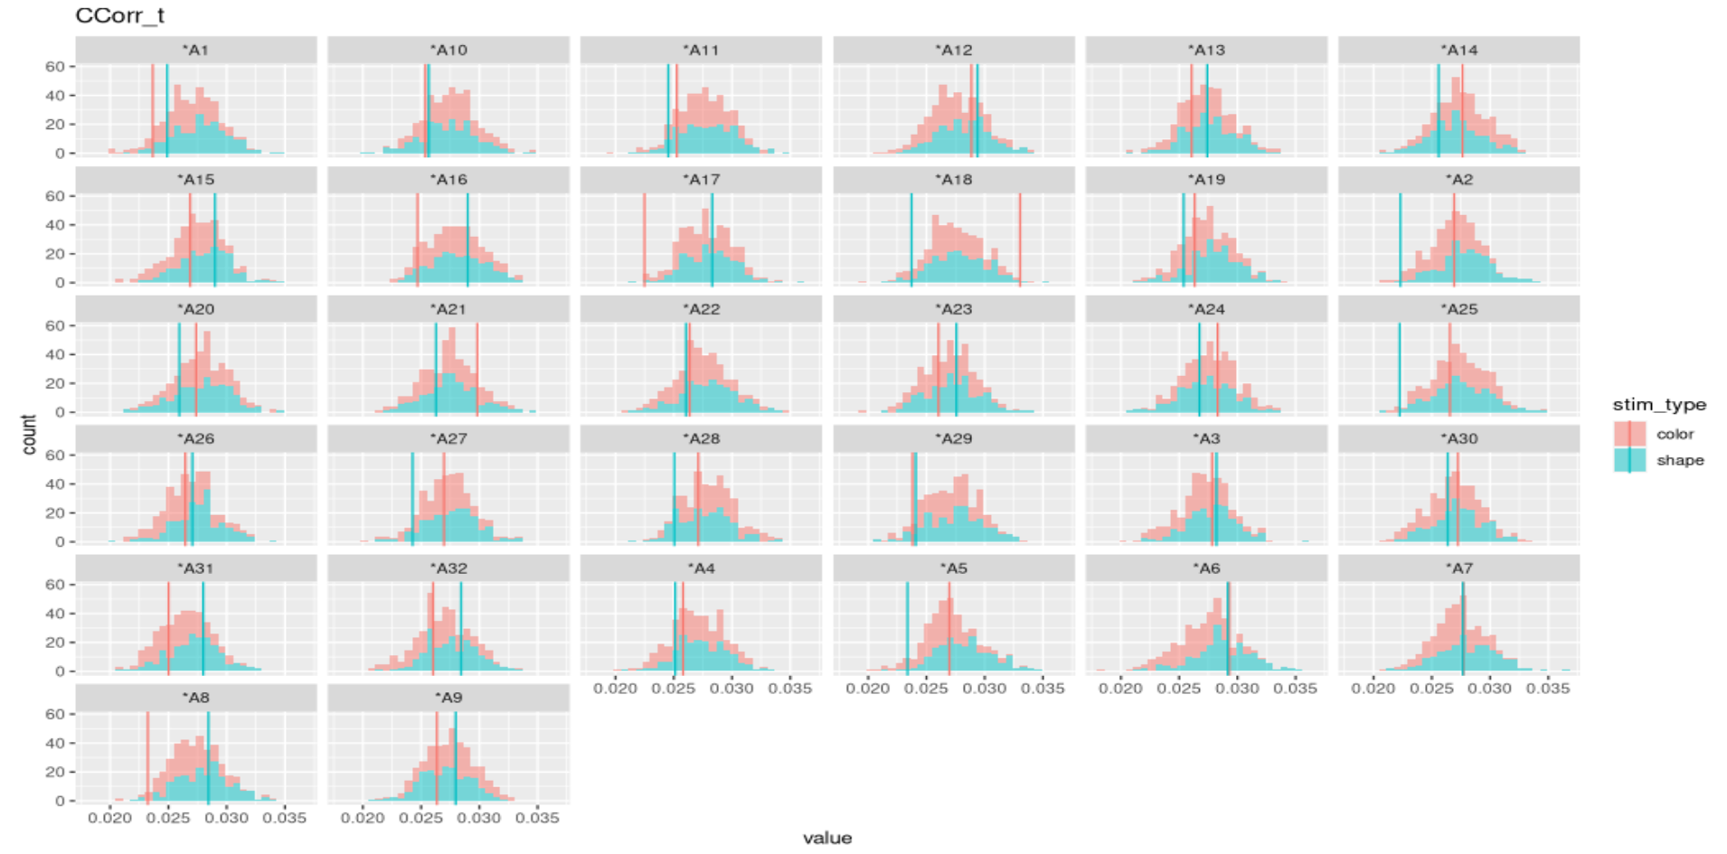

Slide 12
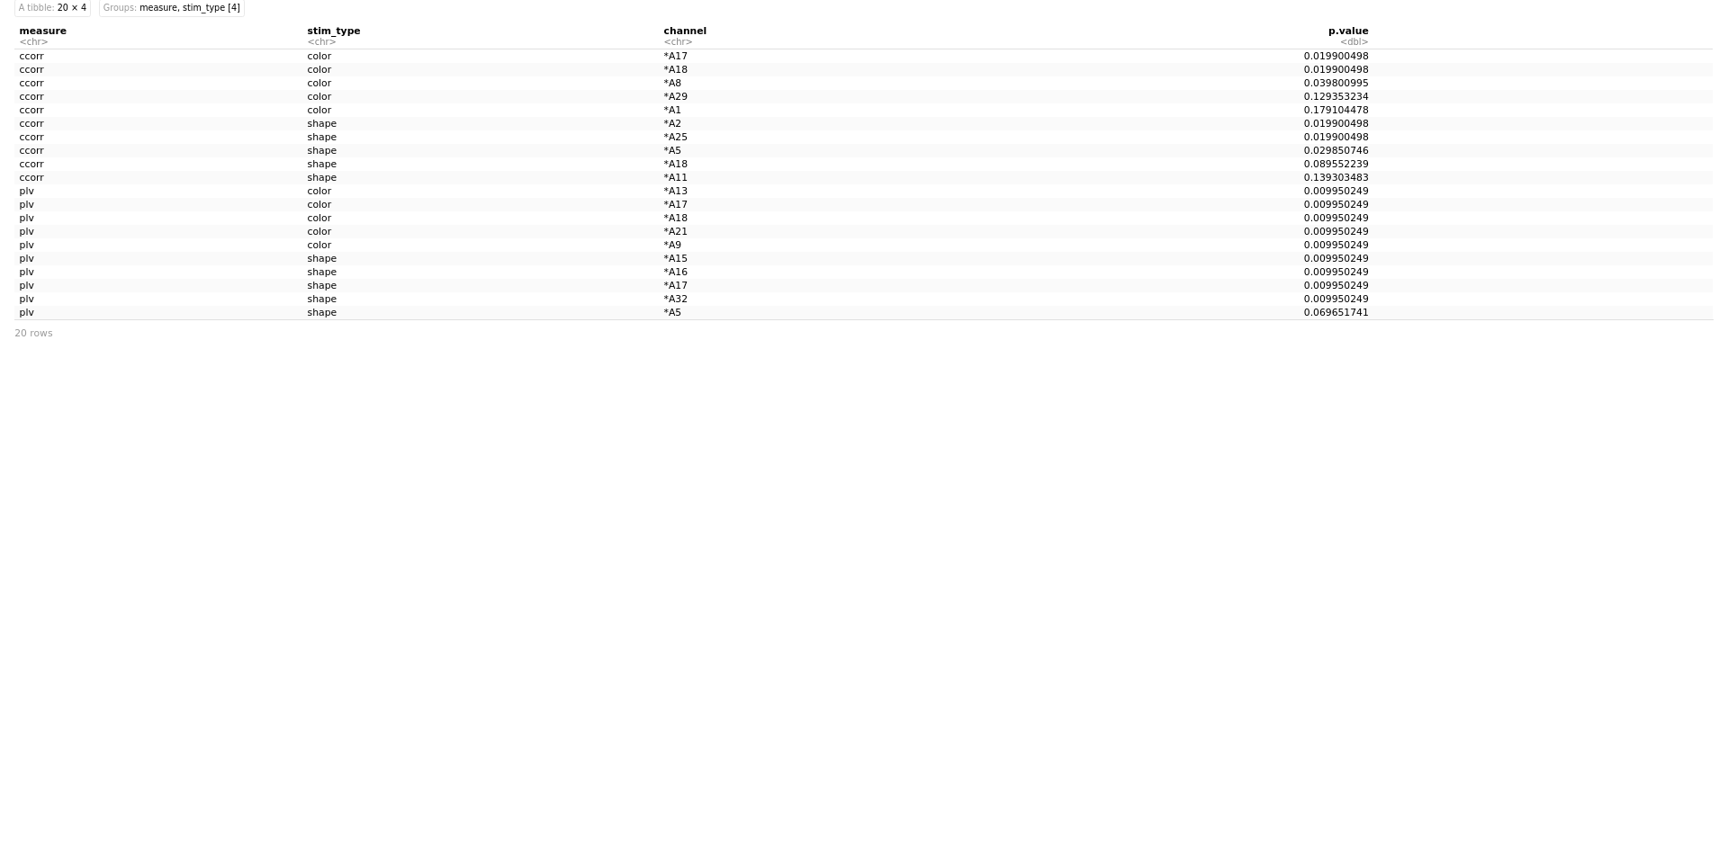

Slide 13
Results: theta
Spectrum-shuffle over time permutation test
  Everything significant
Time-shuffle permutation test
  Null distribution values are higher; not significant for most electrodes
Shuffled dyads: nothing significant

Slide 14
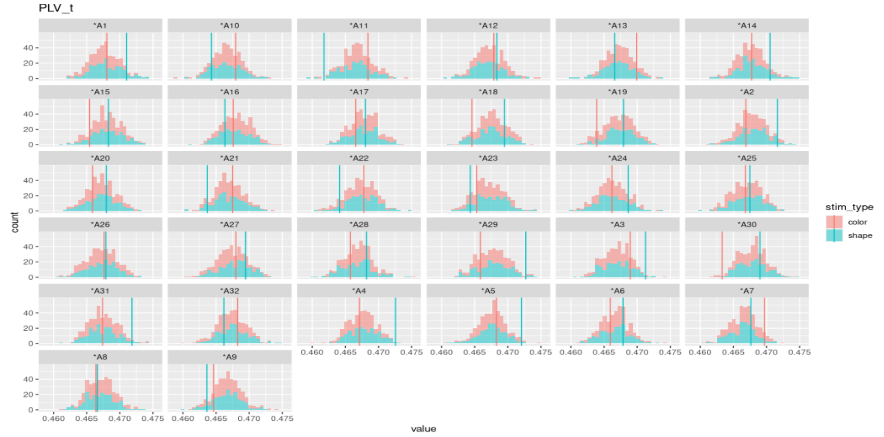

Slide 15
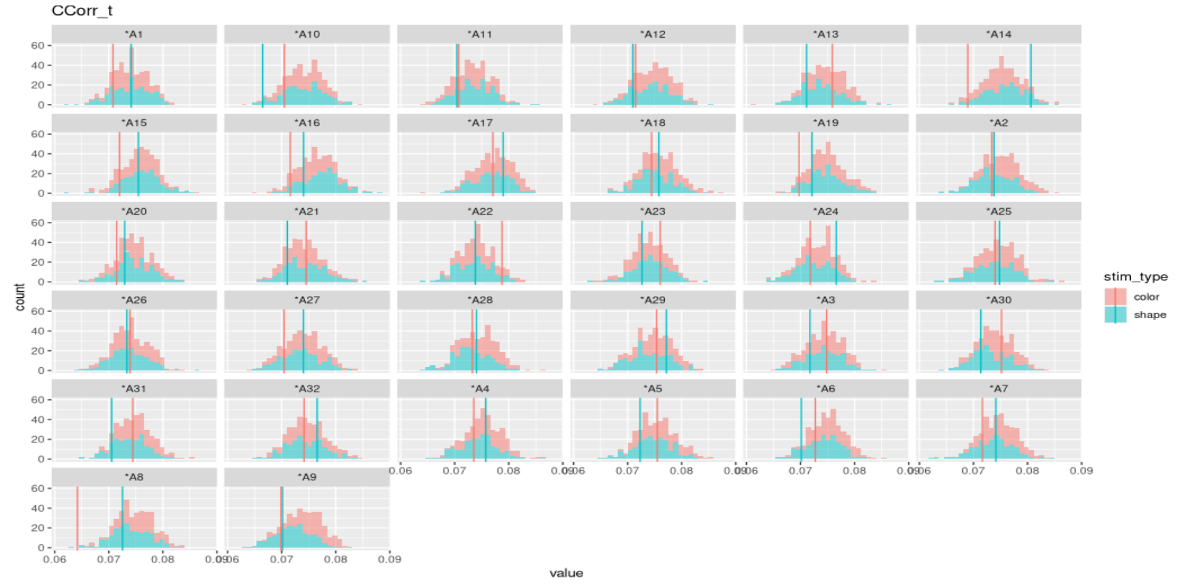

Slide 16
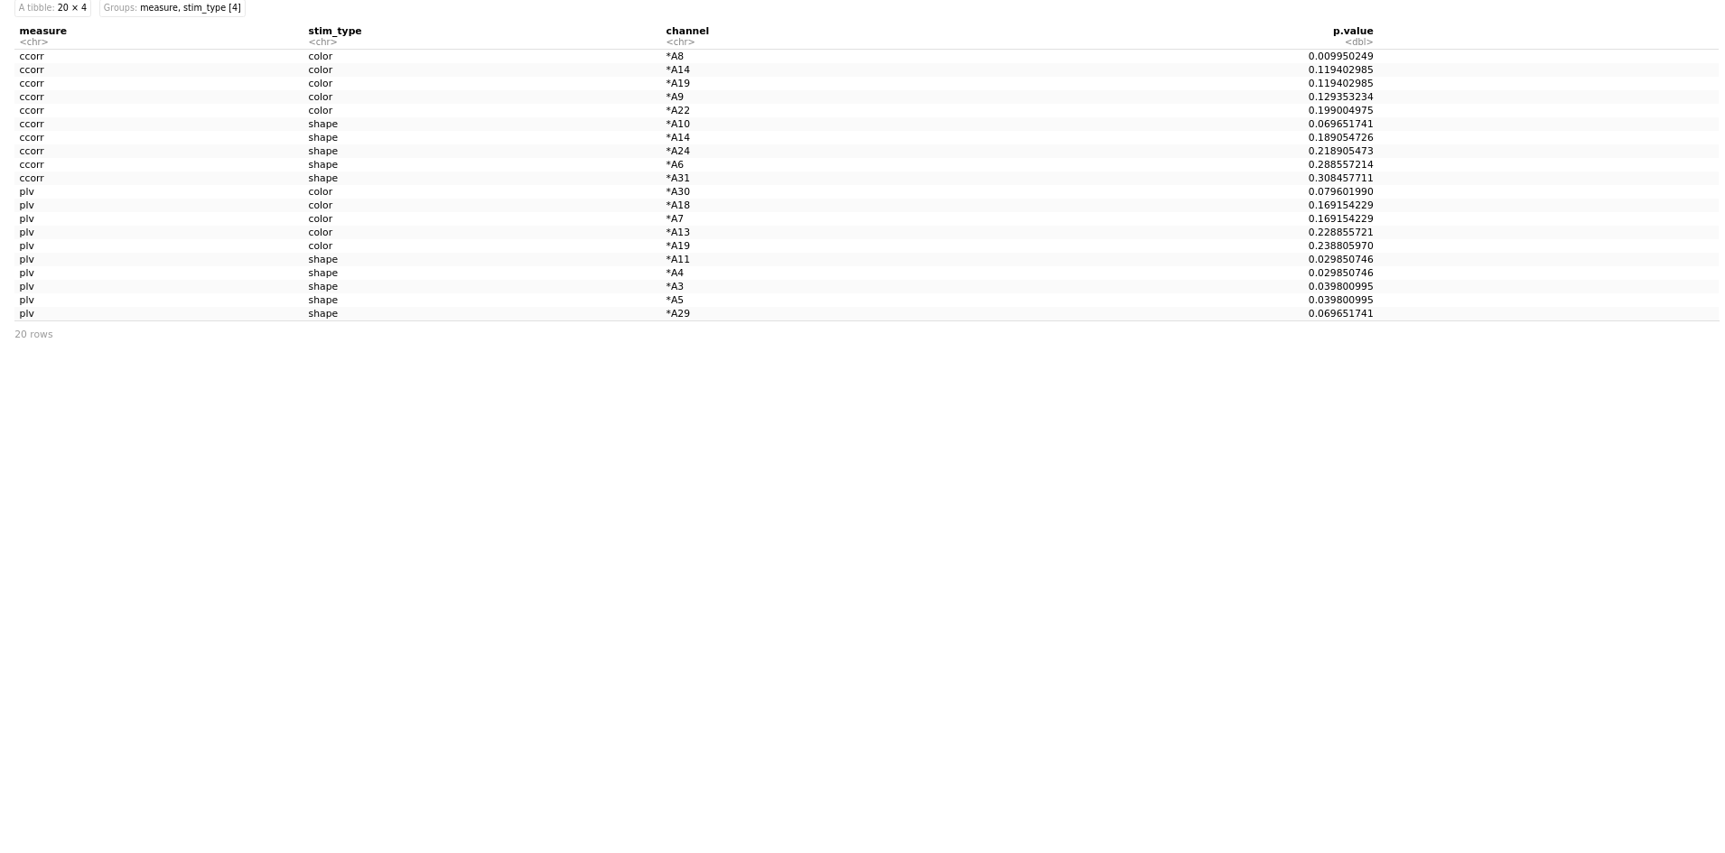

Slide 17
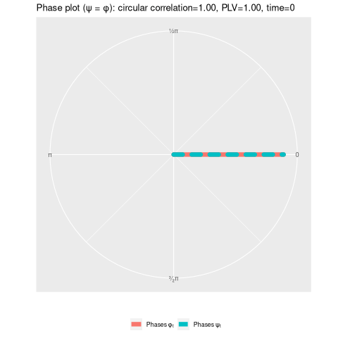
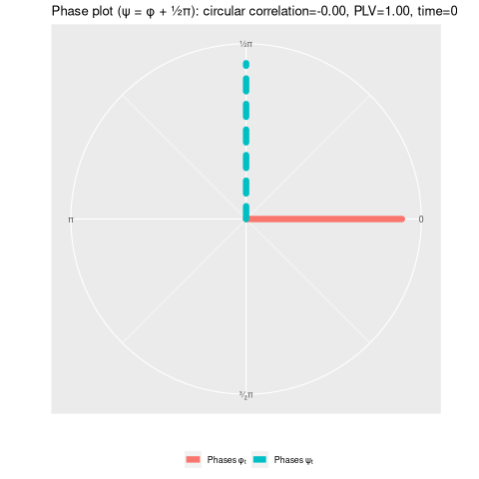
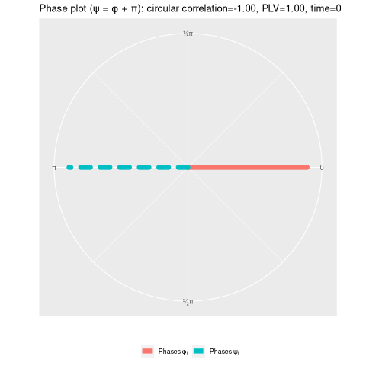
Measure insight (1)

Slide 18
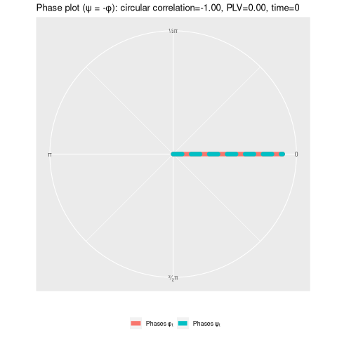
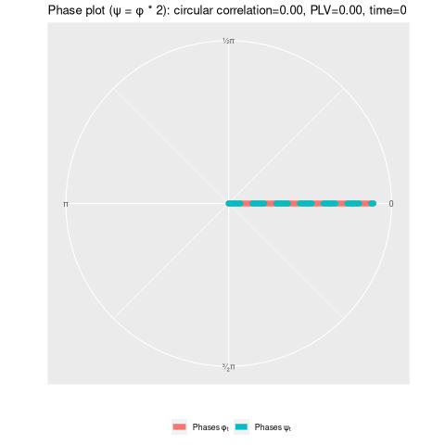
Measure insight (2)

Slide 19
Side project: chosen colour frequency
2 sessions with good accuracy...

Slide 20
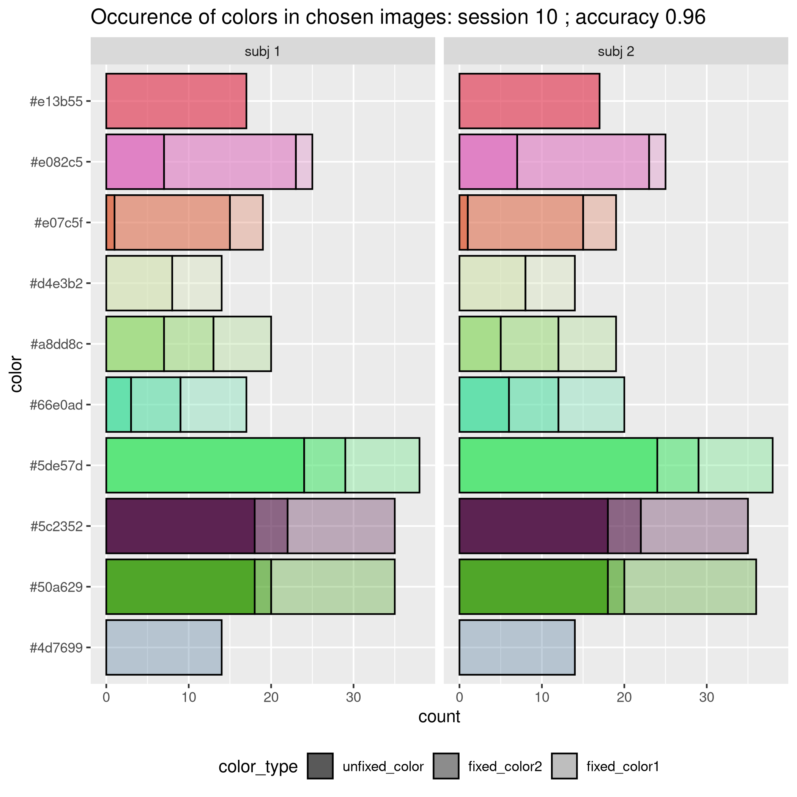

Slide 21
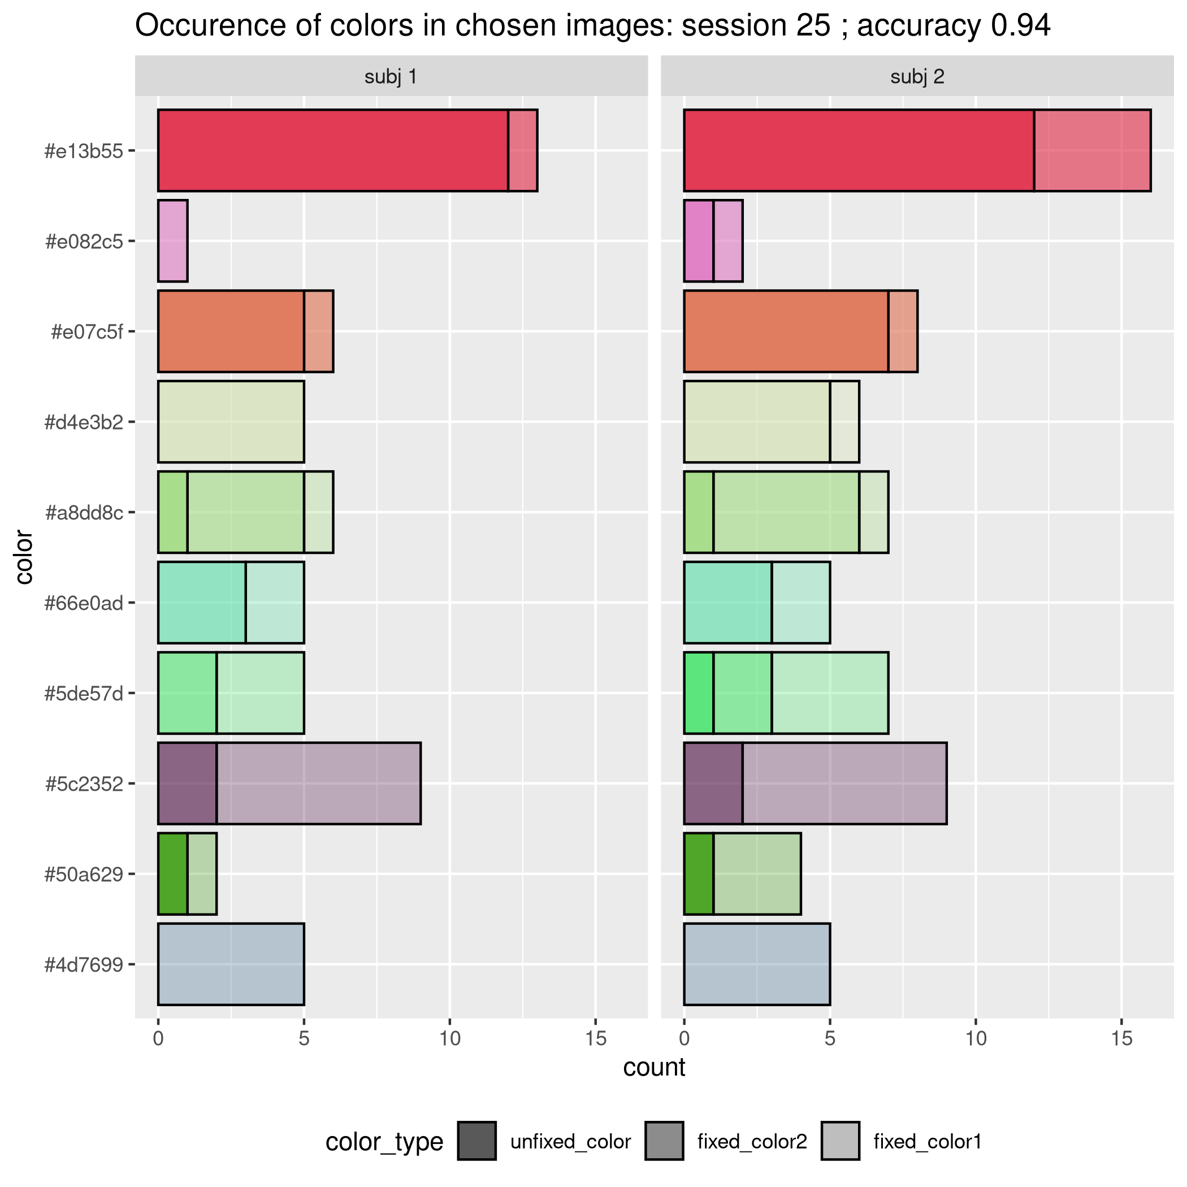

Slide 22
… and 2 sessions with bad accuracy

Slide 23
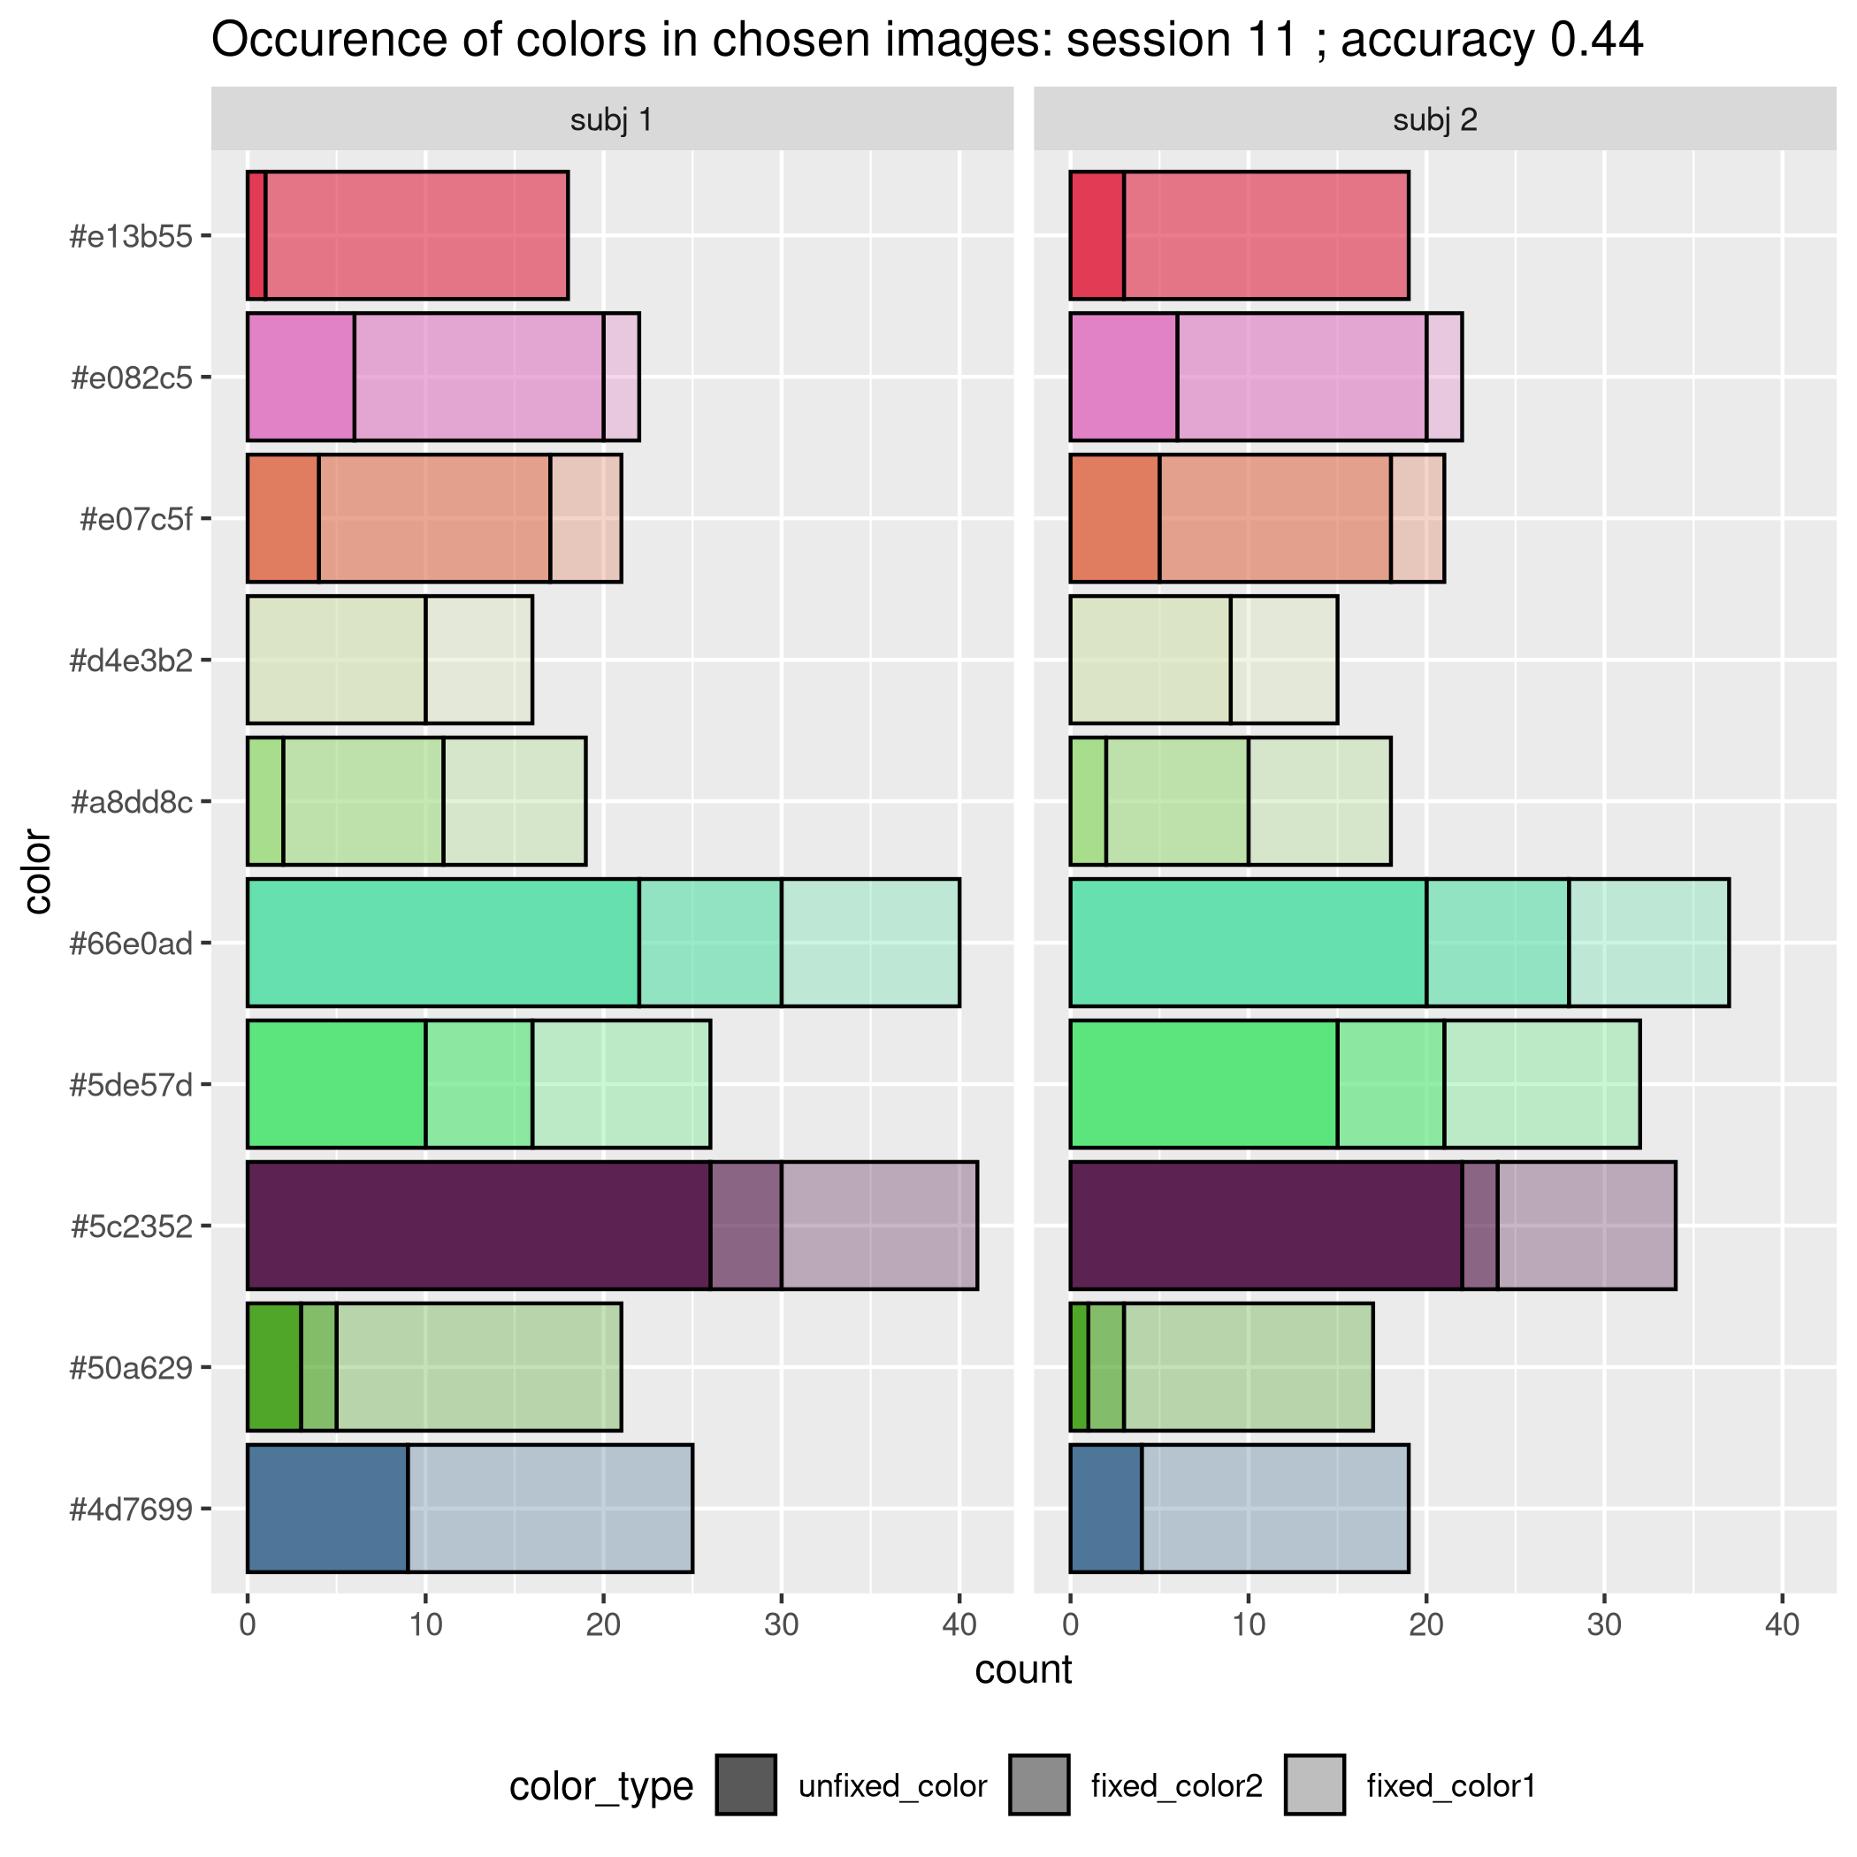

Slide 24
