Slide 1
Meeting 13/05/2022

Slide 2
Introduction: draft
Introduce task as ‘previous work’?
‘Aim’ vs. research questions?

Slide 3
Methods:
Tracked down the original
circular correlation definition

Slide 4
Imaginary coherence:
Implemented but not yet tested
(compare with ‘normal’ coherence?)

Slide 5
Preprocessing: session 72 (condition: pre)
Many rejections, probably too many (?)
5 randomly chosen:

Slide 6
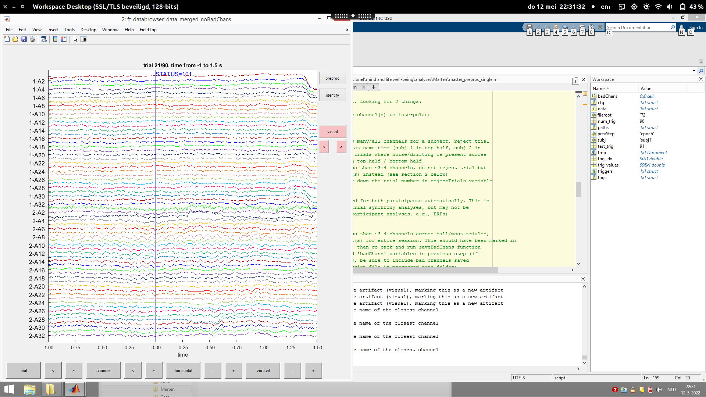

Slide 7
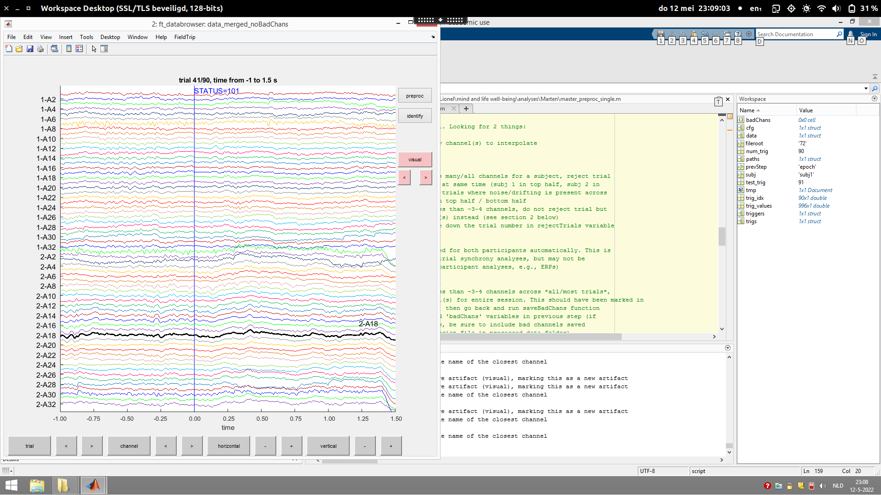

Slide 8
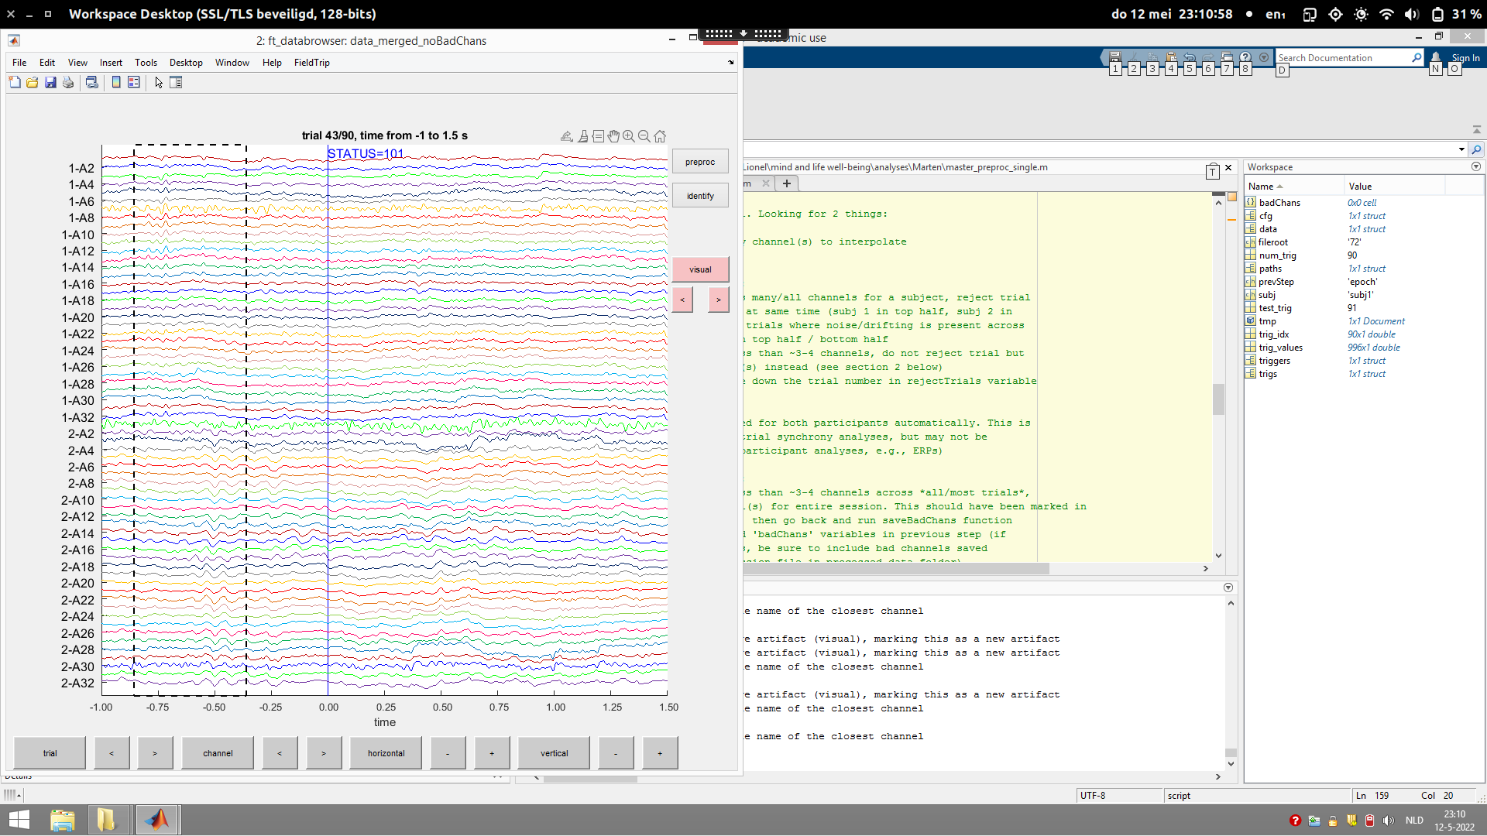

Slide 9


Slide 10
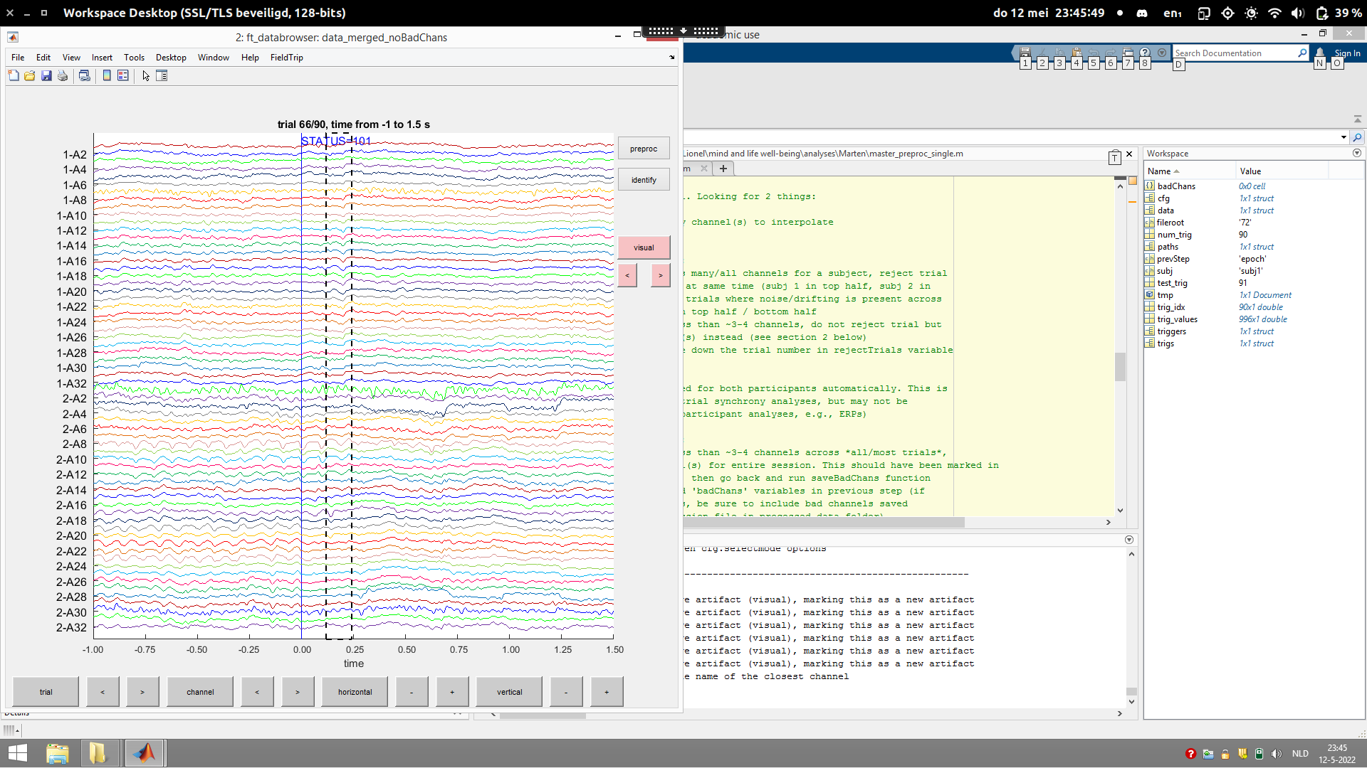

Slide 11
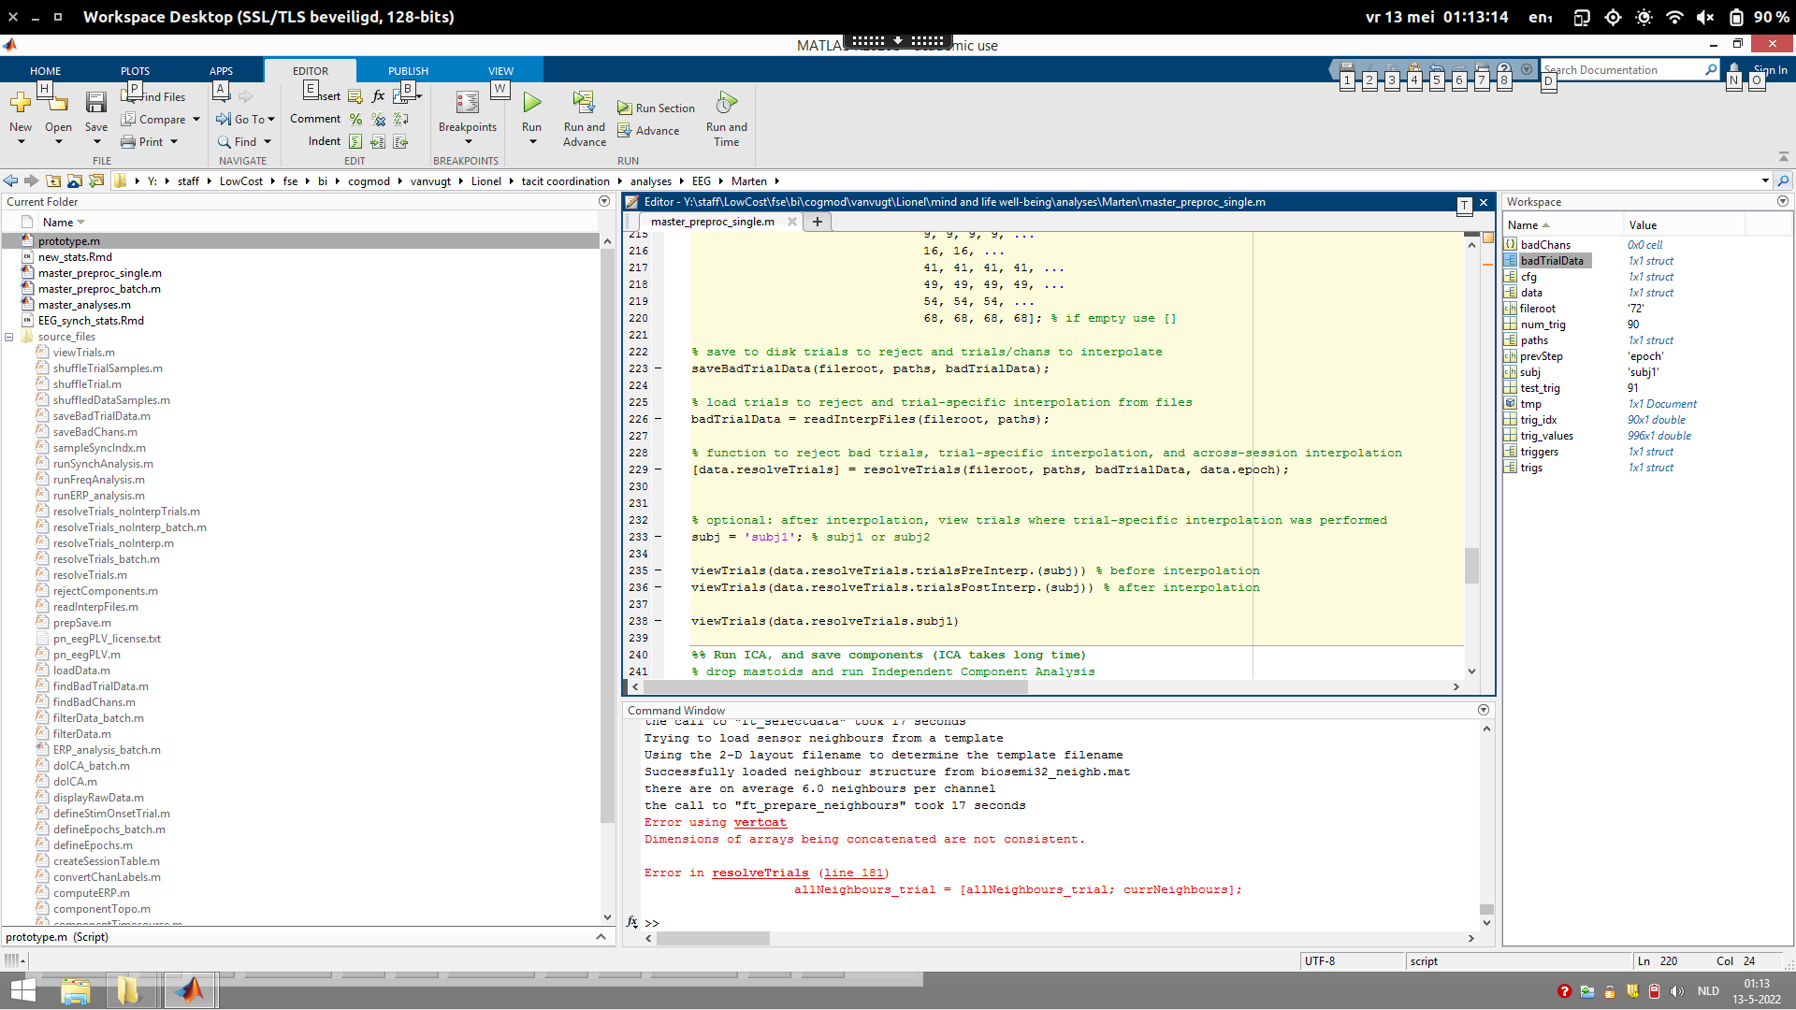

Slide 12
Next steps
More preprocessing
Imaginary coherence: test & run
Continue methods

