Slide 1
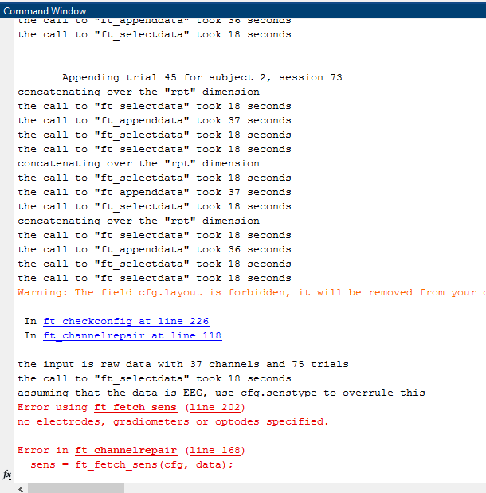
Last week...
Resolved. Thanks!

Slide 2
Preprocessing update
Pre-condition:
Tess: 48, 69
Marten: 72, 73, 11
Missing triggers: 5, 7
Post-condition:
Tess: 72, 69 (WIP)

Slide 3
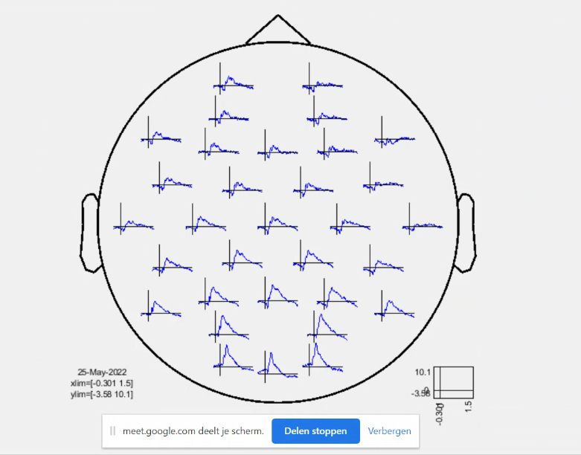
Grand average ERPs (1)

Slide 4
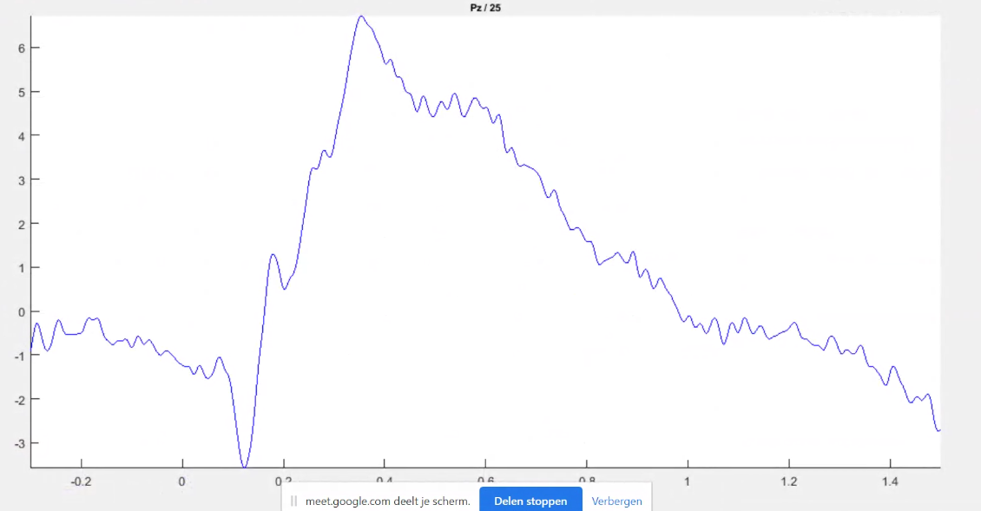
Grand average ERPs (2)

Slide 5
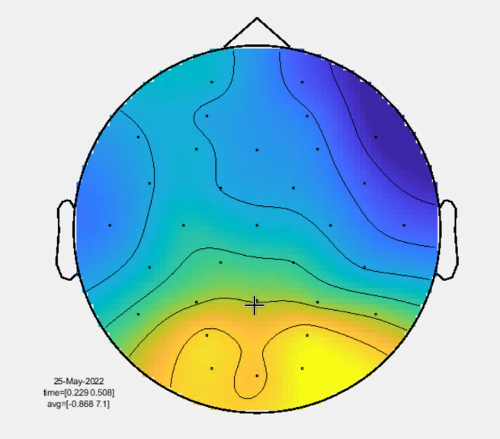
Grand average ERPs (3)
(occipital?)

Slide 6
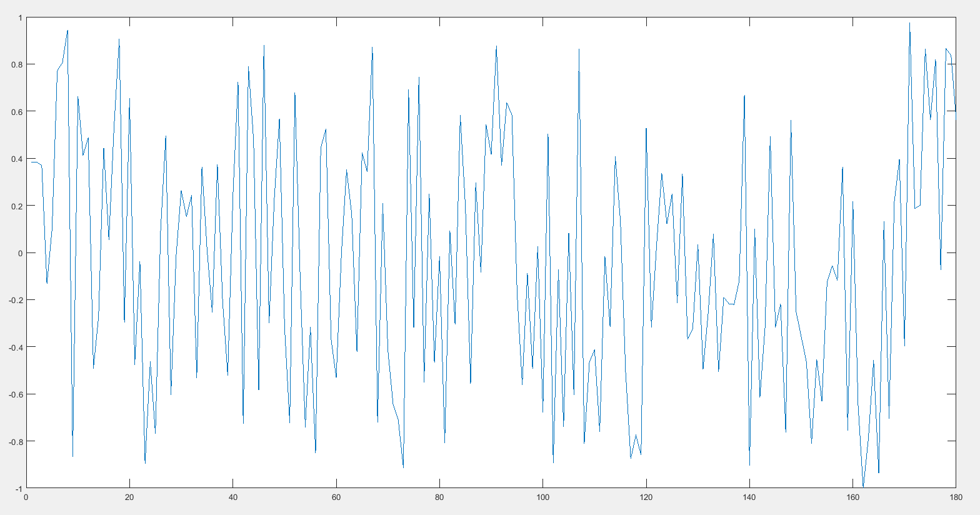
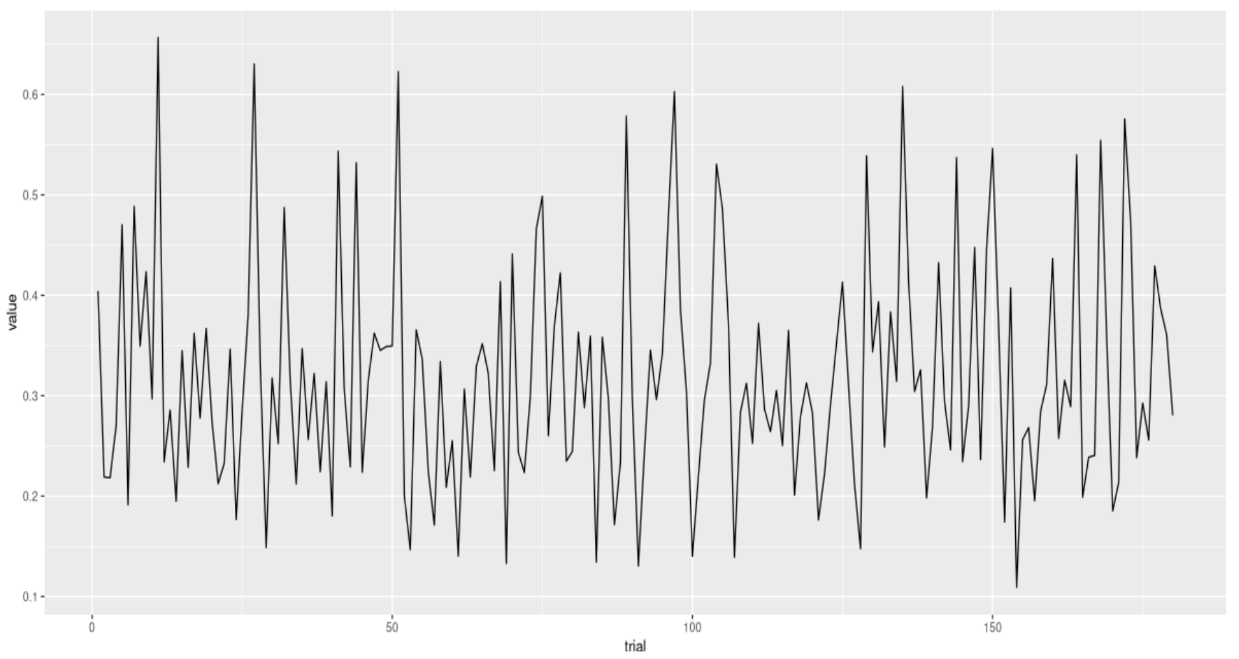
Validating imaginary coherence implementation
Not the same… TBC at a later time.

Slide 7
Upcoming (1)
IBS calculation w/ <censored> (Monday)
… which lead me to...

Slide 8
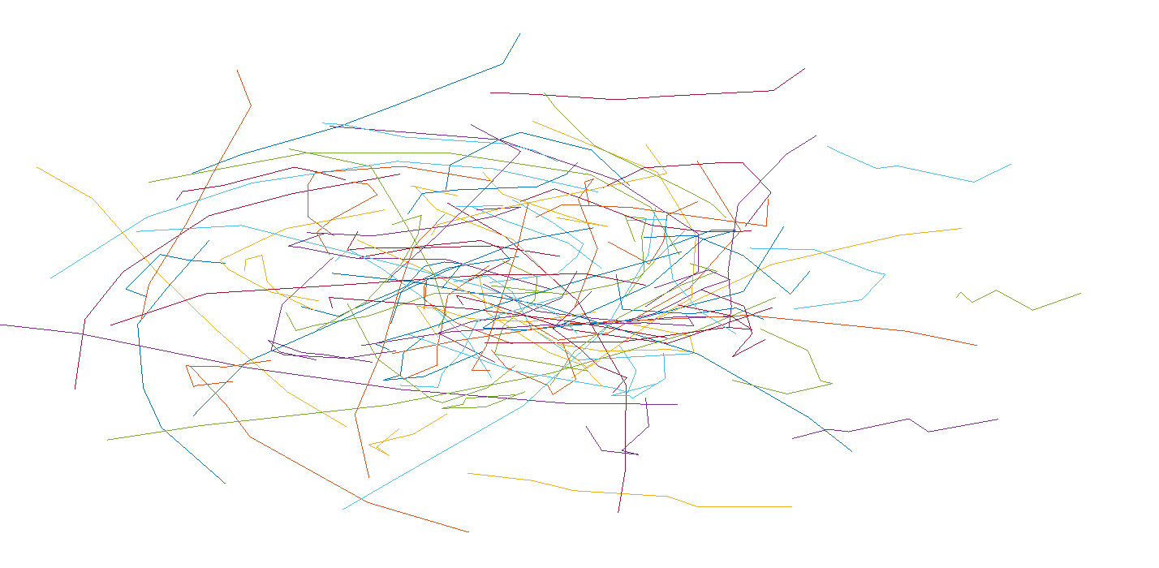
Understanding frequency analysis

Slide 9
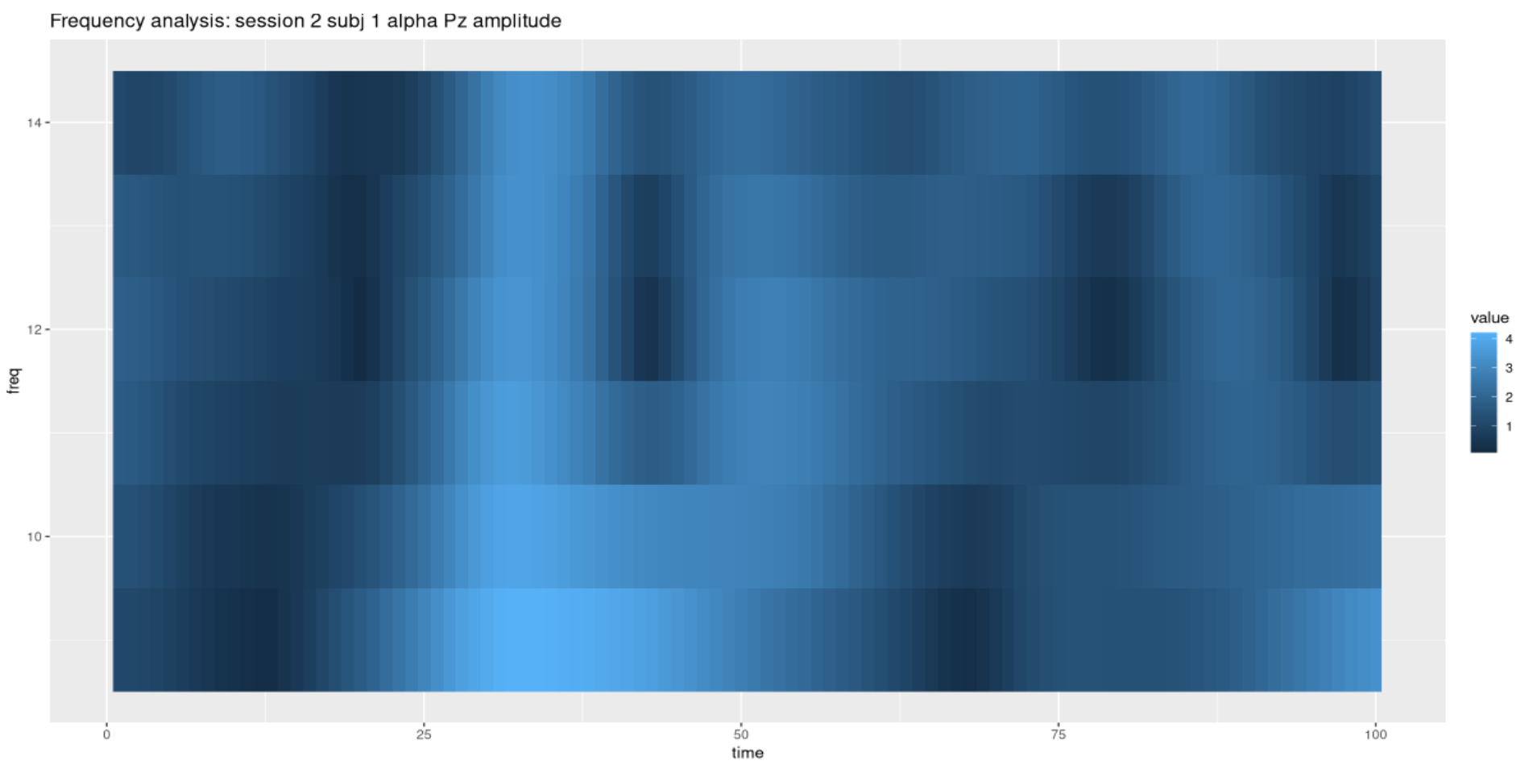

Slide 10
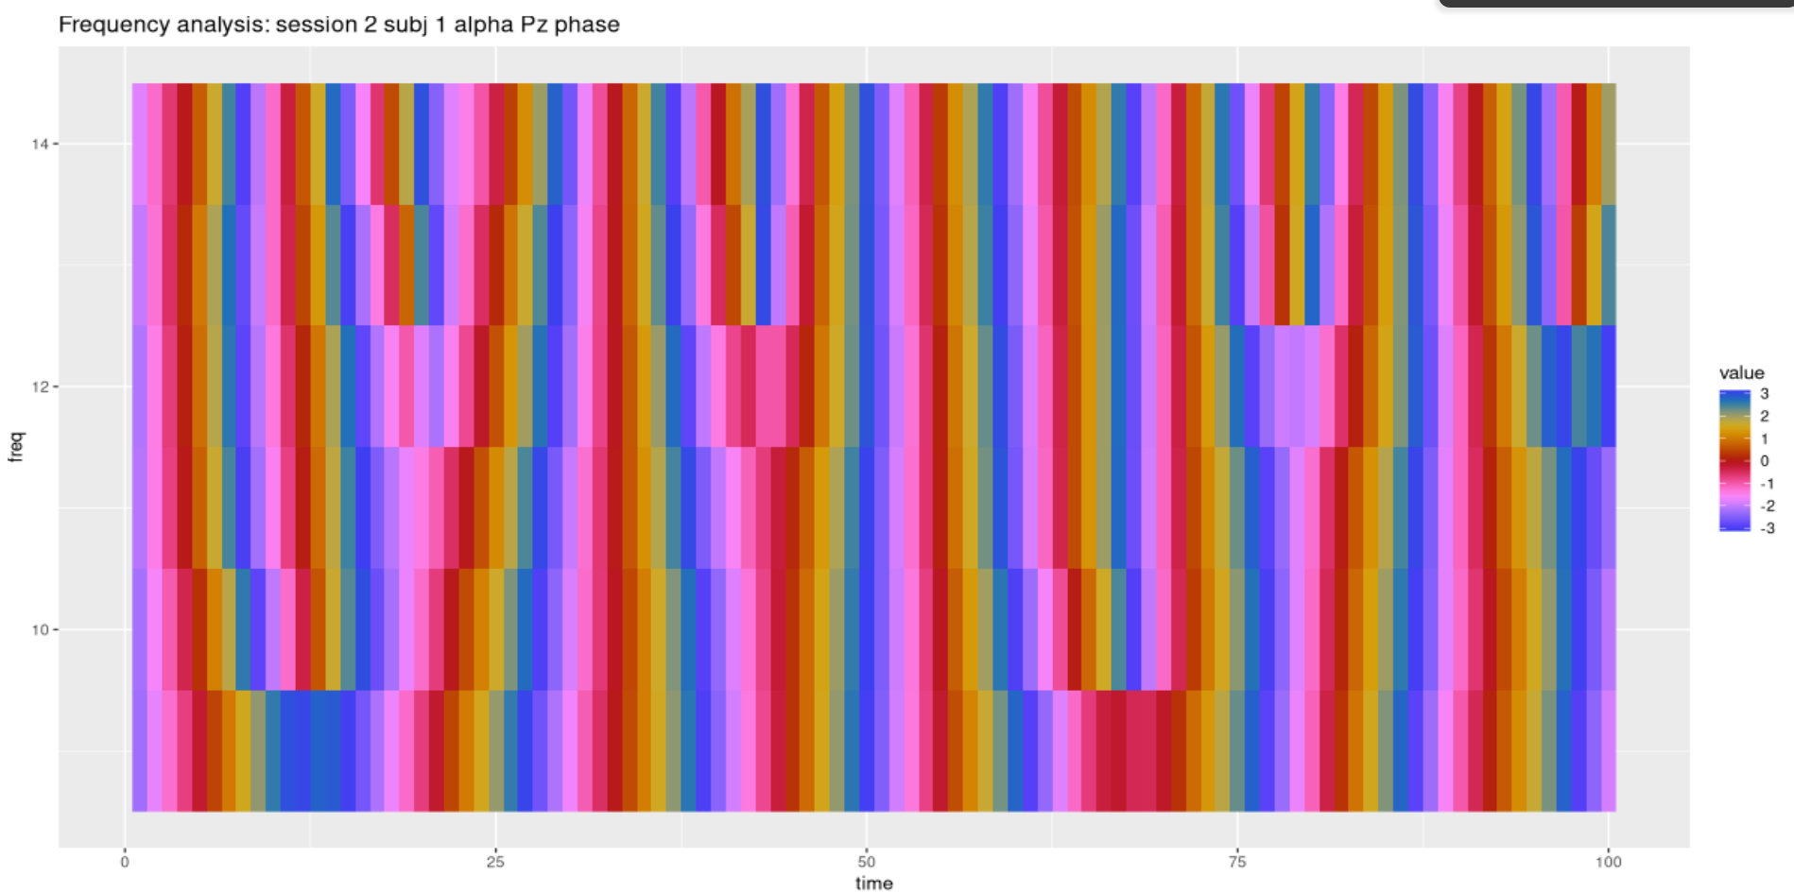

Slide 11
Upcoming (2)
Methods

Slide 12
Progress meeting

