Slide 1
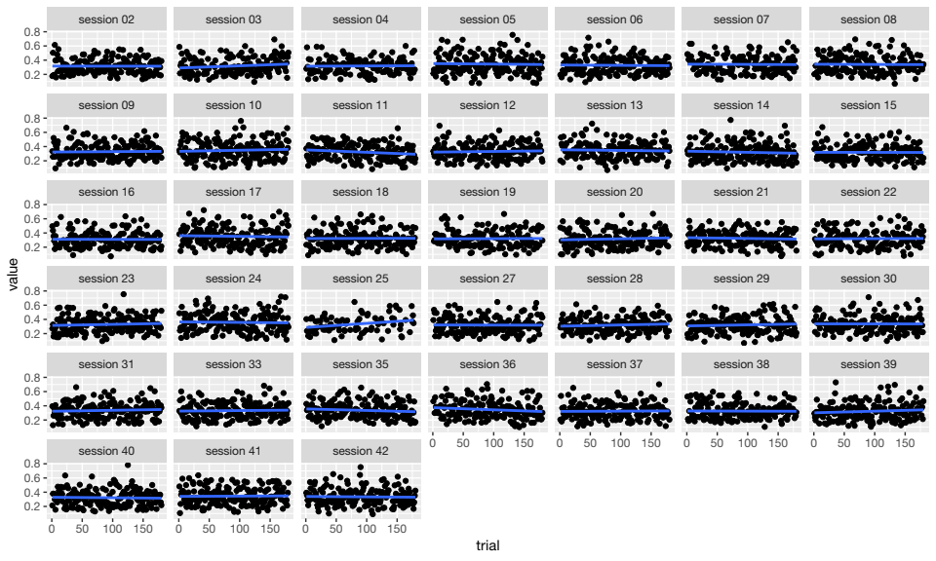
PLV, Pz electrode, linear trends

Slide 2
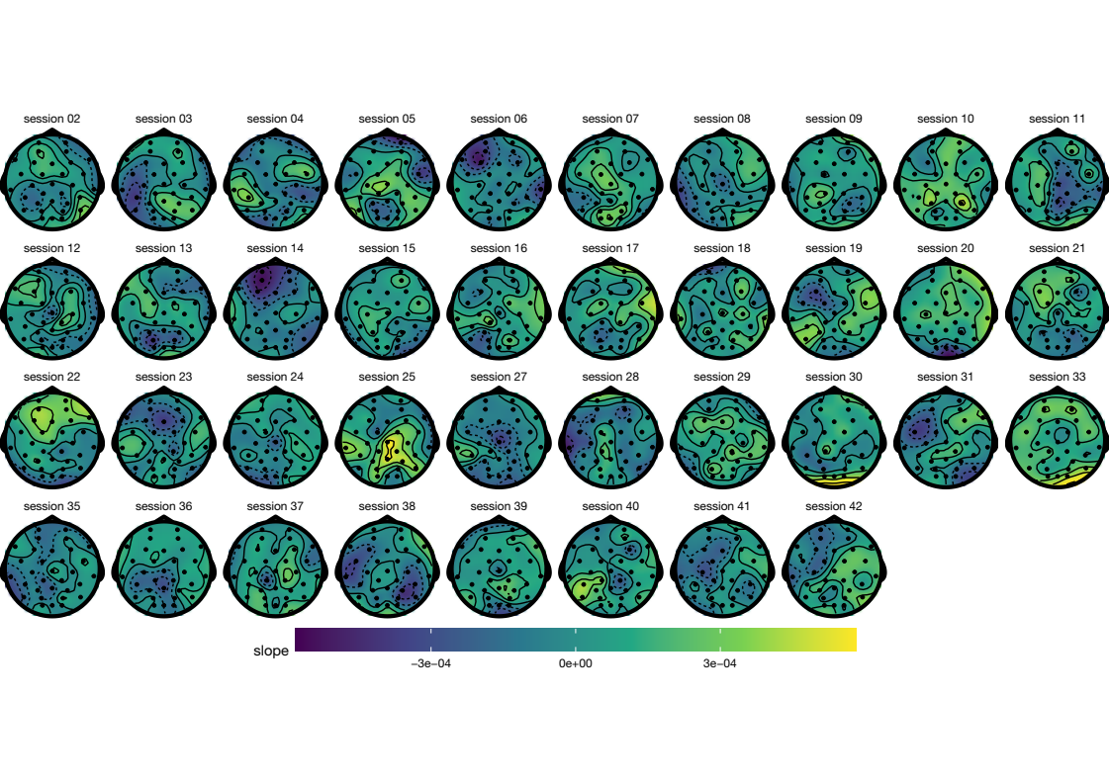
Trend line slope over trials (PLV)

Slide 3
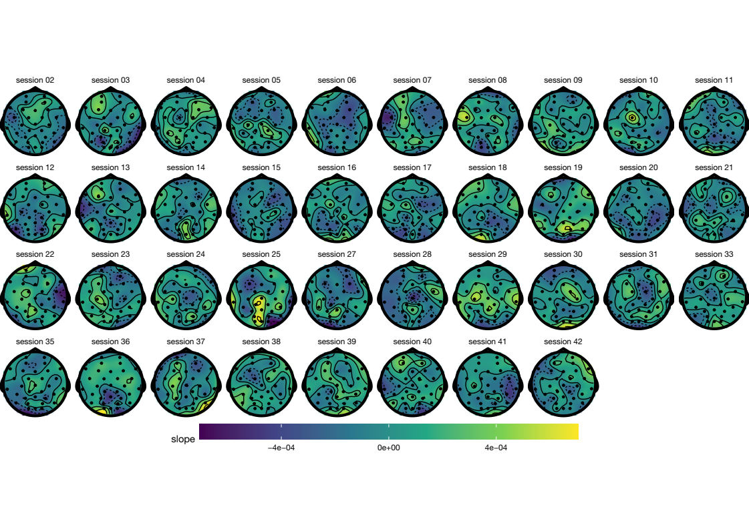
Trend line slope over trials (CCorr)

Slide 4
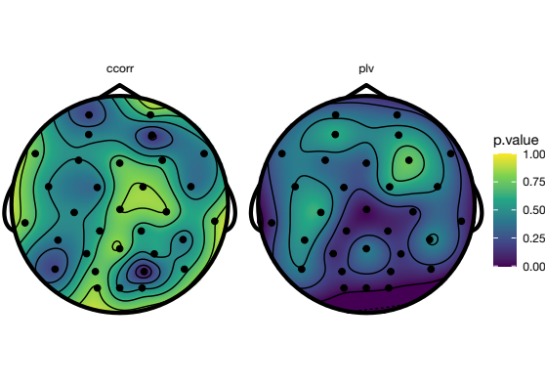
Permutation test (shuffled time)

Slide 5
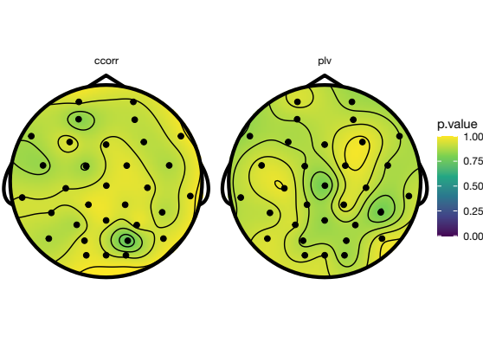
Permutation test (shuffled subjects)

