Slide 1
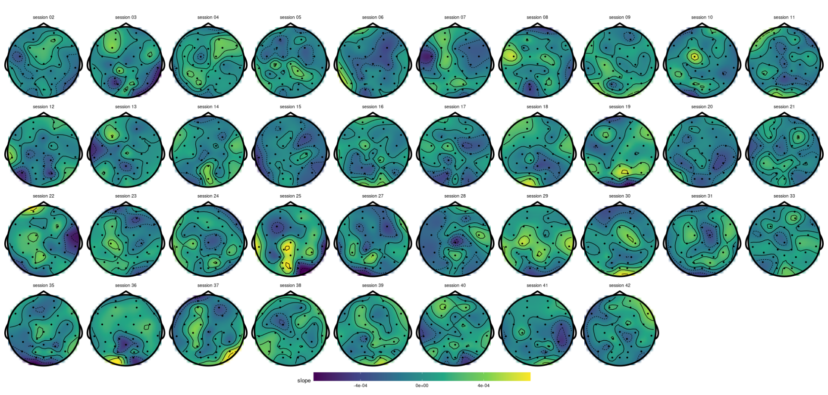
Previously*:
* ccorr is shown here

Slide 2
Solution: statistics
Linear mixed effect model:
  value ~ 1 + (1 | session) vs.
  value ~ 1 + trial + (1 | session)
  boundary (singular) fit, but…
T-test
  One slope per session

Slide 3
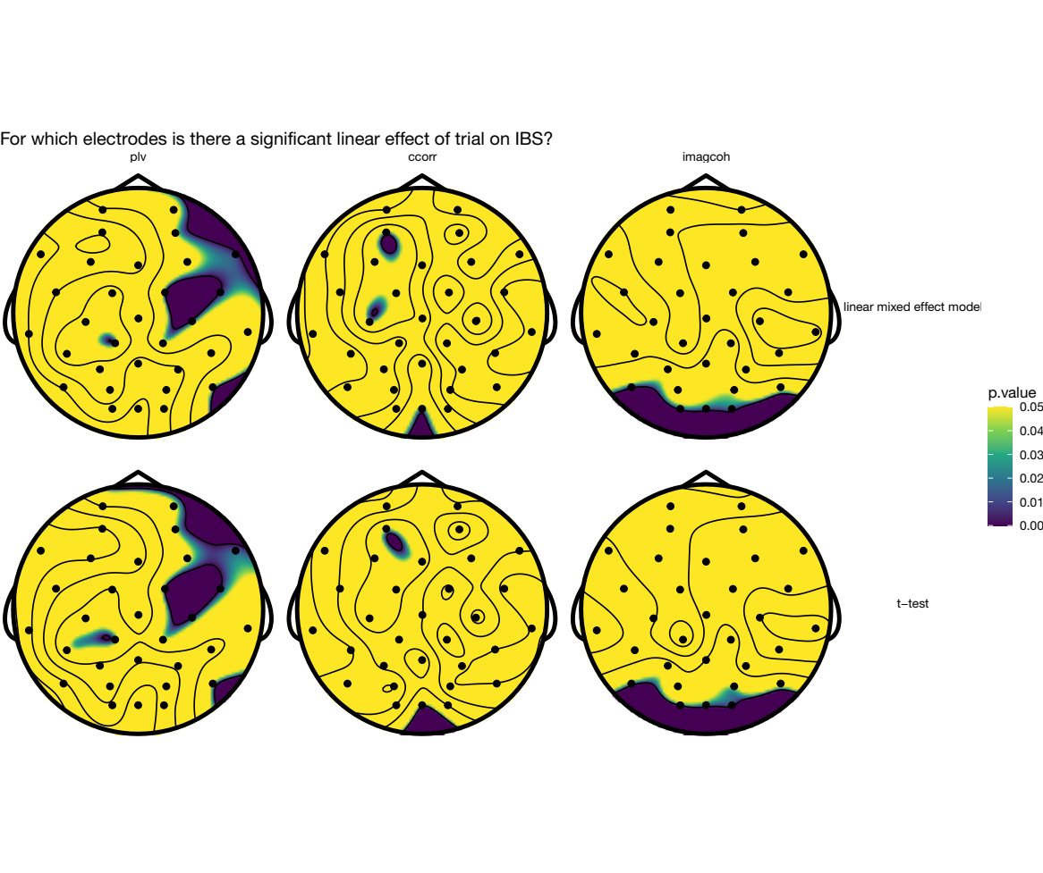
Q: P-value colour scale?
qnorm(1 - p / 2)
norminv?
Q: Correction for multiple
comparisons how? (FDR?)

Slide 4
FDR-corrected: plot these instead?
> ttest %>% mutate(p.value=p.adjust(p.value, method='fdr')) %>% arrange(p.value)
measure electrode p.value method
<fct> <chr> <dbl> <chr>
1 plv C4 0.00823 t-test
2 plv FC2 0.00823 t-test
3 plv FC6 0.00823 t-test
4 imagcoh O1 0.0550 t-test

Slide 5
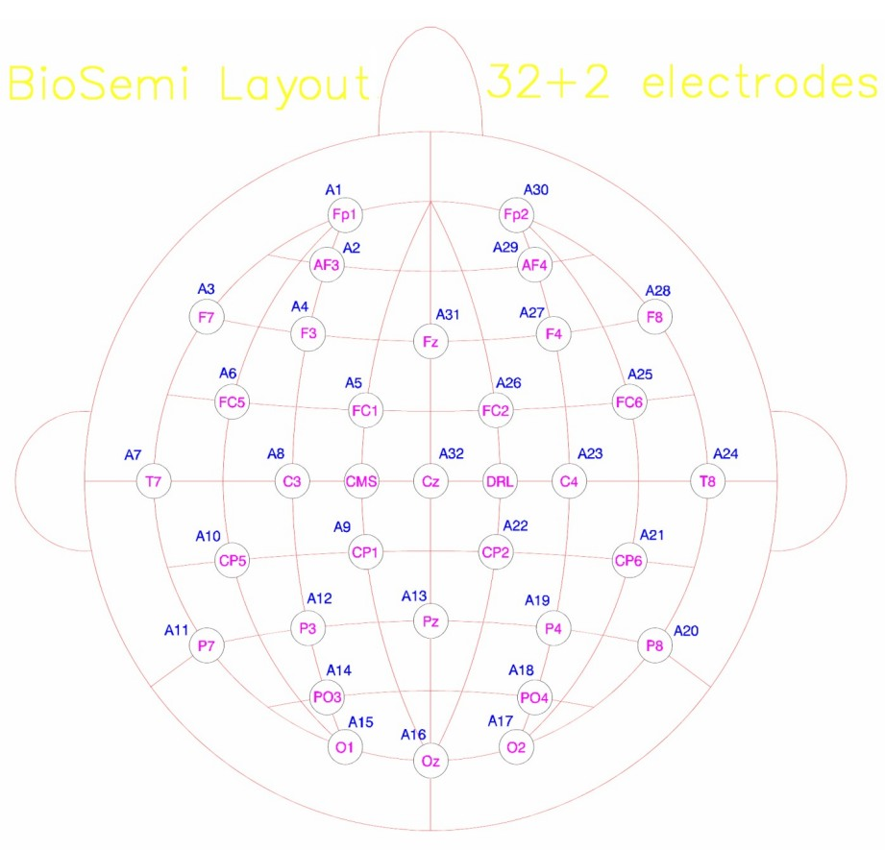

Slide 6
Implementation validation DONE!
PLV matches:
  <censored>’s code
  Fieldtrip (ft_connectivityanalysis; over trials)
Circular correlation matches:
  Matlab circular correlation toolbox
Imaginary part of coherency matches:
  Fieldtrip (ft_connectivityanalysis; over trials)

Slide 7
Making results report-ready
Permutation test data collection
  Shuffle times, shuffle spectrum, shuffle dyads
    Alpha & theta
Frequency analysis variations (alpha band only)
  Hann window vs. Multitapers
  Resolution
  Window size
=> the boring work is done (yay!)

Slide 8
Alpha band; winsize = ‘1.0s’ or ‘1.5s’
plv ~ winsize + trial + (1|session) + (1|electrode)
plv ~ trial + (1|session) + (1|electrode)
χ²(1) = 16092, ΔAIC = 16090, ΔBIC = 16079, p < 0.01
Q: (1 | electrode) ok?

Slide 9
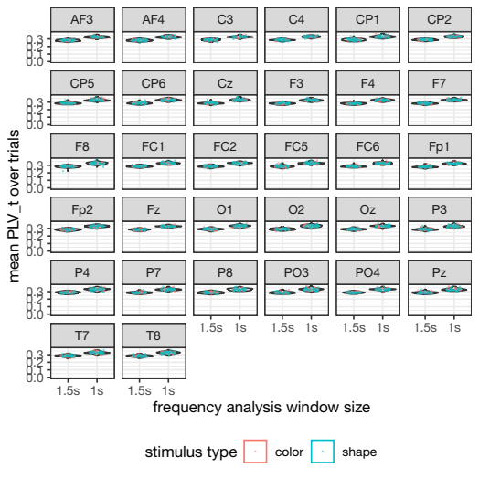
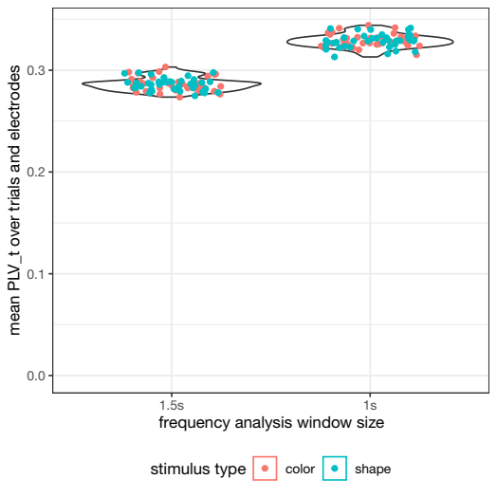
Q: Or show using a graph? How much to show?
→ averaging hides that there is actually some overlap between the conditions

Slide 10
Simulation plots: update
Imaginary part of coherency is conceptually more difficult...
… as it depends on both amplitude and phase (instead of just phase like ccorr/plv)

