Slide 1
Results: first draft

Slide 2
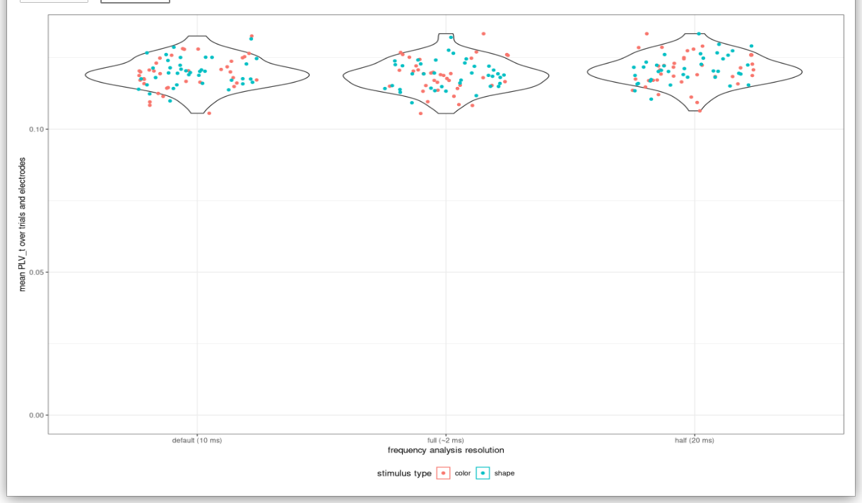
Frequency analysis resolution (1)
Ok at first sight...

Slide 3
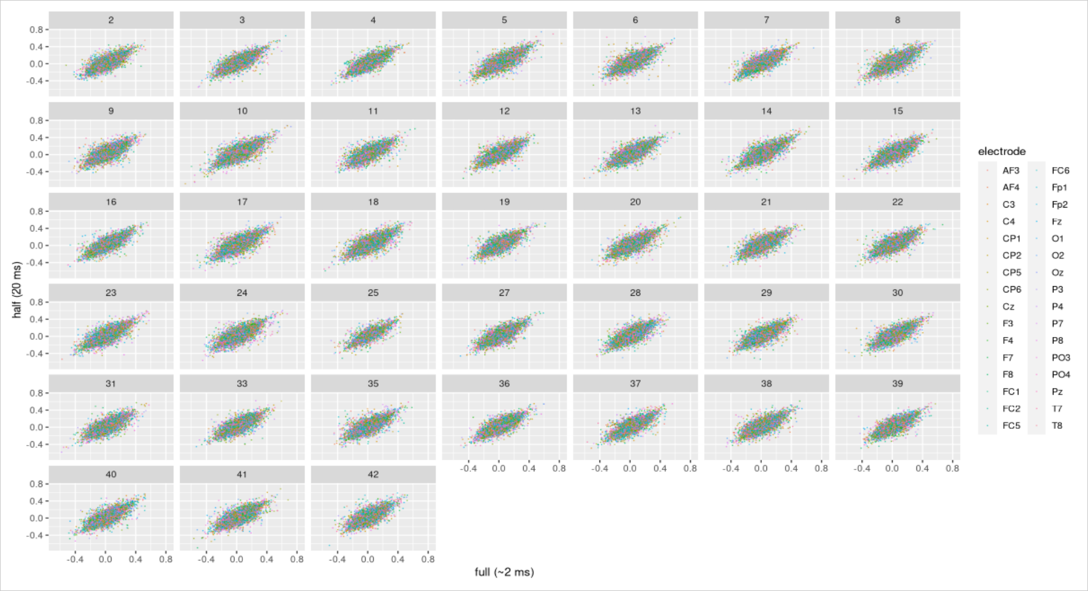
Frequency analysis resolution (2)
But…
CCorr!

Slide 4
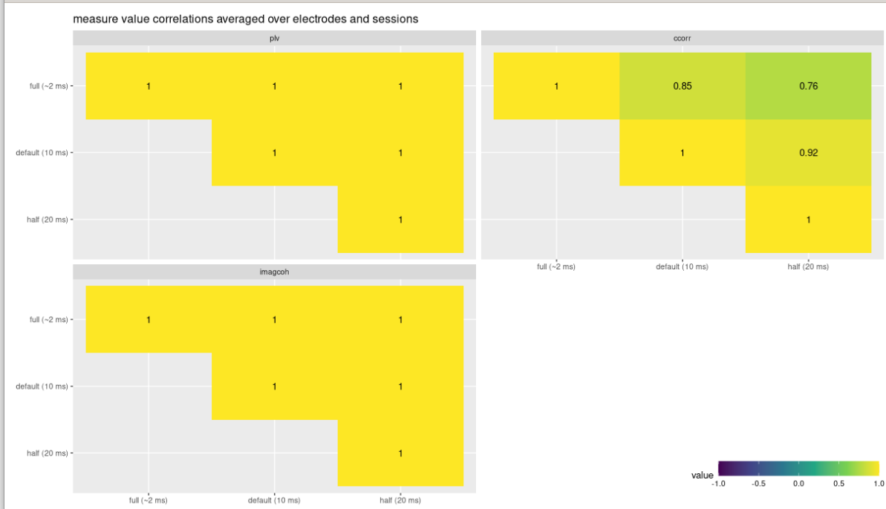
Frequency analysis resolution (3)
Q: Averaging ok?

Slide 5
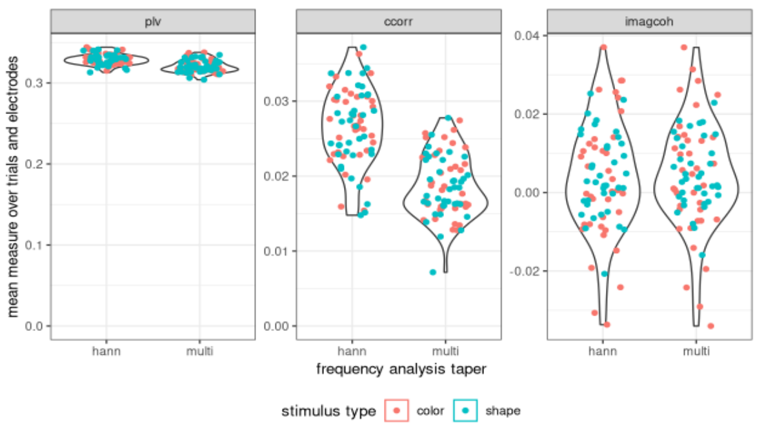
Frequency analysis taper
Bigger influence.
Correlations:
CCorr: 0.42
PLV: 0.92
ImCoh: 0.99

Slide 6
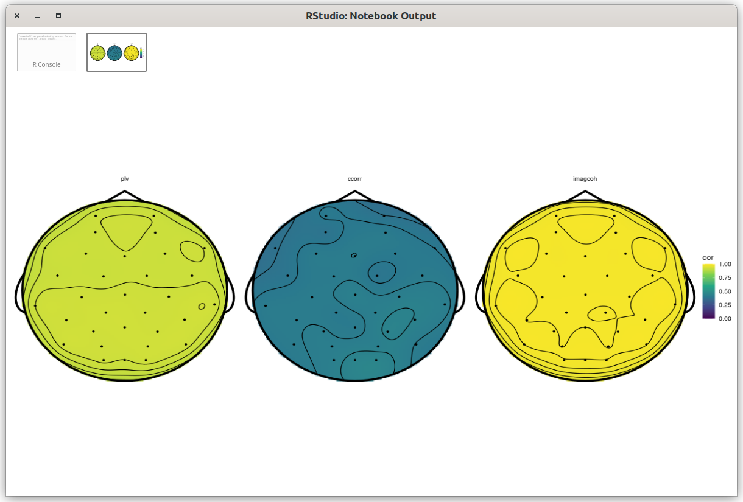
Frequency analysis taper (2)
Bigger influence.
Correlations:
CCorr: 0.42
PLV: 0.92
ImCoh: 0.99

Slide 7
Simulation studies
Permutation test power analysis (monte carlo)
& measure response on artificial data
Q: How to generate fake (random) EEG spectrums?

Slide 8
Next steps?
Kraskov mutual information measure?
Further investigate influence of tapering on measure values (by comparing the spectrums)?
IBS not significant, but could still go through the motions:
  Predict accuracy?
  Test effect of working memory load on IBS?
Validate results so far against mindfulness dataset?

