Slide 1




The Music Encoding Initiative encoding of early music
Research project: Echoes from the Past:
Unveiling a Lost Soundscape with Digital Analysis https://doi.org/10.54499/2022.01957.PTDC
Martha E. Thomae, Elsa De Luca
CESEM-IN2PAST, Universidade NOVA de Lisboa
Notes:
ELSA STARTS

Slide 2
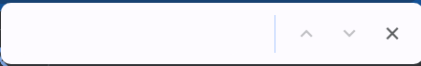
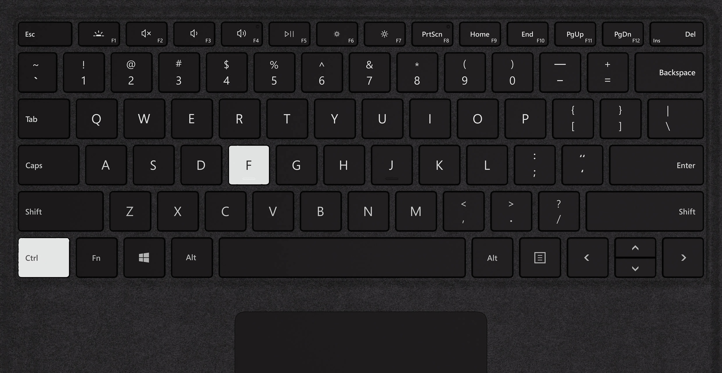
Notes:
"Control+F" (or "Command+F" on a Mac) is the keyboard shortcut for the Find command.
If you're in a document, or in a web browser, pressing the «Ctrl key + the F key» will bring up a search box in the top right corner of the screen. From this box you can search for whatever text or combination of letters and numbers you are interested in.

Slide 3
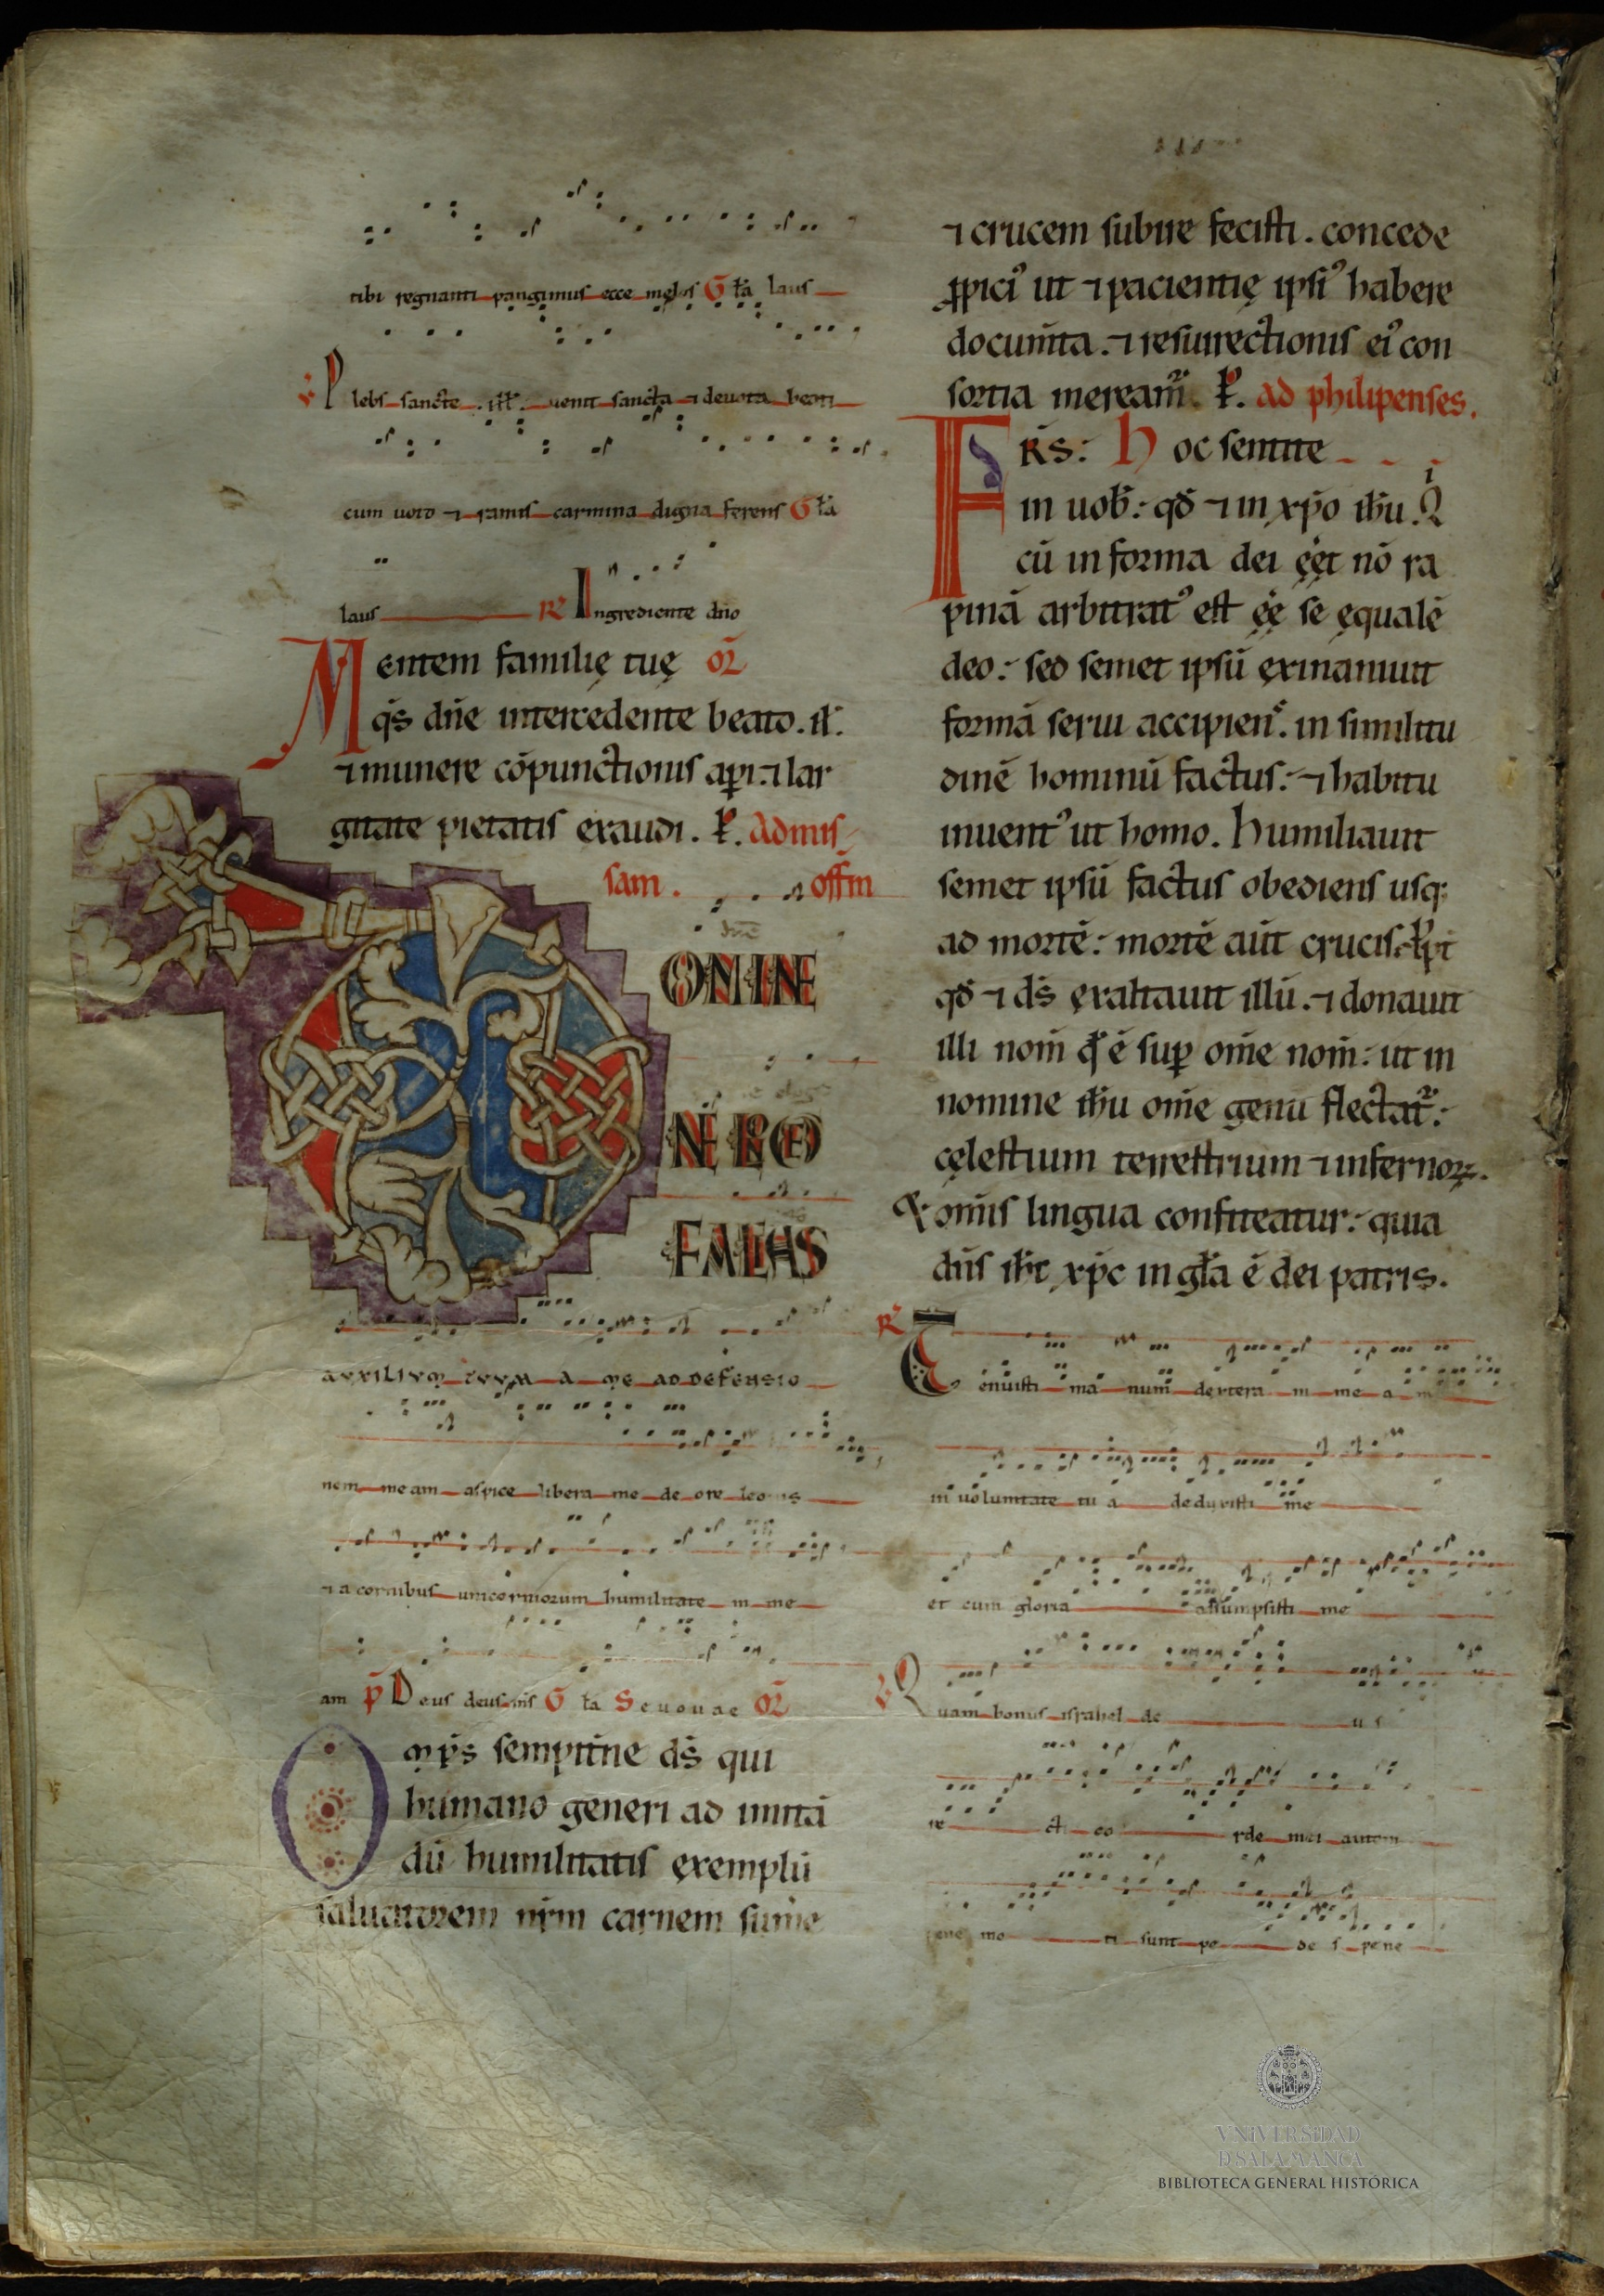
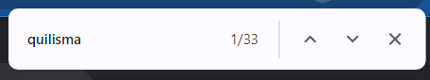
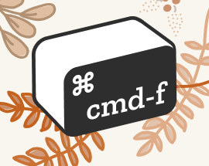
Notes:
Let’s now imagine something else.
For instance, we open a music manuscript available on a digital repository such as the Bibliothèque Nationale de France, or the Bodleyan Library, or the Portuguese Early Music Database, and we press the ‘Find’ key to look for specific neume shapes
CLICK, a quilisma neume, for example.

Slide 4
Notes:
Imagine now that the digital infrastructure behind the curtain... I mean the screen, by magic, automatically browses all the folios of the manuscript and returns all the occurrences of the quilisma.
Wouldn’t this be fantastic? Of course! Because this would increase our understanding of the manuscript, its scribes, history and music.
Alas, today we are not able to perform this kind of analysis simultaneously across a number of manuscripts but the technology that lies behind this kind of search already exists.
Optical Music Recognition (OMR) and music encoding are the two main keys that will enable searching for a neume shape in a manuscript in the blink of an eye.

Slide 5
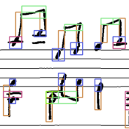
Optical Music Recognition (OMR) is the transformation of images of music notation into digital representations with limited direct human involvement.

Slide 6
Why Would We Want to Encode Music
Machine-readable files → ask the computer:
Perform searches
Melodic search
Search for ornamental neume shapes
Look for melismatic passages
Music analysis
Cross-comparsion
Compute the mode based on: finalis, repercussio, and range

Slide 7

Why Would We Want to Encode Music in MEI?
The Music Encoding Initiative (MEI), inspired by the Text Encoding Initiative (TEI), is a joint effort of an open and cosmopolitan community of technologists, musicologists, musicians, librarians, and music enthusiasts who discuss and approve rules aiming at fully capturing music documents into a machine-readable format

Slide 8
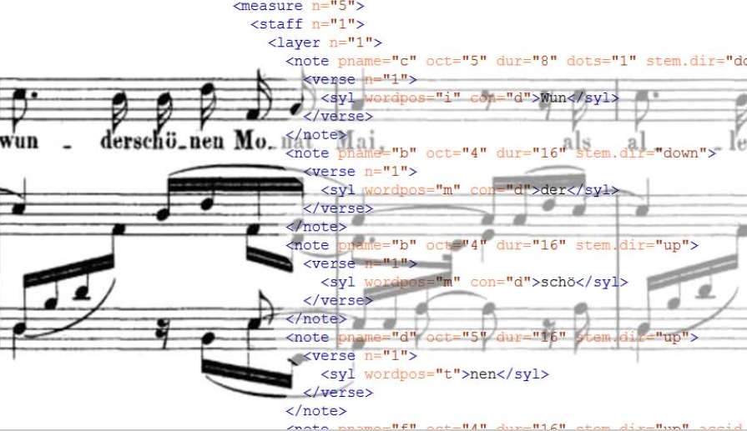
Why Would We Want to Encode Music in MEI?
OMR recognizes the symbols on the page
MEI provides information on the meaning of the musical symbols
Notes:
it is the combination of OMR and MEI that allows the kind of “quilisma” search I presented a moment ago.
While OMR recognizes the symbols on the page, MEI provides information on the meaning of the musical symbols.
MEI focuses on both the actual music (notation and related text and symbols) and the metadata, that is, the information about the music document.
Encoding a music document in a machine-readable structure has applications in libraries and archives since it ensures the preservation of, and long-term access, to music documents.

Slide 9
Why Would We Want to Encode Music in MEI?
MEI (or Music Encoding Initiative) is a machine-readable format that allows for the encoding of early music among other things:
Neume | Mensural | Tablature (plus common Western music notation, CMN)
Rich metadata
Relation to facsimiles & recordings
Markup for Analysis and Harmonies
Scholar editions

Slide 10
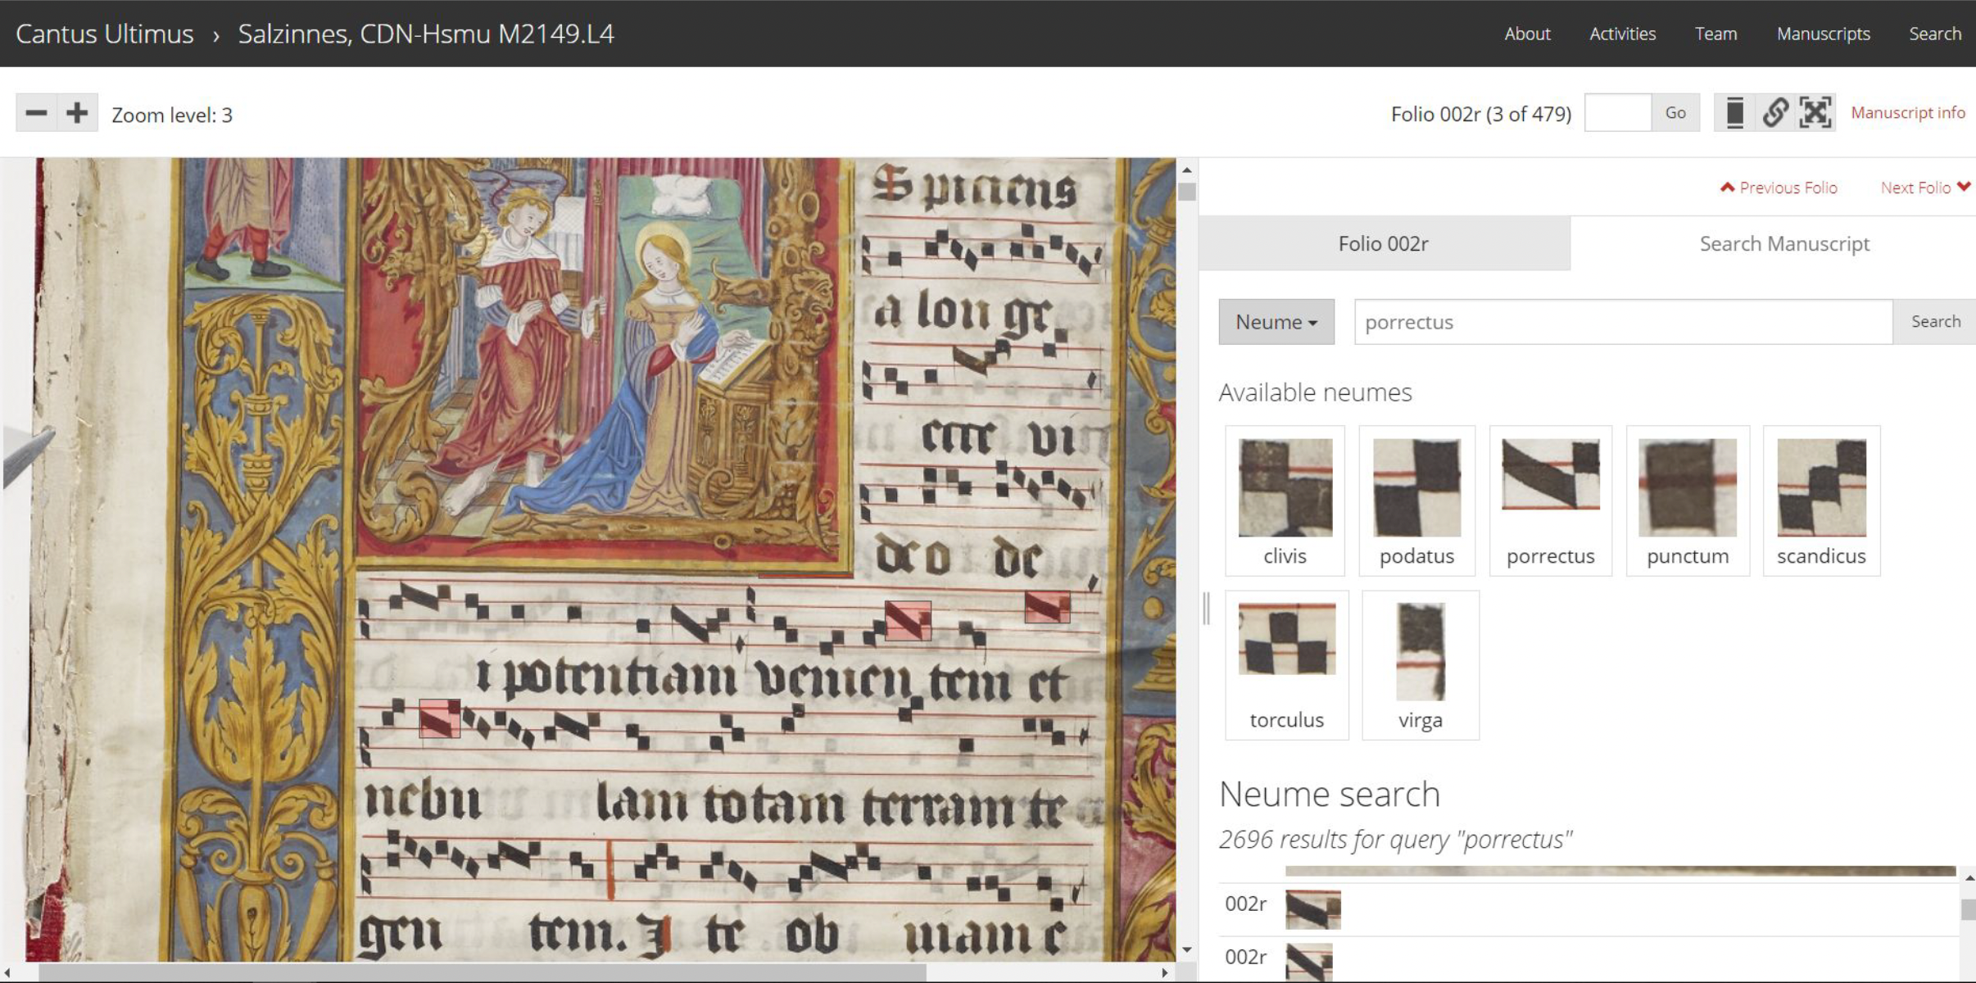
Why Would We Want to Encode Music in MEI?
MEI (or Music Encoding Initiative) is a machine-readable format that allows for the encoding of early music among other things:
Neume | Mensural | Tablature (plus common Western music notation, CMN)
Rich metadata
Relation to facsimiles & recordings
Markup for Analysis and Harmonies
Scholar editions

Slide 11


Two practical examples #1
<neume>
<nc curve= "a"/>
<nc tilt="ne" intm="d"/>
</ neume >
Notes:
The length of the pen-stroke
can have an effect upon two things: Size and Proportions
Size: overall area occupied by the neume on the page
Proportion: is the relative length of each neumatic component
We can see two neumes with the same proportions but different size

Slide 12
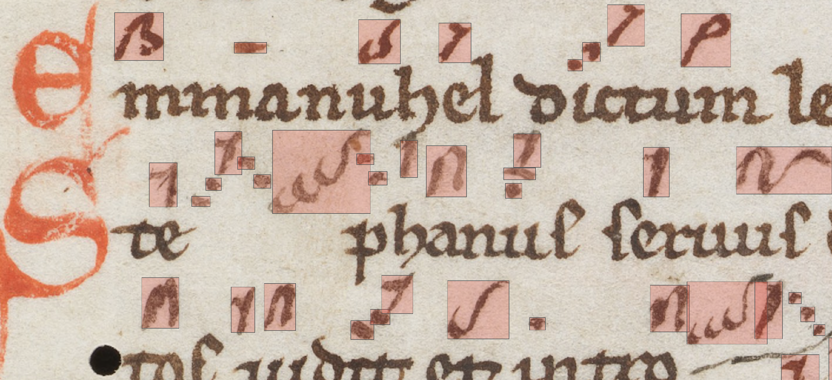
Two practical examples #1
Notes:
Bounding boxes are in the MEI file, they come from the OMR process

Slide 13


Two practical examples #2
<neume>
<nc tilt="ne"/>
<nc tilt="se" rellen="s" intm="d"/>
</neume>
<neume>
<nc tilt="ne"/>
<nc tilt="se" rellen="l" intm="d"/>
</neume>
Notes:
@rel_len {s | l} (shorter, longer) (the relative length of the pen stroke to the previous <nc>; this is optional and to be used only if necessary; it should not be used for the first <nc> within a <neume>)

Slide 14
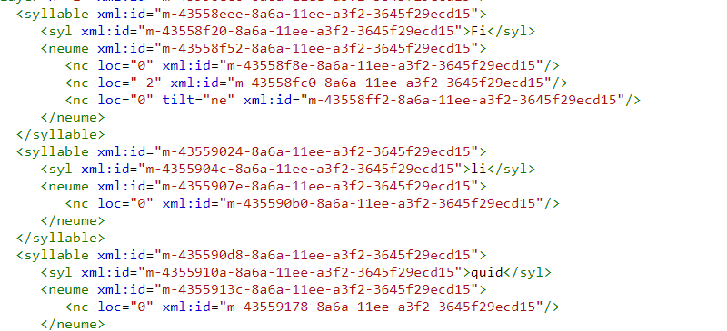
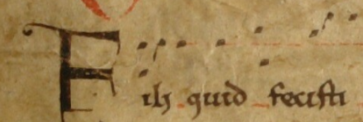
MEI is a hierarchical system of tags employed to describe in a machine-readable language the notation of a specific manuscript

Slide 15
Short Introduction to MEI
Notes:
MARTHA TAKES OVER

Slide 16

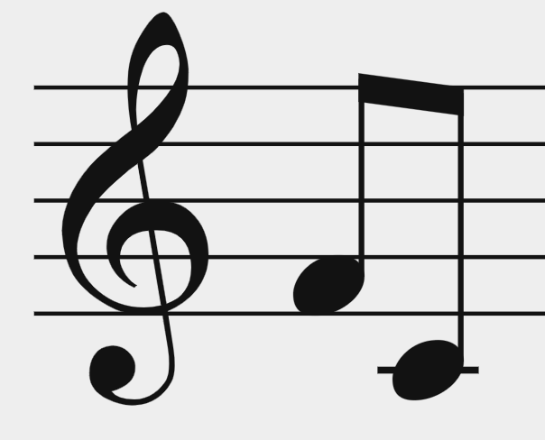
Music Encoding Initiative (MEI)
A community and a format
The format: Encodes music notation in XML (eXtensible Markup Language)
Hierarchical encoding (tree structure)
Its core objects are elements (tags, e.g. <note>)
Opening tags & closing tags → when there is content in between
Self-closing tags → when there is no content to be included in between tags
Uses attributes to define the properties of elements
XML does not ”do” anything, it is just information wrapped in tags
Goal: Encode a wide variety of music documents
<beam>
<note pname="f" oct="4" dur="8"/>
<note pname="c" oct="4" dur="8"/>
</beam>
Opening tag
Self-closing tag
Closing tag
Notes:
"parent - children" relationship
- measure is the PARENT of these <staff> elements
- or you could say: <staff> elements are CHILDREN of the <measure> element
You also have "sibling" relationship
- Those three <staff> elements
- siblings
- they are at the same hierarchy level

Slide 17

XML is a hierarchical encoding system
<neume>
<nc tilt="e" />
<nc tilt="n" intm="u" />
</neume>
<neume> is the parent element
<nc> is a child element
@tilt is an attribute of <nc>
@intm is an attribute of <nc>
= Sign representing one or more musical pitches
= Sign representing a single pitched event, although
the exact pitch may not be known
= Direction of the pen-stroke
= Encodes the melodic interval from the previous pitch

Slide 18
Basic Structure of an MEI File

Slide 19
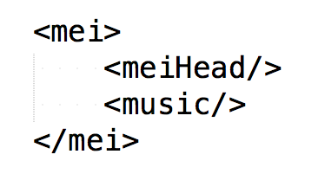
Basic Structure of an MEI File
Metadata
Music
Notes:
In MEI, as in any XML structure, you ALWAYS have a "root element"
So, an element that contains all other elements
The root element for MEI is this tag called "<mei>"
This root <mei> element has TWO children
<meiHead> & <music>

Slide 20
Basic Structure of an MEI File
Metadata
Notes:
In MEI, as in any XML structure, you ALWAYS have a "root element"
So, an element that contains all other elements
The root element for MEI is this tag called "<mei>"
This root <mei> element has TWO children
<meiHead> & <music>

Slide 21
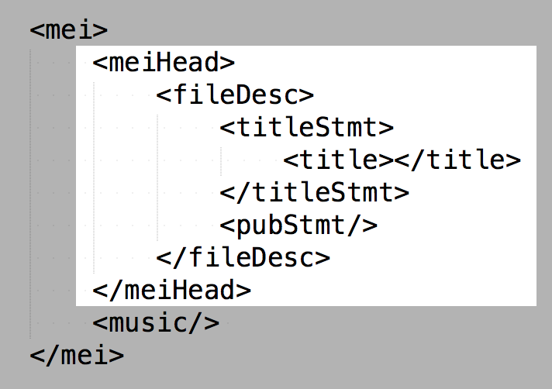
<meiHead> basic elements
TUTORIALS
https://music-encoding.org/ resources/tutorials.html
XML Basics and Minimal MEI File Structure
Outermost basic structure of an MEI-conformant document
(conforms to the schema of MEI)
Basic structure of a “valid” MEI file
Notes:
This is the bare minimum structure for <meiHead>
THIS, FROM BEGINNING TO END:
the <mei> root element with the <meiHead> and the <music> element as children, and with this bare minimum structure within <meiHead>
IS THE MINIMAL / THE MOST BASIC STRUCTURE YOU NEED FOR AN MEI FILE.
AND THEN YOU CAN BUILD UPON THIS BASIC STRUCTURE TO ENCODE MORE DETAILS. BUT THIS IS THE MINIMUM YOU NEED.
[CLICK!] [TUTORIAL]
It will guide you step-by-step on building this minimal MEI file structure
And it will give you the description of each of these elements
[AFTER]
This (with XMLNS [click!]) is the outermost basic structure …
[AFTER 2]
You want more than a basic structure
You want to encode music
And as of now we have seen the basic elements in <meiHead>
-------------------------------------------------------------------------------
[In Tutorial – 1st]
“File Description” element:
direct child element of <meiHead>
provides for a full bibliographic description of a MEI file
“Tittle Statement” element:
A container element for title and responsibility meta-data (composer, arranger, etc.)
The title of a bibliographic entity is given via its mandatory sub-element <title>
“Publication Statement” element:
A container element for information regarding the publication or distribution of a bibliographic item, including the publisher's name and address, the date of publication, and other relevant details
[In Tutorial – 2nd]
What was missing?
@xmlns
What is it?
Defined the name-space being used.
Useful because…
[In Tutorial – 3rd]
MEI-CONFORMANT:
It conforms with the pre-established rules on how to encode an MEI file 🡪 this is, it conforms with the MEI schema
Basic structure of a “VALID” MEI file
[In Tutorial – 4th – LAST]
You have just written a valid MEI file and successfully finished this tutorial. You should be able now:
to understand the basic principles of XML and how it is the basis for MEI
to identify and to write the outermost basic structure of an MEI-conformant document including its title
to differentiate between two main sections of a MEI file responsible for metadata information (<meiHead>) or information about the musical content (<music>).

Slide 22
Basic Structure of an MEI File
Music
Notes:
In MEI, as in any XML structure, you ALWAYS have a "root element"
So, an element that contains all other elements
The root element for MEI is this tag called "<mei>"
This root <mei> element has TWO children
<meiHead> & <music>

Slide 23
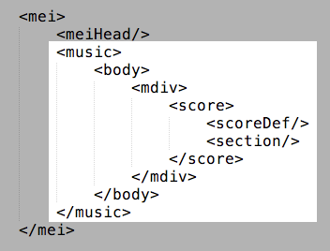
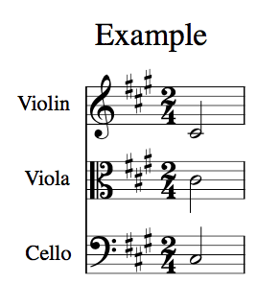
<music> basic elements
“Metadata,” but for the voices
Actual music content
Notes:
This is the basic structure of the music element
<music> will have a child <body> ...
Regardless of which piece of music you are encoding, you will always need to provide this structure ( you have to include all these elements )
So, this structure will be the same for all of you regardless of which piece you are entering
BUT the contents of [CLICK!] THESE two elements would vary depending on the music you are encoding.
scoreDef 🡪 “metadata” but for the voices not for the whole work
Section 🡪 actual music content (notes)
Let’s take a look at each of them individually

Slide 24
<music> basic elements
“Metadata,” but for the voices
Notes:
So let's start with <scoreDef>

Slide 25
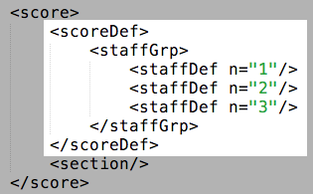
<scoreDef> - General Information for Voices
General information for ALL voices
Meter
Key
Specific information for EACH voice
Clef
Label
Number of staff-lines (@lines)
@n
required for validation
https://music-encoding.org/guidelines/v5/content/shared.html
Notes:
MEANINGS!
(Structure, with names element names and names-expanded)
Brown box (& go to example box)
<scoreDef> MUST CONTAIN a <staffGrp>
Magenta box (& go to example cicles)
The first occurrence of <staffDef> must indicate the number of staff lines via @lines
Each <staffDef> must contain an @n attribute [ I will explain later its importance ]

Slide 26
<music> basic elements
Actual music content
Notes:
The section element

Slide 27
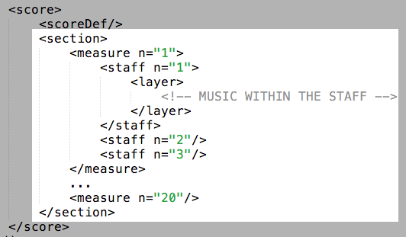
<section> - Actual Music
https://music-encoding.org/guidelines/v5/content/shared.html
Notes:
Made up of <measures> which are then made up of [CLICK]
<staffs>

Slide 28
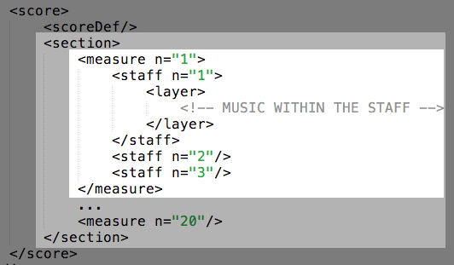
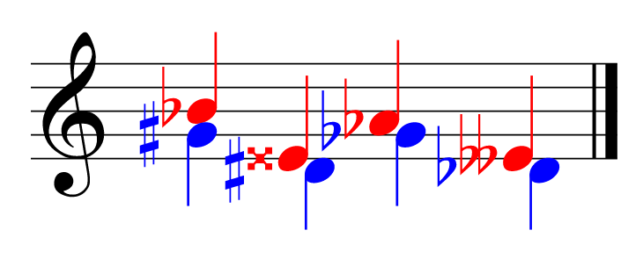
<section> - Actual Music
<layer n=”1”>
<layer n=”2”>
https://music-encoding.org/guidelines/v5/content/shared.html
Notes:
[After Click] <staffs!>
In each <staff> you HAVE TO HAVE a <layer> element 🡪 HERE IS WHERE THE NOTES GO!
<layer> allows for having different layers (“voices”) in a single staff.
So, FINALLY, lets see how to encode NOTES / RESTS! [ next! ]

Slide 29
Early Music has No Measures!
Notes:
[SHORT BREAK!]

Slide 30
Monophonic Music has a Single Staff
Notes:
[SHORT BREAK!]

Slide 31
Common Structure for Monophonic Music
“Metadata,” but for the voices
Actual music content
Notes:
common structure
here (dotted rectangle) --> where your files will look different depending on the music you are encoding

Slide 32
MEI for Neume Notation
Most neume notation is used to set music to an existing text. Therefore, the “syllable” is the fundamental unit of structure, with the neumes themselves serving as a means of “sonifying” the text.
Therefore, the syllable element provides high-level organization in this repertoire.
Notes:
The `syllable` element is used as the primary organizational element for neume notation within a `layer` element. Within `syllable`, the `syl` element defined in the `MEI.shared` module is used for encoding the textual content, while the `neume` and `nc` elements are used to encode the neumes themselves.

Slide 33
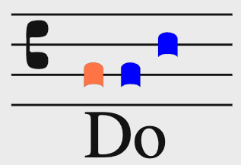
Elements
<syllable>
One <syl> child
One or more <neume> children
neume component <nc> children, these are the individual notes that form part of the neume
<syllable>
<syl>Do</syl>
<neume>
<nc loc="2" />
</neume>
<neume>
<nc loc="2" />
<nc loc="4" />
</neume>
</syllable>
Notes:
The `syllable` element is used as the primary organizational element for neume notation within a `layer` element. Within `syllable`, the `syl` is used for encoding the textual content, while the `neume` and `nc` elements are used to encode the neumes themselves.
one syl
Several neumes (with their nc)
---
<syllable> Neume notation can be thought of as “neumed text”. Therefore, the syllable element provides high-level organization in this repertoire.
<syl> (syllable) – Individual lyric syllable.
<neume> Sign representing one or more musical pitches. As such, a <neume> consists of one or more <nc> element(s)
<nc> Sign representing a single pitched event, although the exact pitch may not be known

Slide 34
Elements
<syllable>
One <syl> child
One or more <neume> children
neume component <nc> children, these are the individual notes that form part of the neume
Attributes of neume components:
Pitch
@pname = c | d | e | f | g | a | b
@oct = … 2 | 3 | 4 …
@loc: position in the staff (integer, 0 is the first line) = … -2 | -1 | 0 | 1 | 2 …
@intm: melodic interval (integer: negative, zero, positive) = … -2 | -1 | 0 | 1 | 2 …
Shape
@tilt: direction of penstroke = n | s | se | …
@curve = c | a
…
Notes:
<syllable> Neume notation can be thought of as “neumed text”. Therefore, the syllable element provides high-level organization in this repertoire.
<syl> (syllable) – Individual lyric syllable.
<neume> Sign representing one or more musical pitches. As such, a <neume> consists of one or more <nc> element(s)
<nc> Sign representing a single pitched event, although the exact pitch may not be known

Slide 35
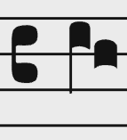
Elements
<syllable>
One <syl> child
One or more <neume> children
neume component <nc> children, these are the individual notes that form part of the neume
Attributes of neume components:
Pitch
@pname = c | d | e | f | g | a | b
@oct = … 2 | 3 | 4 …
@loc: position in the staff (integer, 0 is the first line) = … -2 | -1 | 0 | 1 | 2 …
@intm: melodic interval (integer: negative, zero, positive) = … -2 | -1 | 0 | 1 | 2 …
Shape
@tilt: direction of penstroke = n | s | se | …
@curve = c | a
…
<neume>
<nc pname="d" oct="3" tilt="n" />
<nc pname="c" oct="3" />
</neume>
Notes:
<syllable> Neume notation can be thought of as “neumed text”. Therefore, the syllable element provides high-level organization in this repertoire.
<syl> (syllable) – Individual lyric syllable.
<neume> Sign representing one or more musical pitches. As such, a <neume> consists of one or more <nc> element(s)
<nc> Sign representing a single pitched event, although the exact pitch may not be known

Slide 36
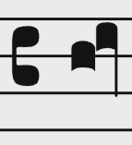
Elements
<syllable>
One <syl> child
One or more <neume> children
neume component <nc> children, these are the individual notes that form part of the neume
Attributes of neume components:
Pitch
@pname = c | d | e | f | g | a | b
@oct = … 2 | 3 | 4 …
@loc: position in the staff (integer, 0 is the first line) = … -2 | -1 | 0 | 1 | 2 …
@intm: melodic interval (integer: negative, zero, positive) = … -2 | -1 | 0 | 1 | 2 …
Shape
@tilt: direction of penstroke = n | s | se | …
@curve = c | a
…
<neume>
<nc loc="4" />
<nc intm="1" tilt="s" />
</neume>
Notes:
<syllable> Neume notation can be thought of as “neumed text”. Therefore, the syllable element provides high-level organization in this repertoire.
<syl> (syllable) – Individual lyric syllable.
<neume> Sign representing one or more musical pitches. As such, a <neume> consists of one or more <nc> element(s)
<nc> Sign representing a single pitched event, although the exact pitch may not be known

Slide 37
Elements
<syllable>
One <syl> child
One or more <neume> children
neume component <nc> children, these are the individual notes that form part of the neume
Attributes of neume components:
Pitch
@pname = c | d | e | f | g | a | b
@oct = … 2 | 3 | 4 …
@loc: position in the staff (integer, 0 is the first line) = … -2 | -1 | 0 | 1 | 2 …
@intm: melodic interval (integer: negative, zero, positive) = … -2 | -1 | 0 | 1 | 2 …
Shape
@tilt: direction of penstroke = n | s | se | …
@curve = c | a
…
<neume>
<nc tilt="e" />
<nc tilt="n" intm="u" />
</neume>
Notes:
<syllable> Neume notation can be thought of as “neumed text”. Therefore, the syllable element provides high-level organization in this repertoire.
<syl> (syllable) – Individual lyric syllable.
<neume> Sign representing one or more musical pitches. As such, a <neume> consists of one or more <nc> element(s)
<nc> Sign representing a single pitched event, although the exact pitch may not be known

Slide 38
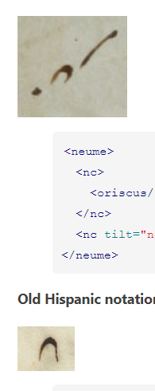
Elements
<syllable>
One <syl> child
One or more <neume> children
neume component <nc> children, these are the individual notes that form part of the neume
Attributes of neume components:
Pitch
@pname = c | d | e | f | g | a | b
@oct = … 2 | 3 | 4 …
@loc: position in the staff (integer, 0 is the first line) = … -2 | -1 | 0 | 1 | 2 …
@intm: melodic interval (integer: negative, zero, positive) = … -2 | -1 | 0 | 1 | 2 …
Shape
@tilt: direction of penstroke = n | s | se | …
@curve = c | a
…
<neume>
<nc tilt="ne" />
<nc tilt="se" curve="c" intm="d" />
</neume>
Old hispanic notation
Notes:
<syllable> Neume notation can be thought of as “neumed text”. Therefore, the syllable element provides high-level organization in this repertoire.
<syl> (syllable) – Individual lyric syllable.
<neume> Sign representing one or more musical pitches. As such, a <neume> consists of one or more <nc> element(s)
<nc> Sign representing a single pitched event, although the exact pitch may not be known

Slide 39
Elements
<syllable>
One <syl> child
One or more <neume> children
neume component <nc> children, these are the individual notes that form part of the neume
<nc> can have children too:
<episema>
<hispanTick>
<liquescent>
<oriscus>
<quilisma>
<strophicus>
https://music-encoding.org/guidelines/v5/elements/nc.html#mayContain_class_tab
Notes:
<syllable> Neume notation can be thought of as “neumed text”. Therefore, the syllable element provides high-level organization in this repertoire.
<syl> (syllable) – Individual lyric syllable.
<neume> Sign representing one or more musical pitches. As such, a <neume> consists of one or more <nc> element(s)
<nc> Sign representing a single pitched event, although the exact pitch may not be known

Slide 40
Elements
<syllable>
One <syl> child
One or more <neume> children
neume component <nc> children, these are the individual notes that form part of the neume
<nc> can have children too:
<neume>
<nc tilt="e"/>
<nc>
<oriscus/>
</nc>
<nc tilt="ne" intm="u"/>
</neume>
<episema>
<hispanTick>
<liquescent>
<oriscus>
<quilisma>
<strophicus>
St. Gall
https://music-encoding.org/guidelines/v5/elements/nc.html#mayContain_class_tab
Notes:
<syllable> Neume notation can be thought of as “neumed text”. Therefore, the syllable element provides high-level organization in this repertoire.
<syl> (syllable) – Individual lyric syllable.
<neume> Sign representing one or more musical pitches. As such, a <neume> consists of one or more <nc> element(s)
<nc> Sign representing a single pitched event, although the exact pitch may not be known

Slide 41
Elements
<syllable>
One <syl> child
One or more <neume> children
neume component <nc> children, these are the individual notes that form part of the neume
<nc> can have children too:
Attributes for <episema>:
@form ‘v’ (vertical) or ‘h’ (horizontal)
@place placement on <nc>
Attributes for <liquescent>:
@curve direction of curve
@looped boolean (when present, ‘true’)
<neume>
<nc tilt="e"/>
<nc>
<oriscus/>
</nc>
<nc tilt="ne" intm="u"/>
</neume>
<episema>
<hispanTick>
<liquescent>
<oriscus>
<quilisma>
<strophicus>
St. Gall
https://music-encoding.org/guidelines/v5/elements/nc.html#mayContain_class_tab
Notes:
<syllable> Neume notation can be thought of as “neumed text”. Therefore, the syllable element provides high-level organization in this repertoire.
<syl> (syllable) – Individual lyric syllable.
<neume> Sign representing one or more musical pitches. As such, a <neume> consists of one or more <nc> element(s)
<nc> Sign representing a single pitched event, although the exact pitch may not be known

Slide 42
Attributes of neume components:
@pname (pitch name) {[a-g] | unknown}
@oct (octave number) {[0-9]}
@rellen (length of pen stroke relative to previous <nc> in the neume) {s = shorter | l = longer}
@tilt (direction of pen stroke) {n | ne | e | se | s | sw | w | nw}
@con (connection to the previous <nc> in the neume) {g = gapped | l = looped | e = extended}
@ligated {true | false}
Attributes of neume components in stafless notation:
@intm (melodic interval relative to previous <nc> in the neume) {u = up | d = down | s = same}
@s-shape (described by the direction of the initial penstroke) {n = north | s = south | …}
@curve (pen stroke) {c = clockwise | a = anti-clockwise}
https://music-encoding.org/guidelines/v5/elements/nc.html#attributes_full_tab

Slide 43
<neume>
<nc tilt="ne"/>
<nc tilt="se" rellen="s" intm="d"/>
</neume>
<neume>
<nc tilt="ne"/>
<nc tilt="se" rellen="l" intm="d"/>
</neume>
Notes:
I USED THIS EXAMPLE ABOVE

Slide 44




Neumatic connections Neutral – High – Low neumes
<neume>
<nc curve="a"/>
<nc tilt="ne" rellen="l" intm="u"/>
<nc tilt="se" rellen="s"
intm="d" curve="c"/>
</neume>
<neume>
<nc tilt="se"/>
<nc con="g" tilt="ne" rellen="l"
intm="u"/>
<nc tilt="se" rellen="l" intm="d"/>
</neume>
<neume>
<nc tilt="se"/>
<nc tilt="ne" rellen="l" intm="u"/>
<nc tilt="se" intm="d"/>
</neume>
<neume>
<nc s-shaped="s"/>
<nc con="l" tilt="ne" intm="u"/>
<nc tilt="se" rellen="s" intm="d"/>
</neume>

Slide 45
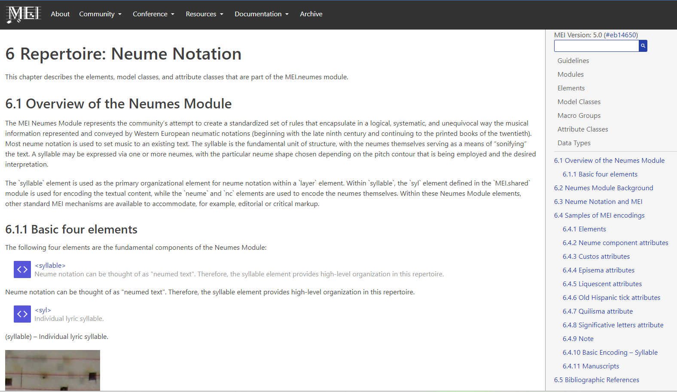
MEI has a long list of <elements> and @attributes employed to capture the meaning of early notations
https://music-encoding.org/guidelines/v5/content/neumes.html
Notes:
MEI has a long list of <elements> and @attributes employed to capture the meaning of early notations and some DACT members, including Jennifer Bain and Debra Lacoste being here today, contributed to the development of the current list of elements and attributes for neumes in MEI.
In the next slides, I’d like to think about neumes from the point of view of a modern music encoder. Specifically, I’d like to introduce the three main challenges in encoding neumes in MEI

Slide 46

Notes:
ELSA is back

Slide 47
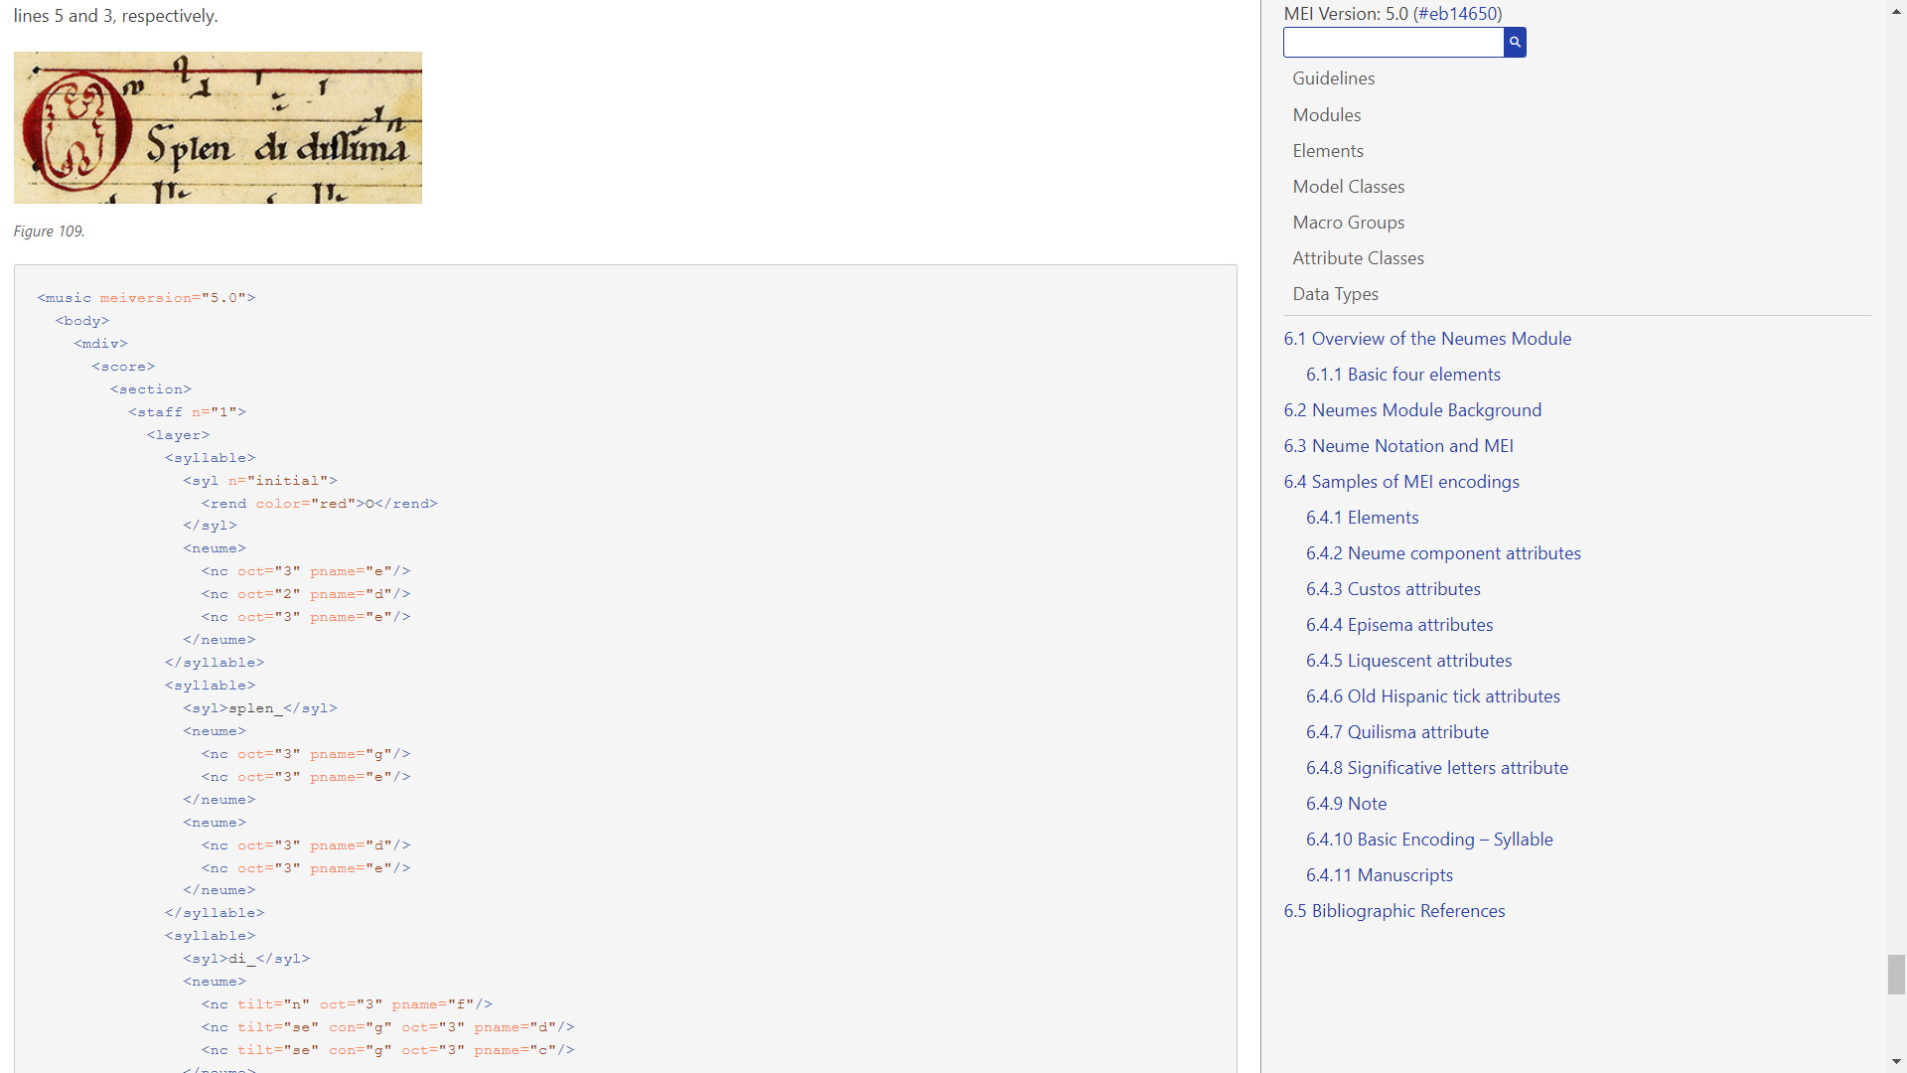

Slide 48

There are three main challenges in
encoding neumatic notations in :
Convey only partial musical information
Great variety of signs and existence of different regional styles of early notation
Some regional styles occasionally share graphically similar shapes; these are understood by modern scholars to represent the same, a similar or even a different musical meaning.
The neume shapes could either mirror graphically the musical characteristics of the sound being represented or the meaning attached to them was ruled by conventions
Notes:
The first relates to the fact that early notation was just a mnemonic aid that helped the readers to recall the music they already knew by heart and, as such, it conveys only partial musical information.

Slide 49
There are three main challenges in
encoding neumatic notations in :
Convey only partial musical information
Great variety of signs and existence of different regional styles of early notation
Some regional styles occasionally share graphically similar shapes; these are understood by modern scholars to represent the same, a similar or even a different musical meaning.
The neume shapes could either mirror graphically the musical characteristics of the sound being represented or the meaning attached to them was ruled by conventions
Notes:
The second challenge refers to the great variety of signs and existence of different regional styles of early notation; early-music manuscripts display a great graphical variety of musical signs, which include both neumes and extra-notational elements conveying musical information.
Some of those regional notational styles occasionally share graphically similar shapes; these similar shapes within the different notational styles are understood by modern scholars to represent the same, a similar or even a different musical meaning.

Slide 50
There are three main challenges in
encoding neumatic notations in :
Convey only partial musical information
Great variety of signs and existence of different regional styles of early notation
Some regional styles occasionally share graphically similar shapes; these are understood by modern scholars to represent the same, a similar or even a different musical meaning.
The neume shapes could either mirror graphically the musical characteristics of the sound being represented or the meaning attached to them was ruled by conventions
Notes:
CLICK Finally, while on occasion the neume shapes appear to mirror graphically the musical characteristics of the sound being represented (e.g., pen-stroke going up = rising melody), in many instances it is generally understood that the meaning attached to the neumes (or the extra-notational elements) may not be so straight-forward, but instead was ruled by conventions shared by the people who knew orally the musical repertory being fixed in written form by means of notation.

Slide 51
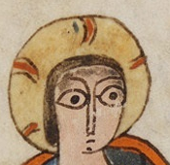
What’s the impact of these challenges on music encoding?
In the next slides we’ll see some different neume shapes that are given the same name by medieval scribes.
We start with the oriscus
Notes:
What’s the impact of these challenges on music encoding?
To answer this question, we’ll have a look at some complicated examples.
In the next slides we’ll see some different neume shapes that are given the same name by medieval scribes. We start with the oriscus

Slide 52
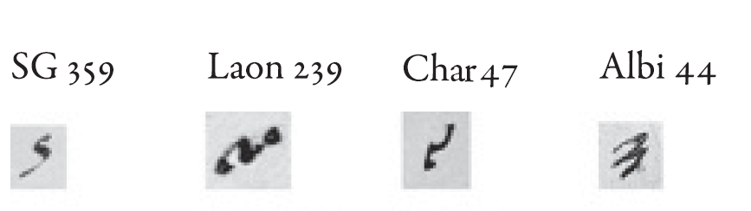
Ex. from: J. Grier, Musical Notation in the West, Cambridge University Press, 2021, p. 30
<oriscus>
Neumatic
Scripts:
St Gall
Lotharingian
Breton
Aquitanian
Notes:
Medieval writers called the oriscus without defining its meaning.
In Western chant the orisicus is a special neume signifying one note and it is usually the middle note of a three-note raising gesture
The Oriscus neumes gathered in this example come from four different manuscripts written in the ninth/tenth century.
Modern scholars accept the terminology used in medieval musical treatises but we are not sure that these ‘oriscus’ were performed the same way everywhere.
Hence, it is not sufficient to encode these neumes simply using the element <oriscus>. Instead, it is crucial to employ further elements and attributes that allow us to differentiate the graphical appearance of these neumes.

Slide 53
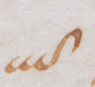
<quilisma>
The quilisma is a neume found in most early notational dialects, and it gives information on a specific vocal delivery
It is usually between two notes a third apart. Medieval music theorists spoke of it as a trembling and rising sound.

Slide 54
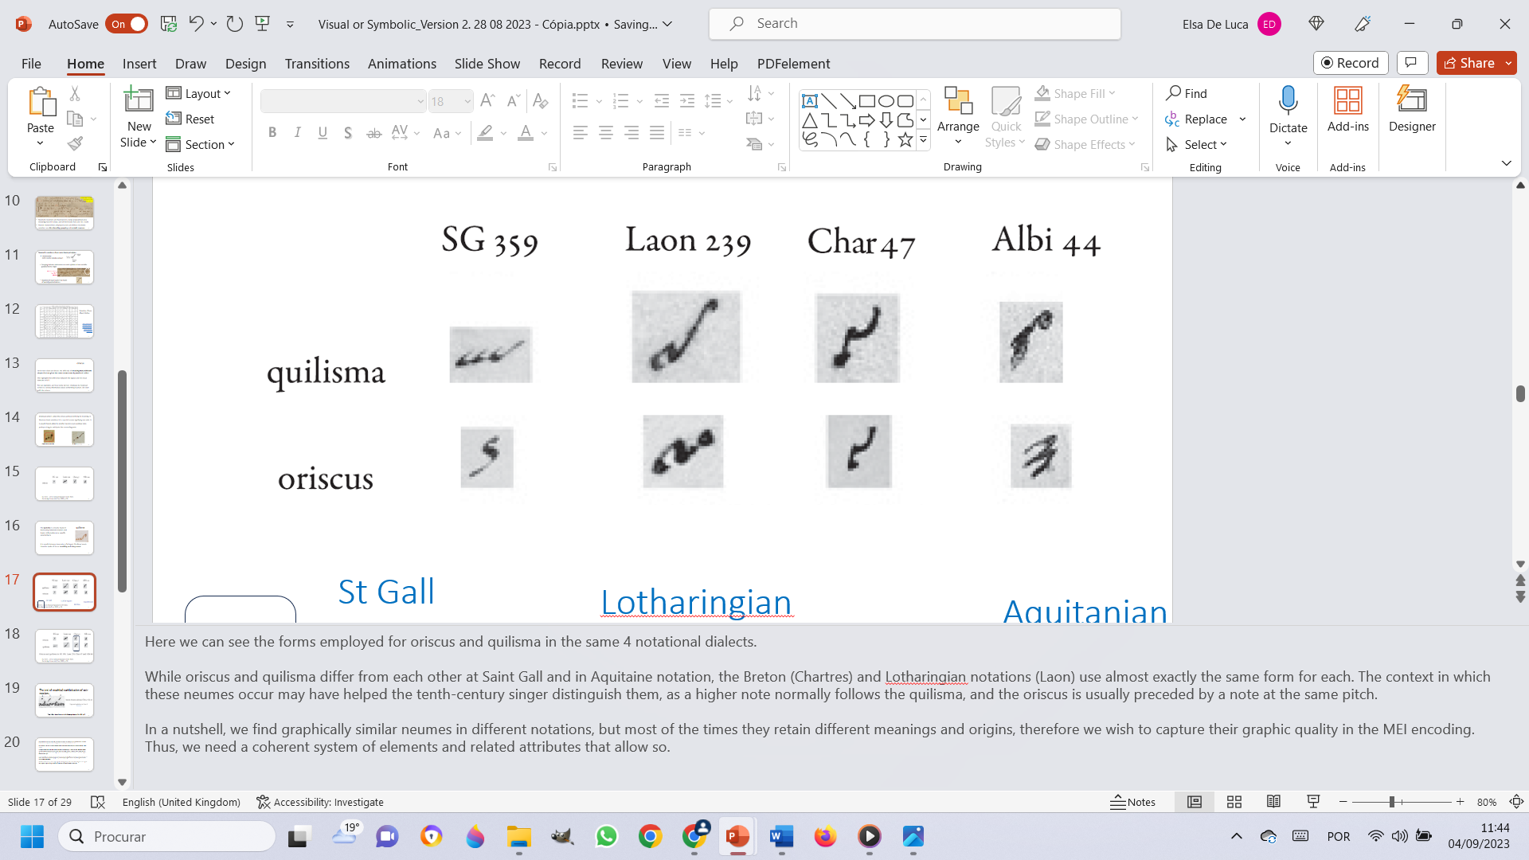
<quilisma>
<oriscus>
NOTATIONS:
St Gall
Lotharingian
Aquitanian
Breton
Ex. from: J. Grier, Musical Notation in the West, Cambridge University Press, 2021, p. 30
Notes:
Here we can see the forms employed for oriscus and quilisma in the same 4 notational dialects.
While oriscus and quilisma differ from each other at Saint Gall and in Aquitanian notation, the Breton and Lotharingian notations use almost exactly the same form for each. The context in which these neumes occur may have helped the tenth-century singer distinguish them, as a higher note normally follows the quilisma, and the oriscus is usually preceded by a note at the same pitch.
This example shows that we can find graphically similar neumes in different notations, but most of the times they retain different meanings and origins.
This has meant a particular set of challenge for modern scholar who attempt to express neumatic notation in MEI schemas.

Slide 55
The encoding must be conceived as a coherent system of elements and related attributes that allow us to capture the graphic quality of the neumes and their meaning.

Slide 56
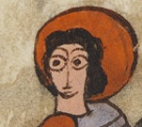
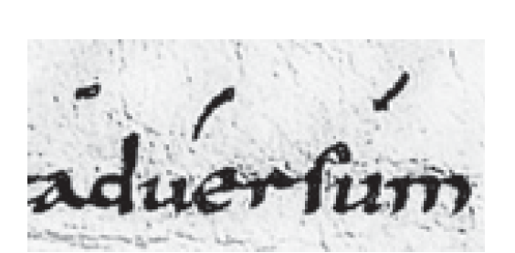
The level of graphical sophistication of early notations
1
2
3
Chartres 47,
fol. 6v,
adversum
Ex. from: J. Grier, Musical Notation in the West, Cambridge University Press, 2021, p. 29
Notes:
In this final example we can appreciate the level of graphical sophistication of early notations.
The second and third syllables of “aduersum” use two very similar signs, one is a curved tilt (neume n. 2), the other is a straight tilt (neume n. 3).
The second neume shows two notes, and the third neume represent only one note, higher than the previous one.
The curve in the second neume also indicates that some special attention should be paid to the pronunciation of the consonant cluster ‘r’ and ‘s’ in the text (adversum).
This example is important because it shows that it is of paramount importance to be intimately familiar with the meaning of neume shapes in order to encode them correctly.
Furthermore, in the encoding of early notations we want to be able to retain BOTH graphical and symbolic information about the neumes because even if we do not grasp entirely the meaning of graphical variants, they could represent different styles of vocal performance.

Slide 57

Developing MEI for early music is great fun for palaeographers!

Slide 58
Developing MEI for early music is great fun for palaeographers!
MEI challenges our modern understanding of musical notation and forces us to clarify the difference between what we see and what we know, or believe to know.
Notes:
MEI challenges our modern understanding of musical notation and forces us to clarify the difference between what we see and what we know, or believe to know.
Deciding the encoding rules (hierarirchy of elements and their relative attributes) implies that we must clarify if our interpretation has a solid foundation or if it is, simply, an educated guess.
Besides, it also forces us to observe and take into account the tiniest graphical variants because they could represent different styles of vocal performance

Slide 59
The ongoing digital revolution holds the potential to unveil unforeseen possibilities which could challenge and overturn traditional research methodologies and allow entirely new opportunities for music research.
Automatic analysis across larger repertories would probably allow us to discover new patterns of usage and work out the meaning of early neumatic scripts!

Slide 60
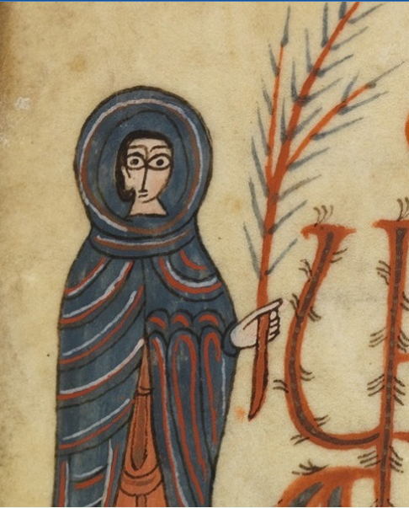

Thank you!

