Slide 1
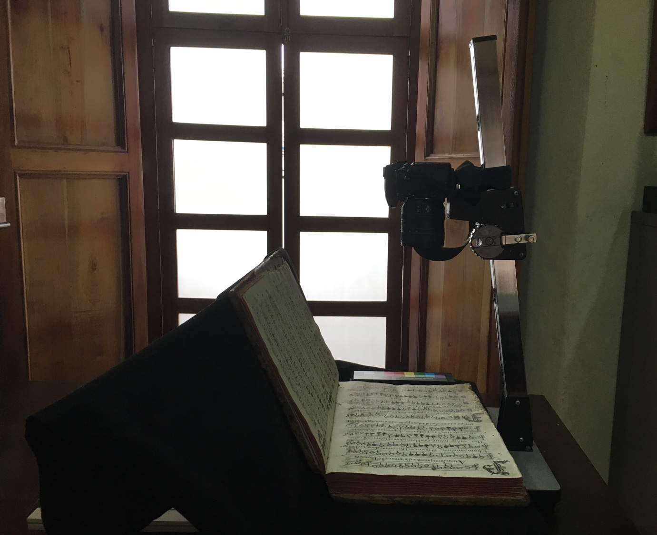
From Manuscript to Pixel: Tips for a Digitizing Campaign and for Handling Endangered Sources Digitization of Polyphonic Choirbooks in Guatemala
Martha E. Thomae
Postdoctoral research fellow at CESEM, NOVA University of Lisbon
Research Seminars Series “Musicologists and Their Sources: The Alchemy of Turning Parchment into Pixels”
NOVA University of Lisbon, Portugal, 22 June 2024
Notes:
A project I conducted as part of my PhD studies at McGill University in Canada

Slide 2
Outline
Guatemalan Cathedral (GuatC) polyphonic choirbook collection
Digitization of GuatC 1
Final remarks
Notes:
1st) briefly describe the corpus
2nd) The digitization process itself
3rd) Final remarks about this paper
---
STEPS FOLLOWING DIGITIZATION, because the project is not only about obtaining digital images, but also using OMR and other music-encoding technologies to obtain symbolic files that encode this music.

Slide 3
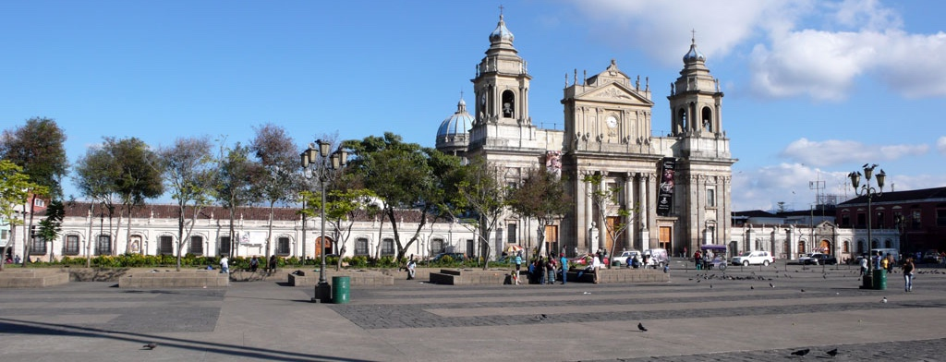
The GuatC Collection
Collection of six choirbooks, held at the Archivo Histórico Arquidiocesano de Guatemala (Archdiocesan Historical Archive of Guatemala, AHAG) in Guatemala City.
Notes:
(Metropolitan Cathedral + Archiepiscopal palace)

Slide 4
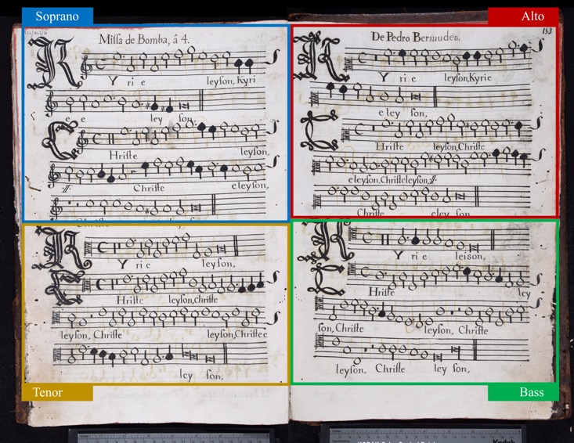
The GuatC Collection
Collection of six choirbooks, held at the Archivo Histórico Arquidiocesano de Guatemala (Archdiocesan Historical Archive of Guatemala, AHAG) in Guatemala City.
Manuscripts written in paper
Large dimensions
Average folio size = 30 cm x 45 cm
Book 6, size = 21.5 cm x 30 cm
In mensural notation
Voices in choirbook format
Notes:
[1] & [2] so, they are oversize items
And these two characteristics will play a role on which technologies can be used to digitize the folios
[3] Music notation system used in Europe in the thirteenth to sixteenth centuries
[4] choirbook format → as shown in the left, where each of the voices is contained on a different area of the BOOK OPENING. In case of a four-voice piece, as in the image, each voice lies on a different quadrant of the opening.

Slide 5
The GuatC Collection
Copied in the 17th and 18th centuries
Repertoire: mostly 16th c. polyphonic music
Document a continuous performance tradition of sacred choral music from the Renaissance to early 19th century
Notes:
[IMPORTANT COLLECTION;
BUT NOT AS ACCESSIBLE]

Slide 6
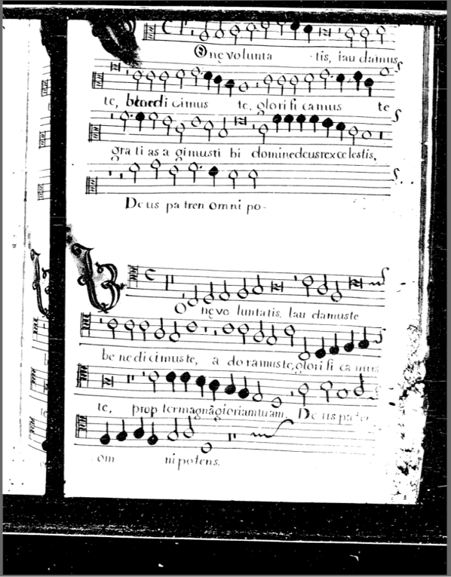
The GuatC Collection
Inventories of books 1 to 3:
Pujol (1965), Stevenson (1970), Snow (1996)
General overview of the repertoire
Morales Abril (2015)
Transcriptions into modern notation
Snow’s transcription of 4th book
Dieter Lehnhoff and Omar Morales Abril
Microfilms (1984) → Books 1 to 3
Access → Permission from the archive
Microfilm at Centro de Investigaciones Regionales de Mesoamérica (CIRMA).
DjVu file at Música Colonial Archive. Reel 9. Folio 2r. (https://www.cpdl.org/wiki/index.php/M%C3%BAsica_Colonial_Archive)
Notes:
[NOT AS ACCESSIBLE]
(1), (2), (3) Snow did a full transcription of book 4. But other than that, we have a few pieces transcribed by Guatemalan musicologists DL and OMA
MUSIC CONTENT
IMAGING
(4) Microfilms --> (books 1–3) --> IMAGE ON THE RIGHT --> the images are cropped & missing pages.
(5) Access to the music --> archive
SO, the goal of this dissertation project was to… [NEXT SLIDE]

Slide 7
Preserve and increase access to this music corpus by using digitization and music-encoding technologies
Notes:
The goal of this dissertation project is to…

Slide 8
Digitization of GuatC 1
Notes:
I am going to talk about the project now

Slide 9
The Start
Request of permission for the project to the AHAG:
Contacted Guatemalan musicologist Omar Morales Abril
Morales Abril advised me to contact the AHAG archivist Alejandro Conde
Conde suggested to ask permission for a pilot project involving only one of the choirbooks
Wrote a letter to the chancellor of the Ecclesiastical Curia of Santiago de Guatemala and director of the AHAG, Father Eddy René Calvillo, to ask permission for the pilot (23 October 2018)
The archivist hand it to Father Calvillo
Approved on 31 October 2018
Notes:
[request permission --> nerve-recking process --> personally invested in the project --> really really want them to say yes]
successful & not-that successful stories
Approved one week later on Halloween 2018
Once I obtained permission, I started to do look for digitization and conservation options

Slide 10
The Survey & Findings
The AHAG does not have its own digitization and conservation departments
Outsource digitization and conservation
Paper conservation:
Centro de Rescate, Estudio y Análisis Científico del Arte (CREA)
Non-profit institution
Conservation assessment of the six choirbooks (November 2018)
Notes:
[1] & [2]
[3] For conservation, I needed people with experience in "paper" conservation.
Normally, you need conservators to take a look at the item to digitize, to evaluate if it is ok to digitize it and advise you on how to handle it during digitization. And they also provide conservation treatment to the item prior to digitization (like unfolding, cleaning, dusting).
[3.1&2] I found a non-profit institution that does paper conservation, the ...
[3.3 End] Based on the conservation report, I chose the best preserved choirbook for the pilot

Slide 11
The Survey & Findings
Digitization:
Survey for digitization equipment and services in Guatemala City
Nothing suitable due to the large dimensions or conservation status of the manuscripts
Do It Yourself (DIY) Book Scanner
No digitization technician with experience with special collections → Professional photographer (suggested by another archive)
Notes:
Now, for digitization
[After 1] Look in the National Library, the National Bank, University Libraries, and private digitization services.
Common for public institutions to not have resources for digitization + that was the case of the NL
I had better luck with private institutions.
But in the end [2], so I ended up [3]
--
[4 SUBpoint] He helped one time on the digitization of a large map → so he had experience with digitizing oversized items
So, we agreed that I would handle the manuscript & he will set the camera parameters at the beginning of the project.
-- TRANSITION --
We have our personnel now. So let’s talk about the <ANIMATION> DIY Book Scanner. </ANIMATION>

Slide 12
Digitization of GuatC 1
THE EQUIPMENT

Slide 13
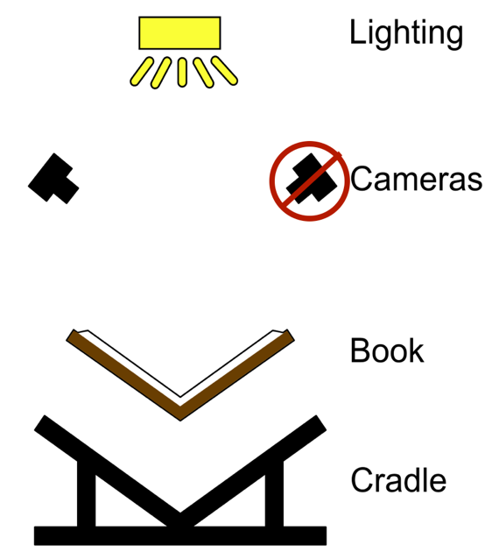
DIY Book Scanner
Book cradle
Built by German Thomae (my father)
Camera(s)
Borrowed from the McGill Music Library
Nikon D750 (Image sensor of 24.3-effective-megapixels)
Images saved at 300-dpi resolution (with no interpolation)
Lighting
Borrowed from DDMAL Lab, McGill University
Two natural-light LED panels
FADGI approved
http://diybookscanner.org
Notes:
All the parts were either built or borrowed.
[1] Built out of wood by my father in Guatemala
[2] Given the sensor’s effective resolution and the size of the manuscript → we can save images at 300 dpi resolution → a good archival resolution according to the Federal Agencies Digitization Guidelines Initiative or FADGI (used mostly in the USA, like the Library of Congress). It is even better to have 400 dpi as suggested by DIAMM and FADGI itself, and higher values are even better; but 300dpi is an acceptable archiving resolution.
[3] Lights
Let’s talk about the one built part → the cradle

Slide 14
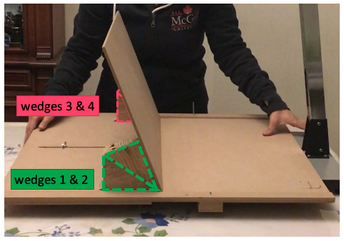
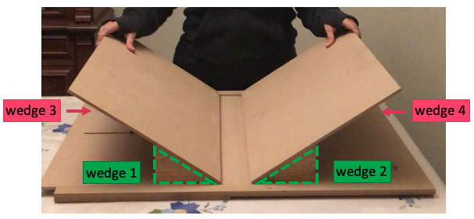
Book Cradle: Two Configurations
Both allow for the book to be opened at 110º angle
By using four wedges of 35º
Notes:
2nd config → Result of an at home test
And I provide the link to those videos in the paper as well as the diagrams and dimensions to build this cradle for other projects.
---
(Scanner rig with Adjustable camera mounts)

Slide 15
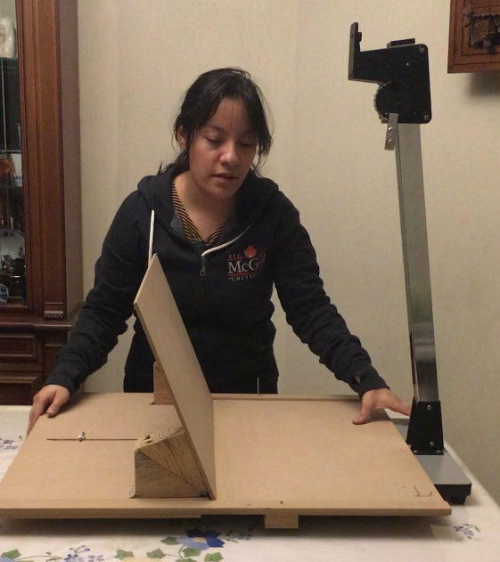
The Book Cradle (with copy stand)
Easier to set the camera perpendicular to the page
And to keep the camera at a constant distance from the page
Notes:
I ended up using this open-at-one-side cradle configuration with a copystand since it was easier to
[1] Set the camera perpendicular to the page using a copystand
[2] And to keep the camera at a constant distance from the page using the copystand’s graded arm

Slide 16
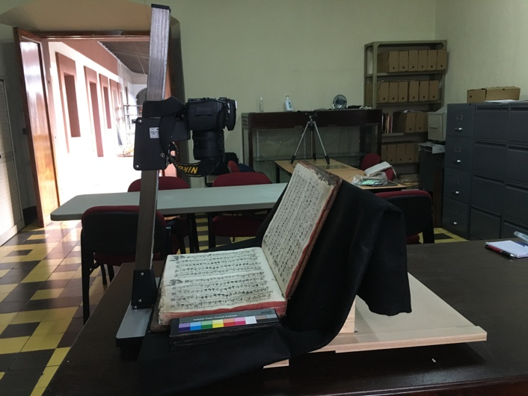
Cradle & Camera

Slide 17
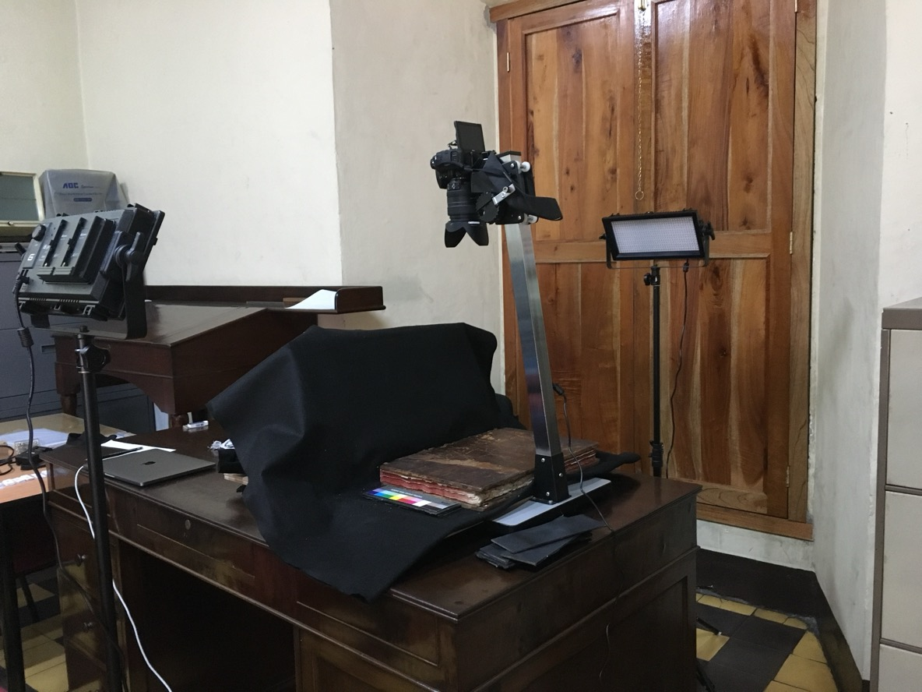
Lighting
Two natural-light LED panels
Not recommended to use flash or natural light
One at each side → even distribution
Angle → avoid reflections on the camera lens

Slide 18
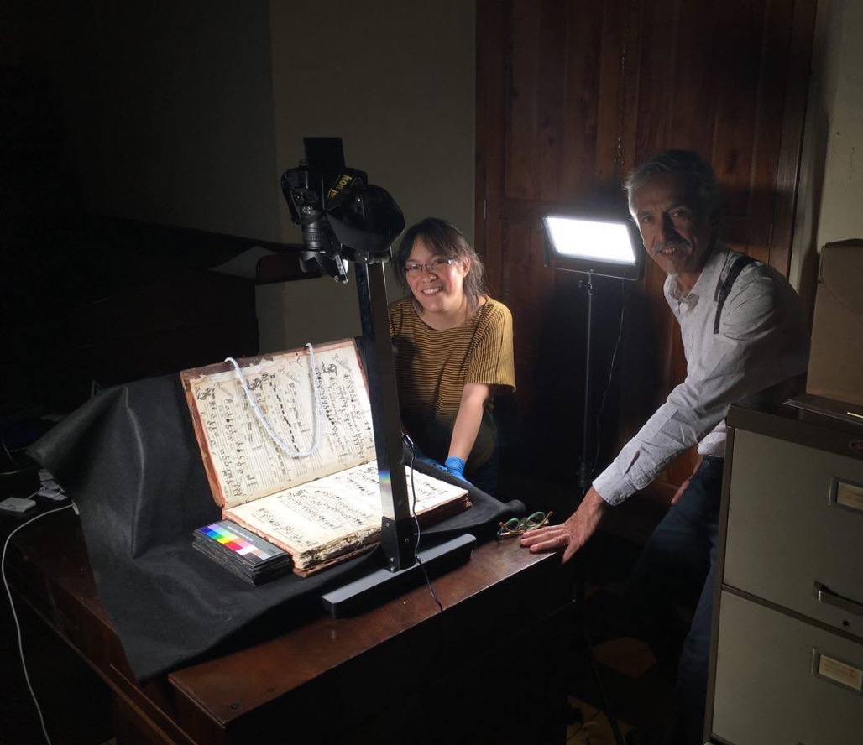
DIY Book Scanner
Advice from:
Digital Image Archive of Medieval Music (DIAMM)
Julia Craig-McFeely
Bibliothèque et Archives Nationales du Québec (BAnQ)
McGill Library
Canadian institutions
with professional photographer Daniel Hernández-Salazar
Notes:
Here I am with the professional photographer Daniel Hernández Salazar
Institutions

Slide 19
Digitization of GuatC 1
THE PROCESS
Notes:
And some issues

Slide 20
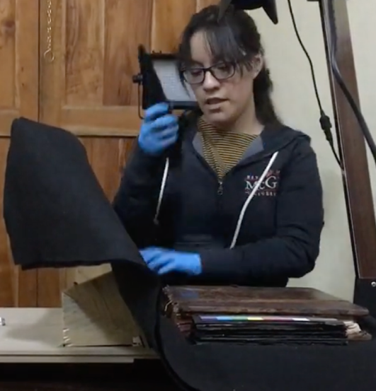
Digitization Process & Issues
The photographer set the camera parameters on the first day
Since I conducted the digitization on my own, he set the camera to shoot in one of its auto modes (Mode A – Aperture-Priority Auto)
Also, auto white balancing & auto-focus
Have to come up with a small workflow (series of steps) to make the digitization process as consistent as possible
The “page falling” and the “increase in curvature” issues when reaching the other end of the book
Notes:
[1] The photographer set the camera parameters on the first day
Since I conducted the digitization on my own, he set the camera to perform a few actions in automatic mode,
Like auto white balancing & auto focus
And also shoot in mode A or Aperture-Priority Auto
Where the photographer sets the aperture value of the camera
(you can see in the paper how he set this value)
And the camera calculates the shutter speed based on this aperture value and the room conditions.
Therefore, I tried to keep the room conditions as constant as possible by:
turning all the lights off,
shutting close the wooden doors of the windows,
and only using the two LED panels as my light source.
[2] I have videos of the digitization process → I will include the Youtube channel of this at the end
[3] (explain with picture)

Slide 21
Digitization Process & Issues
Shooting tethered with the camera connected wirelessly to my computer:
Preview the photos on a larger monitor
Shoot remotely
Issues with computer application tethered to the camera
Solution during digitization: Switched to mobile tethered application
In the future: camera’s official tethering app, connect through a (long) cable, and save images on external hard drive
Notes:
Use the camera’s official tethering app
→ compatibility issues
Connect the camera using a cable rather than wirelessly
→ connection issues
Save the images on an external hard drive
→ memory issues
==============================================================================================
1 (DlsDashboard)
2 (Nikon’s Wireless Mobile Utility, WMU)
----
1st time shooting tethered
Other advantages to explore from tethering software in the future:
Adding comments → beneficial to keep track of verso numbers
Changing file path → to save the images directly on the external hard drive
Adding starts → for selecting the preferred image from a set of photographs of the same page.

Slide 22
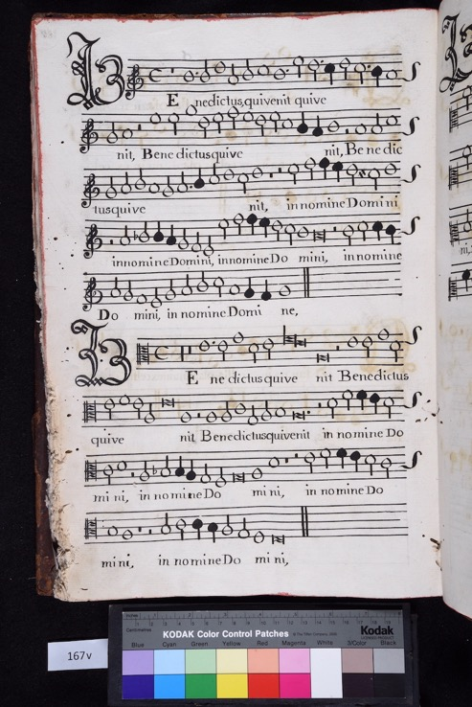
Digitization Process & Issues
As with most manuscripts, the verso of the pages is not numbered (only the front of the pages are numbered)
Difficult to keep track of the page number for versos
Although the tethering app can do that
Solution proposed by the photographer: Include the verso numbers in the photograph itself

Slide 23

Digitization Process & Issues
As with most manuscripts, the verso of the pages is not numbered (only the front of the pages are numbered)
Difficult to keep track of the page number for versos
Although the tethering app can do that
Solution proposed by the photographer: Include the verso numbers in the photograph itself

Slide 24
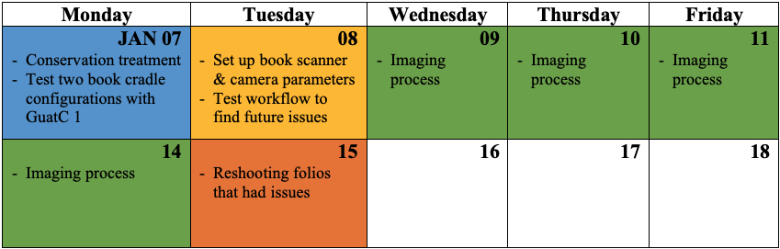
The Digitization Project (January 2019)
Photographing the manuscript
Photographing the manuscript
Photographing the manuscript
Photographing the manuscript
Master: NEFF (Nikon’s RAW format) & TIFF, unmodified
Access: JPEG
Resolution: 300 dpi
Bit depth: 24 bits
From a total of approx. 580 photos taken, approx. 187 were discarded
Notes:
The whole process took a week and a half:
I used four days of shooting
Plus, the previous two days for testing and preparation,
And one day at the end for evaluation of the images and reshooting
Information about the pictures taken …

Slide 25
Final Remarks
Try to present a realistic solution for the digitization of old music books in an archive that lacks the resources and personnel for this kind of project
There are many music documents locked in archives around the world
Not all these archives have digitization and conservation departments
Present a case study of a digitization project conducted under such conditions
Hope it is useful for similar initiatives

Slide 26
Final Remarks
Hope it is useful for similar initiatives
Website: https://martha-thomae.github.io/projects/digit_guatemala
YouTube Playlist: https://www.youtube.com/playlist?list=PLC08Ptt ZdHNBpl8z1MV2U3UZFNBL3jQ5g
Paper: Martha E. Thomae, Julie E. Cumming, and Ichiro Fujinaga. 2022. Digitization of Choirbooks in Guatemala. In Proceedings of the 9th International Conference on Digital Libraries for Musicology (DLfM '22). Association for Computing Machinery, New York, NY, USA, 19–26. https://doi.org/10.1145/3543882.3543885

Slide 27
Acknowledgements
Omar Morales Abril, Guatemalan musicologist that provided me with advice and information about the choirbooks
Alejandro Conde, AHAG’s archivist that supported and facilitated the project
José German Thomae Villela for constructing the cradle
Darryl Cameron for lending the copystand
Daniel Hernández-Salazar for setting the camera parameters
The following experts for their advice regarding digitization and conservation of special collections: Julia Craig-McFeely and Lynda Sayce (DIAMM), Jessica Régimbald, Marie-Chantal Anctil, and Michel Legendre (BAnQ), and Gregory Houston (McGill Library)

Slide 28
Acknowledgements
Archivo Histórico Arquidiocesano de Guatemala (AHAG) for granting permission for the project
Distributed Digital Music Archives and Libraries (DDMAL) Lab at McGill University for lending the lights and other parts of the equipment
Marvin Duchow Music Library at McGill University for lending the camera
Centro de Rescate, Estudio y Análisis Científico del Arte (CREA) for the conservation assessment of the collection and the conservation treatment of the choirbook

Slide 29













Thank you!
marthathomae@fcsh.unl.pt
https://martha-thomae.github.io/projects/digit_guatemala

Slide 30
Extra Slides

Slide 31
Digitization of GuatC 1
THE EQUIPMENT:
Cradle

Slide 32
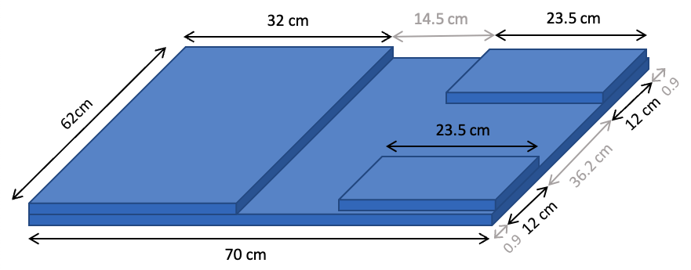
Bottom of the Cradle

Slide 33
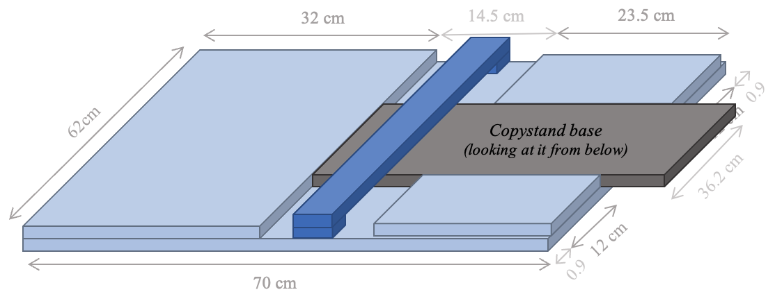
Bottom of the Cradle

Slide 34
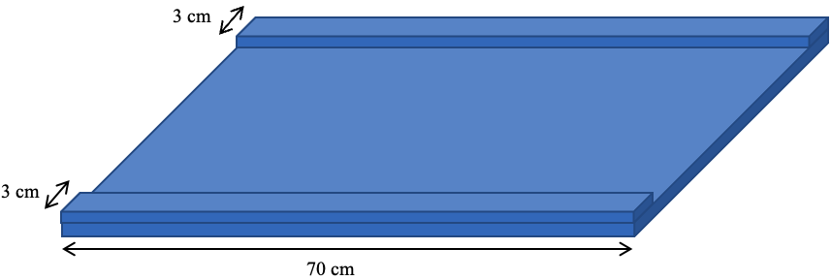
Top of the Cradle

Slide 35
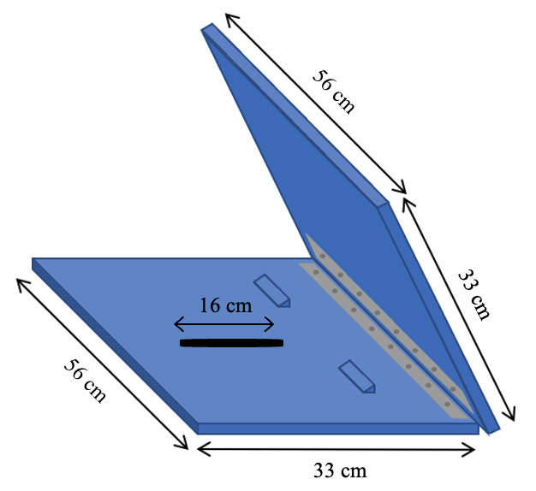
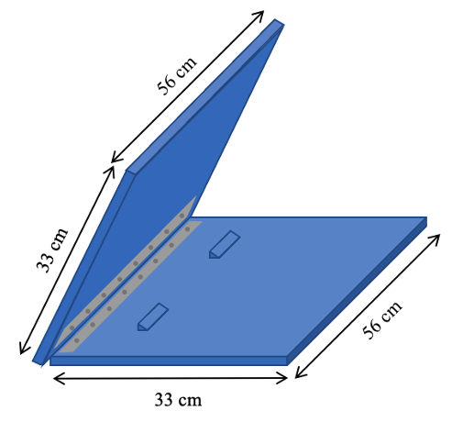
Left Door
Right Door

Slide 36
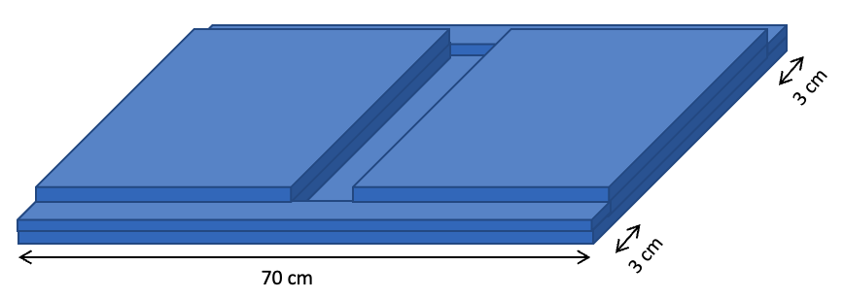
Cradle with (Closed) Doors

Slide 37
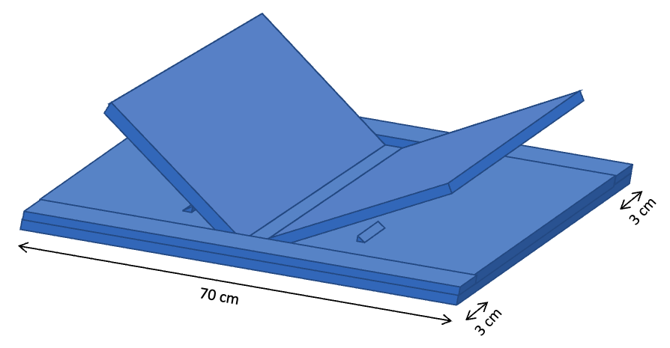
Cradle with (Opened) Doors

Slide 38
Digitization of GuatC 1
NEXT STEPS

Slide 39
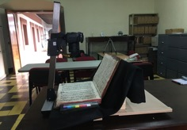
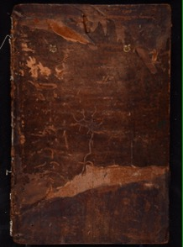
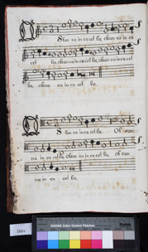
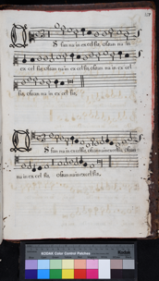
Digitization Do-it-yourself (DIY) book scanner
Digitization
Part of a larger workflow to preserve and increase access to this music corpus through digital images and symbolic scores
Manuscript
Digital images
Notes:
[I HAVE DONE IT!]

Slide 40


Three-Step Workflow
Digitization
Optical music recognition (OMR)
Automatic voice alignment & editorial correction
Manuscript
Digital images
Notes:
[I HAVE DONE IT!]

Slide 41
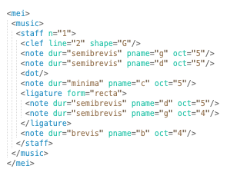
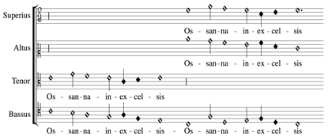
Three-Step Workflow
Digitization
Optical music recognition (OMR)
Automatic voice alignment & editorial correction
MEI Score file
interpreted durations (i.e., alteration & imperfection)
Manuscript
MEI Parts file encodes the symbols in each part/voice of the images
Digital images
Notes:
(I developed the scoring-up part of the Measuring Polyphony Editor)
Workflow to go from the manuscript to digital images to machine-readable files encoding the mensural music in score format
TO HAVE A SYSTEM that semi-AUTOMATICALLY TRANSCRIBE MENSURAL MUSIC FROM DIGITAL IMAGES OF MANUSCRIPTS IN MENSURAL NOTATION
OF COURSE, THIS IS ALL DISCUSSED IN MY DISSERTATION

Slide 42
The GuatC Collection

Slide 43
The GuatC Collection
Composers | Pieces by Composer (%)
Iberian Peninsula (never set foot in the Americas and traveled to the Americas) | 53%
Local composers (born and trained in Guatemala or Mexico) | 12%
Other parts of Europe | 8%
Region of activity is still unknown | 1%
Anonymous & chant pieces | 26%
Notes:
Includes the great triumvirate of Spanish polyphonists: Victoria, Morales, and Guerrero
Spanish composers that did travel to the Americas: Hernando Franco and Pedro Bermudez.
--
Local → Gaspar Fernandez → Guatemalan (before: believed he was the Gaspar Fernandes from Evora, Portugal)
--
[These 3 → among the most frequently found composers in various archives from the Mesoamerican region.]
--
Other parts of Europe: Lassus and Palestrina
--

Slide 44
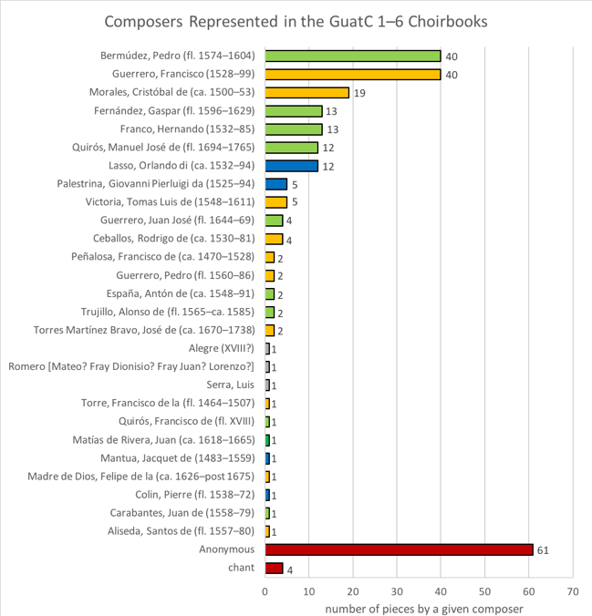
The GuatC Collection
This is a graphic representation of the information provided by Morales Abril (2015, 119–120)
Notes:
Make it bigger (next slide)

Slide 45

*
*
KEY:
Iberian Peninsula (never set foot in the Americas)
Active in the Viceroyalty of New Spain
Other European composers
This is a graphic representation of the information provided by Morales Abril (2015, 119–120)
Notes:
Yellow --> composers from the Iberian Peninsula that never set foot in the Americas
Includes the great triumvirate of Spanish polyphonists: Victoria, Morales, and Guerrero
Green --> composers that were active in the Viceroyalty of New Spain at some point (either European composers that came to the Americas or composers born in the Americas)
This include these 3 --> Pedro Bermudez, Gaspar Fernandez, and Hernando Franco who are among the most frequently found composers in various archives from the Mesoamerican region. The three of them were actually chapel masters at the Cathedral of Guatemala [(also the next one, Quiroz) and Gaspar Fernandez copied various of the choirbooks].
Bermudez and Franco --> Spanish
Fernandez --> Guatemalan (before: believed he was the Gaspar Fernandes from Evora, Portugal)
Here are other local composers (born and trained Guatemalan / Mexican composers)
These two, Fernandez and Quiros are the scribes involved in the choirbook.
Other European composers: Lassus and Palestrina
===============================================================
So, Bermudez [Catedral de Guatemala, de Puebla] and Franco [Catedral de Segovia, de Santo Domingo, de Santiago de Cuba, de Guatemala, de México] are Spanish composers
& Gaspar Fernandez [Catedral de Guatemala, de Puebla] is actually Guatemalan. It was previously believed that he was Portuguese, but recent studies by Omar Morales Abril revealed that this Gaspar Fernandez was born and trained in Guatemala.
===============================================================

Slide 46
*
*
This is a graphic representation of the information provided by Morales Abril (2015, 119–120)
Notes:
---
The choirbooks contain works by Spanish composers (53%),
composers who were born or trained in Guatemala or Mexico (12%),
other European composers (8%),
anonymous pieces (26%),
and pieces by composers whose origin is unknown (1%)

Slide 47
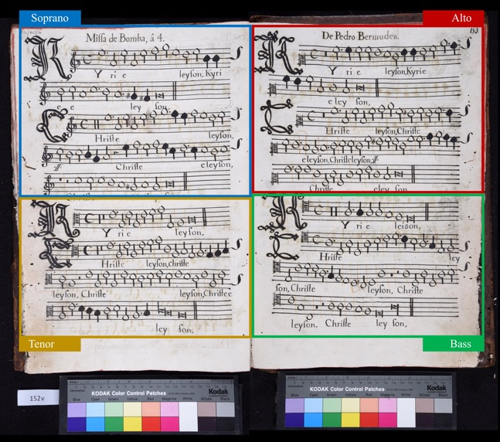
The GuatC Collection
Collection of sacred music
GuatC 1: Book of Masses
GuatC 2: Book of hymns and Magnificats
GuatC 3: Miscellaneous sacred contents
GuatC 4: Book for Holy Week and Salve services
GuatC 5: Miscellaneous sacred contents
GuatC 6: Office of the Dead
Notes:
Collection of SACRED MUSIC

Slide 48
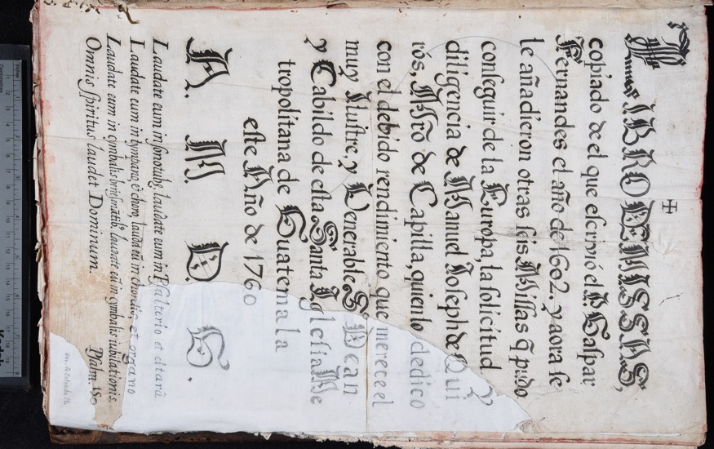
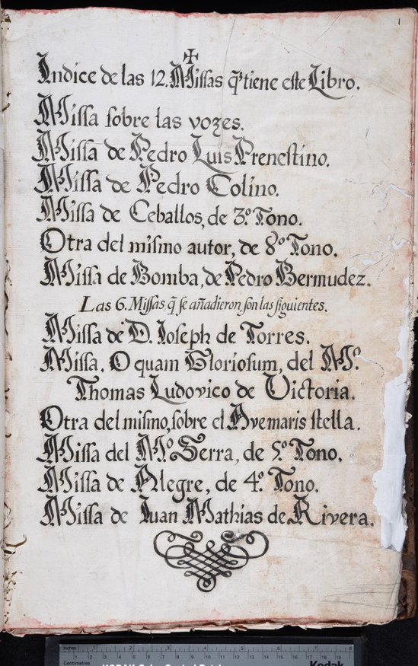
GuatC 1 Book of Masses
12 masses
15 polyphonic liturgical pieces (eighteenth-century addition)
GuatC 1, folio 0r
GuatC 1, folio 1r
Notes:
12 masses, 6 copied in 1602, 6 added in the 1760s
here they are (index page)
----NOT: Gregorio Allegri (Italian, c. 1582 – 17 February 1652)----
15 short polyphonic pieces
Why this choirbook for the pilot project? I will talk about this soon when providing details about the project
===============================================================
IN CASE OF QUESTIONS:
12 masses:
Six of them come from a previous book copied in 1602 (by Gaspar Fernández)
Cristobal de Morales (1), Palestrina (1), Colin (1), Ceballos (2), Bermúdez (1)
The other six were added in the eighteenth century (by Manuel José de Quiroz)
Victoria (2), Torres y Martínez Bravo (1), Serra (1), Alegre (1), Matías de Rivera (1)
15 brief polyphonic pieces (eighteenth century additions)
Pedro Bermúdez, Hernando Franco, Francisco Guerrero, and others
Microfilm images (cropped and missing pages)
Some pieces have been transcribed
Selected items from the microfilms have been transcribed into modern scores and are available in the Choral Public Domain Library “Música colonial scores” site (http://www0.cpdl .org/wiki/index .php/Category:Música_colonial _scores). Unsurprisingly, because the GuatC 1 choirbook is well preserved, many of its pieces have been transcribed. Ten out of its twelve masses can be found in the CPDL Música colonial scores website (missing only Palestrina and one Victoria), but only four of its short pieces have been transcribed (Christus natus est, Bermúdez, folios 180v–181r; Christus natus est, Anonymous, f. 183v–184; Lumen ad revelationem, Hernando Franco, 186v–187rñ Victimae Paschali laudes, Francisco Guerrero, 190v–192r).
All of the masses from the original Libro de Kyries except one, Pedro
Bermúdez’s Missa de Bomba, were brought from Europe. Snow mentions
concordant sources for Morales, Palestrina, Colin, and one of Ceballos’s
masses (his popular Missa tertii toni). The Missa de 8vo Tono by Ceballos is
his Missa Simile est regnum caelorum, a parody mass based on a motet by
Morales. The Missa de Bomba by Pedro Bermúdez, Guatemalan choirmaster
between 1601 and 1603, is a parody mass based on the ensalada La Bomba
by Mateo Flecha (el Viejo). According to Snow, from the group of six masses
added in the eighteenth century, only the ones by Torres, Serra, Alegre, and
Rivera appear to be unique to this manuscript.
===============================================================

Slide 49
Acknowledgements
David Rizo, Karen Desmond, and Juliette Regimbal who made possible for MuRET and the MP-Editor to communicate with one another
Craig Stuart Sapp whose work allowed for the dissonance labels to be displayed in the MP-Editor
Jorge Calvo-Zaragoza, Francisco Castellanos, Antonio Ríos Vila, and José Manuel Iñesta who developed the models used in MuRET
Laurent Pugin for his work on Verovio
Alexander Morgan for his Renaissance dissonance labeler script
Peter Schubert for his expert advice in counterpoint matters
Geneviève Gates-Panneton for her work in the experiment

