Slide 1
Music Retrieval Tools Optical Music Recognition (OMR) and Music Analysis
Antoine Phan CESEM-IN2PAST, NOVA University of Lisbon and McGill University
Martha E. Thomae CESEM-IN2PAST, NOVA University of Lisbon
Elsa De Luca CESEM-IN2PAST, NOVA University of Lisbon
Research Seminars Series “Musicologists and Their Sources: The Alchemy of Turning Parchment into Pixels”
NOVA University of Lisbon, Portugal, 24 June 2024

Slide 2
Music Information Retrieval Tools
Optical music recognition (OMR) Martha E. Thomae
Music search & analysis Antoine Phan
Focus: Early music written in neumatic and mensural scripts

Slide 3
Optical Music Recognition (OMR)
Similar to Optical Character Recognition (OCR)
Where the characters of a digital text document are readable by the computer
It allows to perform content-based searches
For music: Optical Music Recognition (OMR)
The music characters (and text) are readable by the computer
Therefore, in addition to search music pieces by their metadata (e.g., composer, title of the piece, and date)
The music content is searchable (e.g., ask the computer to look for a melody → melodic search)
Moreover, perform computational music analysis

Slide 4
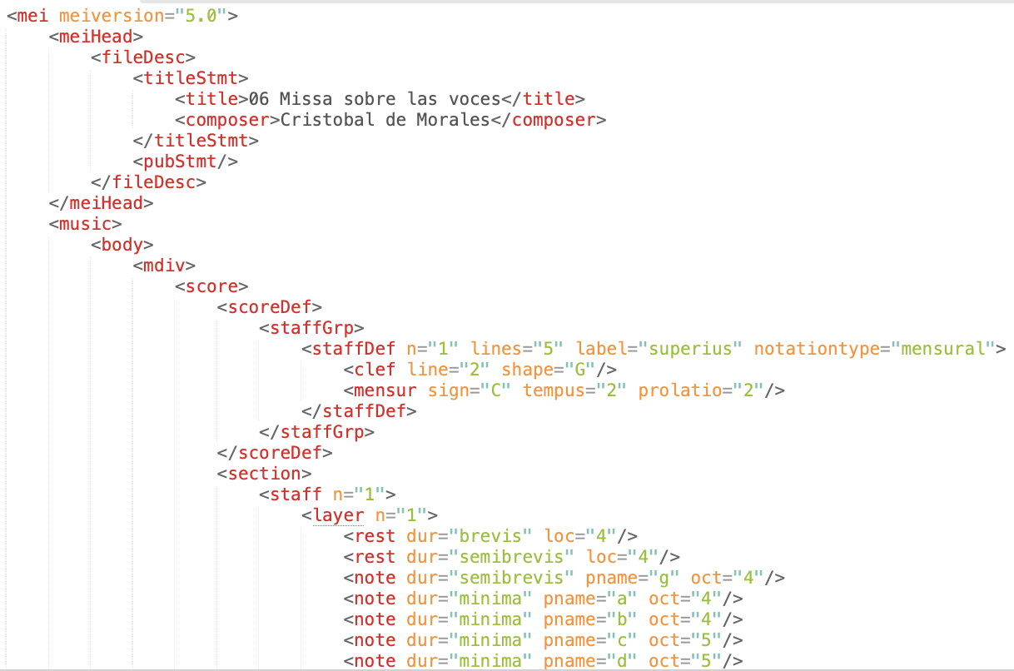
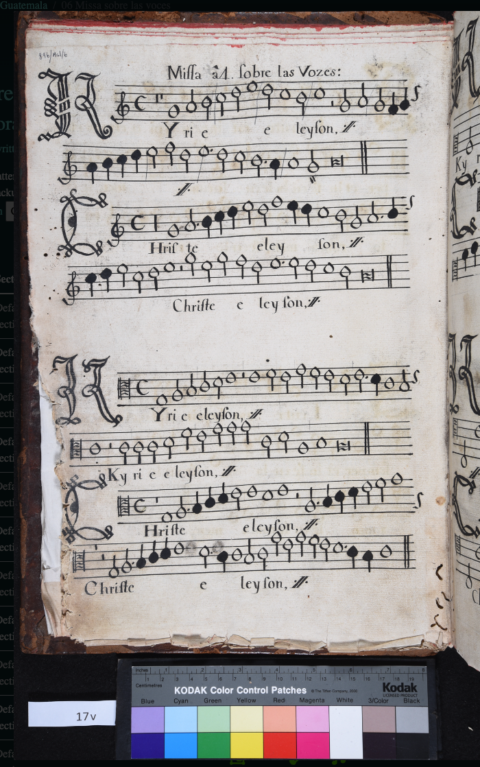
The Traditional OMR Pipeline
Optical Music Recognition

Slide 5
The Traditional OMR Pipeline
Preprocessing or Document Analysis or Document Segmentation
Music Recognition
(a) Staff processing
(b) Music symbol processing
(c) music symbol classification
Music Notation Reconstruction or Music Notation Recognition or Notation Assembly or Music Reconstruction
Final Representation Construction or Music Encoding

Slide 6
Step 1: Preprocessing or Document Analysis
Preprocessing or Document Analysis or Document Segmentation
Music Recognition
(a) Staff processing
(b) Music symbol processing
(c) music symbol classification
Music Notation Reconstruction or Music Notation Recognition or Notation Assembly or Music Reconstruction
Final Representation Construction or Music Encoding

Slide 7
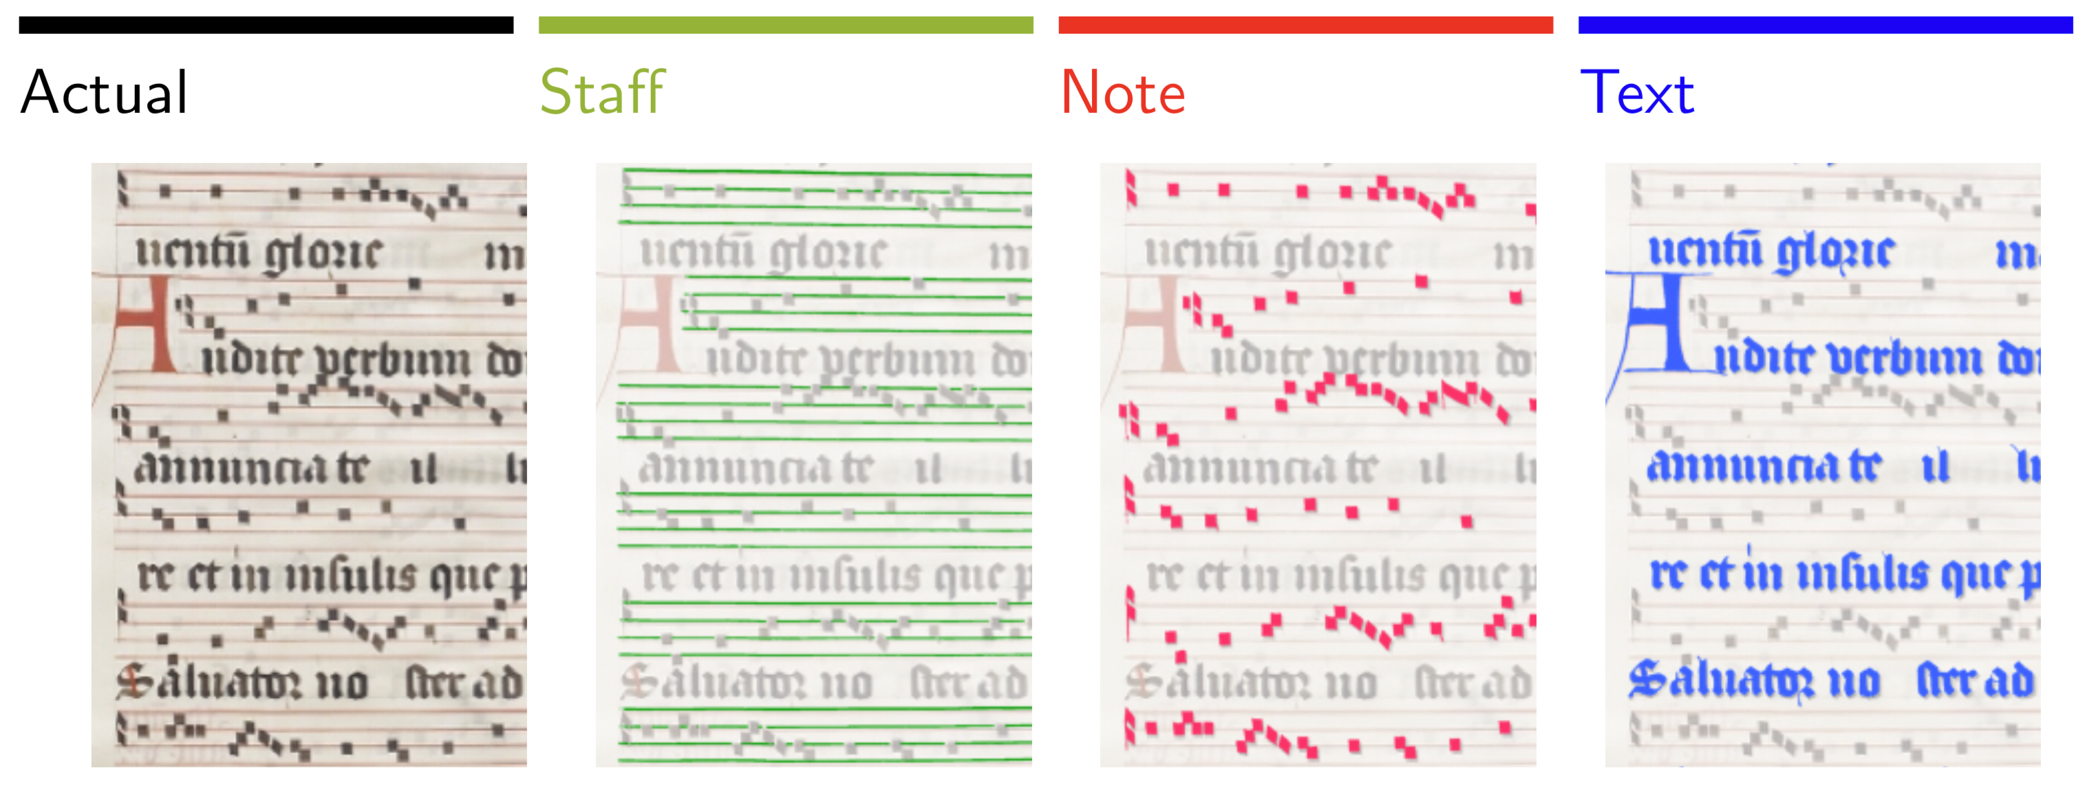
There is always a pre-processing step that prepares the data needed for the following steps in the pipeline
Normally, this step segments the document into layers: music symbols & staves & text layers
Step 1: Preprocessing or Document Analysis or Document Segmentation

Slide 8
There is always a pre-processing step that prepares the data needed for the following steps in the pipeline
Normally, this step segments the document into layers: music symbols & staves & text layers
Sometimes the music symbols are not separated from their staff and the staff regions (with their music) are used for the next step
Step 1: Preprocessing or Document Analysis or Document Segmentation

Slide 9
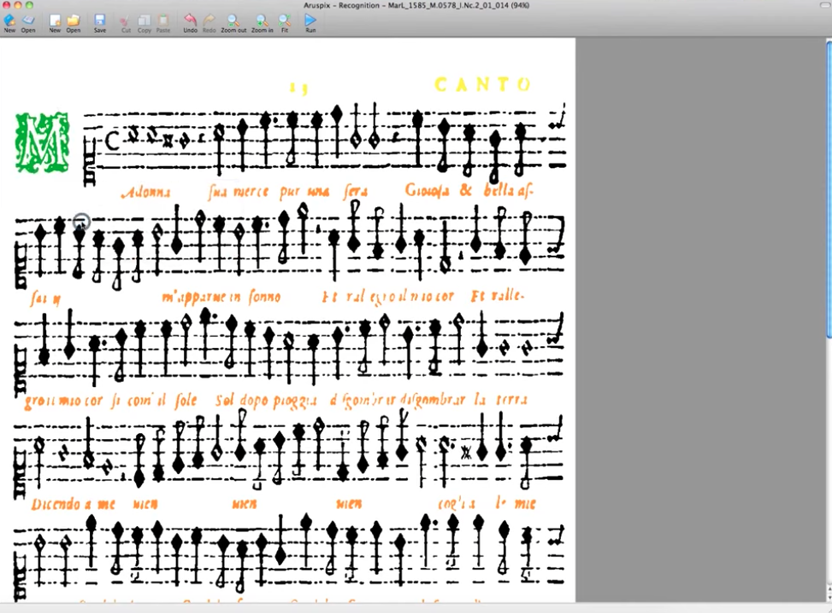

There is always a pre-processing step that prepares the data needed for the following steps in the pipeline
Normally, this step segments the document into layers: music symbols & staves & text layers
Sometimes the music symbols are not separated from their staff and the staff regions (with their music) are used for the next step
Step 1: Preprocessing or Document Analysis or Document Segmentation

Slide 10
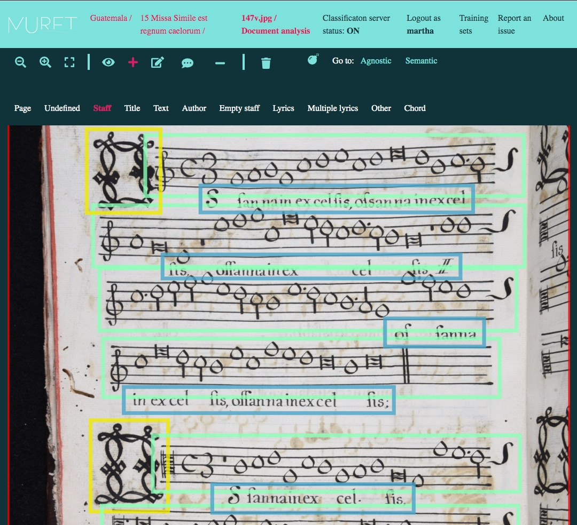

There is always a pre-processing step that prepares the data needed for the following steps in the pipeline
Normally, this step segments the document into layers: music symbols & staves & text layers
Sometimes the music symbols are not separated from their staff and the staff regions (with their music) are used for the next step
Step 1: Preprocessing or Document Analysis or Document Segmentation

Slide 11
There is always a pre-processing step that prepares the data needed for the following steps in the pipeline
Normally, this step segments the document into layers: music symbols & staves & text layers
Train the computer to do this layer separation
Step 1: Preprocessing or Document Analysis or Document Segmentation

Slide 12
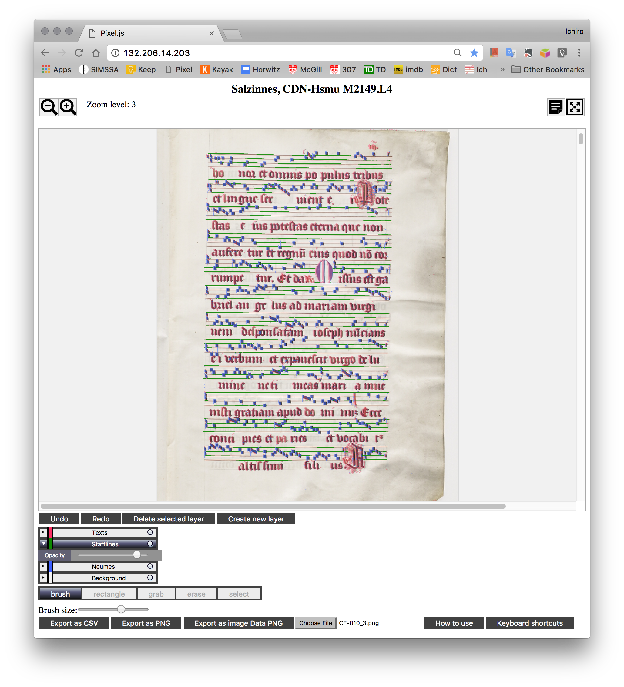
There is always a pre-processing step that prepares the data needed for the following steps in the pipeline
Normally, this step segments the document into layers: music symbols & staves & text layers
Train the computer to do this layer separation
Step 1: Preprocessing or Document Analysis or Document Segmentation
Pixel.js

Slide 13
There is always a pre-processing step that prepares the data needed for the following steps in the pipeline
Normally, this step segments the document into layers: music symbols & staves & text layers
Train the computer to do this layer separation

Slide 14
There is always a pre-processing step that prepares the data needed for the following steps in the pipeline
Normally, this step segments the document into layers: music symbols & staves & text layers
Train the computer to do this layer separation
Step 1: Preprocessing or Document Analysis or Document Segmentation
Notes:
ML

Slide 15
Step 2: Music Recognition
Preprocessing or Document Analysis or Document Segmentation
Music Recognition
(a) Staff processing
(b) Music symbol processing
(c) music symbol classification
Music Notation Reconstruction or Music Notation Recognition or Notation Assembly or Music Reconstruction
Final Representation Construction or Music Encoding

Slide 16
Step 2: Music Recognition
Preprocessing or Document Analysis or Document Segmentation
Music Recognition
(a) Staff processing
(b) Music symbol processing
(c) music symbol classification
Music Notation Reconstruction or Music Notation Recognition or Notation Assembly or Music Reconstruction
Final Representation Construction or Music Encoding

Slide 17
Step 2: Music Recognition
(a) Staff processing
(b) Music symbol processing &
(c) Music symbol classification

Slide 18
Step 2: Music Recognition
(a) Staff processing

Slide 19
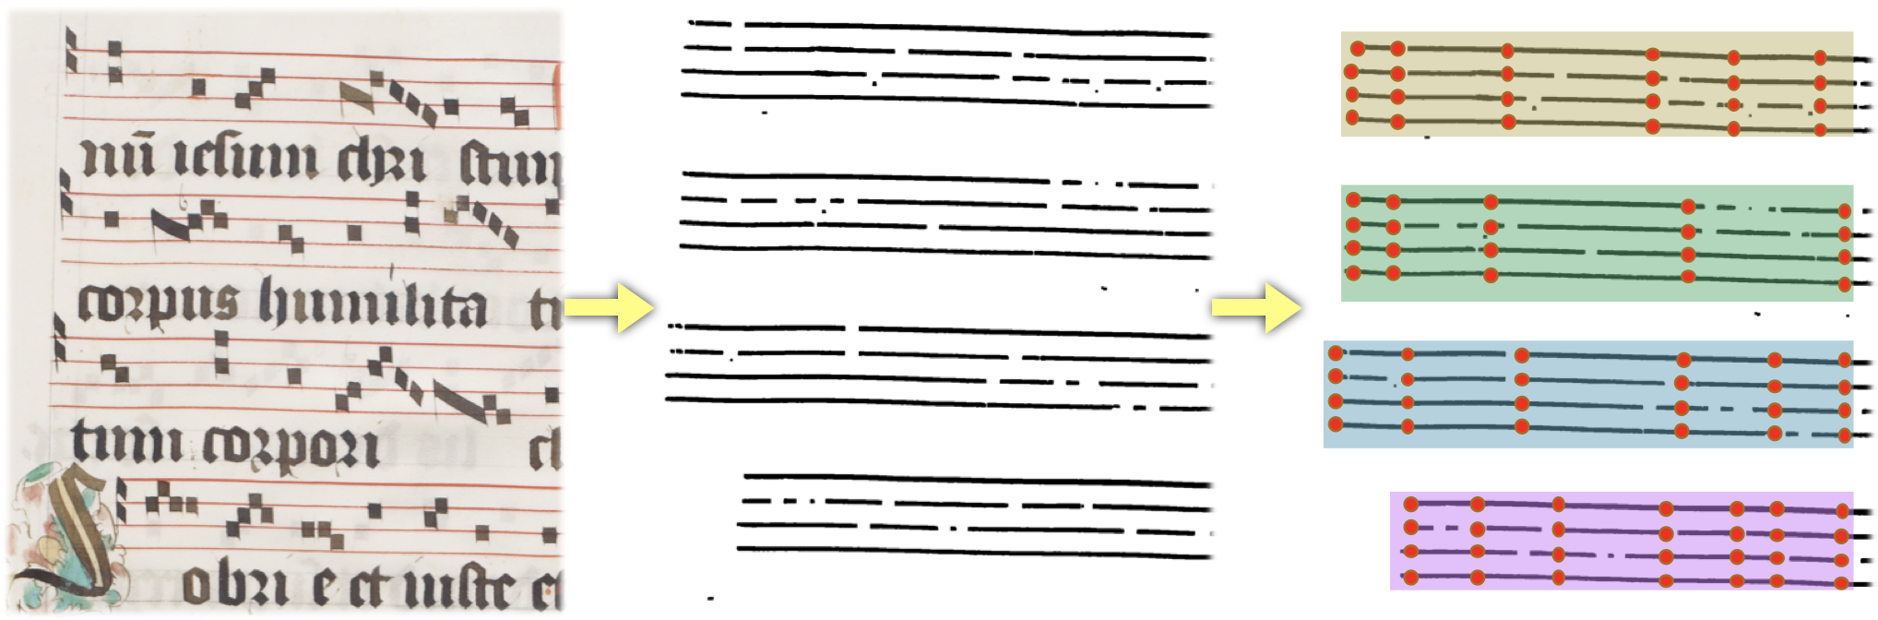
Step 2: Music Recognition
(a) Staff processing
Track the staff line path
Notes:
Material condition of the page → is wrinkled

Slide 20
Step 2: Music Recognition
(b) Music symbol processing
“Detection” of music symbols

Slide 21
Interactive Classifier
Step 2: Music Recognition
(b) Music symbol processing
“Detection” of music symbols
(c) Music symbol classification
Notes:
machine learning → training the computer with examples
Climacus
Clivis
Green symbols → manually classified
With examples, ask the computer to classify the rest of the page for you
Yellow symbols → computer classified
SHOW THE ERRORS (Pes in Clivis examples)
THE AUTOMATIC STEPS REQUIRE “HUMAN EYE REVISION”
Iterative process → to improve classification results
Incremental process

Slide 22
Step 3: Music Notation Reconstruction
Preprocessing or Document Analysis or Document Segmentation
Music Recognition
(a) Staff processing
(b) Music symbol processing
(c) music symbol classification
Music Notation Reconstruction or Music Notation Recognition or Notation Assembly or Music Reconstruction
Final Representation Construction or Music Encoding
Notes:
"semantics"
reconstruct the music, the notation, its semantics

Slide 23
Take the various individual sources of information recognized on previous steps (e.g., music symbols and staff lines) and bring them together to reconstruct the “music notation” (or “music semantics”)
→ Pitch detection
Overlay the symbols on top of the staff lines and use the tracked staff lines path to interpret the pitch of each symbol
Step 3: Music Notation Reconstruction also known as “notation assembly” or “music reconstruction”

Slide 24
What about text?
Step 3: Music Notation Reconstruction also known as “notation assembly” or “music reconstruction”

Slide 25
What about text?
Step 3: Music Notation Reconstruction also known as “notation assembly” or “music reconstruction”
OCR has issues with recognizing handwritten text

Slide 26
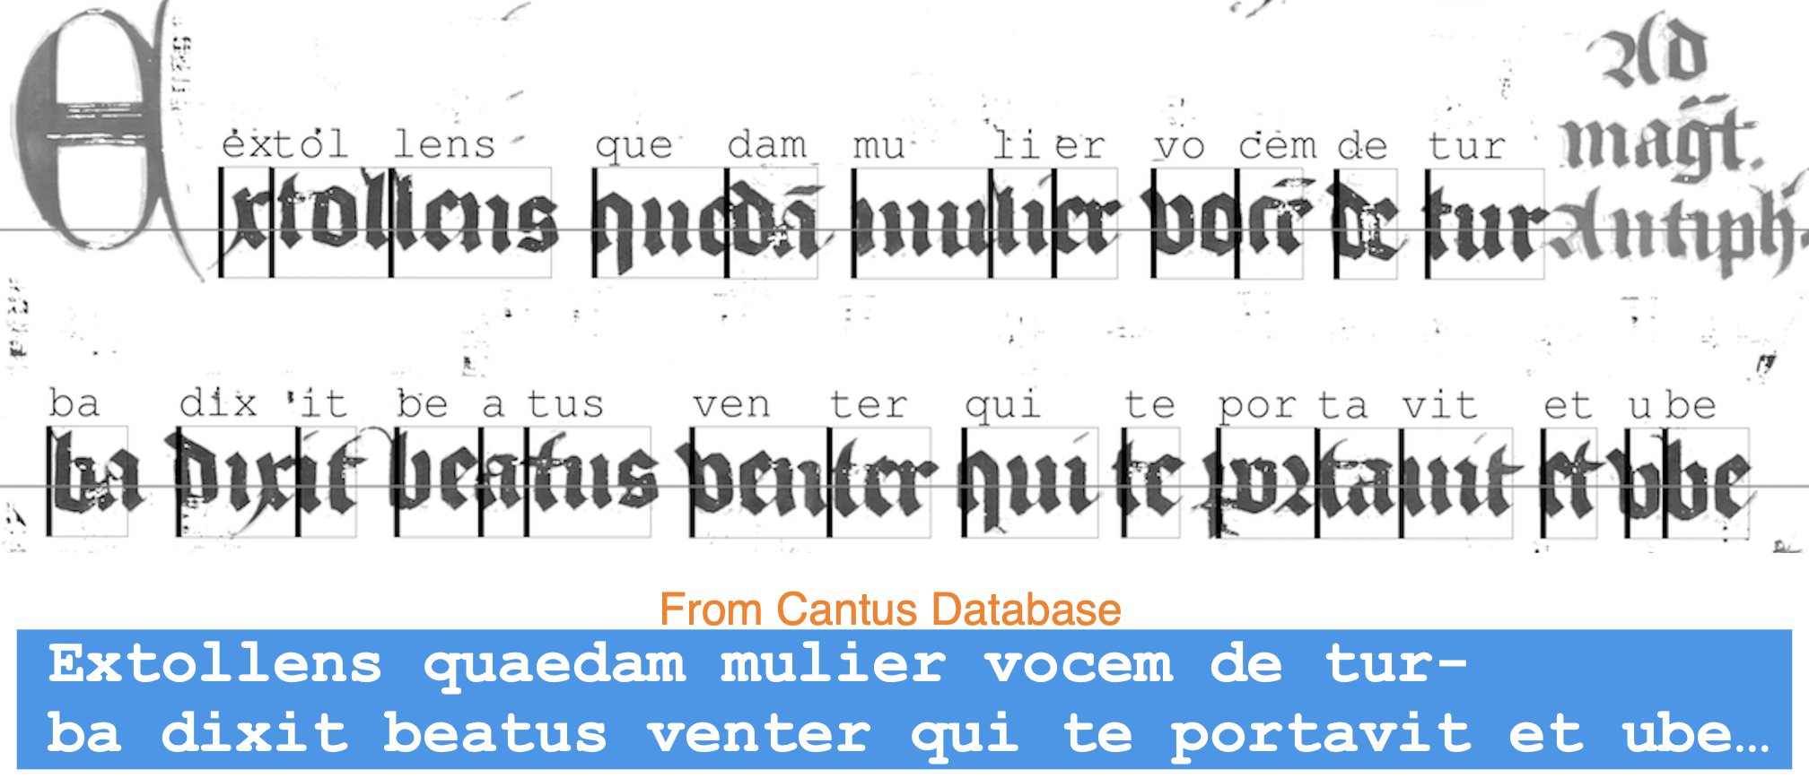
Step 3: Music Notation Reconstruction also known as “notation assembly” or “music reconstruction”
OCR has issues with recognizing handwritten text
Notes:
Performing OMR on a manuscript already indexed in Cantus Database (or any of the broader databases in the cantus index net) makes the process easier.
The manuscript version of the chant text is already indexed. And this can be used as a guide for the OCR of the chant text.
BOUNDING BOX: Rectangular area on the page that circumscribe the symbol (in this case, the syllable)

Slide 27
Step 4: Final Representation or Music Encoding
Preprocessing or Document Analysis or Document Segmentation
Music Recognition
(a) Staff processing
(b) Music symbol processing
(c) music symbol classification
Music Notation Reconstruction or Music Notation Recognition or Notation Assembly or Music Reconstruction
Final Representation Construction or Music Encoding

Slide 28
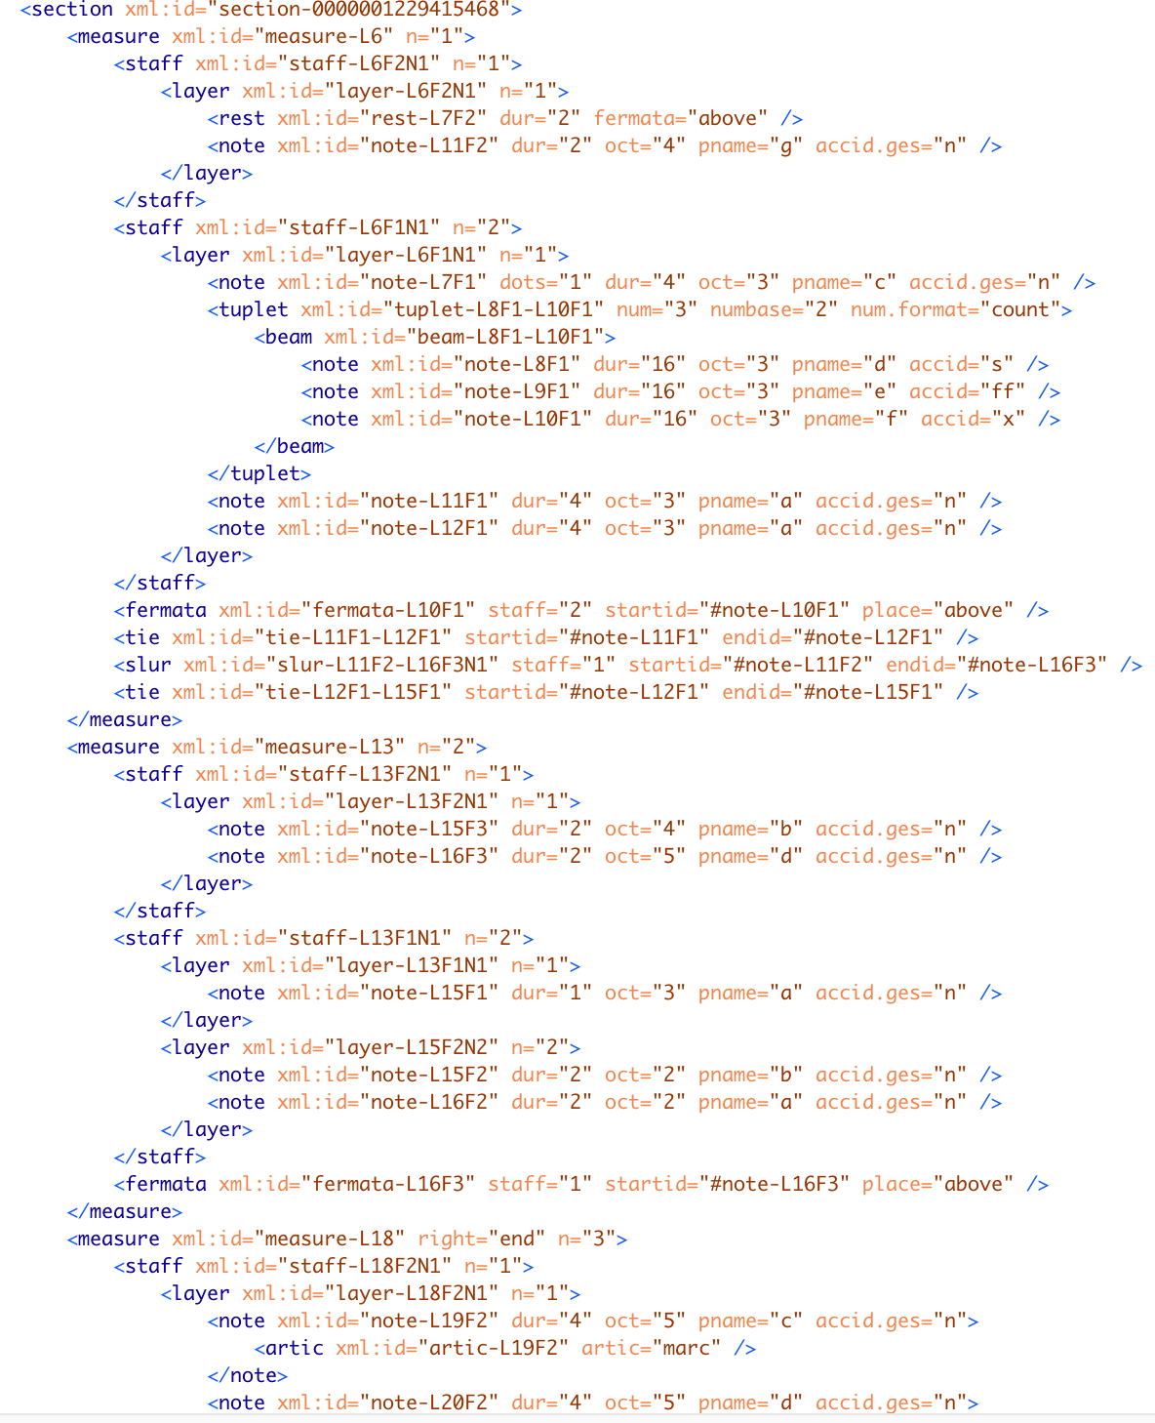
Step 4: Final Representation Construction (or Music Encoding)
The music is encoded in a standard music-encoding format (e.g., MusicXML and MEI)
Notes:
MusicXML → it can be exported by all "graphic score editors," like Finale, Sibelius, or MuseScore.
MEI → which you will hear about tomorrow
Open-source, flexibility for early music (not in MusicXML)

Slide 29
The music is encoded in a standard music-encoding format (e.g., MusicXML and MEI)
For early music notation → MEI
Step 4: Final Representation Construction (or Music Encoding)

Slide 30
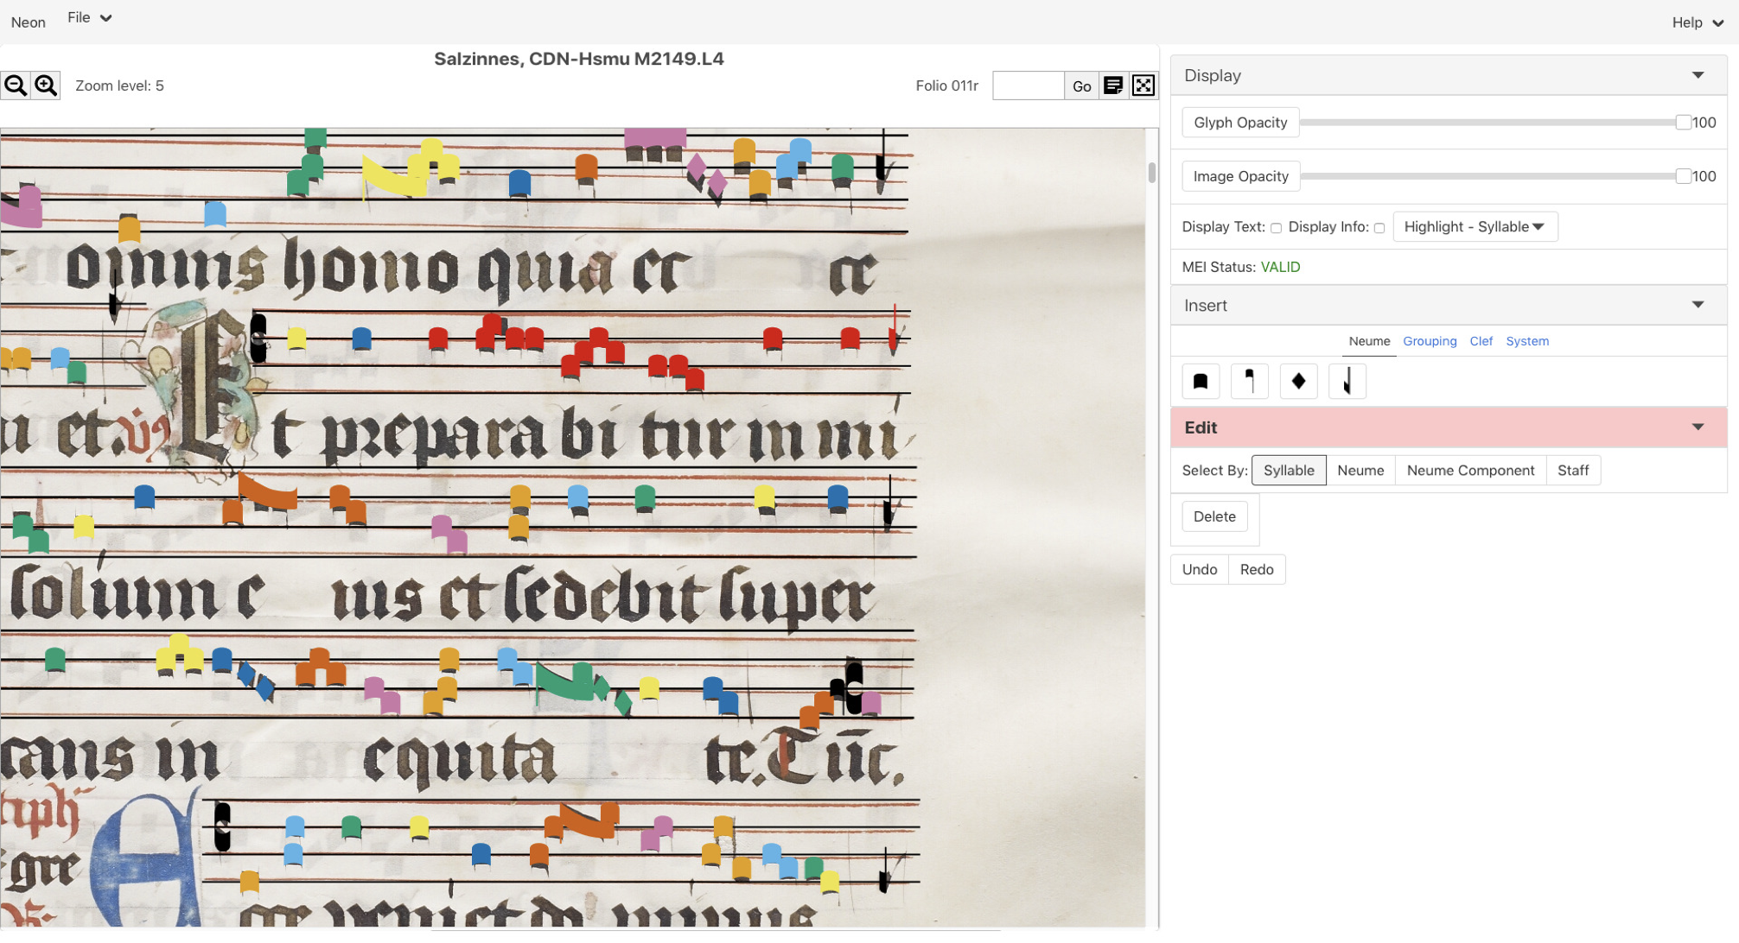
Neon.js
Neume Editor Online
The music is encoded in a standard music-encoding format
For early music notation → MEI
Interfaces for correction of the resulting MEI file (e.g., Neon for neume notation)
Step 4: Final Representation Construction (or Music Encoding)

Slide 31

Some OMR Frameworks for Neume Scripts
OMMR4all

Slide 32
Rodan and the Single Interface for Music Score Searching & Analysis (SIMSSA) Project
Workflow manager created by Andrew Hankinson, used for OMR in the SIMSSA project, led by Ichiro Fujinaga (McGill)
Notes:
SIMSSA: Targets digitized music scores to design a global infrastructure for searching and analyzing music scores. Specifically, the project seeks to provide researchers, musicians, and others to access the contents and metadata of a large number of scores in a searchable, digital format.

Slide 33
Rodan and the Single Interface for Music Score Searching & Analysis (SIMSSA) Project
Workflow manager created by Andrew Hankinson, used for OMR in the SIMSSA project, led by Ichiro Fujinaga (McGill)
Document Segmentation
Notes:
SIMSSA: Targets digitized music scores to design a global infrastructure for searching and analyzing music scores. Specifically, the project seeks to provide researchers, musicians, and others to access the contents and metadata of a large number of scores in a searchable, digital format.

Slide 34
Rodan and the Single Interface for Music Score Searching & Analysis (SIMSSA) Project
Workflow manager created by Andrew Hankinson, used for OMR in the SIMSSA project, led by Ichiro Fujinaga (McGill)
Document Segmentation
Notes:
SIMSSA: Targets digitized music scores to design a global infrastructure for searching and analyzing music scores. Specifically, the project seeks to provide researchers, musicians, and others to access the contents and metadata of a large number of scores in a searchable, digital format.

Slide 35
Rodan and the Single Interface for Music Score Searching & Analysis (SIMSSA) Project
Workflow manager created by Andrew Hankinson, used for OMR in the SIMSSA project, led by Ichiro Fujinaga (McGill)
Document Segmentation
Notes:
SIMSSA: Targets digitized music scores to design a global infrastructure for searching and analyzing music scores. Specifically, the project seeks to provide researchers, musicians, and others to access the contents and metadata of a large number of scores in a searchable, digital format.

Slide 36
Rodan and the Single Interface for Music Score Searching & Analysis (SIMSSA) Project
Workflow manager created by Andrew Hankinson, used for OMR in the SIMSSA project, led by Ichiro Fujinaga (McGill)
Document Segmentation
Notes:
SIMSSA: Targets digitized music scores to design a global infrastructure for searching and analyzing music scores. Specifically, the project seeks to provide researchers, musicians, and others to access the contents and metadata of a large number of scores in a searchable, digital format.

Slide 37
Rodan and the Single Interface for Music Score Searching & Analysis (SIMSSA) Project
Staff-line processing
Workflow manager created by Andrew Hankinson, used for OMR in the SIMSSA project, led by Ichiro Fujinaga (McGill)
Document Segmentation
Notes:
SIMSSA: Targets digitized music scores to design a global infrastructure for searching and analyzing music scores. Specifically, the project seeks to provide researchers, musicians, and others to access the contents and metadata of a large number of scores in a searchable, digital format.

Slide 38
Rodan and the Single Interface for Music Score Searching & Analysis (SIMSSA) Project
Staff-line processing
Workflow manager created by Andrew Hankinson, used for OMR in the SIMSSA project, led by Ichiro Fujinaga (McGill)
Document Segmentation
Music symbol processing & classification
Notes:
SIMSSA: Targets digitized music scores to design a global infrastructure for searching and analyzing music scores. Specifically, the project seeks to provide researchers, musicians, and others to access the contents and metadata of a large number of scores in a searchable, digital format.

Slide 39
Rodan and the Single Interface for Music Score Searching & Analysis (SIMSSA) Project
Staff-line processing
Workflow manager created by Andrew Hankinson, used for OMR in the SIMSSA project, led by Ichiro Fujinaga (McGill)
Document Segmentation
Music symbol processing & classification
Text Alignment (OCR & Cantus Database text)
Notes:
SIMSSA: Targets digitized music scores to design a global infrastructure for searching and analyzing music scores. Specifically, the project seeks to provide researchers, musicians, and others to access the contents and metadata of a large number of scores in a searchable, digital format.

Slide 40
Rodan and the Single Interface for Music Score Searching & Analysis (SIMSSA) Project
Staff-line processing
Workflow manager created by Andrew Hankinson, used for OMR in the SIMSSA project, led by Ichiro Fujinaga (McGill)
Pitch Finding
Document Segmentation
Music symbol processing & classification
Text Alignment (OCR & Cantus Database text)
Notes:
SIMSSA: Targets digitized music scores to design a global infrastructure for searching and analyzing music scores. Specifically, the project seeks to provide researchers, musicians, and others to access the contents and metadata of a large number of scores in a searchable, digital format.

Slide 41
Rodan and the Single Interface for Music Score Searching & Analysis (SIMSSA) Project
Staff-line processing
Workflow manager created by Andrew Hankinson, used for OMR in the SIMSSA project, led by Ichiro Fujinaga (McGill)
Pitch Finding
Document Segmentation
Music symbol processing & classification
MEI Encoding & Correction interface (NEON)
Text Alignment (OCR & Cantus Database text)
Notes:
SIMSSA: Targets digitized music scores to design a global infrastructure for searching and analyzing music scores. Specifically, the project seeks to provide researchers, musicians, and others to access the contents and metadata of a large number of scores in a searchable, digital format.

Slide 42
Rodan and the Single Interface for Music Score Searching & Analysis (SIMSSA) Project
Staff-line processing
Workflow manager created by Andrew Hankinson, used for OMR in the SIMSSA project, led by Ichiro Fujinaga (McGill)
Pitch Finding
Document Segmentation
Music symbol processing & classification
MEI Encoding & Correction interface (NEON)
Text Alignment (OCR & Cantus Database text)
Martha Thomae: Making Rodan work for you (DHEMR 2021/1, Session 2) https://youtu.be/_TeGXG9Fh2M?si=v_IQOBysIGi7GtLL
Notes:
SIMSSA: Targets digitized music scores to design a global infrastructure for searching and analyzing music scores. Specifically, the project seeks to provide researchers, musicians, and others to access the contents and metadata of a large number of scores in a searchable, digital format.

Slide 43
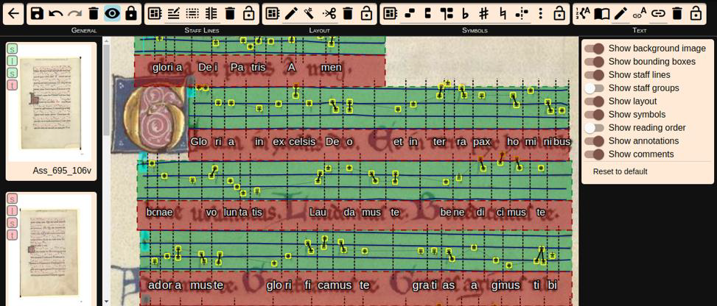
OMMR4All
Created by Cristopher Wick (University of Würzburg), and it is being used in the Corpus Monodicum project
general
staff lines
layout
symbols
text
Alexander Hartelt & Jan Hajič: Collaborative digital editions with OMMR4All (DHEMR 2021/1 sess. 3): https://youtu.be/hX9pGOdfbZ8?feature=shared

Slide 44
OMR Frameworks for Neume Notation
Old Myths, New Facts (OMNF). Recordings available from first Digital Humanities in Early Music Research workshop of 2021. https://www.smnf.cz/en/news/Recordings-available-from-first-Digital-Humanities-in-Early-Music-Research-workshop-of-2021/ The project “Old Myths, New Facts: Czech Lands in Center of 15-century Music Developments” (Czech Science Foundation EXPRO 19-28306X) focuses on the study of music repertory from 15th century Bohemia and its reflection in modern Czech music culture.
Ichiro Fujinaga: Large-scale OMR for neumes with Rodan (DHEMR 2021/1, Session 1). https://www.youtube.com/watch?v=FXkKrwatIwM
Martha Thomae: Making Rodan work for you (DHEMR 2021/1, Session 2). https://www.youtube.com/watch?v=_TeGXG9Fh2M
Alexander Hartelt & Jan Hajič: Collaborative digital editions with OMMR4All (DHEMR 2021/1 session 3). https://www.youtube.com/watch?v=hX9pGOdfbZ8

Slide 45
Some OMR Frameworks for Mensural Scripts

Slide 46
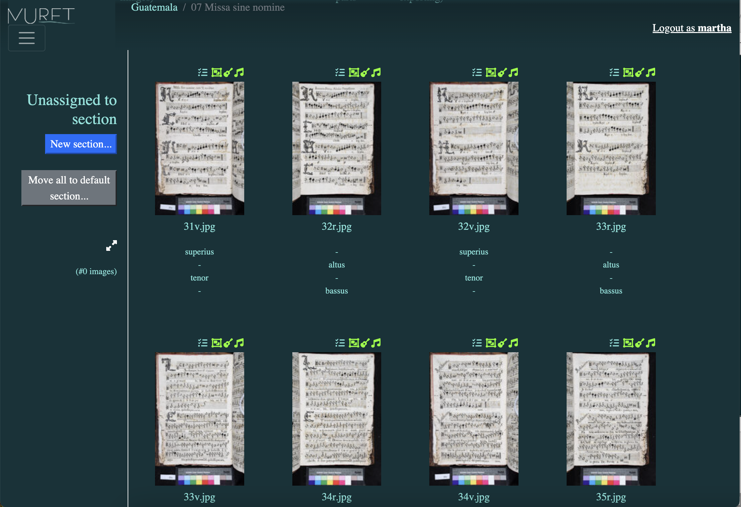
MuRET The Piece Interface
Music Recognition Encoding and Transcription (MuRET)
OMR framework developed by David Rizo (University of Alicante)

Slide 47
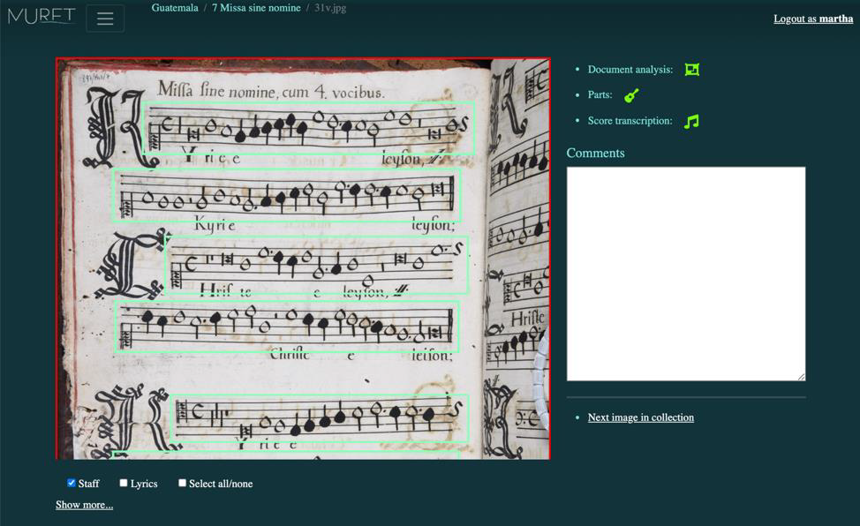
MuRET The Page Interface

Slide 48
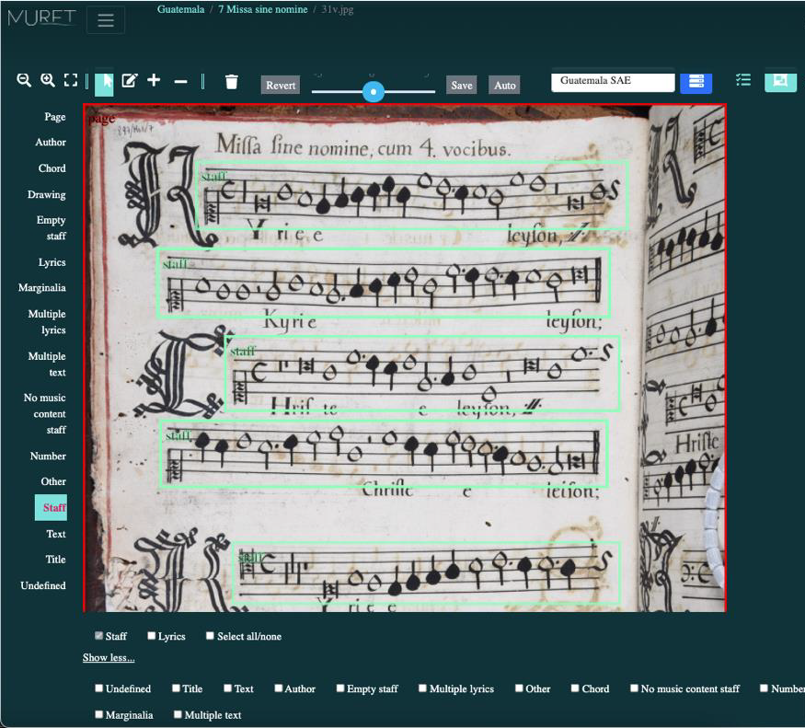
MuRET OMR Stage 1: Preprocessing or Document Analysis

Slide 49
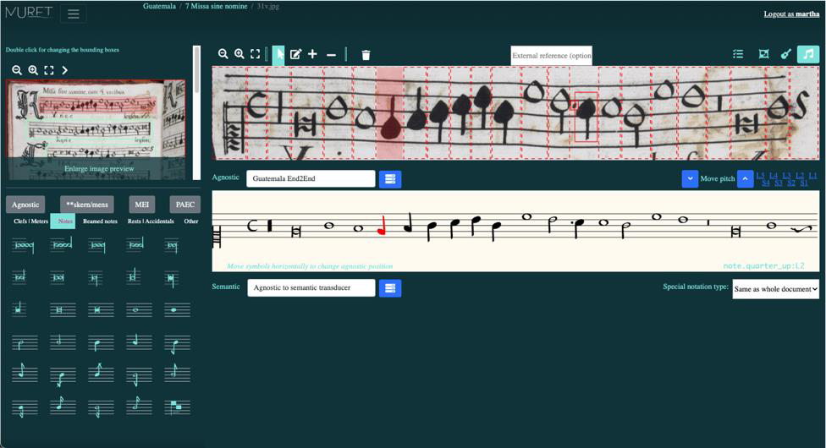
MuRET OMR Stage 2: Music Symbol Recognition

Slide 50
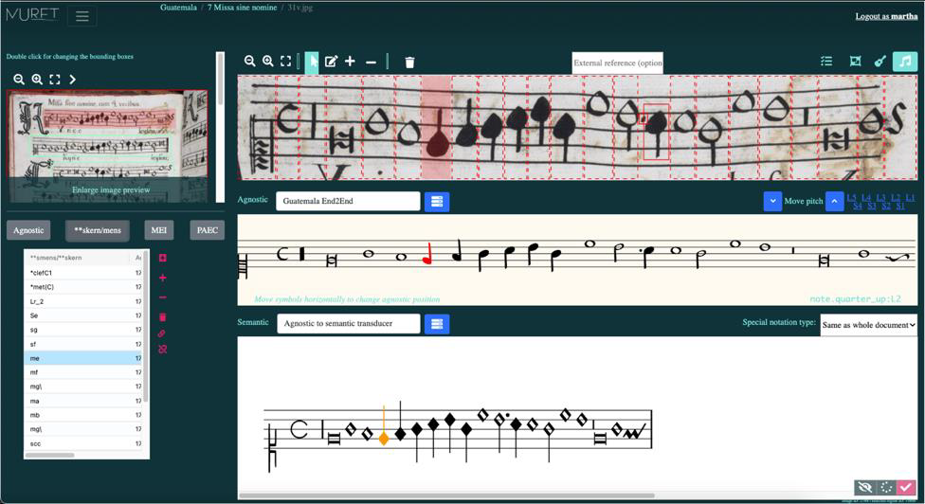
MuRET OMR Stage 3: Music Notation Reconstruction

Slide 51
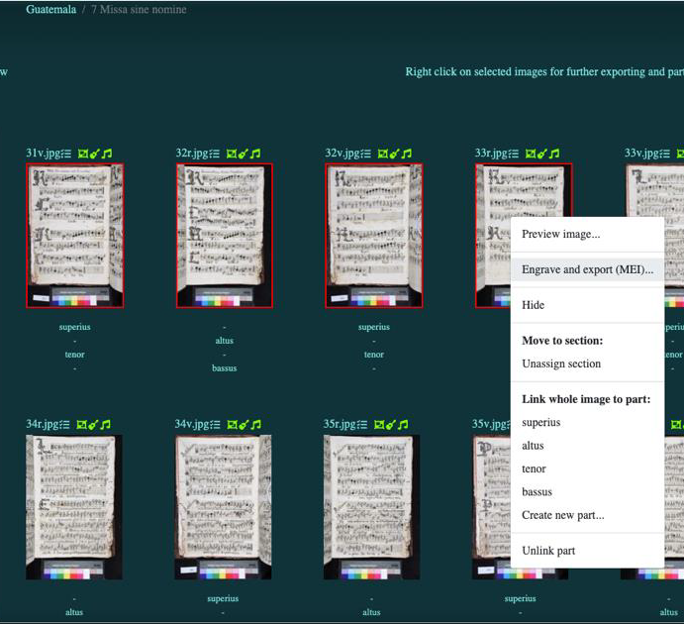
MuRET OMR Stage 4: Music Encoding

Slide 52
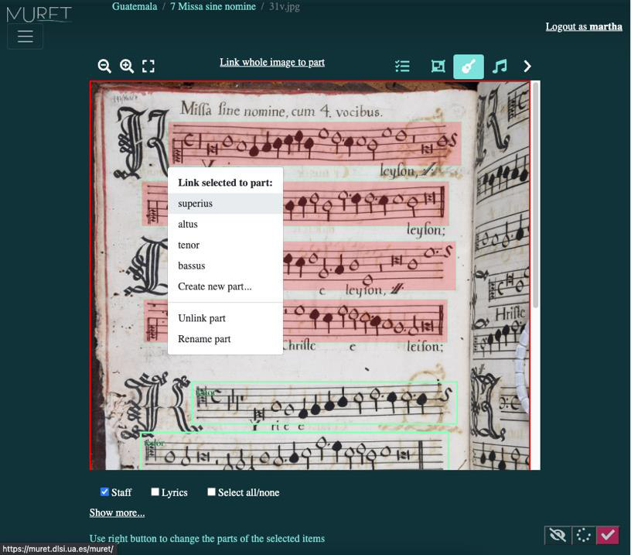
MuRET Extra Step: Assignation of Voices

Slide 53
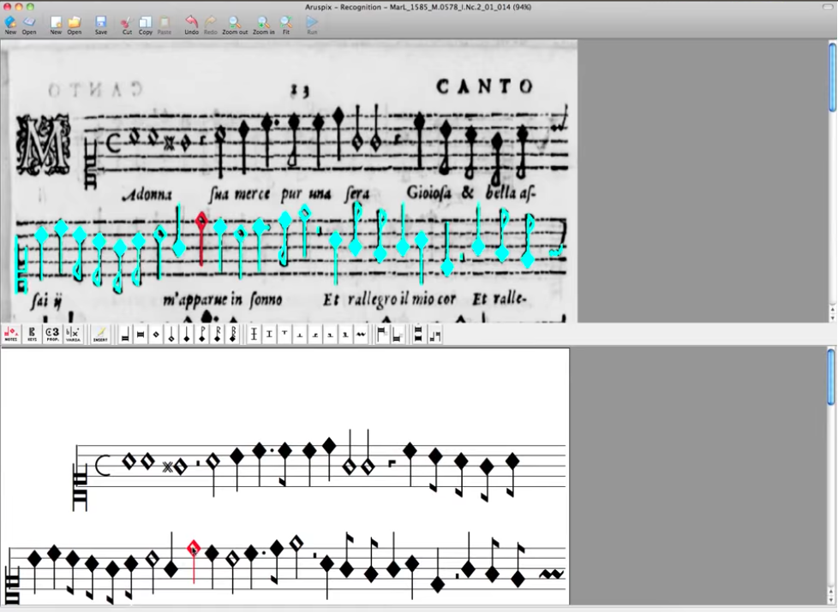
Aruspix
Developed by Laurent Pugin http://www.aruspix.net
Early typographic music prints
Music printed during the sixteenth and seventeenth centuries with movable typefaces
Preprocessing = Document Analysis
Symbol Recognition
Notes:
Mac OS X

Slide 54
Optical Music Recognition (OMR)
Optical Music Recognition

Slide 55
Now… What can we do with the retrieved music that is encoded in these machine-readable files?

Slide 56
Now… What can we do with the retrieved music that is encoded in these machine-readable files?
Content-based searches & computational music analysis

