Slide 1
Encoding and Analysis of Early Music:
Aquitanian and Square Music Scripts
Elsa De Luca, Martha E. Thomae, Vicente Urones Sánchez
CESEM-IN2PAST, Universidade NOVA de Lisboa
University of North Texas, Denton, TX
Music Encoding Conference (MEC)
21 May 2024
Notes:
this research is part of the [NEXT] ECHOES PROJECT, in which we are working on the

Slide 2
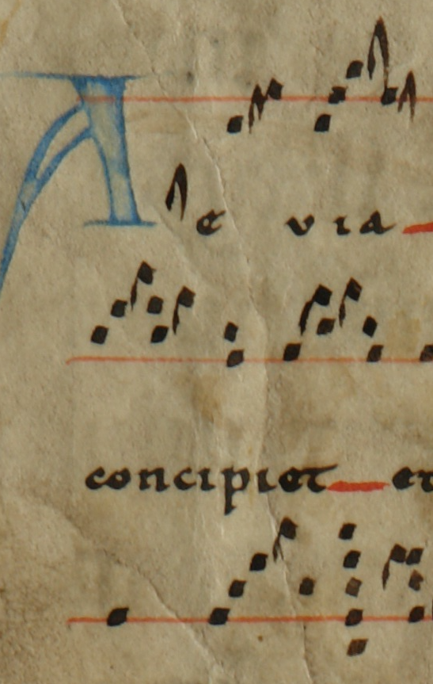
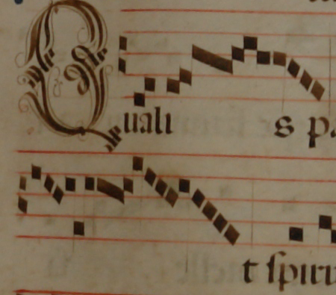
ECHOES PROJECT
Automatic analysis of plainchant found in Portuguese manuscripts 12th–17th centuries currently kept in Braga and Guimarães
Chants in two music scripts:
Neumatic Aquitanian (earlier notation style)
Square notation (later notation style)
Goal: Create a prototype of a music-analysis tool for this corpus encoded in MEI
Notes:
this research is part of the ECHOES PROJECT, in which we are working on the ... [1]

Slide 3
ECHOES PROJECT – The Challenge
Encode and retrieve musical information originally written in two styles of notation
Aquitanian neumes
Provide limited information related to pitch
Provide some information on the nuances of vocal delivery by the various forms of the neumes

Slide 4
ECHOES PROJECT – The Challenge
Encode and retrieve musical information originally written in two styles of notation
Square notation (later system)
More exact in terms of pitch precision
But it lost information on the nuances of vocal delivery

Slide 5
ECHOES PROJECT – The Issue for Encoding
Oldest sources (12th–14th c.) are often in poor material conditions and fragmentary state
Using of optical music recognition (OMR) to encode the little music information found in these fragments in such poor conditions would be an overkill
Moreover, for the purposes of building a prototype tool for music analysis, we are working with a reduced sample of ca. 100 chants
Notes:
Regarding the encoding, we have the issue that the ... [1]
[3] and chants are short in general
Therefore, rather than using OMR to obtain the MEI files encoding these chants, we decided to [NEXT]

Slide 6
ECHOES PROJECT – The Methodology
Decided to manually input the chants into the computer
Using the GABC format (text-based typesetting language)
And convert them later into MEI Neumes
Using GABC as an intermediate format
Python script to convert from GABC to MEI https://github.com/ECHOES-from-the-Past/GABCtoMEI
Notes:
[end]
Why are we using an intermediate format?

Slide 7
Why Using GABC as the Intermediate Format?
Fairly quick to type compared to MEI
Allows to capture both note pitch/height and neume shape information that other easy-to-type formats do not
Volpiano captures only pitch information, not neume shape
MonodiPlus captures pitch and ornamental neume shapes, but it does not make a distinction between punctum and virga shapes
Notes:
[AFTER 1]
And why are we using GABC for intermediate format versus others that are also easy to type?
Because GABC [2]

Slide 8
ECHOES PROJECT – GABC Encoding
We followed the GABC specifications^{[1]}
But we also adapted our “GABC encodings” for the needs of our corpus by restricting the GABC characters used and adding others for unsupported features
Notes:
READ:
[1] FOR OUR ENCODINGS ‘We followed the GABC specifications’
[2] ‘But,’ since they did not cover all the specific cases found in Aquitanian and square music scripts, ‘we also adapted our “GABC encodings” for the needs of our corpus by ...' [2]

Slide 9
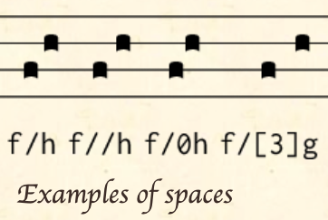
ECHOES PROJECT – GABC Encoding
We followed the GABC specifications^{[1]}
But we also adapted our “GABC encodings” for the needs of our corpus by:
Restricting the characters used
neumatic cut
Notes:
This character (the slash) is called "neumatic cut" in GABC.
It separates the notes into neumes,
everything that precedes the slash is one neume, and everything that follows the slash is part of another neume.
GABC has support for indicating how big is the space between the two neumes separated by the slash.
You can use a double slash for doubling the space between the two neumes,
or use a 0 after the slash for smaller spaces,
or use a number in brackets to act as a factor for larger spaces.
In our encodings, we only considered the simple "neumatic cut" (the slash) as we are interested on capturing the neume boundaries,
but we ignored the different spaces as they encode merely typographical features.

Slide 10
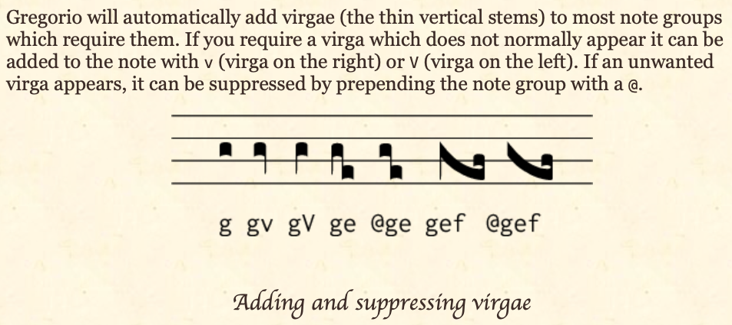
ECHOES PROJECT – GABC Encoding
We followed the GABC specifications^{[1]}
But we also adapted our “GABC encodings” for the needs of our corpus by:
Restricting the characters used
Notes:
Something similar happens here with the "virga"
The virga is this thin vertical stem that happens at the beginning or end of the neume [CLICK TO SHOW GREEN BOX]
The GABC renderers "will automatically add this virga to most note groups that require them. If you require a virga that does not normally appear ..." [lowercase & uppercase v]
You can see here [CLICK FOR RED BOX] it is adding it automatically to the beginning of the neume.
[continue reading text] "If an unwanted virga appears, it can be suppressed by ..." [prepending the group with a @]
However, for larger groups of notes, we have seen some inconsistency on the rendering systems.
So, instead of leaving the renderers (with their own internal rules) to determine which neume should begin/end with a virga. We decided to always use the "lowercase" and "uppercase” “v" to explicitly encode the initial and final stem of neumes.
Therefore, we did not use the "@" character to indicate the absence of said stems—as the mere absence of the “V” character would indicate that already.

Slide 11
ECHOES PROJECT – GABC Encoding
We followed the GABC specifications^{[1]}
But we also adapted our “GABC encodings” for the needs of our corpus by:
Restricting the characters used

Slide 12
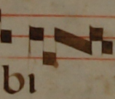
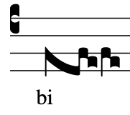

ECHOES PROJECT – GABC Encoding
We followed the GABC specifications^{[1]}
But we also adapted our “GABC encodings” for the needs of our corpus by:
Restricting the characters used
Adding characters to encode missing features
Notes:
Oblique segment of ligatures.
So, you can see an example of a ligature at the top. This ligature includes an oblique section in the middle
At the bottom, you can see how this ligature is rendered by the GABC software.
[CLICK BLUE]
[CLICK ORANGE]
→ SO, we added a character to encode the beginning of the oblique section of the neume.
AGAIN, FOCUSING ON EXPLICITLY ENCODING THINGS
[CLICK GREEN] And, by the way, here we have an example of what I was mentioning on the previous slide, where the renderer automatically adds a virga (a stem down) when there is none.

Slide 13
ECHOES PROJECT – GABC Encoding
Interdisciplinary discussions
Our encoding guidelines and the details of the transformation of the GABC to MEI code are provided in GitHub
Our team: music paleographers, historical musicologists, and music technology scholars
All the specificities of the encoding as they will have a cascade effect on the musical analysis to be performed at a later stage
Notes:
READ:
A lot of interdisciplinary discussion informed our decisions on what was relevant in the encoding. ‘[1]Our encoding guidelines and…’
'[2]our team of ... ‘ discussed at length ‘[3] all the specificities of the encoding ...'

Slide 14
ECHOES PROJECT – Current Contributions
About a hundred GABC and MEI files (in GitHub)
Digital images of the Braga and Guimarães sources → Portuguese Early Music (PEM) Database
Table with visual samples of all the notational shapes (Aquitanian and square) along with the MEI Neumes encoding:
We will develop OMR models to recognize the symbols of both notations as found in some well-preserved books
Valuable resource for the MEI Neumes community
Notes:
[After 2] READ:
The 100 chants in the repository that were manually input into GABC represent a small sample of the numerous chants in the digitized sources from Braga and Guimarães as part of the ECHOES Project
We plan to apply OMR to some of the well-preserved books that have been digitized
So we have a TABLE that includes all the different types of glyphs found in these sources and their corresponding MEI encoding
This table will be used during the OMR process to encode the recognized glyphs into MEI files correctly.
We believe that in addition to its use in OMR, this table is a valuable resource for the MEI Neumes community given the various real-life examples of neume shapes and their corresponding MEI encoding.

Slide 15
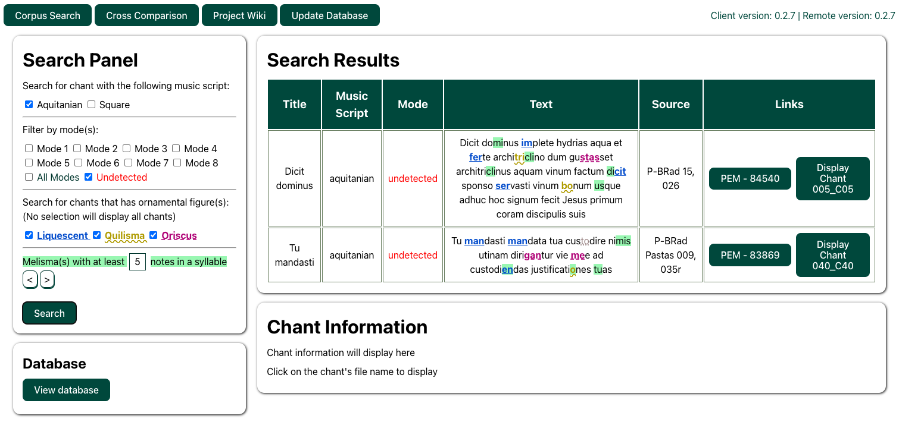
ECHOES PROJECT – Music Analysis Prototype Tool
Work by Antoine Phan (McGill University)
Notes:
Being developed by ANTOINE PHAN (McGill University)

Slide 16
ECHOES PROJECT – Music Analysis Prototype Tool
Music Scripts

Slide 17
ECHOES PROJECT – Music Analysis Prototype Tool
Mode
This information is not in the metadata
We developed heuristics to compute the mode based on the finalis, ambitus, repercussio, and rhombus position

Slide 18
ECHOES PROJECT – Music Analysis Prototype Tool
Ornamental shapes

Slide 19
ECHOES PROJECT – Music Analysis Prototype Tool
Melodic density

Slide 20
ECHOES PROJECT – Music Analysis Prototype Tool
Coming → Melodic search (based on pitch / height / contour similarity)
Work by Antoine Phan (McGill University)

Slide 21
ECHOES PROJECT – Conclusions
Music encoding and analysis are crucial components in our project on Portuguese plainchant written in Aquitanian neumatic and Iberian square music scripts
Contribute to the discussion about methodologies for describing and encoding early notations that have not been explored so far and to the creation of digital tools for early music research
Notes:
READ:
[1].
Specifically, our case study can ‘[2]Contribute to the discussion about methodologies for describing and encoding' two 'early notations that have not been explored so far’ contextually (given that we have the same chants, the same text, in two notational scripts)
We hope that this research will stimulate the discussion around 'digital tools for early music research' and inspire scholars to create similar projects for other styles of early notations whose encodings have not been attempted so far

Slide 22



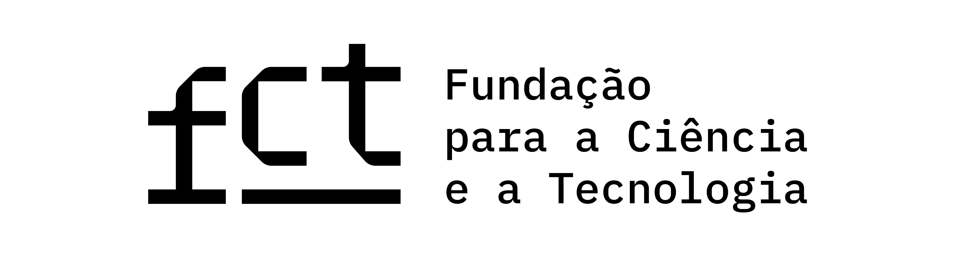
Thank you!
elsadeluca@fcsh.unl.pt
marthathomae@fcsh.unl.pt
vicenteurones@fcsh.unl.pt

Slide 23
References
Echoes Project website: https://echoes.fcsh.unl.pt
Echoes Project GitHub Association: https://github.com/ECHOES-from-the-Past
GitHub repository for GABC to MEI (guidelines, conversion table, and files): https://github.com/ECHOES-from-the-Past/GABCtoMEI
GitHub repository for MEI Analyser: https://github.com/ECHOES-from-the-Past/mei-analyser
Website (GitHub page) for MEI Analyser: https://echoes-from-the-past.github.io/mei-analyser/
Portuguese Early Music (PEM) database: https://pemdatabase.eu/
Neume spreadsheet with MEI encoding: https://docs.google.com/spreadsheets/d/1QDRywn4oUXgU9liCZo6PJFvTkTCyML1pFikKtZjs0eg/edit?usp=sharing
^{[1]} GABC specifications: https://gregorio-project.github.io/gabc/index.html. GABC examples: https://gregobase.selapa.net/scores.php.

