Slide 1
Automatic Scoring-up Tool for Mensural Music
Martha E. Thomae
SIMSSA Workshop XII
CIRMMT, McGill University
Montreal, August 7th, 2017
Notes:
[Next Slide Beg:] Mensural music refers to vocal polyphonic music written between the 1250s and the 1600s.
HERE WE HAVE an example of a mensural piece [Click!]

Slide 2
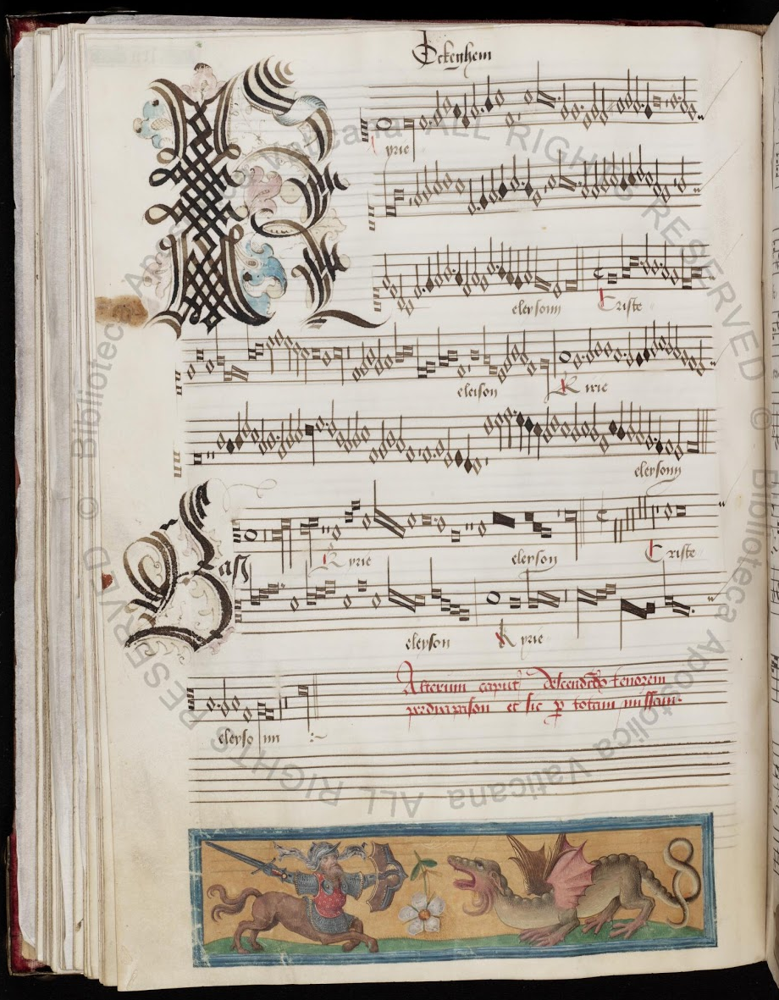
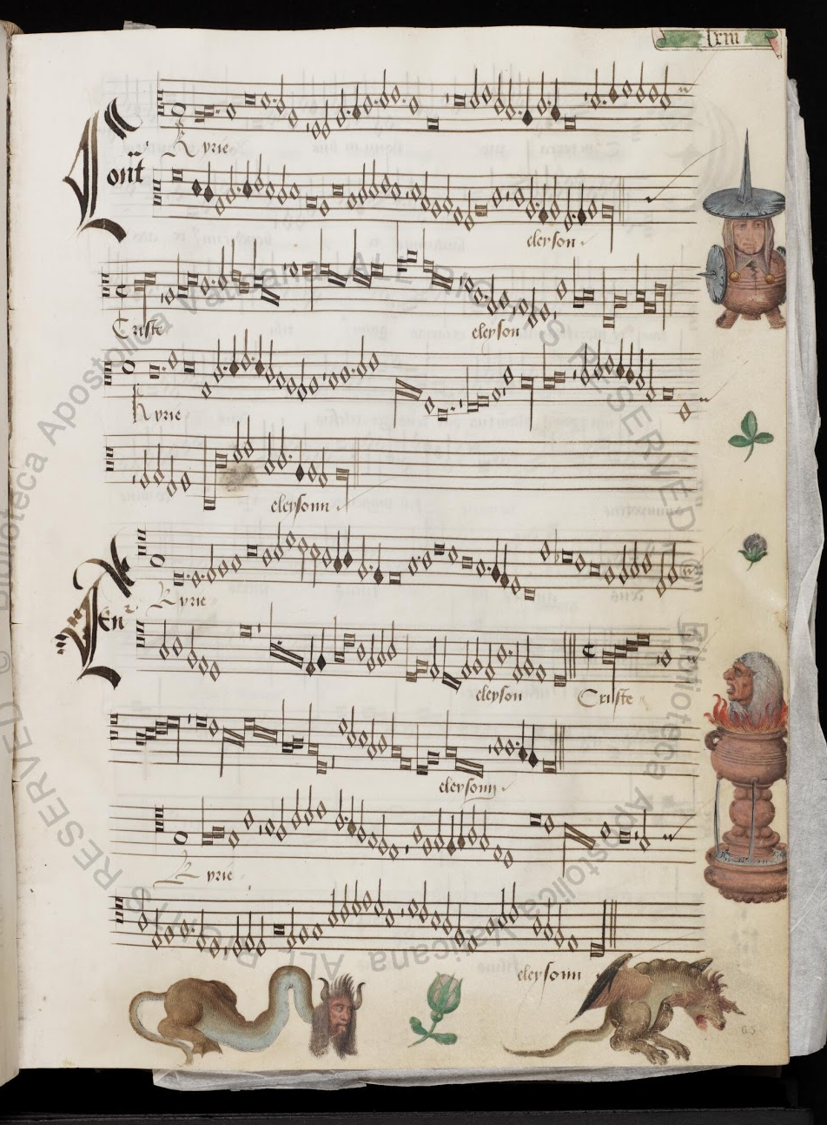
Notes:
As you can see, it is written in a different system of notation, which is called ”Mensural Notation”
This system is the immediate predecessor of our current “Common Western Music Notation” system
And we can already see certain commonalities between the two:
Notate pitch in the same way → staff lines & clefs (these symbols)
Use various note shapes to indicate different note values
One characteristic of this music, is the way in which it displays the various voices of the piece
Instead of using a score format
It present the voices separately, in different areas of the page.
You can see that in this example.
Here you see the “opening” (hand-gesture) of a book
AND ALL THE VOICES ARE CONTAINED IN A different quadrant of the opening
So you see here [click] the “bass”, …
This separate arrangement of the voices makes it harder to analyze this music:
While you have all the melodic information of each voice
You cannot visualize the vertical sonorities that easily, because the notes are not lined-up (as will be the case if the voices were presented in score format)
- - - - -

Slide 3
Motivation
The purpose of this project is to take all the notes from each of the parts (i.e., voices) of a mensural piece and line them up automatically, in order to present the piece in score format, a process that we refer to as “scoring up”
To facilitate counterpoint studies (this is, the study of the relation between the voices)
Notes:
[Aft. 1] So we are developing an automatic scoring-up tool
[Aft. 2] for which we need to visualize the vertical sonorities.

Slide 4
Scoring-up tool
The process of scoring up involves the correct alignment of the notes from the different voices
But, in order to line up the notes, we need to know the duration of each of the notes
This is particularly challenging when dealing with mensural notation

Slide 5
The duration of the individual note symbols in mensural notation is not absolute, but rather context-dependent
Notes:
Lets expand a little on what we mean when saying “context-dependent” nature of mensural notation

Slide 6
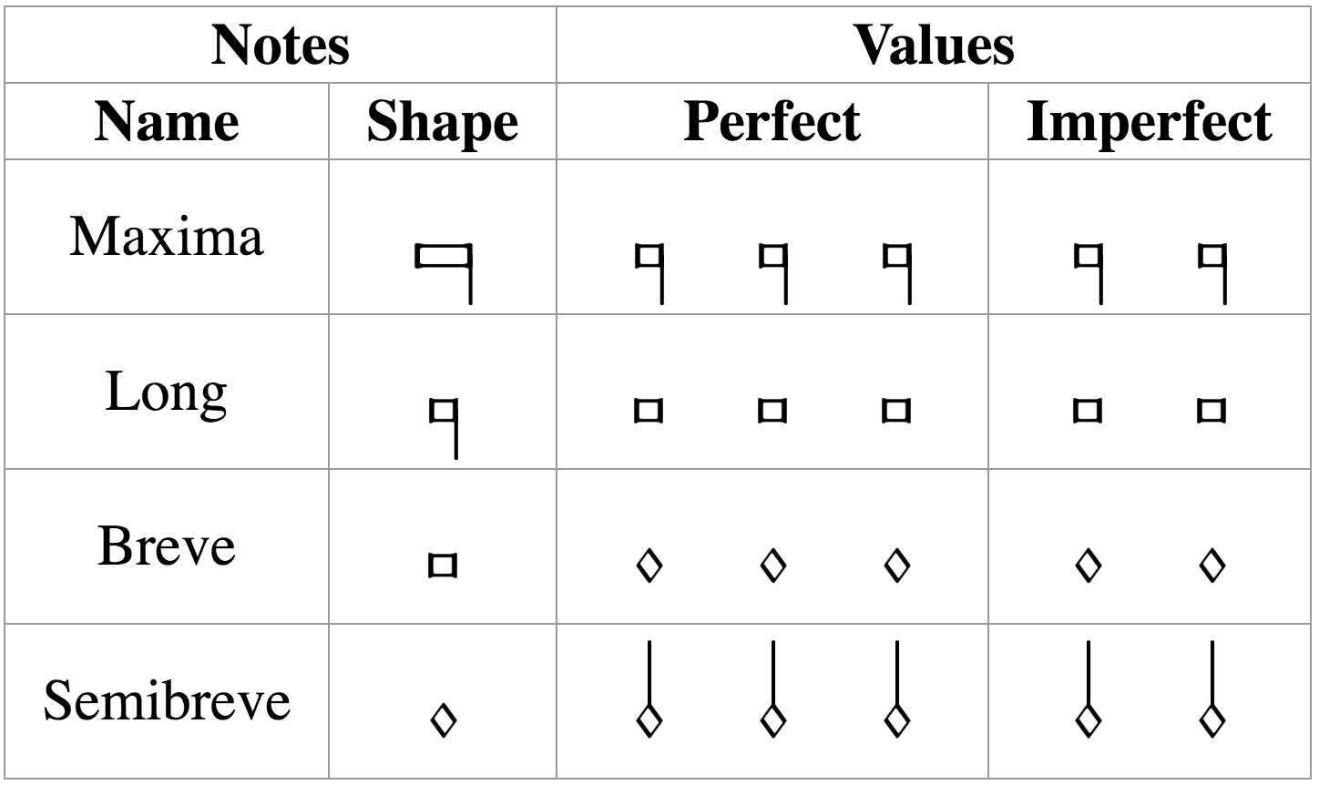
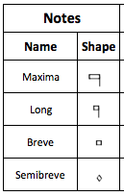
Mensural Notation
There is a clear hierarchy in the note duration
longest
But, the actual value of these notes is ambiguous
shortest
It can either be triple (i.e., “perfect”) or duple (i.e., “imperfect”)
The value is determined by two factors:
Mensuration
Context
Notes:
[third bullet] Mention: “perfect” for the Holy Trinity (so people remember the terms “perfect” and “imperfect”
[SAME, end of third bullet] In the same piece, moreover, in the same voice, the same note can be used with two different values
[Mensuration] IT WILL TELL YOU BY DEFAULT THE VALUE OF THOSE FOUR NOTES, WHETHER IT WILL BE PERFECT OR IMPERFECT
[Context] EXCEPTIONS TO THAT DEFAULT VALUE
There are certain principles on how context affects the note value. I am not going to enumerate all of these principles, but I will give an example of the general idea of on how these principles work.

Slide 7




Examples of Context Changing the Note’s Value
Mensuration: Breve = 3 → Breves are perfect by default
Principles of
Imperfection
and Alteration
Imperfection
Perfect → Imperfect
Alteration
x 2
Notes:
Modus = 3 → mensuration for the long, the default value of the long is perfect
Long + long
Long + Breve + Long
Long + Breve + Breve + Long
During the course of this presentation, I will point out some of these peculiarities
Maybe I overgeneralized certain things, but this is just an introduction to mensural notation, and the important thing I want you to understand is that
There is no one-to-one correspondence between note shape and note value
The default value of a note is given by the mensuration, i.e., it says if a note is either ‘perfect’ or ‘imperfect’ by default
And the context can modify this value,
can switch it from perfect to imperfect (or viceversa), that is one kind of modification
or can double the note value, which is the another kind of modification called “alteration”

Slide 8
Scoring-up tool
Deals with the context-dependent nature of mensural notation
By implementing the “principles of imperfection and alteration”
Deals with other non-context related features:
Dots of Augmentation
Coloration
When?
Distinguish between “dots of division” and “dots of augmentation”
When coloration has an effect on the note value?
Notes:
[START Content of the Slide]
[In Non-Context Related Features]
Dots of augmentation are …
Coloration is ...
Encoding the effect of these is not difficult
Figuring out that we are dealing with a dot of augmentation, or that the coloration does have an effect on the note value, that is the issue.
And the scoring-up tool deals with that

Slide 9
Mensural MEI file
________
________
Scoring-up
Tool
Soprano part
Mensural
MEI file
________
________
________
________
________
Mensural MEI file
________
________
Contra part
Mensural MEI file
________
________
SCORE
Tenor part
Notes:
MEI (Music Encoding Initiative) format for encoding a wide variety of musical documents,
includes support for mensural notation
We have these Mensural MEI files encoding all the notes in each voice.
They encode two types of information regarding the notes:
Pitch and the note-type (or, note shape, long, breve, semibreve, …)
The same info as in the input files (pitch and note-shape) + Duration of the notes
THE MAIN THING THAT THE SCORING-UP DOES IS DETERMINING THE DURATION OF EACH NOTE
(BASED ON THE CONTEXT, AND ON THE OTHER TWO NON-CONTEXT RELATED FEATURES THAT I TALKED ABOUT IN THE PREVIOUS SLIDE)
AND THIS DURATIONAL VALUE IS WHAT WE NEED FOR THE NOTES IN THE DIFFERENT VOICES TO BE LINED UP
ACTUALLY, WHEN WE RENDER THIS IN VEROVIO (which is a render-engine for MEI files), VEROVIO WILL USE THE DURATIONAL VALUES ENCODED IN THE NOTES TO LINE THEM UP, PRESENTING THE PIECE AS A SCORE.
NOW, I WILL SHOW YOU AN EXAMPLE OF THIS.

Slide 10
Example: Parts
Notes:
15th Century OCKEGHEMS’ piece (L’autre D’antan)
Parts
This is how they look like when rendered in Verovio (which is a render engine for MEI files)
Barlines → places where the voices must coincide

Slide 11
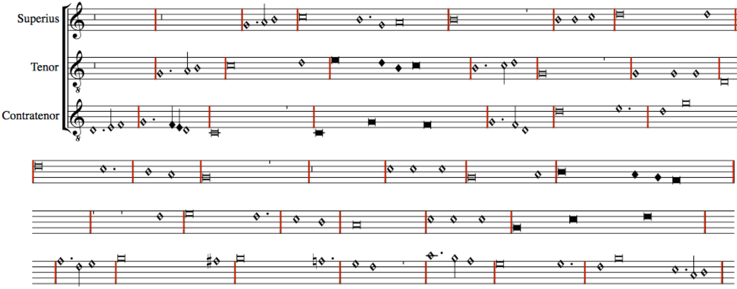
Without using the Scoring-up Tool
Notes:
Say the ”DURATION stuff” HERE TOO
VEROVIO INTERPRETS ALL NOTES AS HAVING THE DURATIONAL VALUE GIVEN BY THE MENSURATION
UNLESS, THE MODIFICATION ON THE DURATION OF A NOTE IS ENCODED WITHIN THE NOTE
WHICH IS WHAT THE SCORING-UP TOOL DOES.
WE NEED TO ENCODE THE EFFECT OF THAT MODIFICATION
THIS IS, WE NEED TO ENCODE THE MODIFIED DURATION.

Slide 12
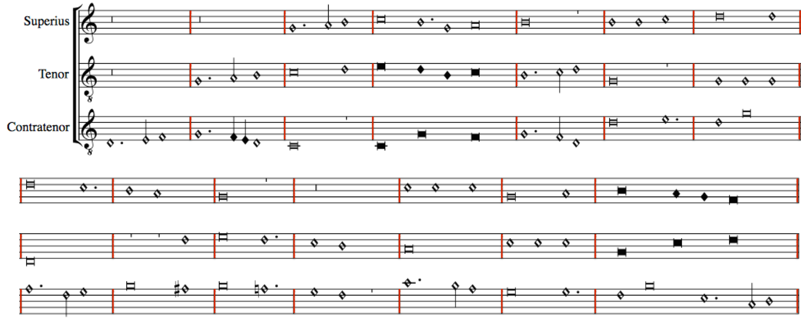
With the Scoring-up Tool
Notes:
Show here:
The Imperfections
The Alterations
The coloration
The distinct dots

Slide 13
Conclusions
The scoring-up tool presents the piece in score format
Facilitates visualizing the vertical sonorities and studying the relation between the voices of a piece, which was difficult given the separate-parts layout of the original sources
Preserves the original note values
Notes:
[Bef 3] (Because generally when studying mensural music, musicologists transcribe it into modern values to write it as a score, but certain information gets lost in this translation process—e.g., you cannot account for different mensurations in different voices)
[After 3] Making it faithful to the source, while providing additional information (regarding the vertical sonorities)

Slide 14
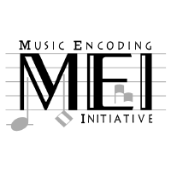


Thank you!

