Slide 1
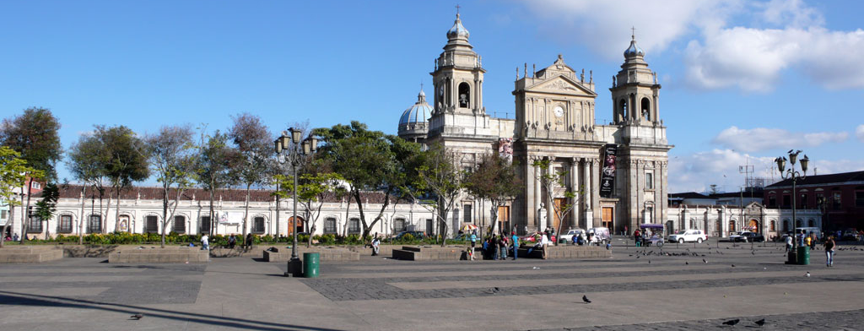
Guatemalan Manuscripts: Digitization Issues and Future Challenges in the Adaptation of the OMR Workflow for Mensural Music
Martha E. Thomae
CIRMMT, McGill University
SIMSSA Workshop XVIII
Vienna, 02 June 2019

Slide 2
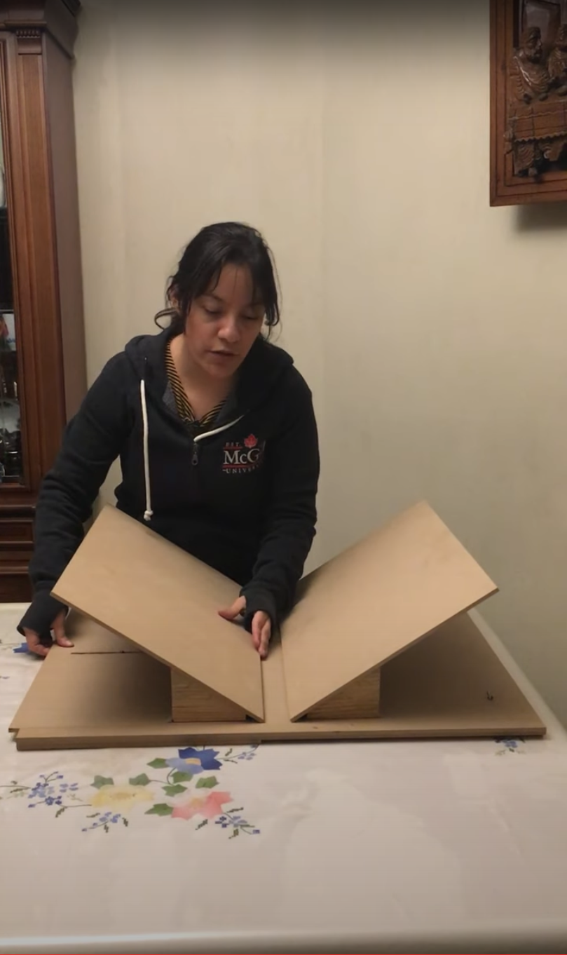
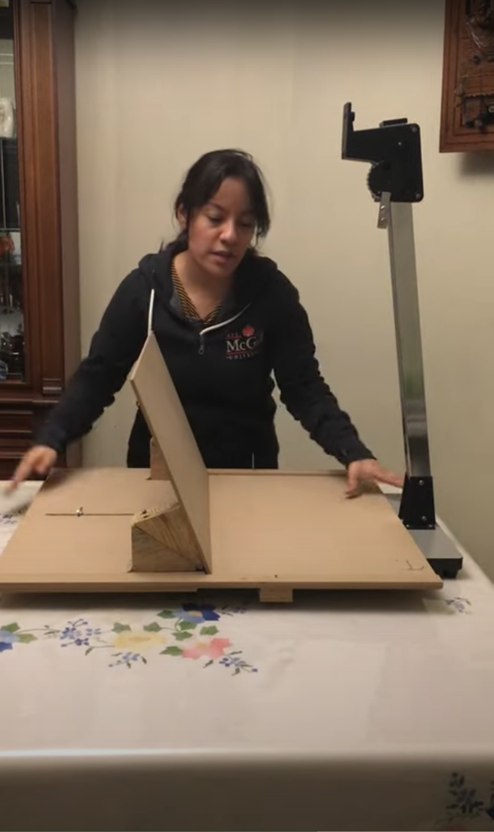
Digitization: Book Cradle Configurations
Upside v-shaped configuration
https://www.youtube.com/watch?v=VDbJQSMjB0s
Open-at-one-side configuration
https://www.youtube.com/watch?v=ULAE4sE2Wqg
Notes:
Originally I was going to go for the fist one.
The second one works better, in the sense that …
Limited time
Good that we have both configurations available

Slide 3
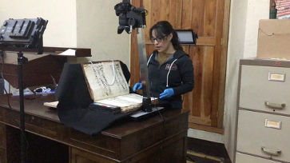
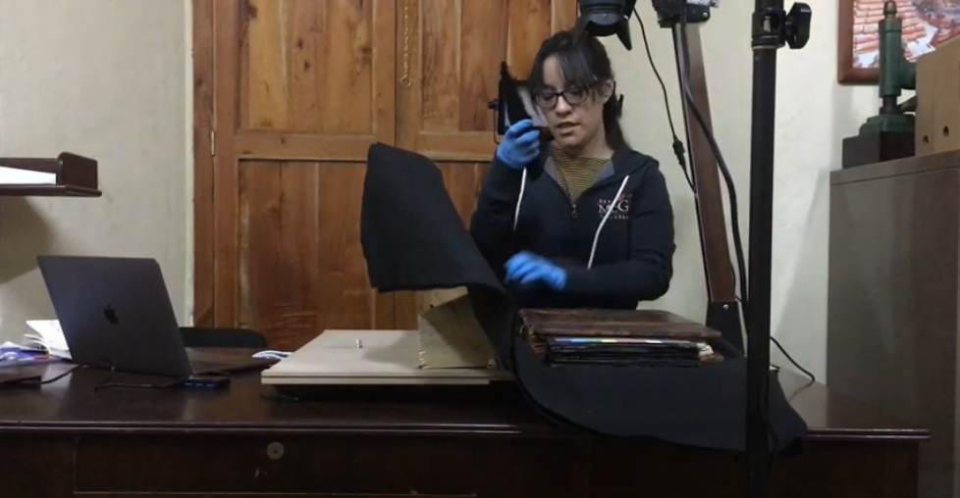
Digitization Process
Workflow
https://www.youtube.com/watch?v=4KFCom8Vndo
Reaching the other end of the book
https://www.youtube.com/watch?v=cDn3b8RsQBM
Have to come up with a small workflow (series of steps) to make the digitization process as mechanic as possible
The page falling and the increase in curvature when reaching the other end of the book
Lack of numbers on versos: Printed numbers
Notes:
(after first video) Mention lower the camera

Slide 4
Complete OMR Workflow
Note shape @dur
Pitch
@pname, @oct
Optical Music Recognition (OMR)
Digitization
(DIY Book Scanner)
Document Segmentation
(Pixel.js & Calvo's Method)
Symbol Recognition
(Interactive Classifier)
Pitch Finding
Correction
(Neon2)
Mensural Scoring-up Tool
OMNE
Duration
Perfect
Imperfect
Altered
@num, @numbase
Notes:
CREATING A NEW ONE CALLED OMNE ( Online Mensural Notation Editor)

Slide 5




Thank you! martha.thomaeelias@mail.mcgill.ca

