Slide 1
Digital Encoding of
Mensural Music
Project Team: Karen Desmond, Martha Thomae
SIMSSA Workshop X
CIRMMT, McGill University
Montreal, September 24th, 2016

Slide 2
Problem
Encode mensural music in a machine-readable format: music symbolic files
Two goals:
Display the piece without the manuscript
Analysis / Search

Slide 3
Create the encodings:
MEI

Slide 4
MEI (Music Encoding Initiative)
<mei>
<meiHead/>
<music>
<scoreDef>
<staffDef n = 1 />
<staffDef n = 2 />
<staffDef n = 3 />
</scoreDef>
<section>
<measure n = 1>
<staff n = 1 />
<staff n = 2 />
<staff n = 3 />
</measure>
<measure n = 2>
<staff n = 1 />
<staff n = 2 />
<staff n = 3 />
</measure>
</section>
</music>
</mei>
<mei>
<meiHead/>
<music/>
</mei>
<mei>
<meiHead/>
<music>
<scoreDef/>
<section/>
</music>
</mei>
<mei>
<meiHead/>
<music>
<scoreDef>
<staffDef n = 1 />
<staffDef n = 2 />
<staffDef n = 3 />
</scoreDef>
<section>
<measure n = 1/>
<measure n = 2/>
</section>
</music>
</mei>
MEI is a system for encoding musical documents in a machine-readable structure.
The music notation is represented using XML tags, arranged in a hierarchical relationship
Tree structure → with roots and branches

Slide 5
MEI (Music Encoding Initiative)
MEI has different modules to support different notation systems:
Common Western music notation
Mensural notation
Neume notation
Each module define the elements and the rules on how these elements should interact in a given notational system

Slide 6
Plan
Display → Verovio
Music notation engraving library that works with MEI
It allows you to view (render) what it is encoded on the MEI file
Search / Analysis → VIS Framework (Vertical Interval Successions)
Tool for music analysis
Python library designed for queries in symbolic musical data (like MEI files)
Built on Music21

Slide 7
Encoding the Mensural Pieces
Goal: Encode the pieces in Mensural MEI
Difficult to do this manually
What is the best way to get musicologists to enter a lot of musical documents in the computer?
Using a score-editor that they are already familiar with
Sibelius
Finale
MuseScore
Sibelius
Includes a plugin that converts Sibelius files to MEI files
Sibmei plugin (Andrew Hankinson)

Slide 8
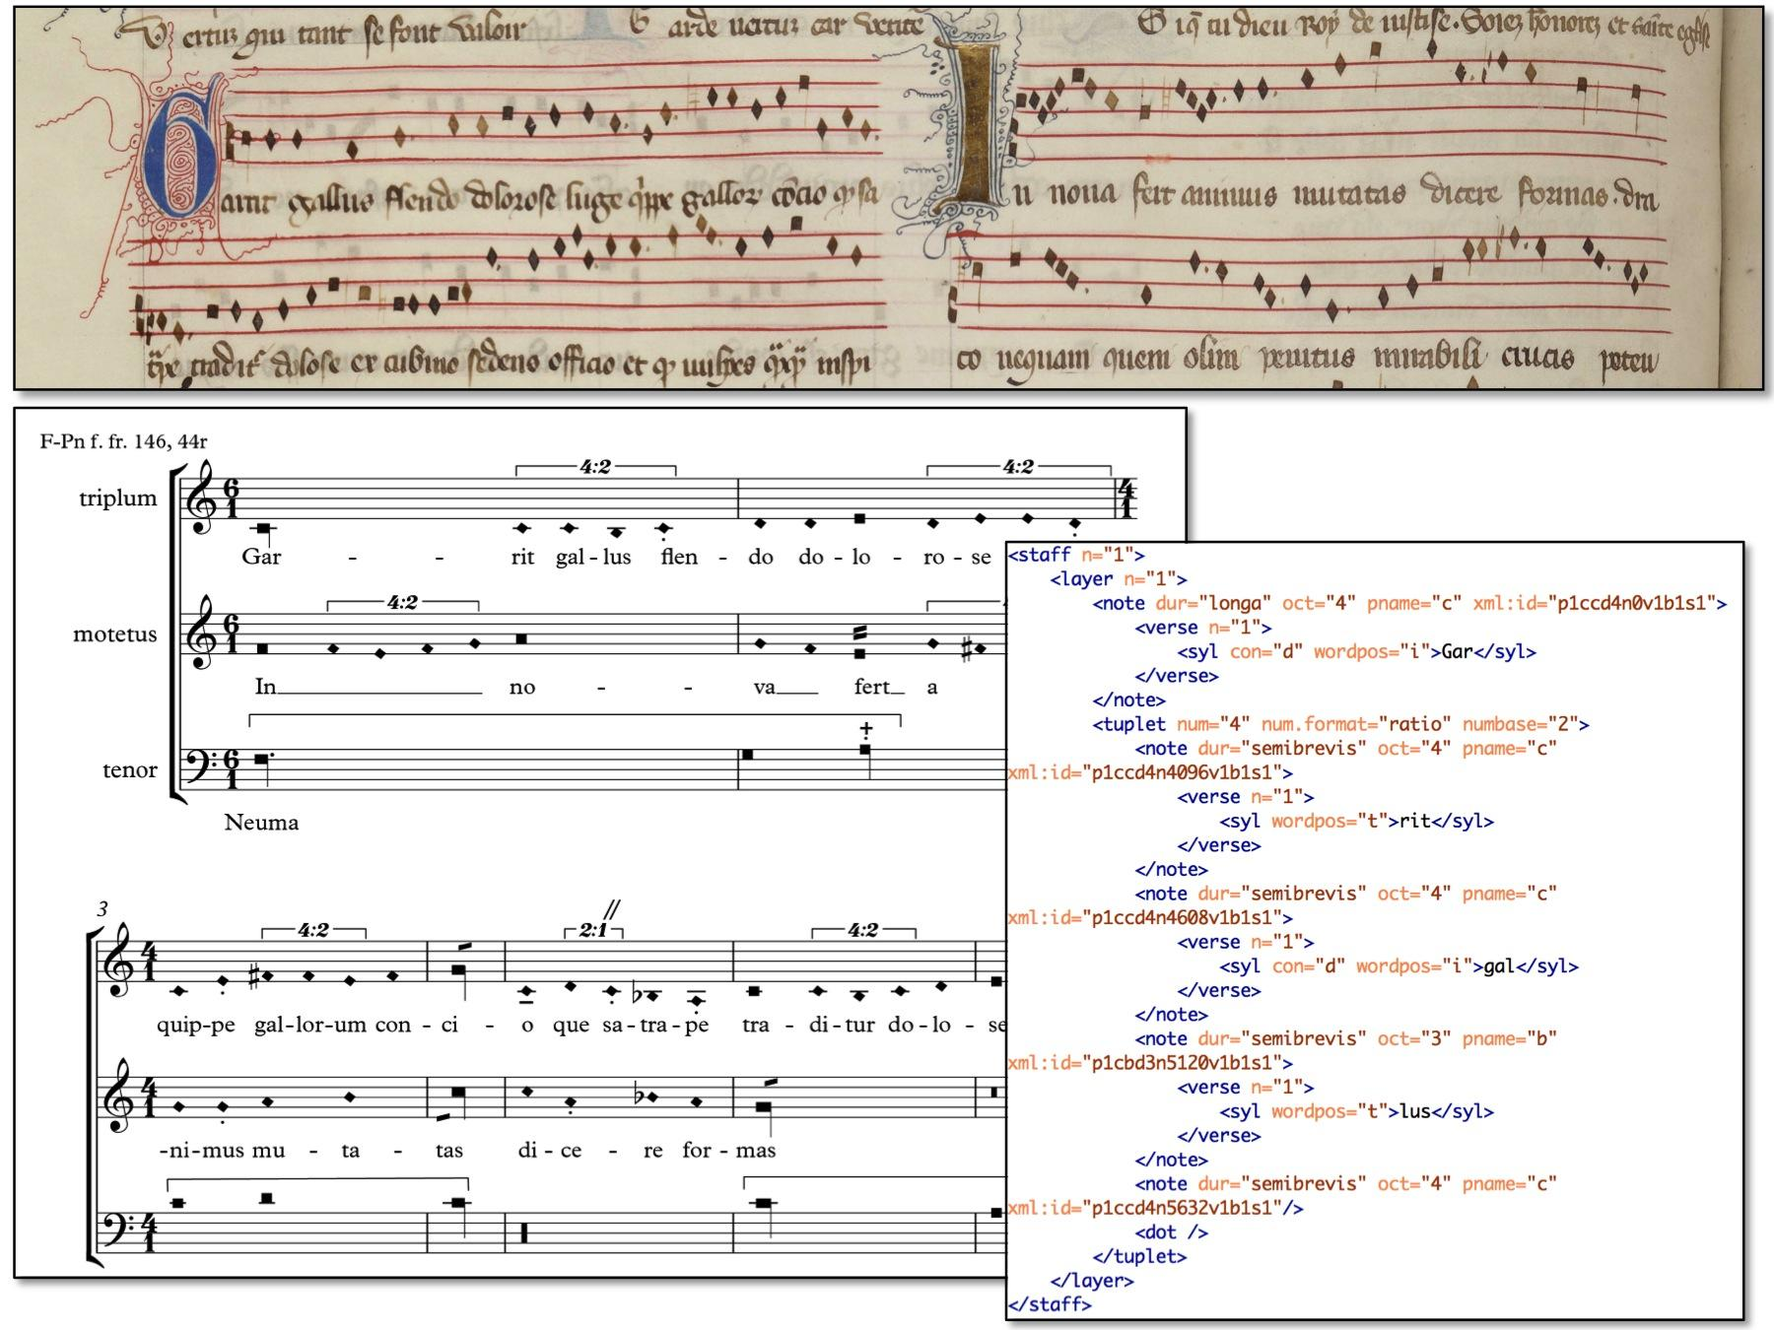
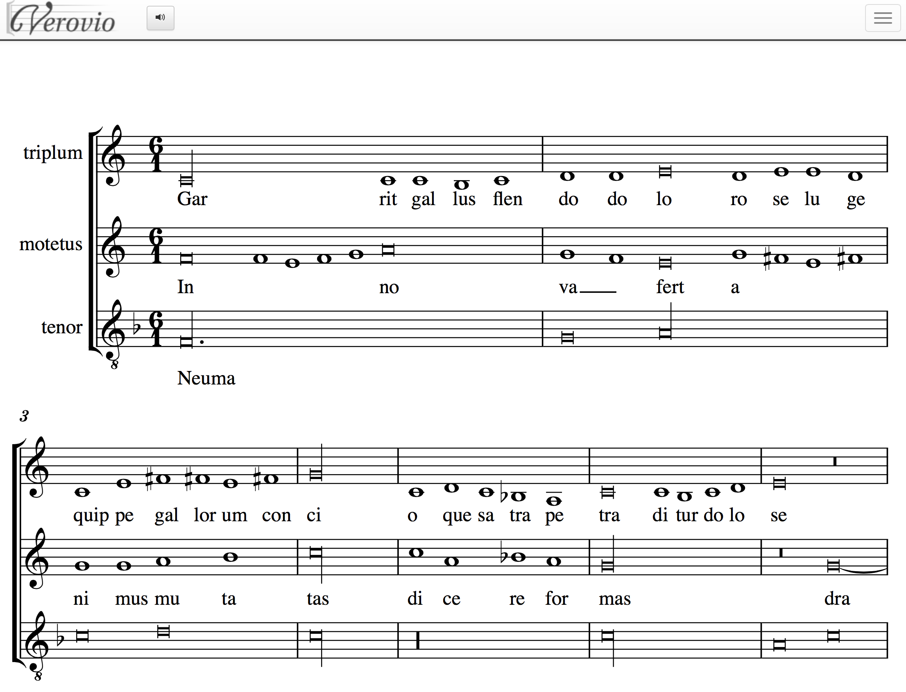
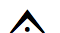
Encoding the Mensural Pieces
Mensural MEI
Document
Common Music Notation MEI
Opening of the motet Garrit gallus / In nova from the manuscript Paris, Bibliothèque nationale, f. fr. 146.
And a marked-up transcription in Sibelius, with articulation marks indicating specific notational features.
Karen Desmond. Ars musicae blog. http://www.arsmusicae.org/wordpress/blog/2015/07/02/digitally-encoding-early-fourteenth-century-motets/

Slide 9
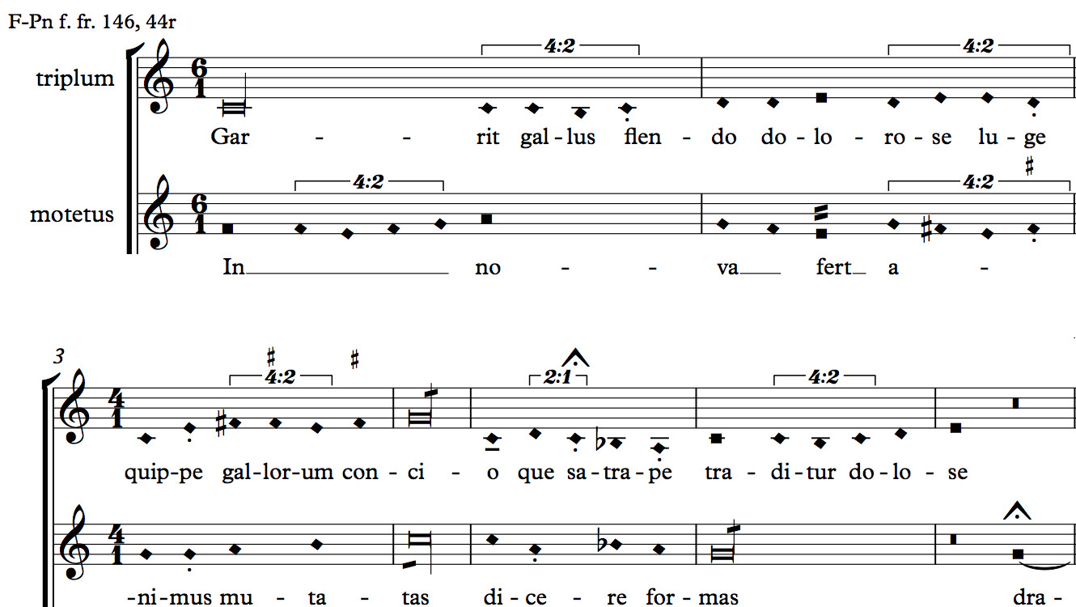
Opening of the motet Garrit gallus / In nova from the manuscript Paris, Bibliothèque nationale, f. fr. 146.
Karen Desmond. Ars musicae blog. http://www.arsmusicae.org/wordpress/blog/2015/07/02/digitally-encoding-early-fourteenth-century-motets/
Transcription in Sibelius contains articulation marks that represent specific notational features

Slide 10
Mensural MEI Translator
Common Music Notation MEI
(CMN MEI)
obtained from Sibelius
Mensural MEI
Decode these encoding conventions from the CMN MEI file
Deal with two main issues of mensural notation:
Note’s shape
Note’s value

Slide 11
Mensural MEI Translator
Was ran over the 64 pieces from the Motet’s Project
Worked on 59
Works fine with pieces with different mensuration between their voices
Still to be implemented:
Deal with changes in mensuration within a voice
Coloration (which is not included in the Mensural MEI module yet)

Slide 12
Digitally encoding mensural music
Making use of the conventions for transcribing mensural pieces in Sibelius
We can have a lot of people entering this music in a familiar and easy way
Getting a lot of music documents encoded in machine readable format
Making them available to a wider audience for:
Analysis and search → research purposes
Display → pedagogical purposes

Slide 13



Thank you!
https://github.com/DDMAL/CMN-MEI_to_MensuralMEI_Translator
Special thanks to:
Karen Desmond
Andrew Hankinson

