Slide 1
MEI Encoding of Early Music The Neumes Module
Martha E. Thomae, Elsa De Luca CESEM-IN2PAST, NOVA University of Lisbon
Research Seminars Series “Musicologists and Their Sources: The Alchemy of Turning Parchment into Pixels”
NOVA University of Lisbon, Portugal, 25 June 2024

Slide 2
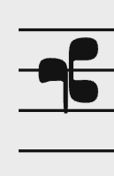
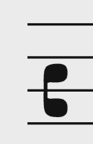





What Can We Encode in Neumes MEI?
Clefs
Notes (also called neume components):
Pitch and octaves / location in the staff / melodic interval
Note shape:
Punctum
Virga
Ornamental: Liquescent, Quilisma, Oriscus, …
Oblique section in neumes
Custos

Slide 3
Short Introduction to MEI

Slide 4

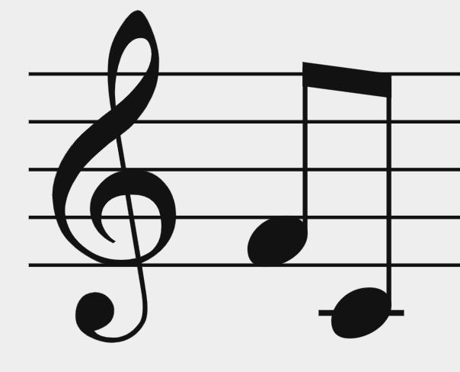
Music Encoding Initiative (MEI)
A community and a format
The format: Encodes music notation in XML (eXtensible Markup Language)
Hierarchical encoding (tree structure)
Its core objects are elements (tags, e.g. <note>)
Opening tags & closing tags → when there is content in between
Self-closing tags → when there is no content to be included in between tags
Uses attributes to define the properties of elements
XML does not ”do” anything, it is just information wrapped in tags
Goal: Encode a wide variety of music documents
<beam>
<note pname="f" oct="4" dur="8"/>
<note pname="c" oct="4" dur="8"/>
</beam>
Opening tag
Self-closing tag
Closing tag
Notes:
"parent - children" relationship
- measure is the PARENT of these <staff> elements
- or you could say: <staff> elements are CHILDREN of the <measure> element
You also have "sibling" relationship
- Those three <staff> elements
- siblings
- they are at the same hierarchy level

Slide 5

XML is a hierarchical encoding system
<neume>
<nc tilt="e" />
<nc tilt="n" intm="u" />
</neume>
<neume> is the parent element
<nc> is a child element
@tilt is an attribute of <nc>
@intm is an attribute of <nc>
= Sign representing one or more musical pitches
= Sign representing a single pitched event, although
the exact pitch may not be known
= Direction of the pen-stroke
= Encodes the melodic interval from the previous pitch

Slide 6
Basic Structure of an MEI File

Slide 7
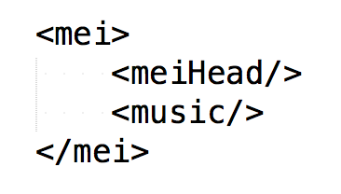
Basic Structure of an MEI File
Metadata
Music
Notes:
In MEI, as in any XML structure, you ALWAYS have a "root element"
So, an element that contains all other elements
The root element for MEI is this tag called "<mei>"
This root <mei> element has TWO children
<meiHead> & <music>

Slide 8
Basic Structure of an MEI File
Metadata
Notes:
In MEI, as in any XML structure, you ALWAYS have a "root element"
So, an element that contains all other elements
The root element for MEI is this tag called "<mei>"
This root <mei> element has TWO children
<meiHead> & <music>

Slide 9
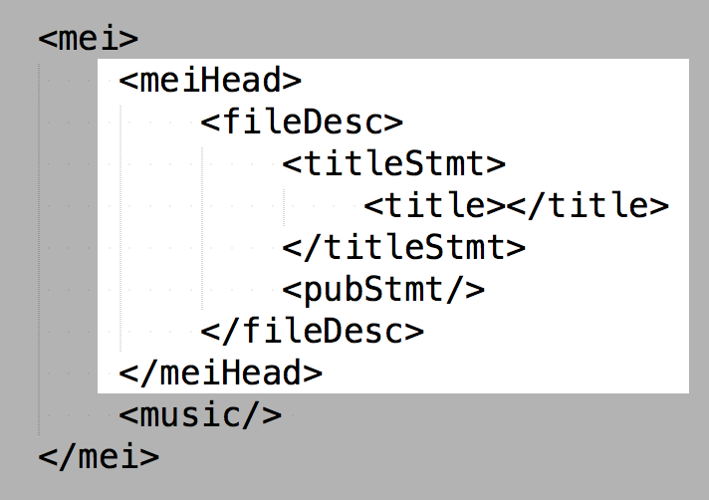
<meiHead> basic elements
@xmlns
TUTORIALS
https://music-encoding.org/ resources/tutorials.html
XML Basics and Minimal MEI File Structure
Outermost basic structure of an MEI-conformant document
(conforms to the schema of MEI)
Basic structure of a “valid” MEI file
Notes:
This is the bare minimum structure for <meiHead>
THIS, FROM BEGINNING TO END:
the <mei> root element with the <meiHead> and the <music> element as children, and with this bare minimum structure within <meiHead>
IS THE MINIMAL / THE MOST BASIC STRUCTURE YOU NEED FOR AN MEI FILE.
AND THEN YOU CAN BUILD UPON THIS BASIC STRUCTURE TO ENCODE MORE DETAILS. BUT THIS IS THE MINIMUM YOU NEED.
[CLICK!] [TUTORIAL]
It will guide you step-by-step on building this minimal MEI file structure
And it will give you the description of each of these elements
[AFTER]
This (with XMLNS [click!]) is the outermost basic structure …
[AFTER 2]
You want more than a basic structure
You want to encode music
And as of now we have seen the basic elements in <meiHead>
-------------------------------------------------------------------------------
[In Tutorial – 1st]
“File Description” element:
direct child element of <meiHead>
provides for a full bibliographic description of a MEI file
“Tittle Statement” element:
A container element for title and responsibility meta-data (composer, arranger, etc.)
The title of a bibliographic entity is given via its mandatory sub-element <title>
“Publication Statement” element:
A container element for information regarding the publication or distribution of a bibliographic item, including the publisher's name and address, the date of publication, and other relevant details
[In Tutorial – 2nd]
What was missing?
@xmlns
What is it?
Defined the name-space being used.
Useful because…
[In Tutorial – 3rd]
MEI-CONFORMANT:
It conforms with the pre-established rules on how to encode an MEI file → this is, it conforms with the MEI schema
Basic structure of a “VALID” MEI file
[In Tutorial – 4th – LAST]
You have just written a valid MEI file and successfully finished this tutorial. You should be able now:
to understand the basic principles of XML and how it is the basis for MEI
to identify and to write the outermost basic structure of an MEI-conformant document including its title
to differentiate between two main sections of a MEI file responsible for metadata information (<meiHead>) or information about the musical content (<music>).

Slide 10
Basic Structure of an MEI File
Music
Notes:
In MEI, as in any XML structure, you ALWAYS have a "root element"
So, an element that contains all other elements
The root element for MEI is this tag called "<mei>"
This root <mei> element has TWO children
<meiHead> & <music>

Slide 11
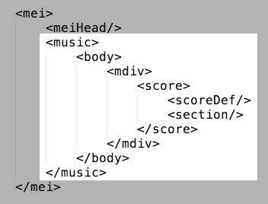
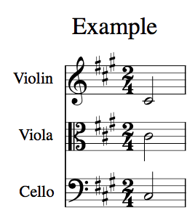
<music> basic elements
“Metadata,” but for the voices
Actual music content
Notes:
This is the basic structure of the music element
<music> will have a child <body> ...
Regardless of which piece of music you are encoding, you will always need to provide this structure ( you have to include all these elements )
So, this structure will be the same for all of you regardless of which piece you are entering
BUT the contents of [CLICK!] THESE two elements would vary depending on the music you are encoding.
scoreDef → “metadata” but for the voices not for the whole work
Section → actual music content (notes)
Let’s take a look at each of them individually

Slide 12
<music> basic elements
“Metadata,” but for the voices
Notes:
So let's start with <scoreDef>

Slide 13
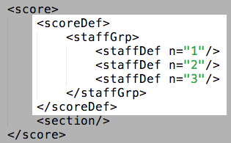
<scoreDef> - General Information for Voices
General information for ALL voices
Meter
Key
Specific information for EACH voice
Clef
Label
Number of staff-lines (@lines)
@n
required for validation
https://music-encoding.org/guidelines/v5/content/shared.html
Notes:
MEANINGS!
(Structure, with names element names and names-expanded)
Brown box (& go to example box)
<scoreDef> MUST CONTAIN a <staffGrp>
Magenta box (& go to example cicles)
The first occurrence of <staffDef> must indicate the number of staff lines via @lines
Each <staffDef> must contain an @n attribute [ I will explain later its importance ]

Slide 14
<music> basic elements
Actual music content
Notes:
The section element

Slide 15
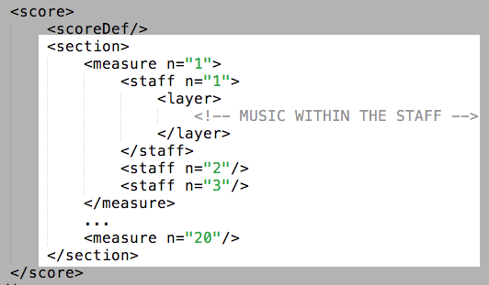
<section> - Actual Music
https://music-encoding.org/guidelines/v5/content/shared.html
Notes:
Made up of <measures> which are then made up of [CLICK]
<staffs>

Slide 16
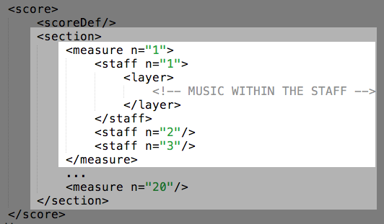
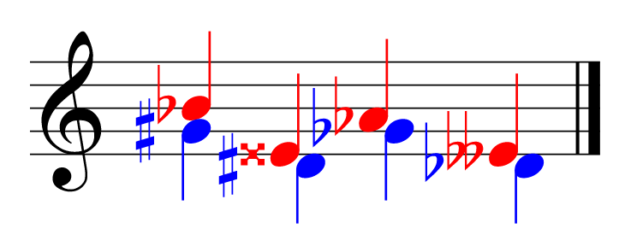
<section> - Actual Music
<layer n=”1”>
<layer n=”2”>
https://music-encoding.org/guidelines/v5/content/shared.html
Notes:
[After Click] <staffs!>
In each <staff> you HAVE TO HAVE a <layer> element → HERE IS WHERE THE NOTES GO!
<layer> allows for having different layers (“voices”) in a single staff.
So, FINALLY, lets see how to encode NOTES / RESTS! [ next! ]

Slide 17
Early Music has No Measures!
Notes:
[SHORT BREAK!]

Slide 18
Monophonic Music has a Single Staff
Notes:
[SHORT BREAK!]

Slide 19
Common Structure
“Metadata,” but for the voices
@xmlns = “http://www.music-encoding.org/ns/mei”
Actual music content
Notes:
common structure
here (dotted rectangle) --> where your files will look different depending on the music you are encoding

Slide 20
MEI for Neume Notation
Most neume notation is used to set music to an existing text. Therefore, the “syllable” is the fundamental unit of structure, with the neumes themselves serving as a means of “sonifying” the text.
Therefore, the syllable element provides high-level organization in this repertoire.
Notes:
The `syllable` element is used as the primary organizational element for neume notation within a `layer` element. Within `syllable`, the `syl` element defined in the `MEI.shared` module is used for encoding the textual content, while the `neume` and `nc` elements are used to encode the neumes themselves.

Slide 21
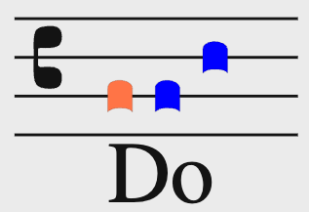
Elements
<syllable>
One <syl> child
One or more <neume> children
neume component <nc> children, these are the individual notes that form part of the neume
<syllable>
<syl>Do</syl>
<neume>
<nc loc="2" />
</neume>
<neume>
<nc loc="2" />
<nc loc="4" />
</neume>
</syllable>
Notes:
The `syllable` element is used as the primary organizational element for neume notation within a `layer` element. Within `syllable`, the `syl` is used for encoding the textual content, while the `neume` and `nc` elements are used to encode the neumes themselves.
one syl
Several neumes (with their nc)
---
<syllable> Neume notation can be thought of as “neumed text”. Therefore, the syllable element provides high-level organization in this repertoire.
<syl> (syllable) – Individual lyric syllable.
<neume> Sign representing one or more musical pitches. As such, a <neume> consists of one or more <nc> element(s)
<nc> Sign representing a single pitched event, although the exact pitch may not be known

Slide 22
Elements
<syllable>
One <syl> child
One or more <neume> children
neume component <nc> children, these are the individual notes that form part of the neume
Attributes of neume components:
Pitch
@pname = c | d | e | f | g | a | b
@oct = … 2 | 3 | 4 …
@loc: position in the staff (integer, 0 is the first line) = … -2 | -1 | 0 | 1 | 2 …
@intm: melodic interval (integer: negative, zero, positive) = … -2 | -1 | 0 | 1 | 2 …
Shape
@tilt: direction of penstroke = n | s | se | …
@curve = c | a
…
Notes:
<syllable> Neume notation can be thought of as “neumed text”. Therefore, the syllable element provides high-level organization in this repertoire.
<syl> (syllable) – Individual lyric syllable.
<neume> Sign representing one or more musical pitches. As such, a <neume> consists of one or more <nc> element(s)
<nc> Sign representing a single pitched event, although the exact pitch may not be known

Slide 23
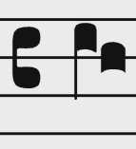
Elements
<syllable>
One <syl> child
One or more <neume> children
neume component <nc> children, these are the individual notes that form part of the neume
Attributes of neume components:
Pitch
@pname = c | d | e | f | g | a | b
@oct = … 2 | 3 | 4 …
@loc: position in the staff (integer, 0 is the first line) = … -2 | -1 | 0 | 1 | 2 …
@intm: melodic interval (integer: negative, zero, positive) = … -2 | -1 | 0 | 1 | 2 …
Shape
@tilt: direction of penstroke = n | s | se | …
@curve = c | a
…
<neume>
<nc pname="d" oct="3" tilt="n" />
<nc pname="c" oct="3" />
</neume>
Notes:
<syllable> Neume notation can be thought of as “neumed text”. Therefore, the syllable element provides high-level organization in this repertoire.
<syl> (syllable) – Individual lyric syllable.
<neume> Sign representing one or more musical pitches. As such, a <neume> consists of one or more <nc> element(s)
<nc> Sign representing a single pitched event, although the exact pitch may not be known

Slide 24
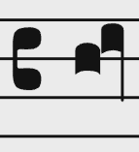
Elements
<syllable>
One <syl> child
One or more <neume> children
neume component <nc> children, these are the individual notes that form part of the neume
Attributes of neume components:
Pitch
@pname = c | d | e | f | g | a | b
@oct = … 2 | 3 | 4 …
@loc: position in the staff (integer, 0 is the first line) = … -2 | -1 | 0 | 1 | 2 …
@intm: melodic interval (integer: negative, zero, positive) = … -2 | -1 | 0 | 1 | 2 …
Shape
@tilt: direction of penstroke = n | s | se | …
@curve = c | a
…
<neume>
<nc loc="4" />
<nc intm="1" tilt="s" />
</neume>
Notes:
<syllable> Neume notation can be thought of as “neumed text”. Therefore, the syllable element provides high-level organization in this repertoire.
<syl> (syllable) – Individual lyric syllable.
<neume> Sign representing one or more musical pitches. As such, a <neume> consists of one or more <nc> element(s)
<nc> Sign representing a single pitched event, although the exact pitch may not be known

Slide 25
Elements
<syllable>
One <syl> child
One or more <neume> children
neume component <nc> children, these are the individual notes that form part of the neume
Attributes of neume components:
Pitch
@pname = c | d | e | f | g | a | b
@oct = … 2 | 3 | 4 …
@loc: position in the staff (integer, 0 is the first line) = … -2 | -1 | 0 | 1 | 2 …
@intm: melodic interval (integer: negative, zero, positive) = … -2 | -1 | 0 | 1 | 2 …
Shape
@tilt: direction of penstroke = n | s | se | …
@curve = c | a
…
<neume>
<nc tilt="e" />
<nc tilt="n" intm="u" />
</neume>
Notes:
<syllable> Neume notation can be thought of as “neumed text”. Therefore, the syllable element provides high-level organization in this repertoire.
<syl> (syllable) – Individual lyric syllable.
<neume> Sign representing one or more musical pitches. As such, a <neume> consists of one or more <nc> element(s)
<nc> Sign representing a single pitched event, although the exact pitch may not be known

Slide 26
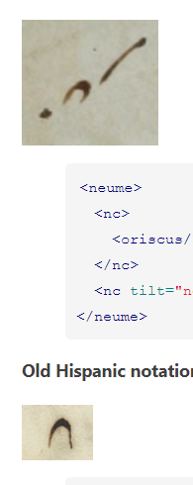
Elements
<syllable>
One <syl> child
One or more <neume> children
neume component <nc> children, these are the individual notes that form part of the neume
Attributes of neume components:
Pitch
@pname = c | d | e | f | g | a | b
@oct = … 2 | 3 | 4 …
@loc: position in the staff (integer, 0 is the first line) = … -2 | -1 | 0 | 1 | 2 …
@intm: melodic interval (integer: negative, zero, positive) = … -2 | -1 | 0 | 1 | 2 …
Shape
@tilt: direction of penstroke = n | s | se | …
@curve = c | a
…
<neume>
<nc tilt="ne" />
<nc tilt="sw" curve="c" intm="d" />
</neume>
Old hispanic notation
Notes:
<syllable> Neume notation can be thought of as “neumed text”. Therefore, the syllable element provides high-level organization in this repertoire.
<syl> (syllable) – Individual lyric syllable.
<neume> Sign representing one or more musical pitches. As such, a <neume> consists of one or more <nc> element(s)
<nc> Sign representing a single pitched event, although the exact pitch may not be known

Slide 27
Elements
<syllable>
One <syl> child
One or more <neume> children
neume component <nc> children, these are the individual notes that form part of the neume
<nc> can have children too:
<episema>
<hispanTick>
<liquescent>
<oriscus>
<quilisma>
<strophicus>
https://music-encoding.org/guidelines/v5/elements/nc.html#mayContain_class_tab
Notes:
<syllable> Neume notation can be thought of as “neumed text”. Therefore, the syllable element provides high-level organization in this repertoire.
<syl> (syllable) – Individual lyric syllable.
<neume> Sign representing one or more musical pitches. As such, a <neume> consists of one or more <nc> element(s)
<nc> Sign representing a single pitched event, although the exact pitch may not be known

Slide 28
Elements
<syllable>
One <syl> child
One or more <neume> children
neume component <nc> children, these are the individual notes that form part of the neume
<nc> can have children too:
<neume>
<nc tilt="e"/>
<nc>
<oriscus/>
</nc>
<nc tilt="ne" intm="u"/>
</neume>
<episema>
<hispanTick>
<liquescent>
<oriscus>
<quilisma>
<strophicus>
St. Gall
https://music-encoding.org/guidelines/v5/elements/nc.html#mayContain_class_tab
Notes:
<syllable> Neume notation can be thought of as “neumed text”. Therefore, the syllable element provides high-level organization in this repertoire.
<syl> (syllable) – Individual lyric syllable.
<neume> Sign representing one or more musical pitches. As such, a <neume> consists of one or more <nc> element(s)
<nc> Sign representing a single pitched event, although the exact pitch may not be known

Slide 29
Elements
<syllable>
One <syl> child
One or more <neume> children
neume component <nc> children, these are the individual notes that form part of the neume
<nc> can have children too:
Attributes for <episema>:
@form ‘v’ (vertical) or ‘h’ (horizontal)
@place placement on <nc>
Attributes for <liquescent>:
@curve direction of curve
@looped boolean (when present, ‘true’)
<neume>
<nc tilt="e"/>
<nc>
<oriscus/>
</nc>
<nc tilt="ne" intm="u"/>
</neume>
<episema>
<hispanTick>
<liquescent>
<oriscus>
<quilisma>
<strophicus>
St. Gall
https://music-encoding.org/guidelines/v5/elements/nc.html#mayContain_class_tab
Notes:
<syllable> Neume notation can be thought of as “neumed text”. Therefore, the syllable element provides high-level organization in this repertoire.
<syl> (syllable) – Individual lyric syllable.
<neume> Sign representing one or more musical pitches. As such, a <neume> consists of one or more <nc> element(s)
<nc> Sign representing a single pitched event, although the exact pitch may not be known

Slide 30
Attributes of neume components:
@pname (pitch name) {[a-g] | unknown}
@oct (octave number) {[0-9]}
@rellen (length of pen stroke relative to previous <nc> in the neume) {s = shorter | l = longer}
@tilt (direction of pen stroke) {n | ne | e | se | s | sw | w | nw}
@con (connection to the previous <nc> in the neume) {g = gapped | l = looped | e = extended}
@ligated {true | false}
Attributes of neume components in stafless notation:
@intm (melodic interval relative to previous <nc> in the neume) {u = up | d = down | s = same}
@s-shape (described by the direction of the initial penstroke) {n = north | s = south | …}
@curve (pen stroke) {c = clockwise | a = anti-clockwise}
https://music-encoding.org/guidelines/v5/elements/nc.html#attributes_full_tab

Slide 31


<neume>
<nc tilt="ne"/>
<nc tilt="se" rellen="s" intm="d"/>
</neume>
<neume>
<nc tilt="ne"/>
<nc tilt="se" rellen="l" intm="d"/>
</neume>

Slide 32




Neumatic connections Neutral – High – Low neumes
<neume>
<nc curve="a"/>
<nc tilt="ne" rellen="l" intm="u"/>
<nc tilt="se" rellen="s"
intm="d" curve="c"/>
</neume>
<neume>
<nc tilt="se"/>
<nc con="g" tilt="ne" rellen="l"
intm="u"/>
<nc tilt="se" rellen="l" intm="d"/>
</neume>
<neume>
<nc tilt="se"/>
<nc tilt="ne" rellen="l" intm="u"/>
<nc tilt="se" intm="d"/>
</neume>
<neume>
<nc s-shaped="s"/>
<nc con="l" tilt="ne" intm="u"/>
<nc tilt="se" rellen="s" intm="d"/>
</neume>

Slide 33
Let’s Encode a Music Example
With mei-friend

Slide 34
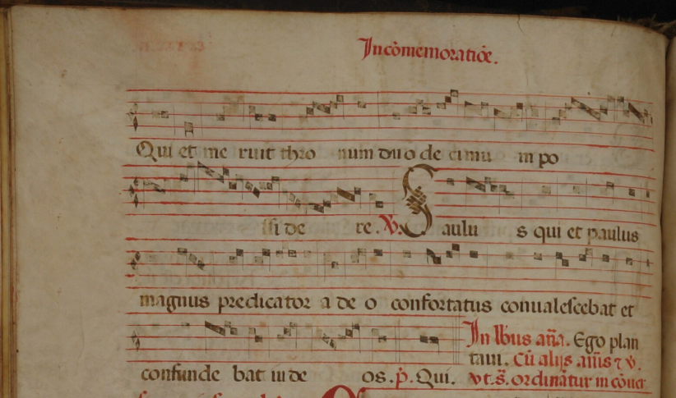
P-BRs (Braga) Archivo da Sé Ms. 028 (f. 092v-093r)

Slide 35
Let’s start
We will encode together a small example in MEI step by step
We will use mei-friend, a web-based MEI editor
Now, open the skeleton MEI file in mei-friend

Slide 36
Minimal MEI file structure
<?xml version="1.0" encoding="UTF-8"?>
<?xml-model href="https://music-encoding.org/schema/5.0/mei-Neumes.rng" type="application/xml" schematypens="http://relaxng.org/ns/structure/1.0"?>
<?xml-model href="https://music-encoding.org/schema/5.0/mei-Neumes.rng" type="application/xml" schematypens="http://purl.oclc.org/dsdl/schematron"?>
<mei xmlns="http://www.music-encoding.org/ns/mei" meiversion="5.0">
<meiHead>
<fileDesc>
<titleStmt>
<title>Basic MEI Mensural skeleton</title>
</titleStmt>
<pubStmt></pubStmt>
</fileDesc>
</meiHead>
<music></music>
</mei>
XML schema definitions
Opening tag of root element with namespace declaration
Header with file description and title statement (all metadata goes here)
Music tag
Closing tag of root element

Slide 37

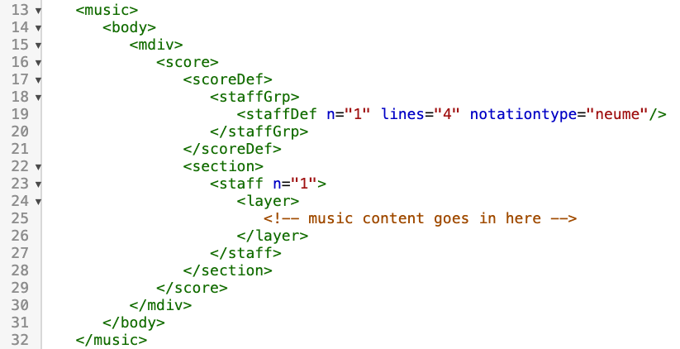
The skeleton of the body of music for “neumes”
The score definition <scoreDef> contains the definitions for the whole score, staff groups, and every single staff
<staffDef> needs at least @n and @lines
Use @notationtype = neume when dealing with neumatic notation
<section> is used to separate music data segments
<staffDef> and <staff> are linked by assigning the same number in @n
A <staff> may contain several <layer> elements for multiple parts

Slide 38
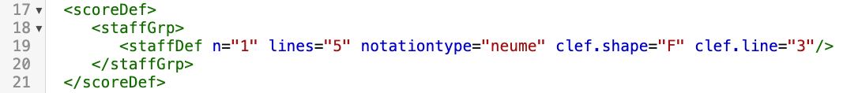
Add a clef in the staff definition
Add clef attributes to <staffDef>:
Add @clef.shape = F
Add @clef.line = 3

Slide 39
Add the children of layer: syllable and their children
Add <syllable> in <layer>
Add the following two children of <syllable>:
Add <syl>
Within the syl opening tag (<syl>) and its closing tag (</syl>), add the text of the corresponding syllable <syl>Sau</syl>
Add <neume> elements for each neume related to the syllable

Slide 40
Add the children of layer: syllable and their children
Fill in the first <neume> with its neume components <nc>
Add attributes @pname=a, and @oct=2 to its <nc>

Slide 41
Add the children of layer: syllable and their children
Add the second <syllable> in <layer>
Add the following two children of <syllable>:
Add <syl>
Within the syl opening tag (<syl>) and its closing tag (</syl>), add the text of the corresponding syllable <syl>lus</syl>
Add two <neume> elements for the two neumes related to the syllable

Slide 42
Add the children of layer: syllable and their children
Fill in the first <neume> of this syllable with its neume four components <nc>
For the first <nc>, add attributes @pname=a and @oct=2
For the second <nc>, add attributes @pname=g and @oct=2
For the third <nc>, add attributes @pname=a and @oct=2
For the fourth <nc>, add attributes @pname=g and @oct=2
Add @ligated = true to the first and second <nc>
And add @tilt = n to the first <nc>

Slide 43
Add the children of layer: syllable and their children
Fill in the second <neume> of this syllable with its neume two components <nc>
For the first <nc>, add attributes @pname=g and @oct=2
For the second <nc>, add attributes @pname=f and @oct=2
Finally, add the attribute @tilt=n to the first <nc>

Slide 44
Add the children of layer: syllable and their children
… continue

Slide 45
Add the children of layer: syllable and their children
Add the new <syllable> in <layer>
Add the following two children of <syllable>:
Add <syl>
Within the syl opening tag (<syl>) and its closing tag (</syl>), add the text of the corresponding syllable <syl>nus</syl>
Add one <neume> element for the one neume related to the syllable

Slide 46
Add the children of layer: syllable and their children
Fill in the <neume> of this syllable with its neume three components <nc>
For the first <nc>, add attributes @pname=a and @oct=2
For the second <nc>, add attributes @pname=g and @oct=2
For the third <nc>, add attributes @pname=f and @oct=2
Add the attribute @tilt=n to the first <nc>
And add the attribute @tilt=se to the second and third <nc> elements in the neume

Slide 47





Thank you!
martha.thomae@fcsh.unl.pt
elsadeluca@fcsh.unl.pt

Slide 48
MEI Guidelines
A quick tour

Slide 49
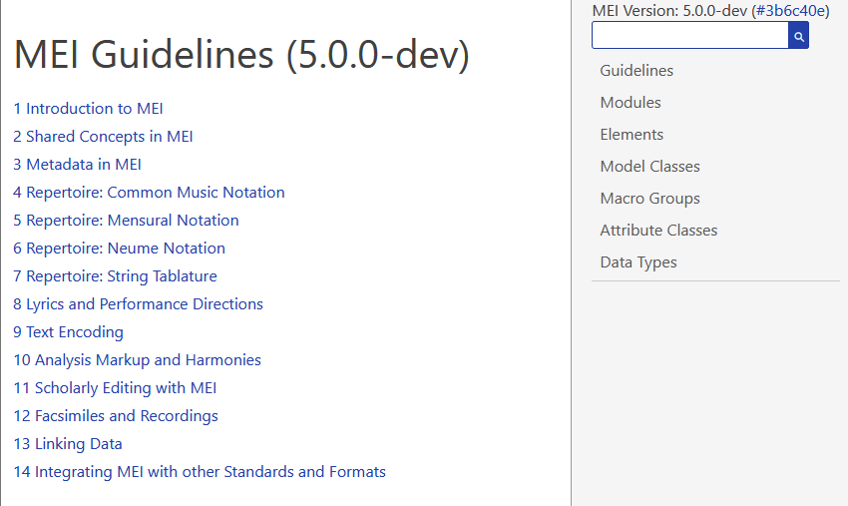
Overview
The MEI Guidelines are available at the MEI website: www.music-encoding.org → Documentation
The Guidelines consist of different parts:
Guideline chapters
Several references contain the schema definition in a human readable form
Learning MEI means learning to use the Guidelines!

Slide 50
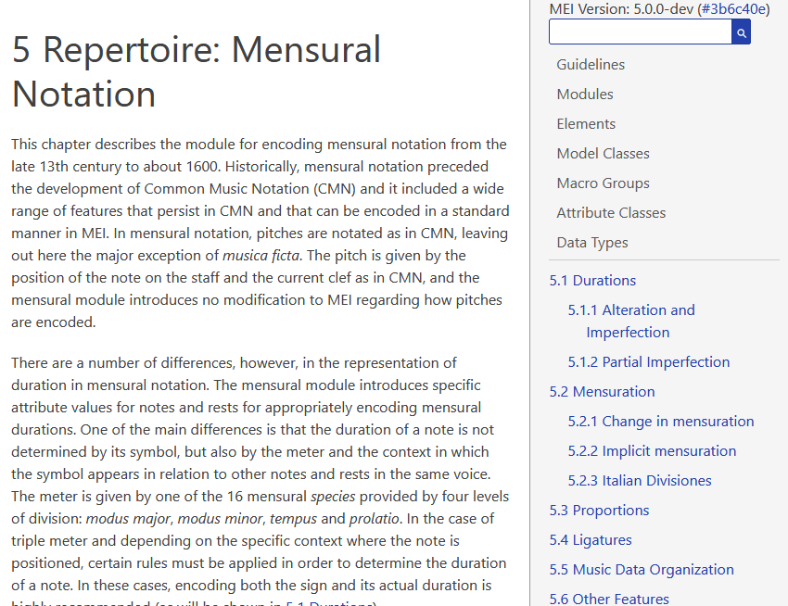
Guideline chapters
Chapters on different topic explain the encoding of a certain set of features, e.g. different forms of notation
Every chapter is written collaboratively by the community
They give an overview on a certain topic and concepts
They explain how to encode
They do not contain explanations on every element and attribute available!

Slide 51
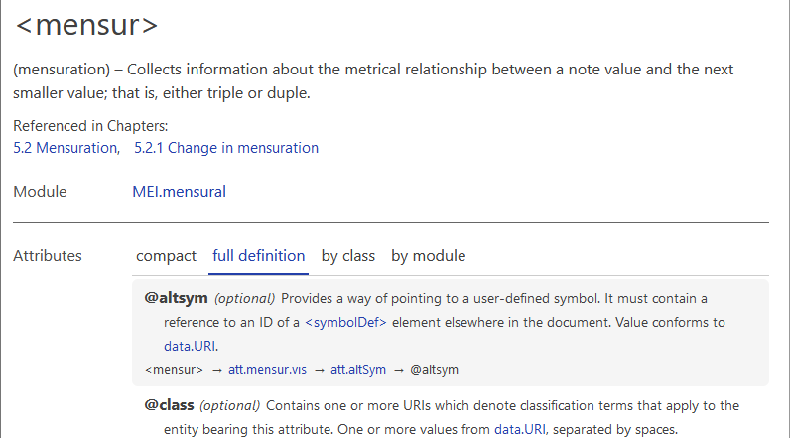
Element description
Heading
Element definition
Chapter references
Module that contains the element
Available attributes
(different views)
Link to overview of possible values

Slide 52
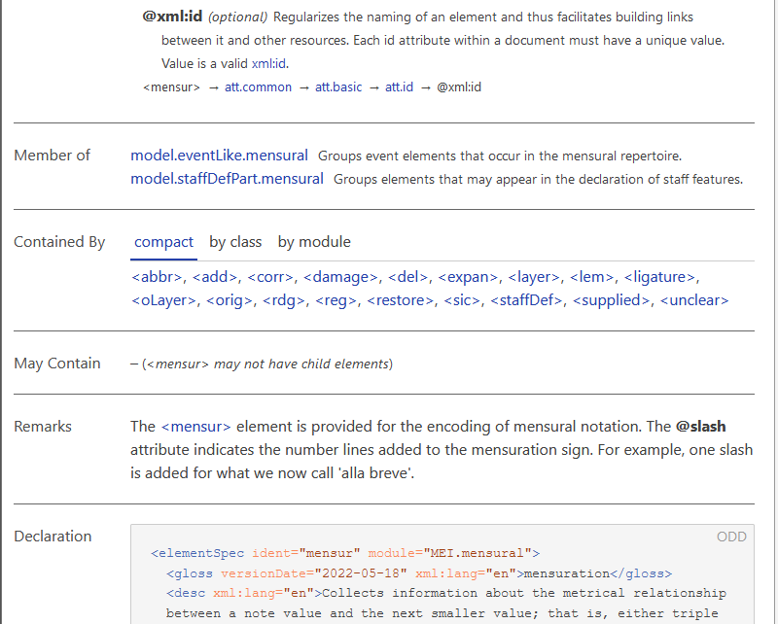
Element description (continued)
List of models (element groups) the element is a member of
Elements that could contain this element
Elements this element is allowed to contain
General remarks
The actual element declaration

Slide 53
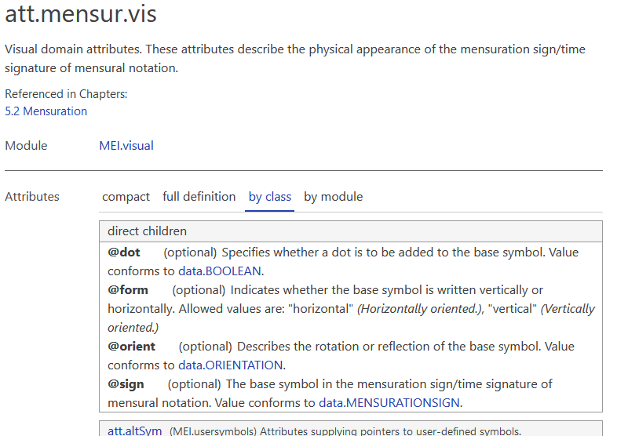
Attribute (class) description
Attribute class name
Attribute class description
Chapter references
Module that contains the attribute class
Overview of all available attributes in this class
(this view shows direct children and attributes of other attribute classes that are a member of this class)
Link to overview of possible values

Slide 54
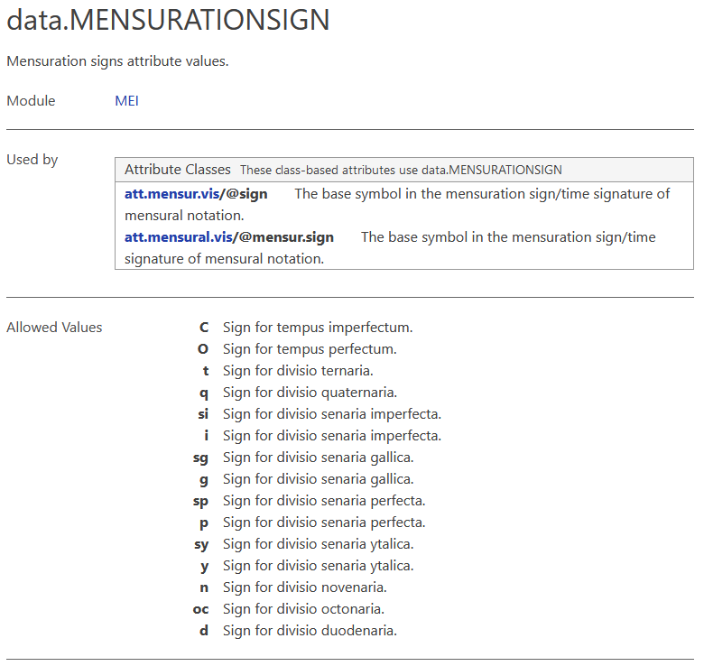
Data types (attribute values)
Attribute values are (mostly) organised as data types
Name and explanation of this data type
Attributes using this data type
List of allowed values and explanation

