Slide 1
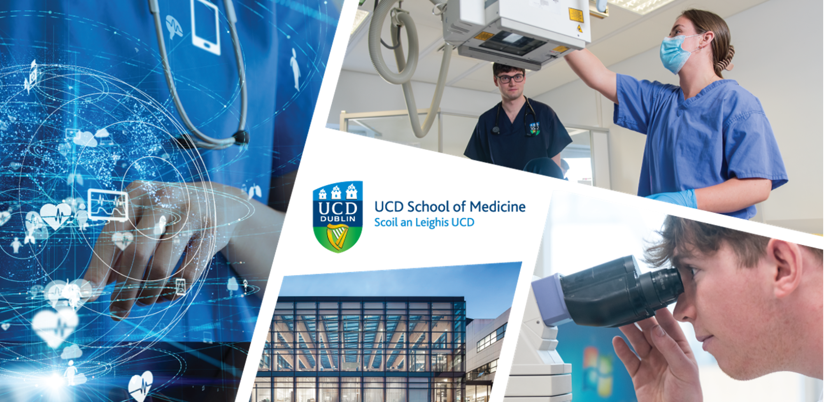
M&Ms-2 Segmentation
UCD Ireland’s Global University
Module: RDGY41710 - AI For Medical Image Analysis
Contributors: William O Brien, Martha Rotter, Yu DU, Devaharish Srikannan, Binhan XIAO
August 11th, 2025

Slide 2
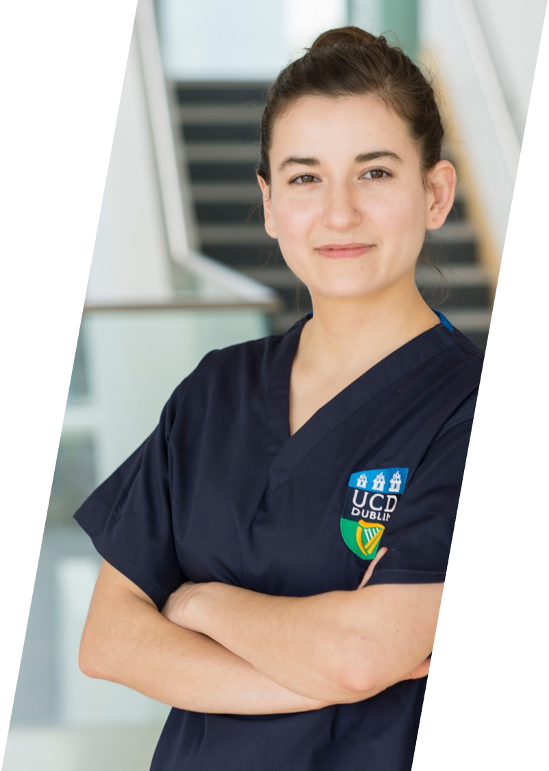
Outline
UCD Ireland’s Global University
Introduction
Methodology
Experiments
Results
Conclusion
Discussion
www.ucd.ie/medicine
2

Slide 25

UCD Ireland’s Global University
Thank You
https://www.ucd.ie/medicine
www.ucd.ie/medicine
25

