Slide 1

Software Testing and Quality Assurance
Black-box Testing:
Introduction and Random Testing
Week 3
Institut Teknologi Del
Jl. Sisingamangaraja
Sitoluama, Laguboti 22381
Toba – SUMUT
http://www.pidel.org
Lecturer : AMS
- PUPL–
- Sem Ganjil 2018/2019 -

Slide 2
Overview
Reliable Test Set Problem
Test case selection strategies
Testing methods of Black Box Testing Group
Random testing and Adaptive Random Testing
Specification-based testing: equivalence partitioning testing, category-partition testing, classification-tree testing
STQA_W2S3

Slide 3
Reliable Test Set Problem
p: a program
D: input domain = all possible inputs for p
By testing p using all inputs in D, if no failures are found, then p is proven as a correct program
However, testing p using all inputs in D is impractical when the size of D is large or infinite
STQA_W2S3

Slide 4
Reliable Test Set Problem (cont’d)
We need to find a reliable test set T where:
  T is subset of D
  if p(T) is correct then p(D) is correct
Problem: T is impossible to attain except if T = D => known as “Reliable Test Set Problem”
In other words: Testing cannot prove the correctness of the problem except we do the exhaustive testing.
However, exhaustive testing is impractical specially when the size of D is large
STQA_W2S3

Slide 5
How to alleviate the reliable test set problem ?
Selection of test cases
STQA_W2S3

Slide 6
Approach to select test cases
Black Box Testing: does not refer to the code of the program
White Box Testing: refers to the code of the program under test
Fault Based Testing: shows the absence of certain type of faults
STQA_W2S3

Slide 7
Black Box testing
Random Testing and Adaptive Random Testing
Specification based testing:
  equivalence partitioning
  category-partition method
  classification-tree method
STQA_W2S3

Slide 8
Random Testing
Select test cases from the entire input domain randomly and independently
Advantages:
  Intuitively simple
  Test case generation process can be automated
  Applicable even when we do not have a complete software
  requirement specification or source code
  since users often crash software in many unexpected ways
  before the software is put into operation, it is important to test the software with random inputs
STQA_W2S3

Slide 9
Random Testing
Two approaches:
Uniform distributions
Every input has a uniform chance of being selected for testing
Operational distributions (profiles)
  Inputs have different chances of being selected for testing
  Their chance depends on how frequently the end users executed the software with these inputs
STQA_W2S3

Slide 10
Random Testing: Example
Suppose that a program accepts one parameter:
int x whose valid value range is 10 ≥ x ≥ -10
consider applying random testing to this range of x: (-10, 10)
STQA_W2S3

Slide 11
Random Testing: uniform distribution
give every input an equal chance to be selected for testing
since there are 21 possible values for X, we assign the probability of 1/21 to each X value.
to construct a test case, we call a random number generator (for example, rand() method in the C library) to obtain a value for X
STQA_W2S3

Slide 12
Random Testing: operational distribution
Reflect how likely the software will fail in the operational environment
The more frequently used inputs should be tested more frequently
Suppose among 100 times of system operation, the usage frequency of each X value is as follows:
STQA_W2S3

Slide 13
Value of X | Frequency | Value of X | Frequency
-10 | 2 | 1 | 5
-9 | 1 | 2 | 5
-8 | 3 | 3 | 4
-7 | 2 | 4 | 2
-6 | 14 | 5 | 1
-5 | 7 | 6 | 5
-4 | 7 | 7 | 11
-3 | 3 | 8 | 3
-2 | 10 | 9 | 4
-1 | 2 | 10 | 2
0 | 7
STQA_W2S3

Slide 14
Random Testing: operational distribution
One possible way to randomly select test cases according to the operational profile is as follows:
First, create an array of integer types:
ArrX = new int[Y] where Y is the total frequency of inputs, in that example is …
Set ArrX[1] = -10, Set ArrX[2] = -10, Set ArrX [3] = -9, Set ArrX [4] = -8, Set ArrX [5] = -8, Set ArrX [6] = -8, Set ArrX [7] = -7, Set ArrX [8] = -7, Set ArrX [9] = -7, ..., Set ArrX [100] = 10
Call rand() to generate a value k between 1 to Y (i.e.
1≤ k ≤ 100). Suppose rand() returns 21 as the value of k.
ArrX[21] (that is, -6) will be selected as a random test input.
STQA_W2S3

Slide 15
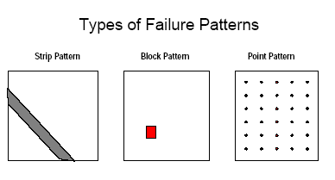
How can we improve Random Testing ?
Identify the types of failure patterns
  Adaptive Random Testing
STQA_W2S3

Slide 16
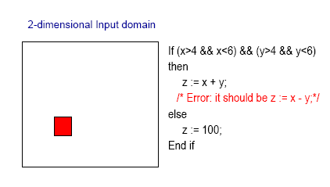
Sample Program of Block Pattern
STQA_W2S3

Slide 17
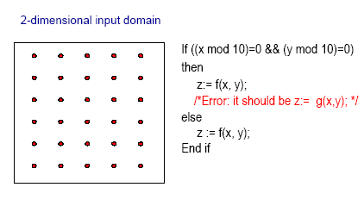
Sample program of point pattern
STQA_W2S3

Slide 18
Exercise
Find a sample of codes where the strip pattern may occur !
STQA_W2S3

