Slide 1
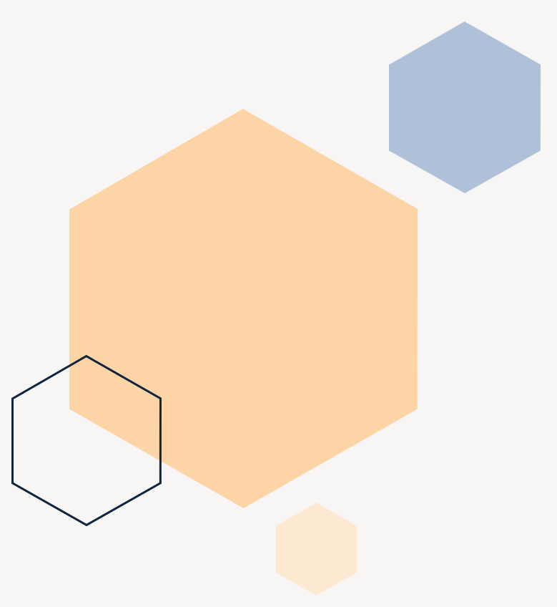
Depression detection in social networks
Martí Caixal i Joaniquet

Slide 2
Agenda
Introduction
Objectives
Methodology &
Development
Results
Conclusions

Slide 3
Introduction
EE/UAB TFG INFORMATICA: Depression detection in social networks

Slide 4

What problem are we facing?
EE/UAB TFG INFORMATICA: Depression detection in social networks
Notes:
Explain there is way more depression messages than cyberbullying.
Not only this, but those depression messages do not receive as much attention as other type of messages.
Why? Unlike bullying, they are not attacking another individual, instead they are attacking themselves. No one reports them and are more difficult to identify.

Slide 5
Objectives
EE/UAB TFG INFORMATICA: Depression detection in social networks

Slide 6
Find out which method gives the best results and how they differ
Shallow Learning:
Naïve Bayes
Decision Tree
Random Forest
SVM
KNN
Hyper Parameter Search
Deep Leaning
RNN
RNN LSTM
RNN GRU
Transformers (BERT)
EE/UAB TFG INFORMATICA: Depression detection in social networks

Slide 7
Methodology & Development
EE/UAB TFG INFORMATICA: Depression detection in social networks

Slide 8

Planification
Short iterations
Friendly to changes
Independent subobjectives
Easy to detect errors
Good control of flow
Agile Methodology
EE/UAB TFG INFORMATICA: Depression detection in social networks

Slide 9

Data used
Mental Health Twitter (Twitter 3)
Depression Twitter (Twitter Scale)
Depression Reddit (Reddit)
Only the message and label
Labeled in a scale from 1 to 5
Already cleaned
Unbalanced,
target class being minority:
Undersampling
Oversampling
Macro Average
EE/UAB TFG INFORMATICA: Depression detection in social networks

Slide 10
Initial preprocessing
Specific approaches
Shallow Learning
Deep Learning
Bag of Words
Word Embedding (GloVe)
TF-IDF
Delete usernames
Delete numbers
Lemmanization
Delete punctuation
Delete Stop Words
EE/UAB TFG INFORMATICA: Depression detection in social networks

Slide 11
Storing results and experiments
model | params | dataset | type | average | recall | time | hyperparameter search | datetime
NB | {”nb alpha”: 45.1} | clean twitter scale | tfidf max features=250 | macro | 0.53 | 1.3 | True | 1/11/2022 16:22
DTC | {”dtc max depth... | clean twitter scale | tfidf max features=250 | macro | 0.53 | 0.2 | True | 1/11/2022 16:22
SVM | {”svc kernel”: ”... | clean twitter scale | tfidf max features=250 | macro | 0.72 | 4.5 | True | 1/11/2022 16:23

Slide 12
Results
EE/UAB TFG INFORMATICA: Depression detection in social networks

Slide 13
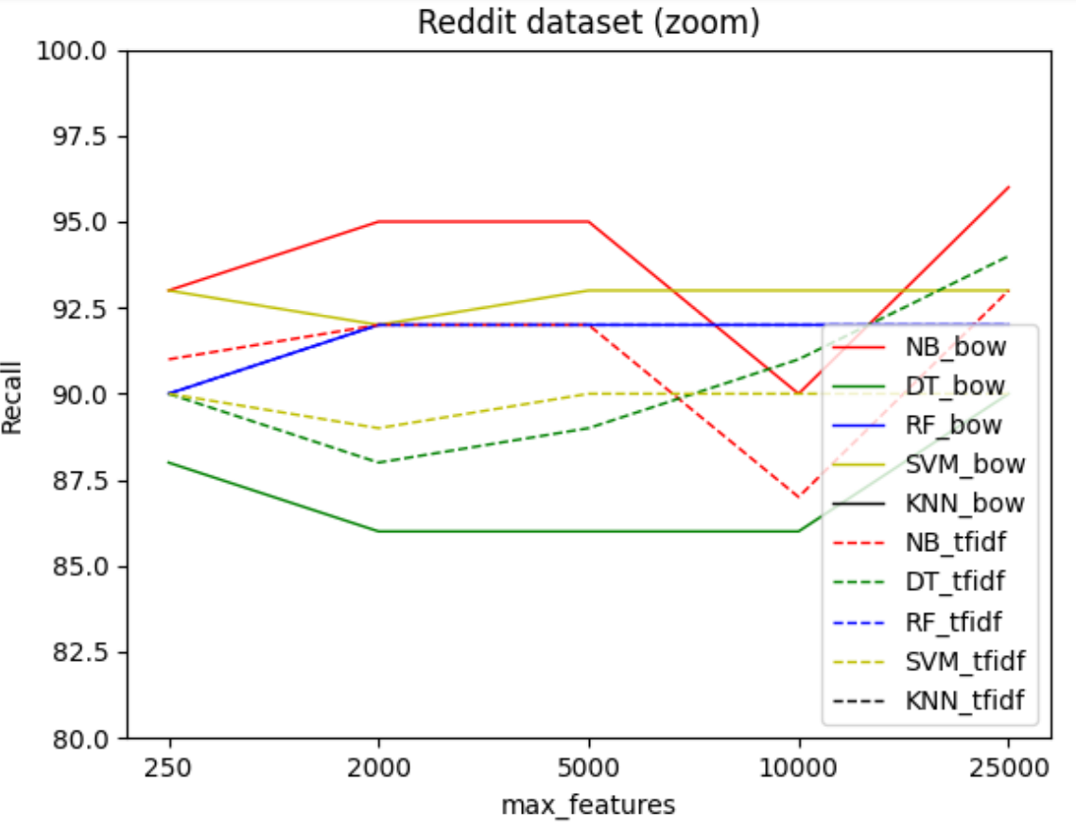
Shallow learning results
EE/UAB TFG INFORMATICA: Depression detection in social networks
Notes:
While they have different results, they all have the same behaviour.
Explain difference between BOW TFIDF, number of max_features,

Slide 14
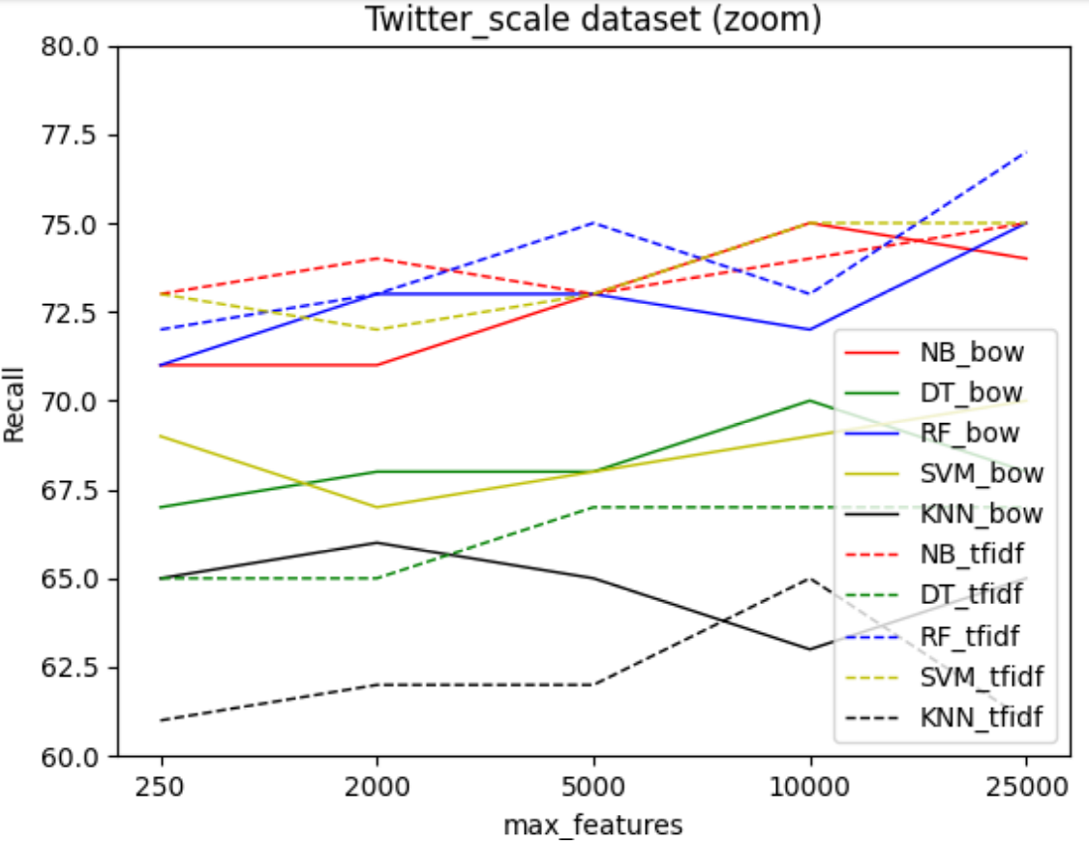
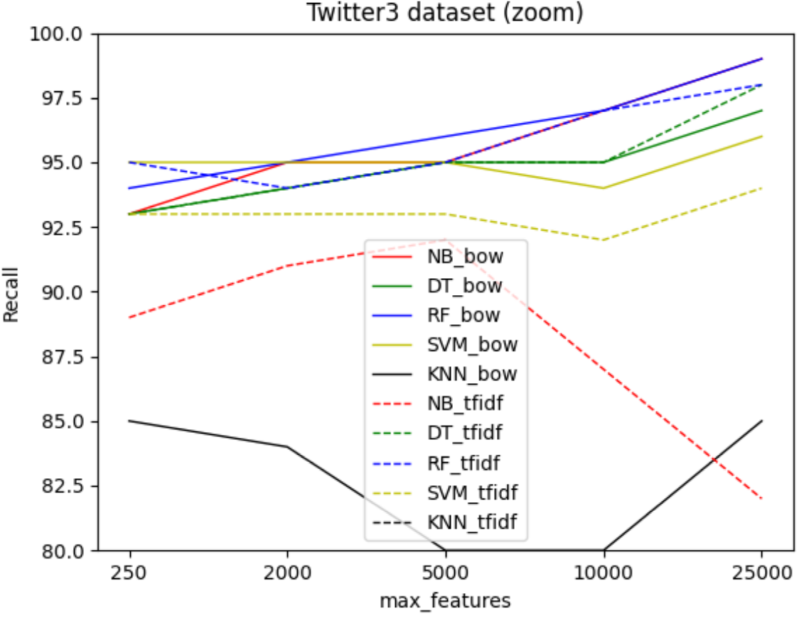
EE/UAB TFG INFORMATICA: Depression detection in social networks

Slide 15
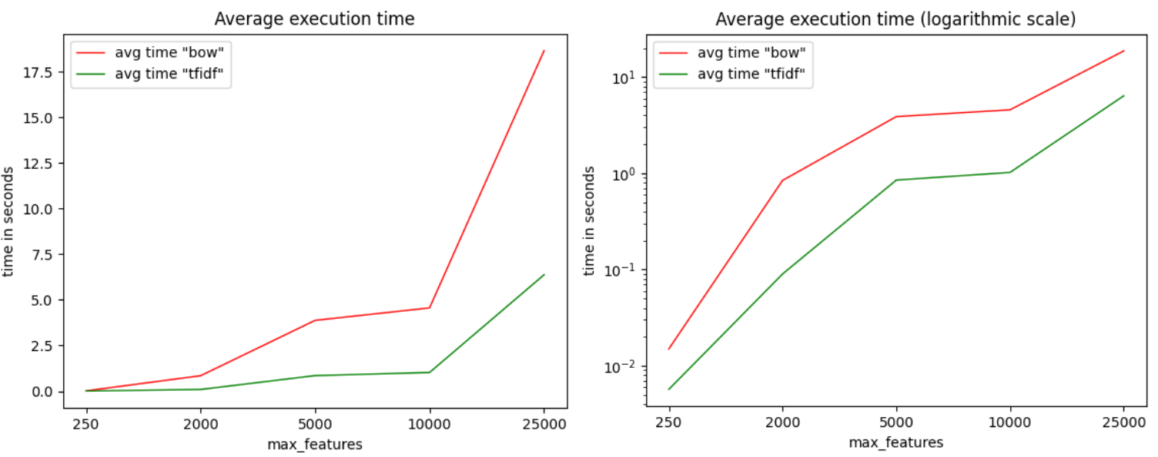
Shallow learning complexity
EE/UAB TFG INFORMATICA: Depression detection in social networks
Notes:
While they have different results, they all have the same behaviour.
Explain difference between BOW TFIDF, number of max_features,

Slide 16
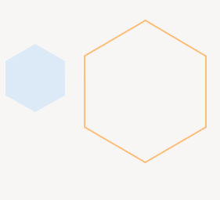
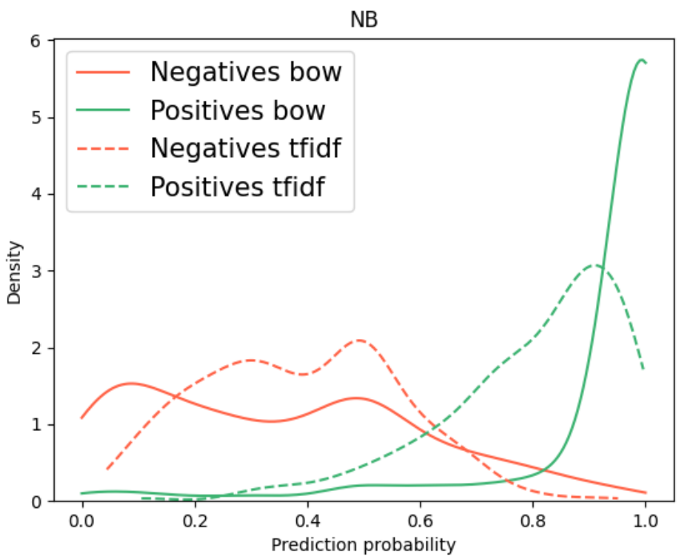
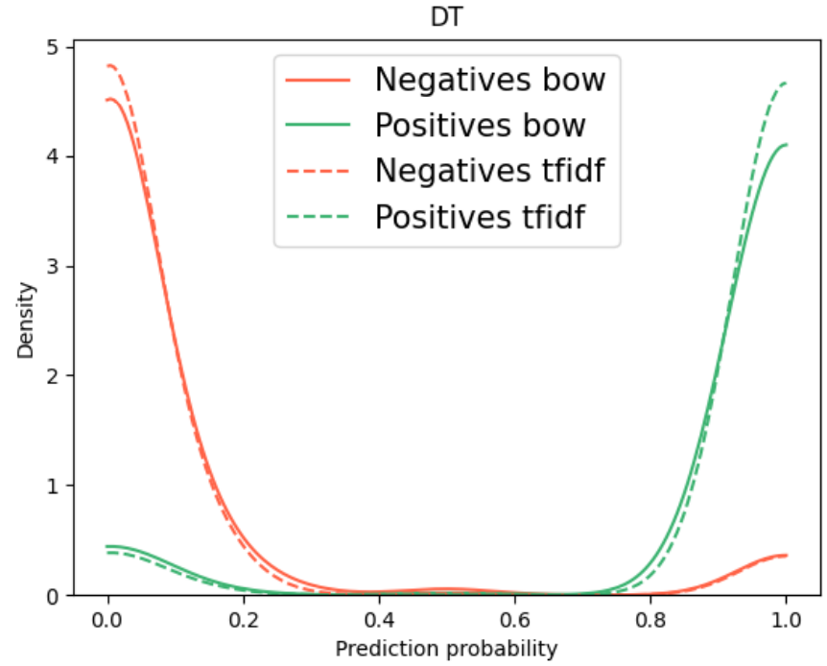
Confidence in predictions
EE/UAB TFG INFORMATICA: Depression detection in social networks

Slide 17
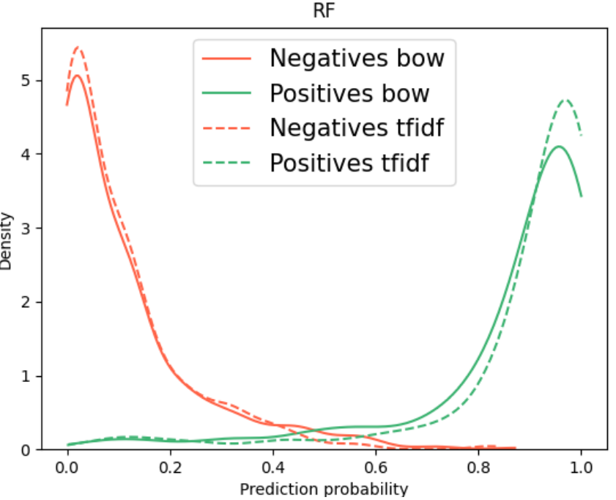
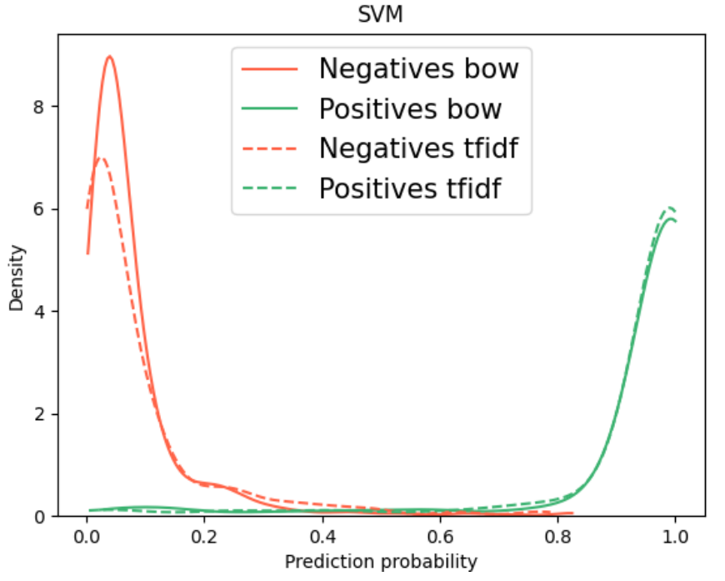
EE/UAB TFG INFORMATICA: Depression detection in social networks

Slide 18
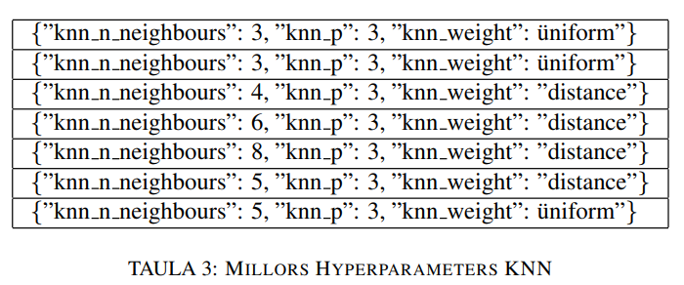
Hyperparameter serach
asdfadf
N]
S
S
s
EE/UAB TFG INFORMATICA: Depression detection in social networks

Slide 19
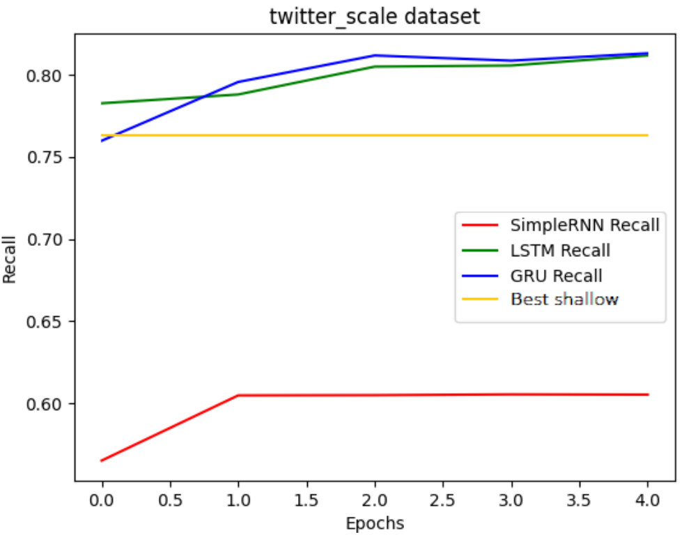
RNN

Slide 20
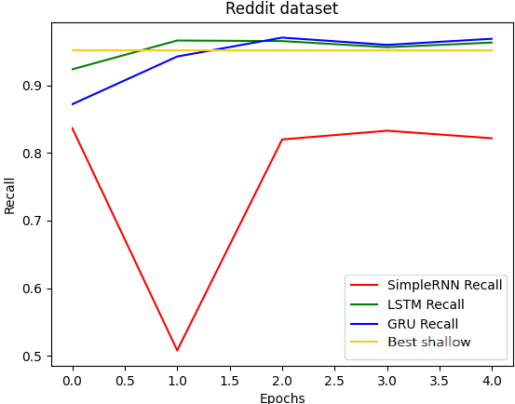
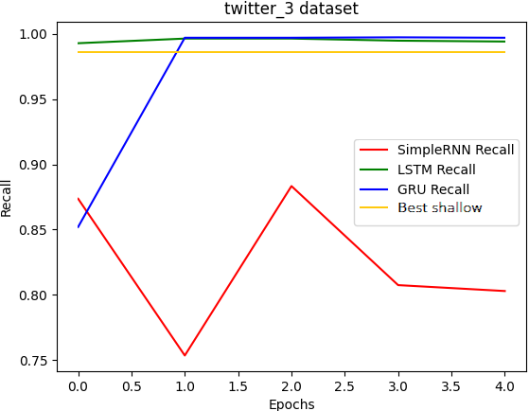

Slide 21
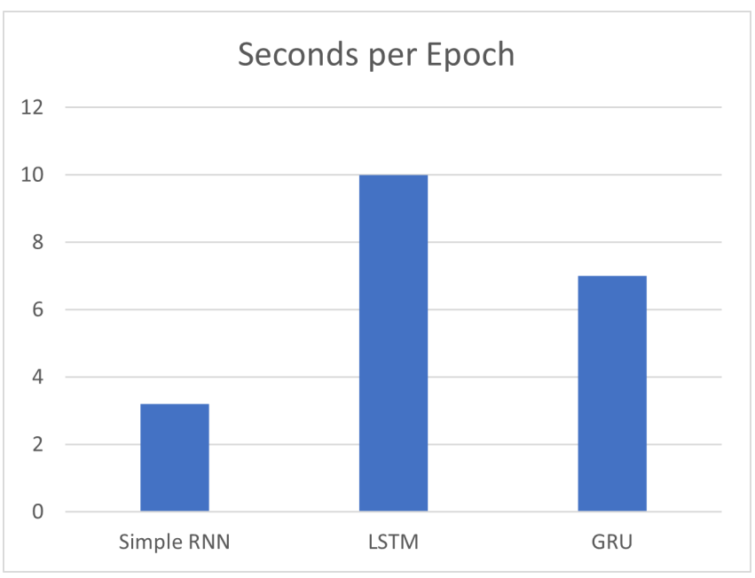
Confidence in predictions
EE/UAB TFG INFORMATICA: Depression detection in social networks

Slide 22
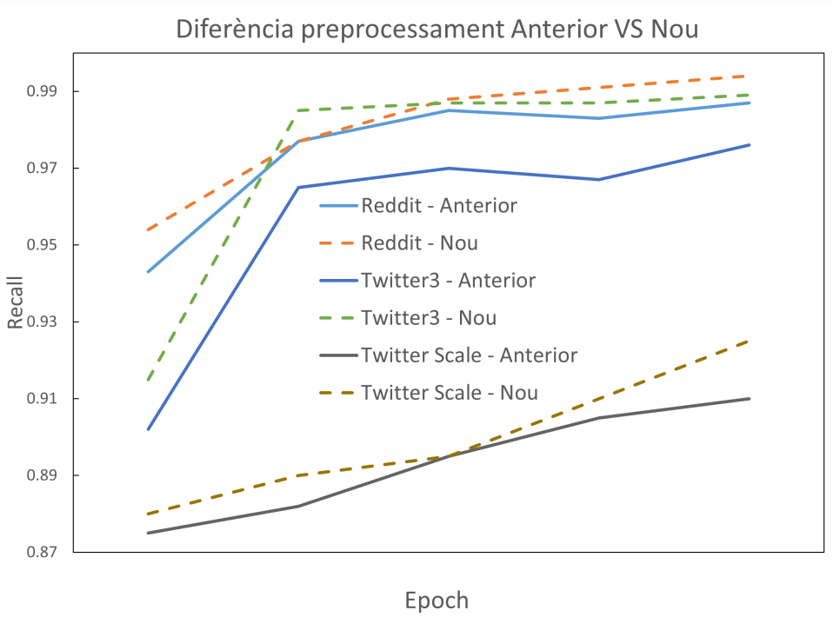
New preprocessing
No lemmanization
Keeping stopwords
EE/UAB TFG INFORMATICA: Depression detection in social networks

Slide 23
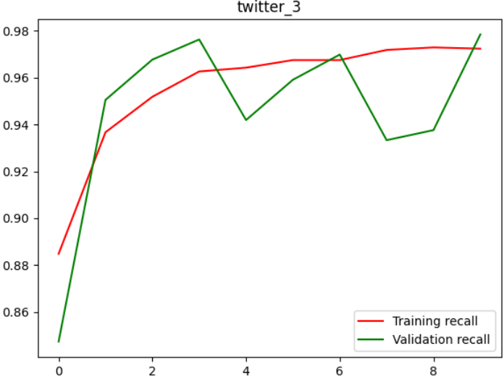
BERT
EE/UAB TFG INFORMATICA: Depression detection in social networks

Slide 24
Differences in predictions
“study finds no casual relationship between cannabis and depression”
“dailytonic exposure to the bacteria in soil can be good for mental hearlth and could treat depression and prevent ptsd”
“don’t be sad, armys are here for you we will always suport you btstwt be strong”
EE/UAB TFG INFORMATICA: Depression detection in social networks

Slide 25
Conclusions
EE/UAB TFG INFORMATICA: Depression detection in social networks

Slide 26
Shallow learning
Best: Naïve Bayes and RF
Preprocessing highly affects on metrics
Feature extraction highly affects on execution time
Confidence in predictions is increased using bagging methods (DT vs RF)
Parameters are not decisive
Deep learning
Simple RNN not good at all, GRU and LSTM are needed
LSTM better than GRU with long messages
Gets the context and relationship between words, improving predictions
BERT does not improve, way more computing resources needed
EE/UAB TFG INFORMATICA: Depression detection in social networks

Slide 27
Thank you
Martí Caixal i Joaniquet

