Slide 1
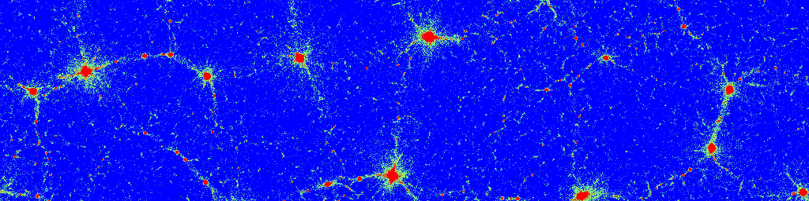
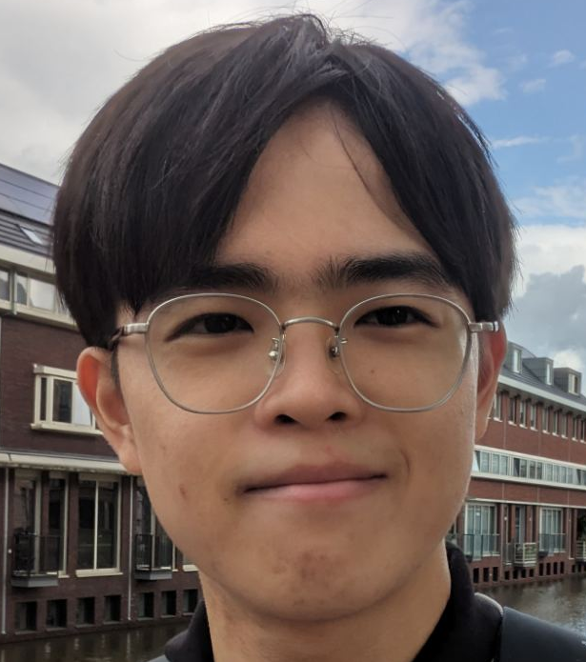
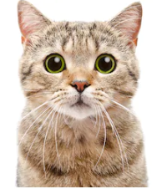
Yutaro Yoshii
EUTD Team | Role | Location | Joined Date
Membership Platform Dept. | Intern (Backend development) | Berlin | 4.9.2023
Previous role(s): Research assistent at AQUA, Advanced Quantum Architecture Skills and Current Projects: React, Kotlin, node.js etc Astrophysics simulation Node.js library development Cloudflare/Openwrt/Nginx/Ubuntu (home server: martian17.com) Anything else you want to share: I love JavaScript, perhaps too much. But I like Kotlin too.

