Slide 1
Parent app
Input Frames
Hub Frame
Input entity
Window entity
Other components
Input entity can set cosmetic attributes of the input frames (i.e. style, input type)
It also handles listening to state change events, such as when the error state changes, and emit it as an event to its parent or the handler.
The handler can then decide to display the error messages (i.e. password too short)
Frames are synced through update-state events.
Input value is a state, and error codes are also part of the state
Model
Input logic handling
Input entity
Window entity
State
On change event, submission, emitting error codes for malformed input values, managing models
Input entity
Window entity
Input entity
Window entity
Model
State
Input entity
Window entity
Blue area: Low level, protocol related
Outside Blue: What’s exposed

Slide 2
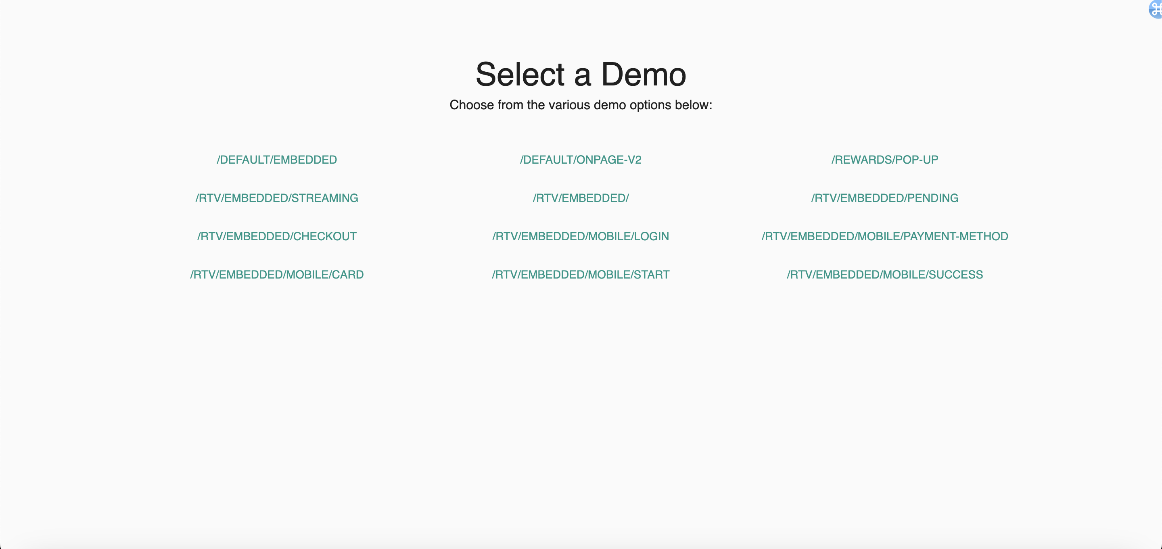
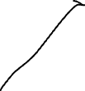

am_es
euesd
euesd

