Slide 1

高性能众核芯片动态热管理技术研究
马健

Slide 2
Outline
Dynamic thermal management
Hierarchical dynamic thermal management
Experimental results
Conclusion

Slide 3
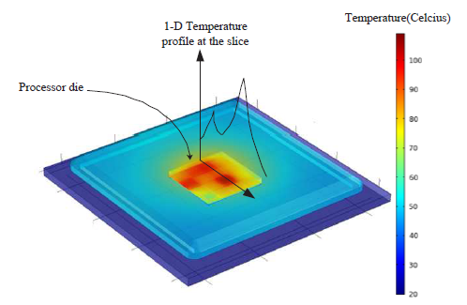
为什么需要动态温度管理
功耗密度不断增长导致高温热问题，在众核领域，高温点问题更加严重
芯片高温或局部高温影响系统可靠性
高温使静态功耗增加
热问题使系统冷却开销很大
Temperature distribution of multi-core chip

Slide 4


动态温度管理技术
动态电压频率调整技术 (DVFS):
P ~ f v²
通过调整电压和频率来降低动态功耗
温度降低的同时处理速度下降
红色核： 温度超出安全温度
黄色核： 温度刚刚在安全温度以下
蓝色核： 温度远低于安全温度

Slide 5
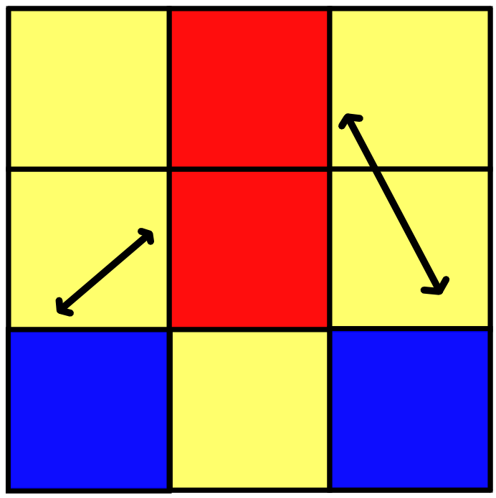

动态温度管理技术
任务迁移：
将高温核上的重负载任务迁出，来避免高温问题
交换任务

Slide 6
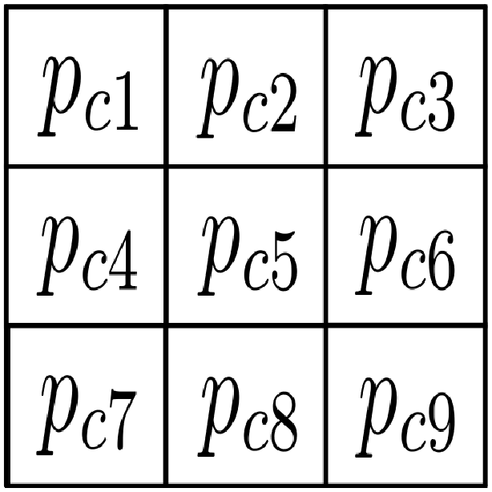
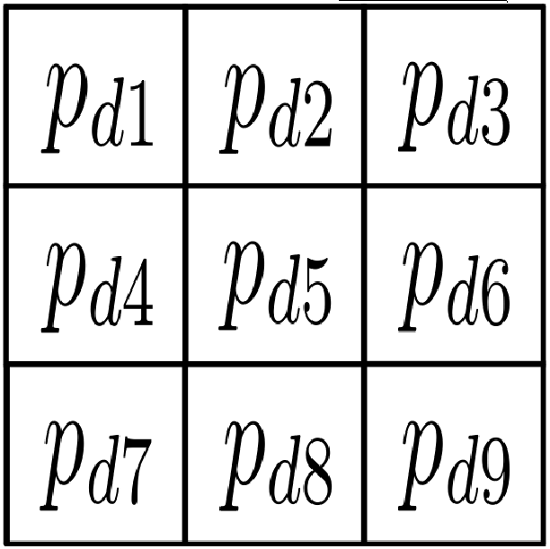

最近的动态温度管理方法
模型预测控制 (MPC)
提供指导性调整意见：计算出期望的功耗分布
当前温度分布
当前功耗分布
MPC
期望的温度分布
调整功耗分布

Slide 7
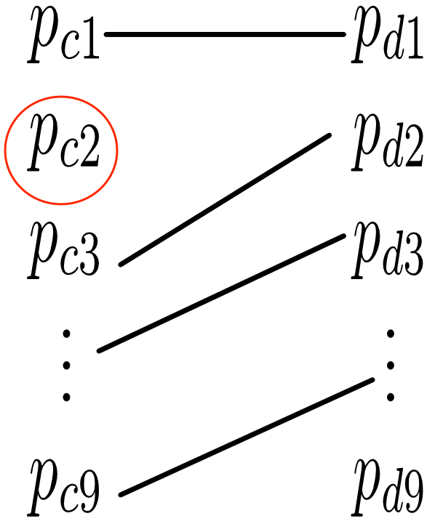
提出的新方法
模型预测控制方法结合任务迁移和DVFS
匈牙利算法：分配任务到正确的核（一定阈值下的二部图匹配）
DVFS保证匹配不上的核在安全温度以下

Slide 8

提出的新方法
有一个问题
随着核数增长，任务迁移决策的计算需要太多时间
100核芯片的例子

Slide 9
Outline
Dynamic thermal management
Hierarchical dynamic thermal management
Experimental results
Conclusion

Slide 10
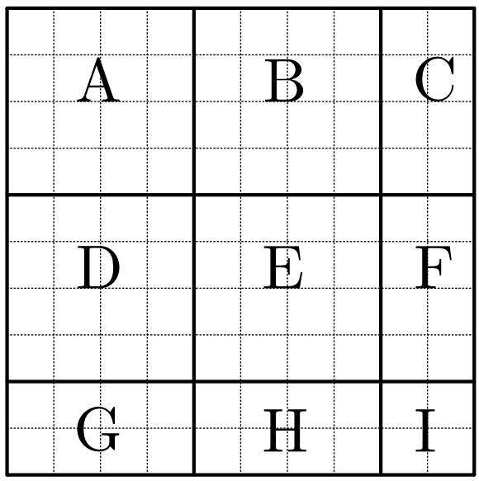
提出的新方法
Partition the chip into blocks.
Task migration inside each block.
Task migration among blocks.

Slide 11
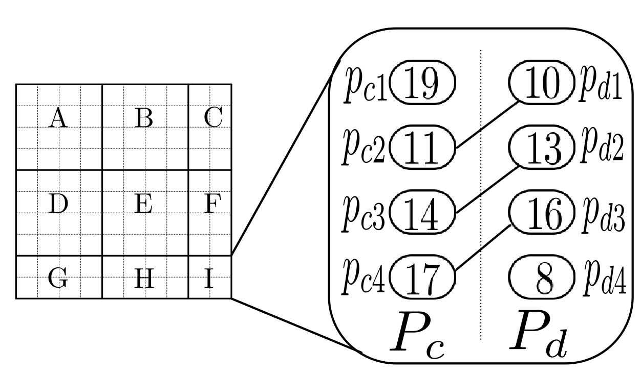
The Hierarchical method
Task migration inside each block
Example of block I (threshold is 3)

Slide 12
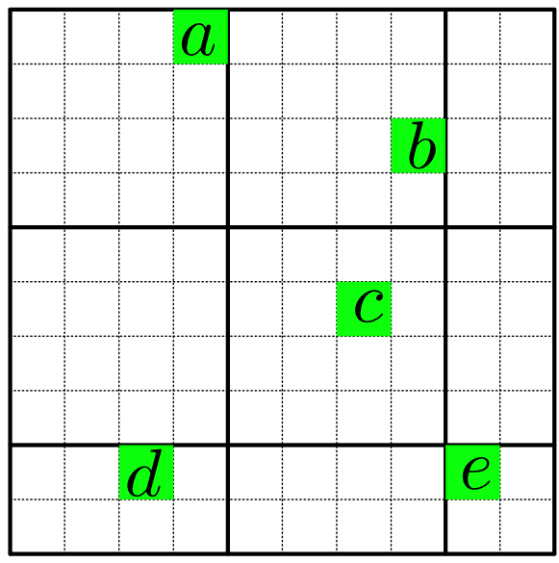
The Hierarchical method
Unmatched cores maybe match between blocks.
Collect unmatched cores.

Slide 13
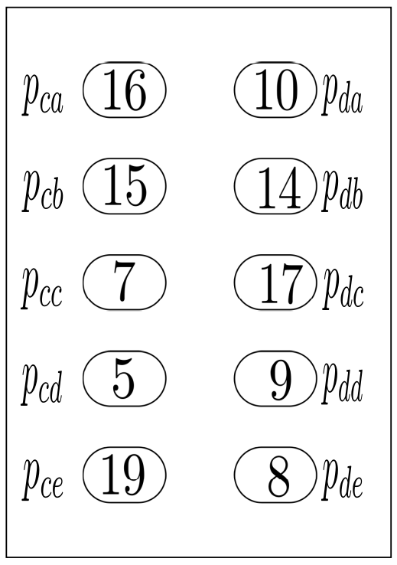
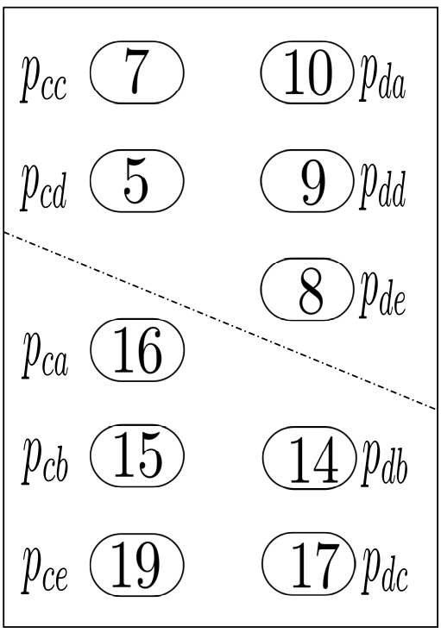
The Hierarchical method
The number of unmatched cores maybe very large.
If there is little unmatched cores, match those directly.
Else partition again using a minimum cut algorithm.

Slide 14
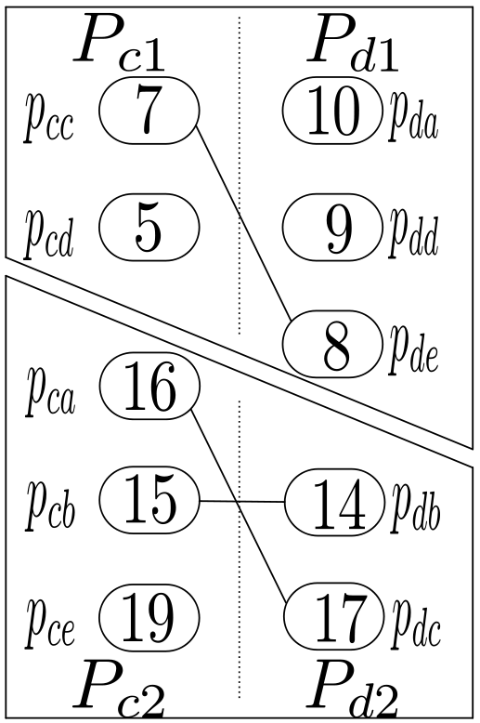
The Hierarchical method
Match inside each part.

Slide 15
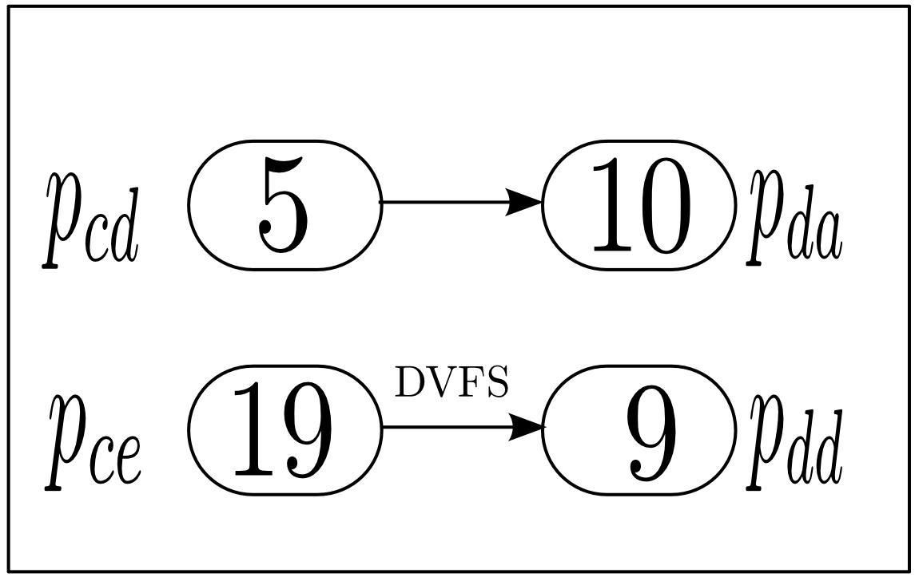
The Hierarchical method
Use DVFS to the last unmatched cores.

Slide 16
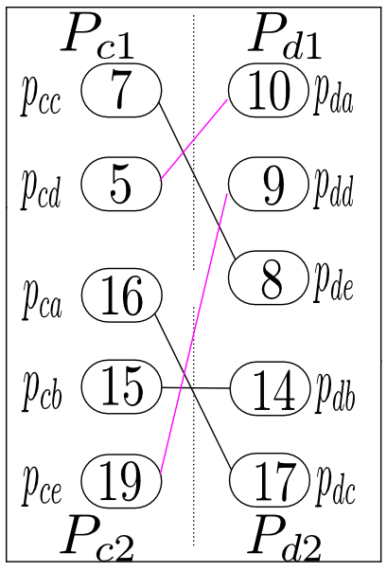
The Hierarchical method
The power profile is redistributed.

Slide 17
Outline
Dynamic thermal management
Hierarchical dynamic thermal management
Experimental results
Conclusion

Slide 18
Experimental setup
Tested on processors with 100 cores, 256 cores, 400 cores, 625 cores.
Thermal model generated using HotSpot.
Power trace generated using Wattch with SPEC benchmarks.
Ambient temperature set to be 20 degree.
Safe temperature set to be 105 degree.

Slide 19
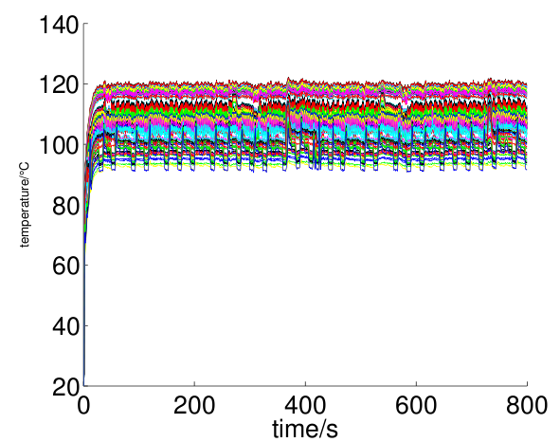
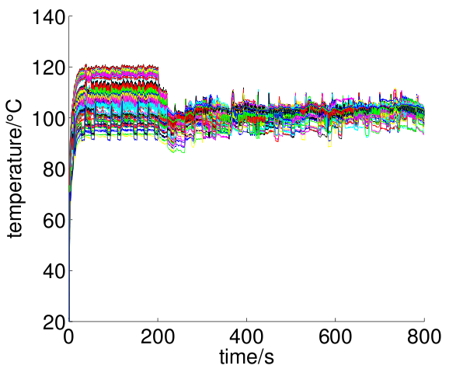
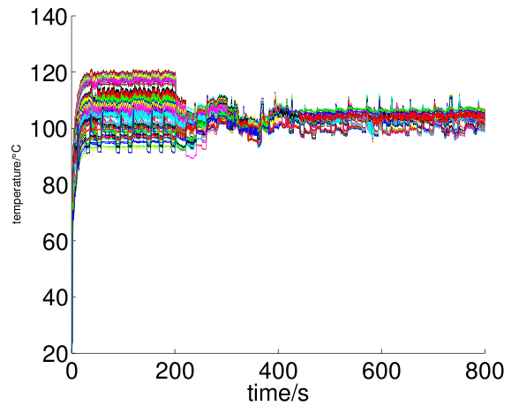
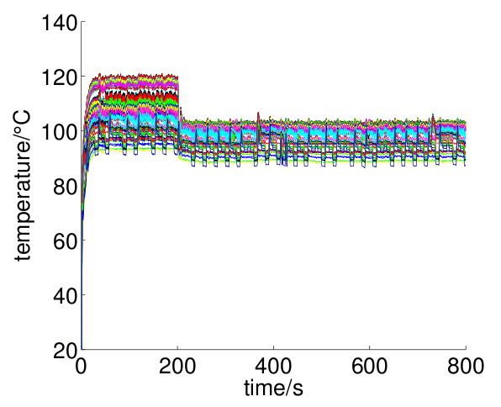
Transient temperature comparison
Temperature without DTM
Temperature with new method
Temperature with method proposed in [1]
Temperature with DVFS only method

Slide 20
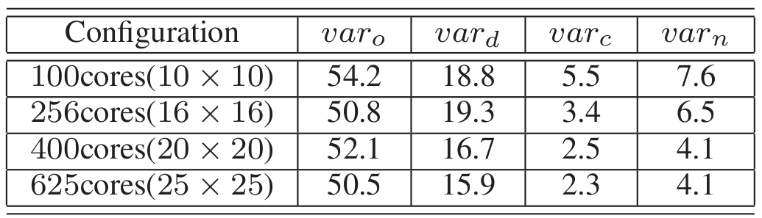
Transient variance comparison
var_{o} is variance of Transient temperature trace without DTM method.
var_{d} is variance of Transient temperature trace with DVFS only method.
var_{c} is variance of Transient temperature trace with method proposed in [1].
var_{n} is variance of Transient temperature trace with new method.

Slide 21
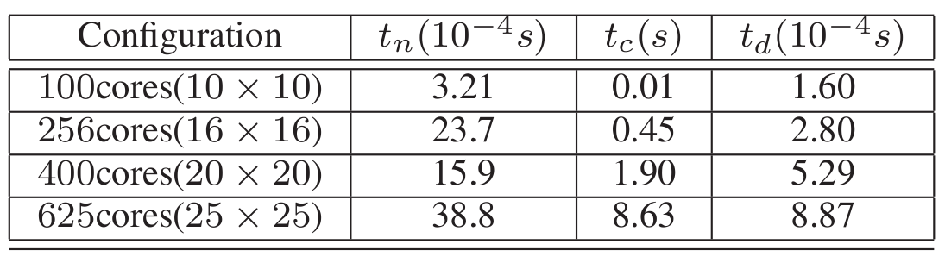
Runtime comparison
t_{n} is runtime per second of new method.
t_{c} is runtime per second of method proposed in [1].
t_{d} is runtime per second of DVFS only method.

Slide 22
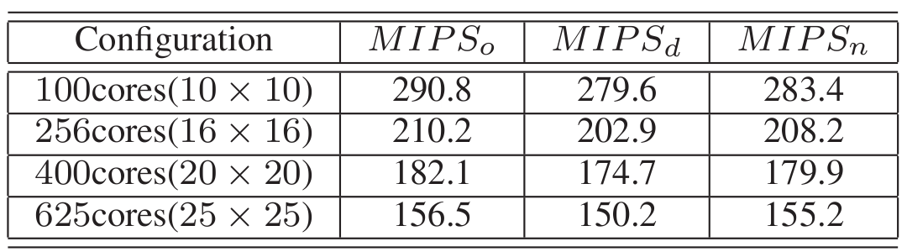
Performance comparison
MIPS_{o} is the average number of IPS in million without DTM.
MIPS_{d} is the average number of IPS in million with DVFS only method.
MIPS_{n} is the average number of IPS in million with new method.

Slide 23
Conclusion
A Hierarchical dynamic thermal management method is proposed.
Two partitioning methods are used: one is partitioning by position, the other is partitioning using a minimum cut algorithm.
The new method is distributed, time spent in computing is reduced so much.

Slide 24
Thank you!

