Slide 1

Hybrid Dynamic Thermal Management method for High-Performance Multi-Core Processors
Hai Wang
University of Electronic Science & Technology of China
ASP-DAC 2015 TPC Meeting Workshop, Aug. 25, 2014, Daejeon, Korea

Slide 2
Outline
Dynamic thermal management
New hybrid dynamic thermal management
Experimental results
Conclusion

Slide 3
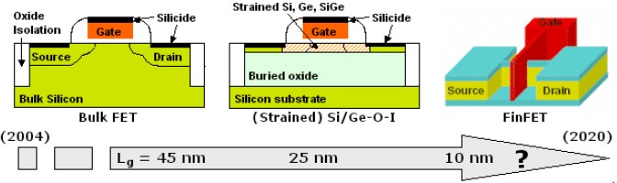
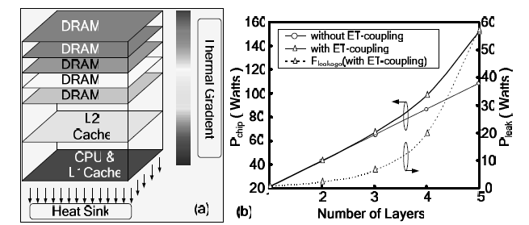
Why dynamic thermal management
Thermal management is vital for high performance many-core processor
Power density keeps increasing, device scaling down, 3-D IC
High power density lead to high temperature which harms the reliability
Performance Reliability issues
Excessive on-chip temperature
scaling
3D Integration

Slide 4
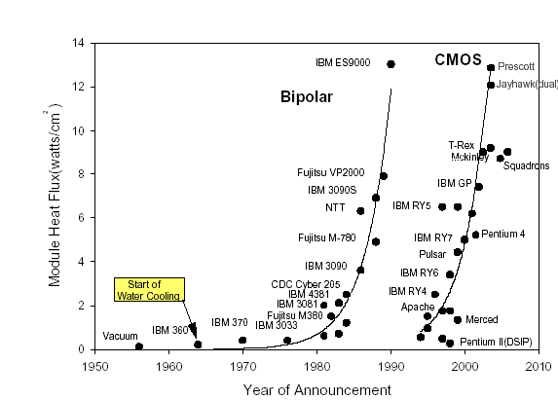
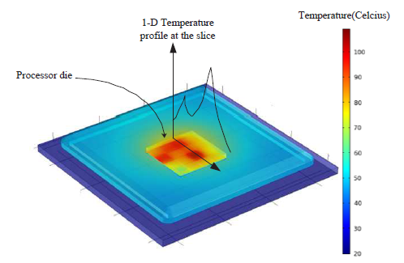
Why dynamic thermal management
Thermal management is vital for high performance many-core processor
Temperature is the limiting factor and first-tiered design constraints
Cooling techniques can be expensive
Non-uniform temperature distribution in multi-core processor needs to be explored
Temperature is the limiting factor and first-tiered design constraints
Power density and air cooling limit
Temperature distribution of multi-core chip

Slide 5
Catalog of thermal management
DVFS based methods: [Herbert: ISLPED’07]
Reduce dynamic power by adjusting voltage and frequency
Compromise data rate with temperature reduction
Task Migration based methods: [Powell: ASPLOS'04]
Migrate heavy tasks away from the heavily loaded core to avoid elevated temperature
Centralized and distributed control (DTB-M) [Ge:DAC’10]
[Herbert: ISLPED’07] S. Herbet, et al. “Analysis of Dynamic Voltage/Frequency Scaling in Chip-Multiprocessors” ISLPED 07
[Powell: ASPLOS'04] M. Powell, et al. “Heat-and-Run: Leveraging SMT and CMP to Manage Power Density Through the Operating System”, ASPLOS 04.
[Ge:DAC’10] Y. Ge, et al. “Distributed task migration for thermal management in many-core systems” DAC 10.

Slide 6
Performance and reliability
Performance and reliability are trade-offs
Balancing performance and reliability is important
DVFS based methods
Good chip reliability: since temperature can be kept below “safe temperature line” through voltage scaling.
Processor performance degrade : because of frequency scaling.
Task migration methods
Good processor performance: since all loads are still processed at full-speed.
Chip reliability degrade : cannot guarantee the peak temperature to be below “safe temperature line”.

Slide 7
Outline
Dynamic thermal management
New hybrid dynamic thermal management
Experimental results
Conclusion

Slide 8
Basic idea of the hybrid method
A hybrid method combining DVFS and task migration may balance performance and reliability.
Basic idea of the hybrid method:
Use task migration before DVFS, in order to minimize DVFS activating times, thus enhancing performance of DVFS.
DVFS after task migration, in order to solve the reliability issue of task migration.
Key challenge for the hybrid method:
Need a guidance for management, i.e., what is the good task distribution for the next time step?
How to make the two work together in an elegant and effective way.

Slide 9
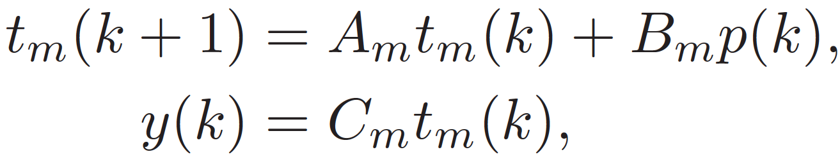
Thermal model
t_{m}(k) is the (state) temperature vector, including temperatures of cores and other blocks.
y(k) is the (output) temperature vector of the cores.
p(k) is the (input) load power vector of cores.

Slide 10
Model predictive control: guidance of the hybrid algorithm
In order to do thermal management, a prediction of desired load profile is preferred.
We do not know what is the desired load distribution directly, but we do know the desired temperature distribution!
Uniform thermal distribution across cores with temperature just below the safe temperature line.
Model predictive control (MPC) is able to calculate the desired (predicted) power (load) profile
Input: thermal profile (safe temperature line in our case) in the future steps
Output: power profile in the future steps (only the next ONE step will be used)

Slide 11
Task migration as assignment problem
With the desired load power profile provided by MPC, we need to re-distribute tasks to match the profile.
This is an assignment problem: assign each person (core) a job (available load) to minimize the total cost (difference between assigned load and desired load).
It is also equivalent to the weighted bipartite matching problem, and can be solved by Hungarian algorithm.
 | Painting | Basketball | Composition
Beethoven | 100 | 200 | 8
James | 120 | 10 | 200
Picasso | 9 | 300 | 150
Numbers are time needed to complete specific task, i.e., costs.

Slide 12
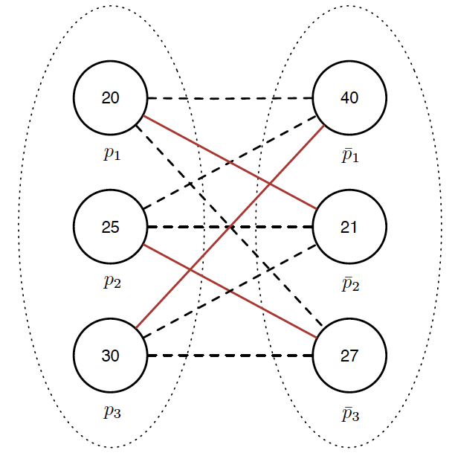
Weighted bipartite matching
The assignment problem can be described as a weighted complete bipartite graph.
The lines (red solid and black dashed) are the candidate matches, and the red lines are the optimal matches (solution).
Cost on each line is not shown for simplicity.
Desired load
Available load

Slide 13
Problem with pure task migration
Task migration alone may provide optimal solution which is not “optimal”.
Wang (me) is not good at all these three works, but is still assigned with a task.
 | Painting | Basketball | Composition
Beethoven | 100 | 200 | 8
James | 120 | 10 | 200
Wang | 2000 | 1000 | 3000

Slide 14
Problem with pure task migration
There are also tasks which have large costs (mismatch) with all desired loads. These tasks may result in high temperature.
Because of such tasks, pure task migration leads to sub-optimal result.
The problem guy
Desired load
Available load

Slide 15
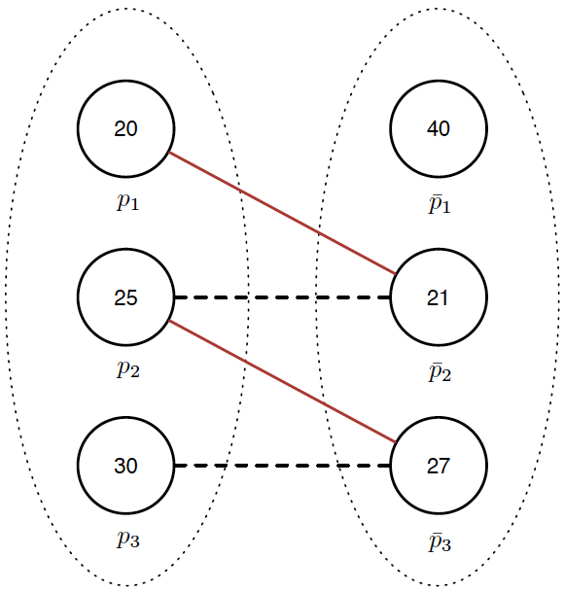
DVFS to the rescue
We can find the good pairs first, by setting a cost threshold and removing the bad candidate pairs.
Then, do the matching with only relatively good candidate pairs.
Cost threshold set as 5:

Slide 16
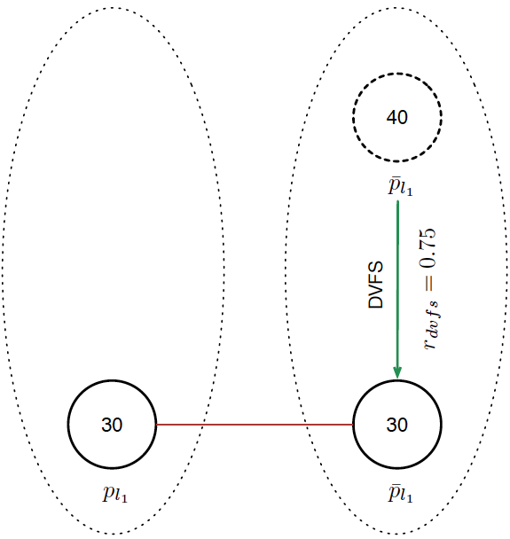

DVFS to the rescue
Next, collect the remaining candidates, and perform DVFS using average power information if the available loads have larger average power than desired loads.
DVFS ratio:

Slide 17
DVFS to the rescue
If the remaining available loads have smaller average power than desired loads:
Which means the remaining loads lead to lower temperature than desired.
Do NOT perform DVFS, just relax the threshold (up to infinity) and do the matching.
All loads should be paired now.

Slide 18
Outline
Dynamic thermal management
Related problems in DTM
New hybrid dynamic thermal management
Experimental results
Conclusion

Slide 19
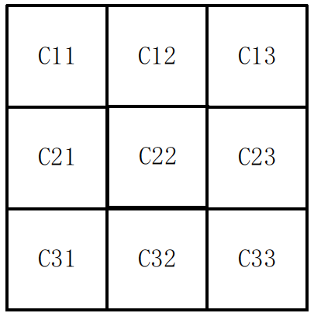
Experimental setup
Tested on a 9-core processor with cores distributed in a 3X3 fashion as shown below:
Thermal model generated using HotSpot.
Power trace generated using Wattch with SPEC benchmarks.
Ambient temperature set to be 20 degree.
Safe temperature set to be 90 degree.

Slide 20
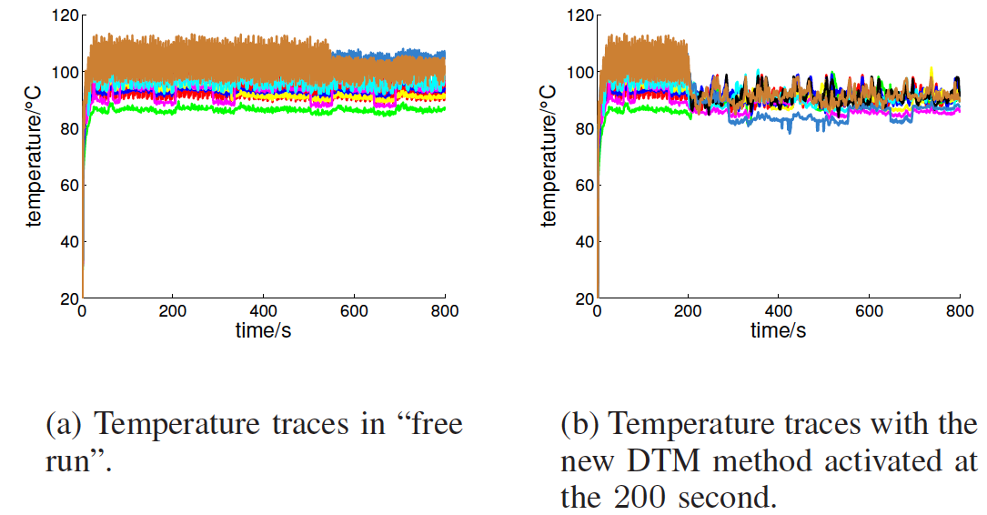
Transient temperature comparison

Slide 21
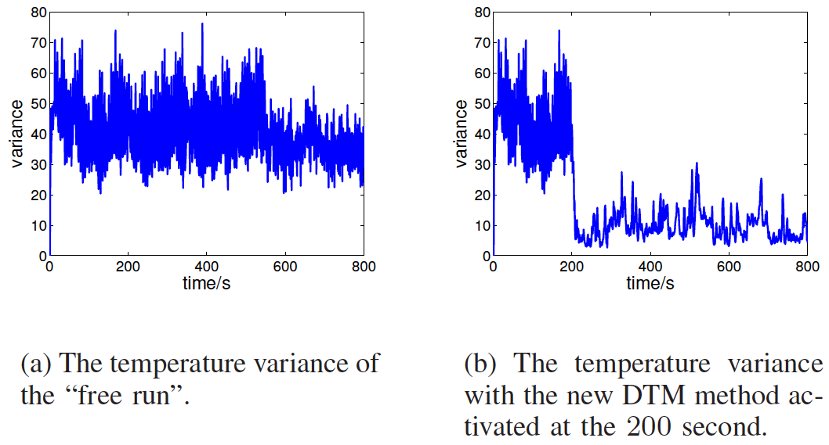
Transient variance comparison

Slide 22
Conclusion
A hybrid dynamic thermal management method is proposed.
The new method uses model predictive control to compute the desired load information.
Task migration and DVFS are combined together in this method.
The new method is able to track the given temperature with limited DVFS actions.

Slide 23
Thank you!

