Slide 1

Hierarchical Dynamic Thermal Management
Method for High-Performance Many-Core
Microprocessors
Jian Ma

Slide 2
Outline
Dynamic thermal management
Hierarchical dynamic thermal management
Experimental results
Conclusion

Slide 3
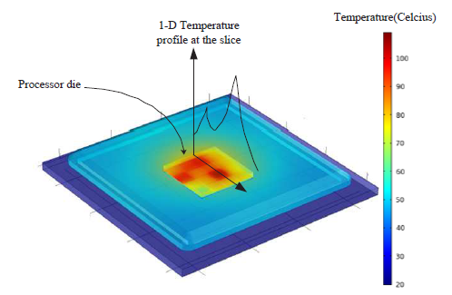
Why dynamic thermal management
Thermal management is vital for high performance many-core processors
Power density keeps increasing, device scaling down, 3-D IC
High power density leads to high temperature which harms the reliability
Cooling techniques can be expensive
Non-uniform temperature distribution in multi-core processor needs to be explored
Temperature distribution of multi-core chip

Slide 4
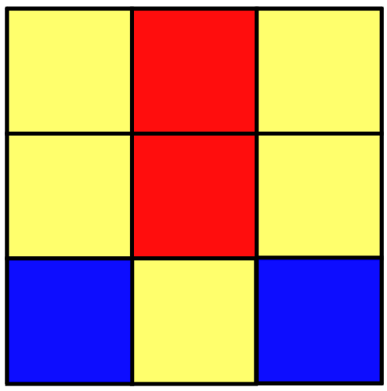
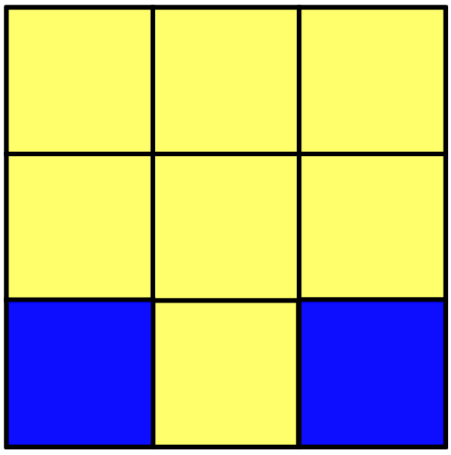
DTM technique
DVFS :
P ~ f v²
Reduce dynamic power by adjusting voltage and frequency
Compromise data rate with temperature reduction
Red core: the temperature above safe temperature.
Yellow core: the temperature just under safe temperature.
Blue core: the temperature far lower than safe temperature.

Slide 5
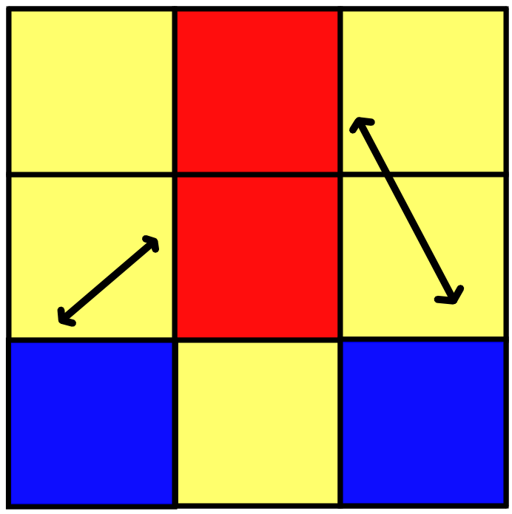
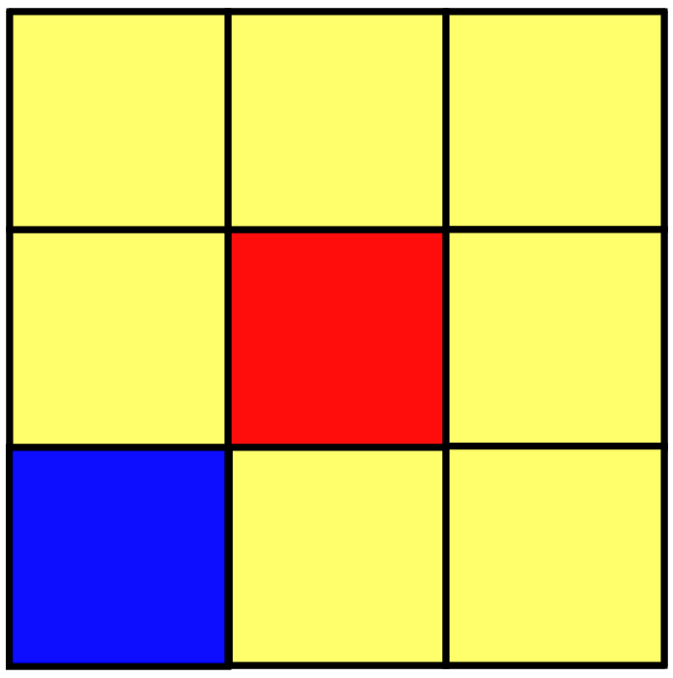
DTM technique
Task Migration :
Migrate heavy tasks away from the heavily loaded core to avoid elevated temperature
Just exchange tasks

Slide 6
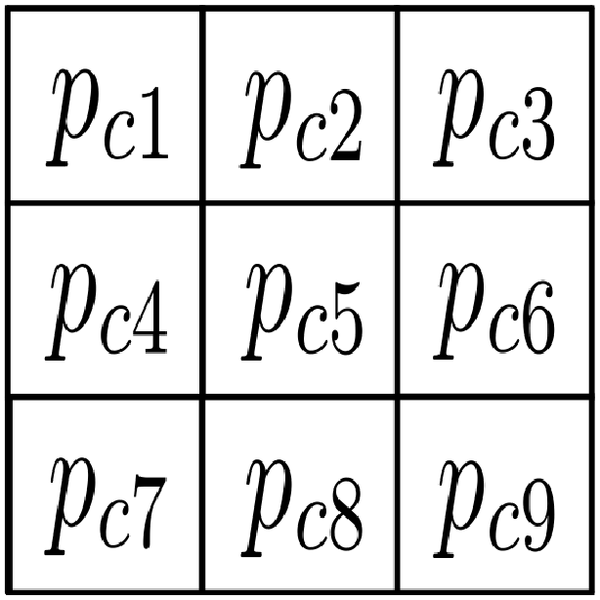
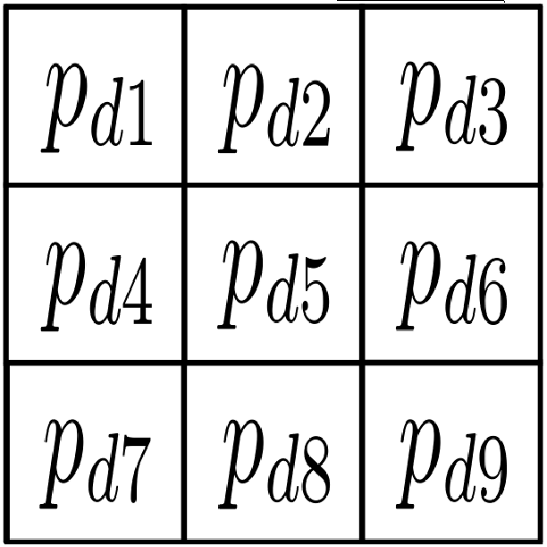

Recent DTM method
Model predictive control (MPC)
Used in Hybrid Dynamic Thermal Management Method with Model Predictive Control [1].
guidance of the method: It can calculate the desired power profile
The current temperature profile
MPC
The temperature profile we desired
Redistribute power profile

Slide 7
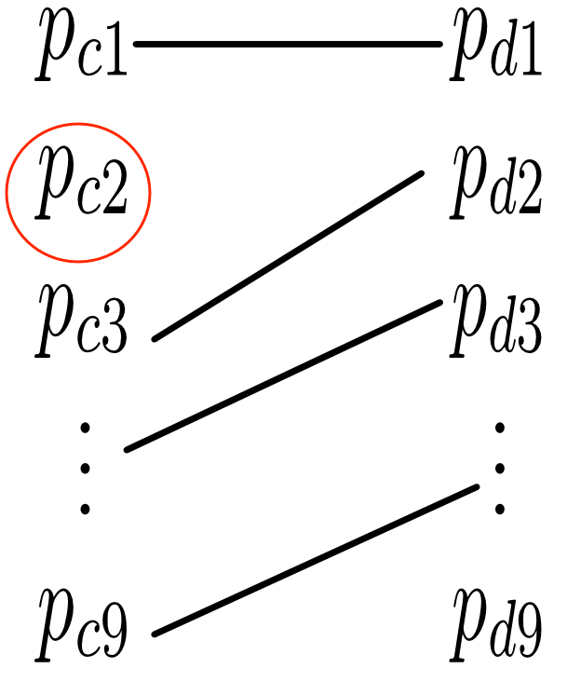
Recent DTM method
Determine task migration and DVFS
Hungarian algorithm: assign task to right core (bipartite matching with a threshold).

Slide 8
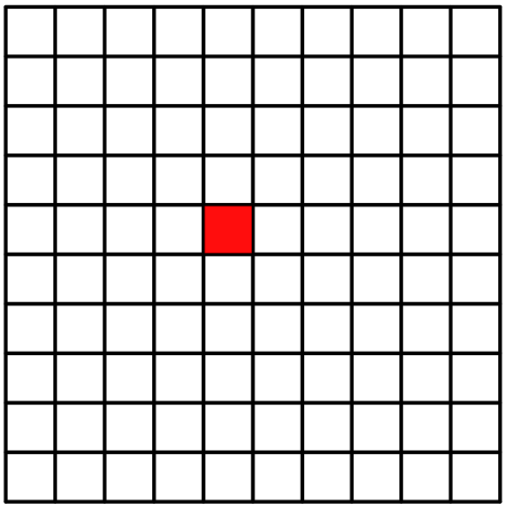
Recent DTM method
Problem
As the scale increase, a lot of time is spent in computing.
A example of 100-core chip

Slide 9
Outline
Dynamic thermal management
Hierarchical dynamic thermal management
Experimental results
Conclusion

Slide 10
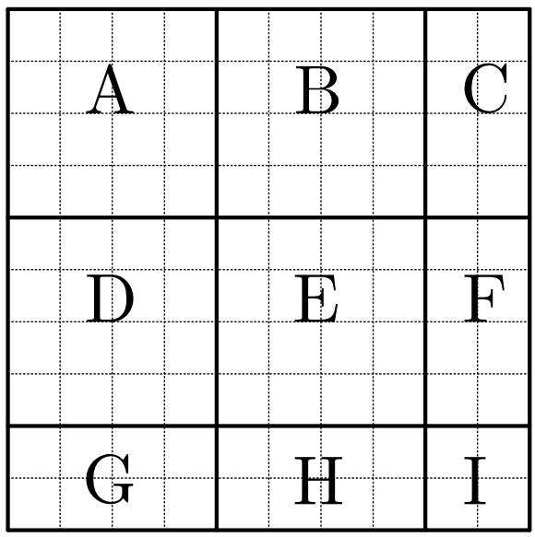
The Hierarchical method
Partition the chip into blocks.
Task migration inside each block.
Task migration among blocks.

Slide 11
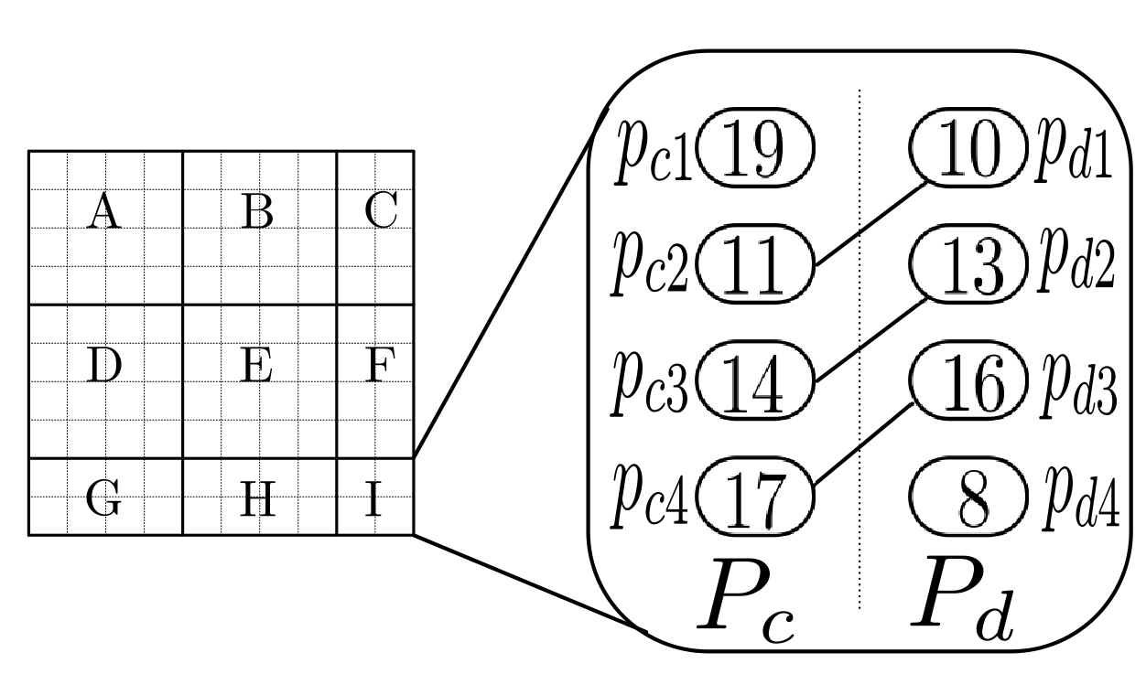
The Hierarchical method
Task migration inside each block
Example of block I (threshold is 3)

Slide 12
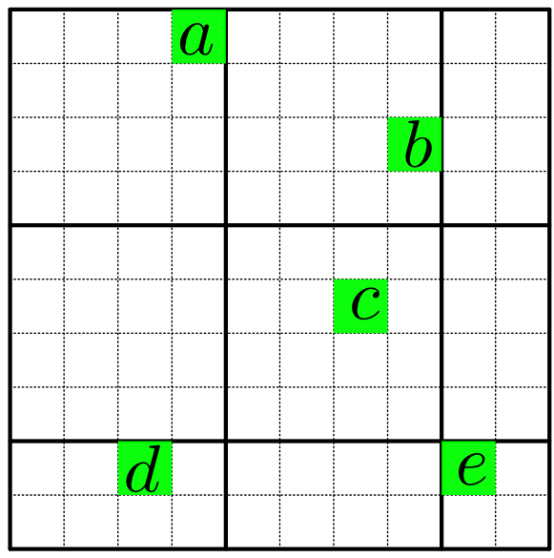
The Hierarchical method
Unmatched cores maybe match between blocks.
Collect unmatched cores.

Slide 13
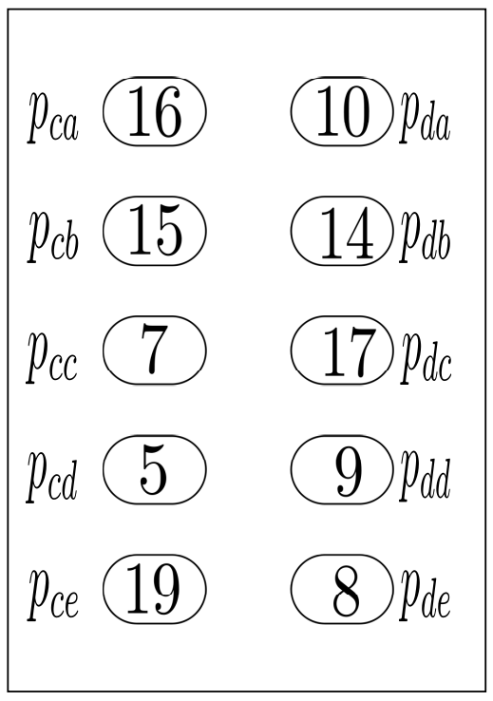
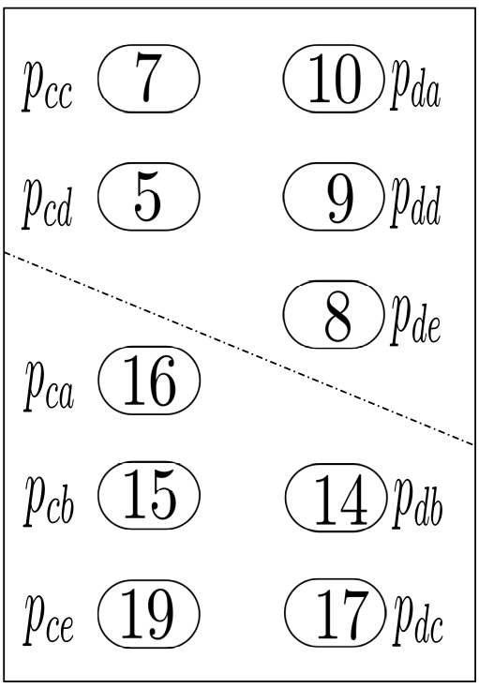
The Hierarchical method
The number of unmatched cores maybe very large.
If there is little unmatched cores, match those directly.
Else partition again using a minimum cut algorithm.

Slide 14
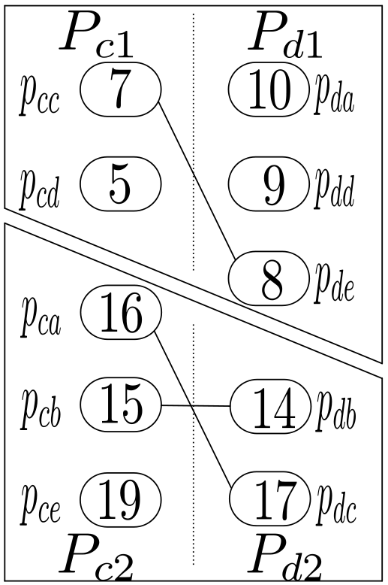
The Hierarchical method
Match inside each part.

Slide 15
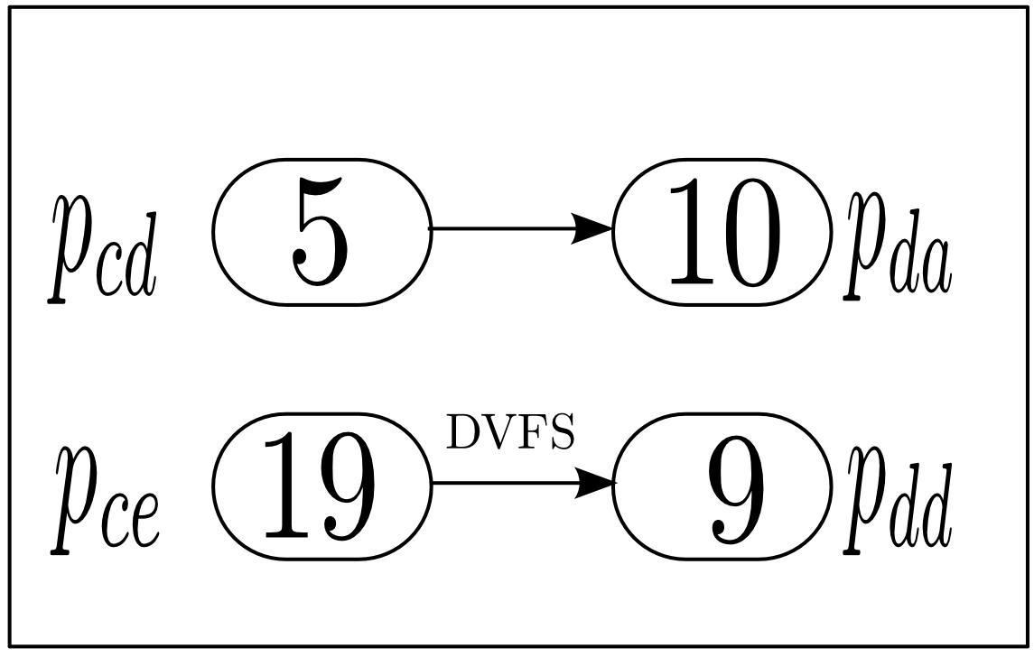
The Hierarchical method
Use DVFS to the last unmatched cores.

Slide 16
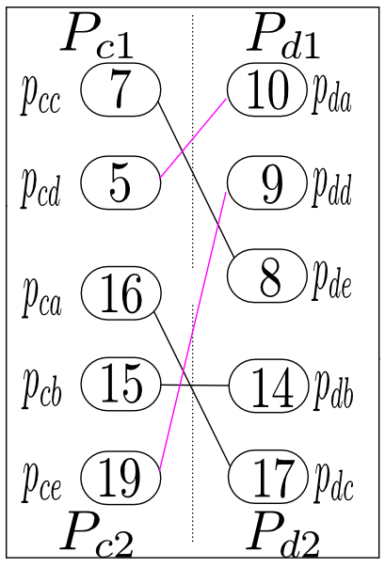
The Hierarchical method
The power profile is redistributed.

Slide 17
Outline
Dynamic thermal management
Hierarchical dynamic thermal management
Experimental results
Conclusion

Slide 18
Experimental setup
Tested on processors with 100 cores, 256 cores, 400 cores, 625 cores.
Thermal model generated using HotSpot.
Power trace generated using Wattch with SPEC benchmarks.
Ambient temperature set to be 20 degree.
Safe temperature set to be 105 degree.

Slide 19
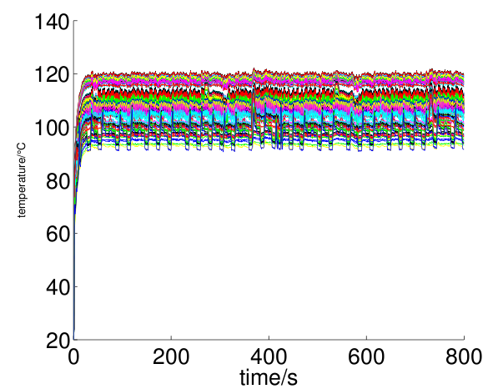
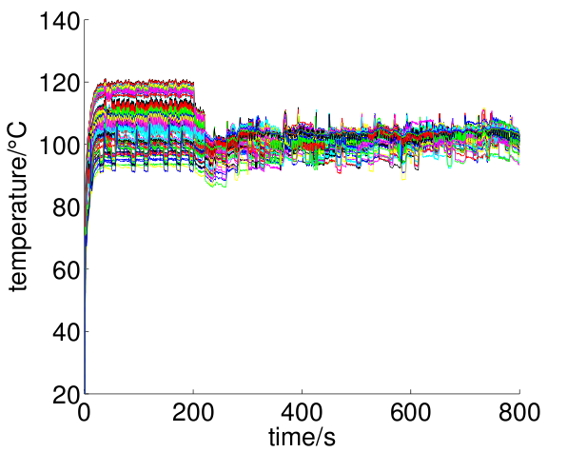
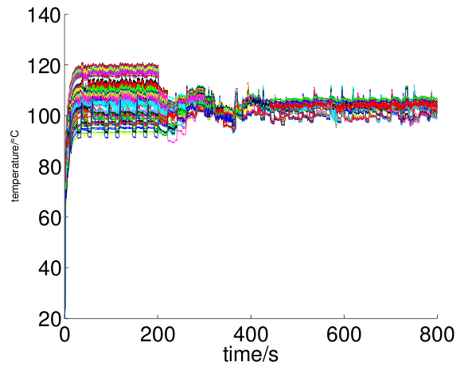
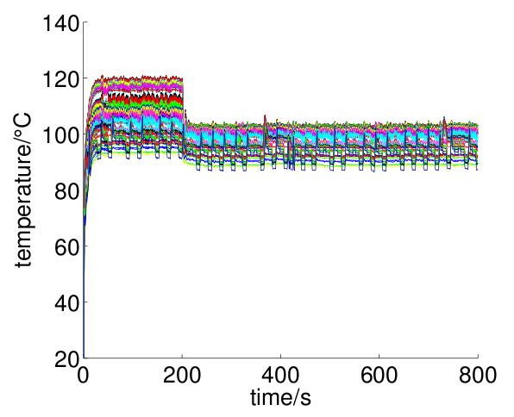
Transient temperature comparison
Temperature without DTM
Temperature with new method
Temperature with method proposed in [1]
Temperature with DVFS only method

Slide 20
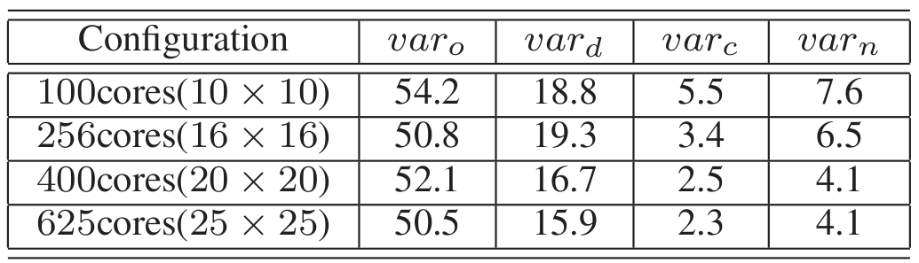
Transient variance comparison
var_{o} is variance of Transient temperature trace without DTM method.
var_{d} is variance of Transient temperature trace with DVFS only method.
var_{c} is variance of Transient temperature trace with method proposed in [1].
var_{n} is variance of Transient temperature trace with new method.

Slide 21
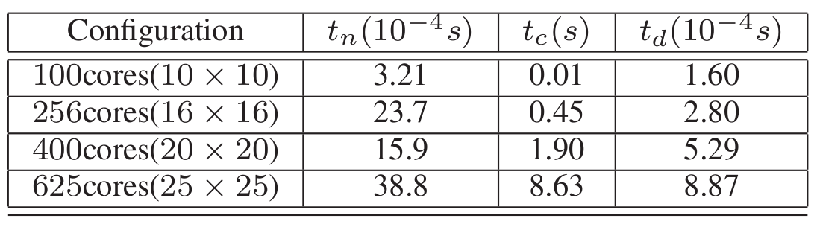
Runtime comparison
t_{n} is runtime per second of new method.
t_{c} is runtime per second of method proposed in [1].
t_{d} is runtime per second of DVFS only method.

Slide 22
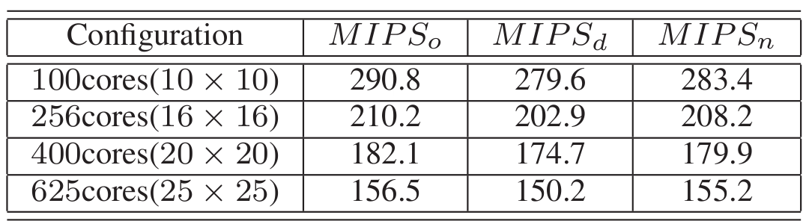
Performance comparison
MIPS_{o} is the average number of IPS in million without DTM.
MIPS_{d} is the average number of IPS in million with DVFS only method.
MIPS_{n} is the average number of IPS in million with new method.

Slide 23
Conclusion
A Hierarchical dynamic thermal management method is proposed.
Two partitioning methods are used: one is partitioning by position, the other is partitioning using a minimum cut algorithm.
The new method is distributed, time spent in computing is reduced so much.

Slide 24
Thank you!

