Slide 1

Dynamic Thermal Management
Method for High-Performance Many-Core
Microprocessors
Jian Ma

Slide 2
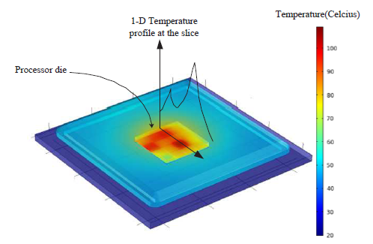
Why dynamic thermal management
Thermal management is vital for high performance many-core processors
Power density keeps increasing, device scaling down, 3-D IC
High power density leads to high temperature which harms the reliability
Cooling techniques can be expensive
Non-uniform temperature distribution in multi-core processor needs to be explored
Temperature distribution of multi-core chip

Slide 3


DTM technique
DVFS :
P ~ f v²
Reduce dynamic power by adjusting voltage and frequency
Compromise data rate with temperature reduction
Red core: the temperature above safe temperature.
Yellow core: the temperature just under safe temperature.
Blue core: the temperature far lower than safe temperature.

Slide 4
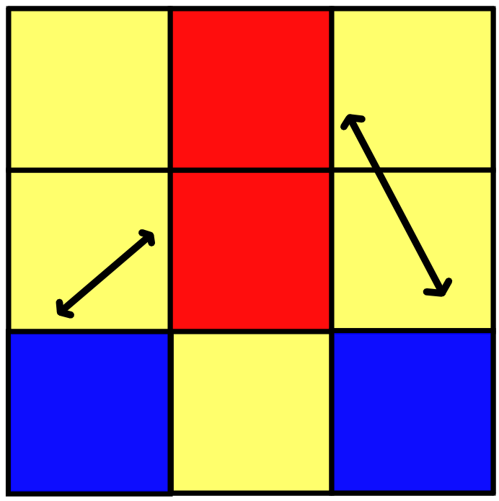

DTM technique
Task Migration :
Migrate heavy tasks away from the heavily loaded core to avoid elevated temperature
Just exchange tasks

Slide 5
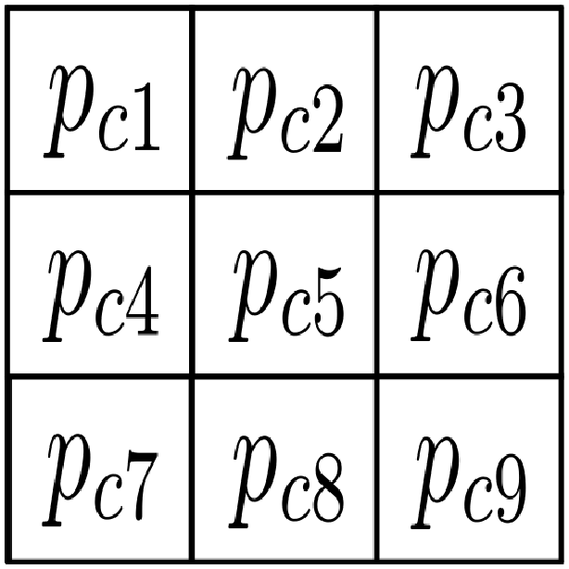
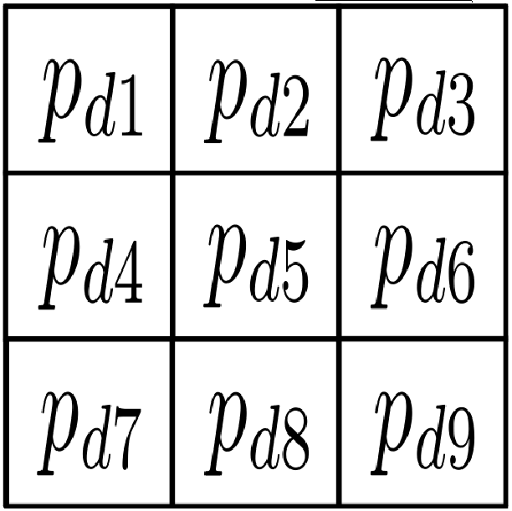

Our work
Model predictive control (MPC)
Used in Hybrid Dynamic Thermal Management Method with Model Predictive Control (1).
guidance of the method: It can calculate the desired power profile
The current temperature profile
MPC
The temperature profile we desired
Redistribute power profile

Slide 6
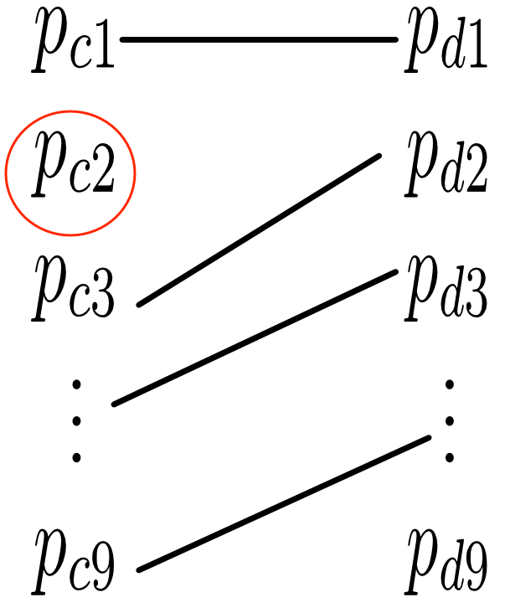
Our work
Determine task migration and DVFS
Hungarian algorithm: assign task to right core (bipartite matching with a threshold).

Slide 7

Our work
Problem
As the scale increase, a lot of time is spent in computing.
A example of 100-core chip

Slide 8
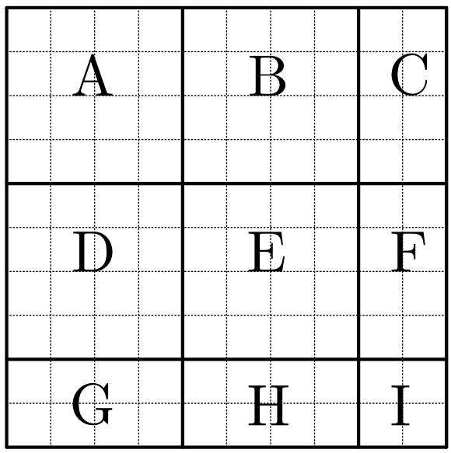
Our work
Partition the chip into blocks.
Task migration inside each block.
Task migration among blocks.

Slide 9
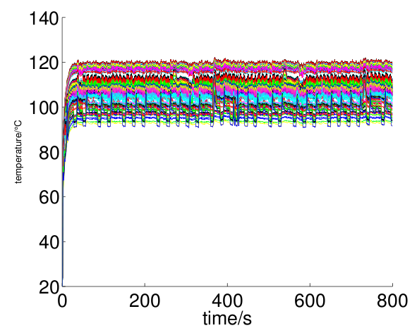
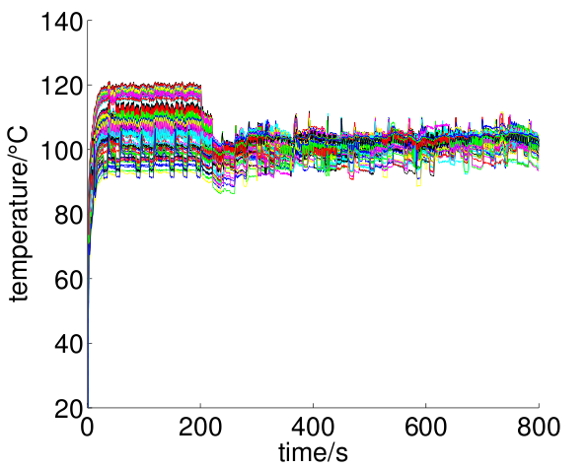
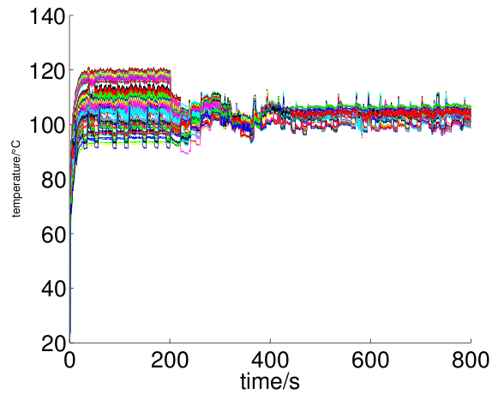
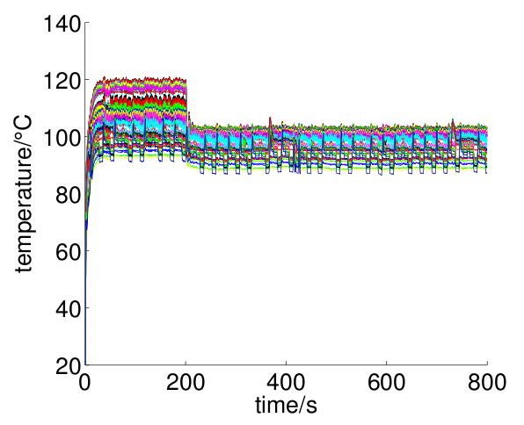
Transient temperature comparison
Temperature without DTM
Temperature with new method
Temperature with method proposed in (1)
Temperature with DVFS only method

Slide 10
Conclusion
Built thermal model of many-core processer.
Propose method of thermal management.
Realize and verify the method.

Slide 11
Thank you!

