Slide 1
CONCORDIA UNIVERSITY · STUDENT SUCCESS CENTRE
Learning strategies for math & problem-solving courses
∑
∂
→
A practical playbook for active learning, durable recall, and exam readiness
Based on a crash course presented by Haleh Raissadat, PhD Ed, MA Ed Tech, B. Eng.
Math and Engineering Learning Specialist · 02 Sep 2026
Notes:
Open by framing this as a practical system rather than a list of tips. The aim is to help learners build solutions independently, retain knowledge over time, and perform under exam constraints.
[Sources]
- User-provided orientation recording, 02 Sep 2026, full session
- User-provided “BEng Cybersecurity” Google Slides notes, slides 6-13: https://docs.google.com/presentation/d/13S7_QtF6DLMYLozmsySsd_jUc_dYBlP_2JYql9yBghA/edit
[/Sources]

Slide 2
THE SHIFT
University math rewards creating solutions—not recognizing them
Recognition can feel fluent.
Creation proves learning.
PASSIVE SUCCESS
Following a worked solution
Assembling familiar pieces
Explaining an answer already shown
ACTIVE MASTERY
Starting from a blank page
Selecting a method independently
Producing the solution under constraints
02
Notes:
Use the presenter’s assignment-versus-exam contrast. Students can earn strong assignment grades by repeatedly consulting examples, yet still struggle in exams because they practiced assembling pieces rather than generating them. The test of learning is independent production.
[Sources]
- User-provided orientation recording, 02 Sep 2026, 00:16:00–00:18:35 and 00:24:30–00:25:45
- User-provided “BEng Cybersecurity” Google Slides notes, slides 9-10: https://docs.google.com/presentation/d/13S7_QtF6DLMYLozmsySsd_jUc_dYBlP_2JYql9yBghA/edit
[/Sources]

Slide 3
FOUNDATIONS
Because problem-solving courses are cumulative, gaps compound
A missing prerequisite is not a minor inconvenience—it weakens every layer built above it.
Future courses
Complex applications
When a gap appears, pause and refresh it quickly. Catching it early costs less than carrying it forward.
Current course concepts
Prerequisite knowledge
03
Notes:
Explain the building-foundation analogy. A learner entering Calculus II without secure Calculus I components should not try to ignore the gap. Previewing helps detect the missing foundation before the new topic depends on it.
[Sources]
- User-provided orientation recording, 02 Sep 2026, 00:06:52–00:08:24
- User-provided “BEng Cybersecurity” Google Slides notes, slide 7: https://docs.google.com/presentation/d/13S7_QtF6DLMYLozmsySsd_jUc_dYBlP_2JYql9yBghA/edit
[/Sources]

Slide 4
THE SYSTEM
Use a four-stage learning engine for every new topic
01
Preview
Build familiarity
and spot gaps
02
Read / review
Learn one small
concept block
03
Solve
Attempt without
seeing the solution
04
Review
Diagnose errors
and plan the next try
Repeat the cycle section by section—not chapter by chapter.
04
Notes:
Introduce the four stages as a repeatable engine. The recording focuses especially on previewing and solving actively, while the source notes summarize the sequence as Preview, Read, Solve, Review. Stress that each cycle should stay small enough to reveal confusion early.
[Sources]
- User-provided orientation recording, 02 Sep 2026, 00:08:24–00:09:00 and 00:18:15–00:23:10
- User-provided “BEng Cybersecurity” Google Slides notes, slides 7-9: https://docs.google.com/presentation/d/13S7_QtF6DLMYLozmsySsd_jUc_dYBlP_2JYql9yBghA/edit
[/Sources]

Slide 5
STAGE 1 · PREVIEW
Previewing creates “mental shelves” before class
15–20
minutes
Big titles
What is this topic about?
Subheadings
How is it organized?
Enough to create familiarity; if it becomes a full study session, it is too long.
Bold terms & formulas
What should feel familiar in class?
Introduction + conclusion
What story connects the parts?
05
Notes:
Use the wardrobe analogy: categories make information easier to find. Previewing creates empty shelves in the learner’s mind, so the lecture has somewhere to place new detail. It also exposes prerequisite gaps and makes it easier to recognize terms and ask confident questions.
[Sources]
- User-provided orientation recording, 02 Sep 2026, 00:09:23–00:15:21
- User-provided “BEng Cybersecurity” Google Slides notes, slides 7-8: https://docs.google.com/presentation/d/13S7_QtF6DLMYLozmsySsd_jUc_dYBlP_2JYql9yBghA/edit
[/Sources]

Slide 6
STAGE 2 · READ / REVIEW
Study in small loops: theory → example → problem
Do not read an entire chapter first and postpone all application until the end.
THEORY
EXAMPLE
PROBLEM
Build layer by layer. Apply each concept before moving to the next section.
Read one concept block
Hide the worked solution
Apply it in a new context
Then repeat for the next section.
06
Notes:
Contrast two approaches: reading all theory and all examples before attempting problems versus cycling through small content blocks. The small-loop method creates immediate retrieval and transfer opportunities, and it prevents misconceptions from surviving an entire chapter.
[Sources]
- User-provided orientation recording, 02 Sep 2026, 00:22:25–00:23:20
- User-provided “BEng Cybersecurity” Google Slides notes, slide 9: https://docs.google.com/presentation/d/13S7_QtF6DLMYLozmsySsd_jUc_dYBlP_2JYql9yBghA/edit
[/Sources]

Slide 7
STAGE 3 · SOLVE
Getting stuck is not failure; it is the start of learning
Cover the solution.
Try it yourself.
Notice the exact moment you get stuck.
?
The challenge reveals what the next learning action should be.
If every practice problem feels easy, the practice is not creating enough challenge.
07
Notes:
Normalize productive struggle. The presenter repeatedly says that learning begins when the learner reaches something they cannot yet do. The goal is not endless frustration; it is a short, observable challenge that can be diagnosed and repaired.
[Sources]
- User-provided orientation recording, 02 Sep 2026, 00:02:30–00:03:30 and 00:18:17–00:20:10
- User-provided “BEng Cybersecurity” Google Slides notes, slide 9: https://docs.google.com/presentation/d/13S7_QtF6DLMYLozmsySsd_jUc_dYBlP_2JYql9yBghA/edit
[/Sources]

Slide 8
STAGE 4 · REVIEW
Name the cause of each error
After checking the solution, do not stop at “I was wrong.” Ask what failed.
KNOWLEDGE
METHOD
EXECUTION
Definition
Terminology
Formula
Wrong pathway
Missed pattern
Incomplete plan
Algebra slip
Sign or unit
Unchecked result
Record the diagnosis → repair the cause → retry with a different problem.
08
Notes:
Model the diagnostic questions aloud: Did I misunderstand a definition? Forget terminology? Choose the wrong formula? Pick method A when method B was needed? This turns an error into a specific intervention instead of a vague loss of confidence.
[Sources]
- User-provided orientation recording, 02 Sep 2026, 00:18:56–00:20:25
- User-provided “BEng Cybersecurity” Google Slides notes, slide 9: https://docs.google.com/presentation/d/13S7_QtF6DLMYLozmsySsd_jUc_dYBlP_2JYql9yBghA/edit
[/Sources]

Slide 9
TRANSFER
Learning shows up when knowledge transfers to a new context
Same method,
different problem.
A
B
C
Changing only the numbers can preserve a memorized procedure. Change the structure, representation, or required decision.
Worked
example
New
representation
Unfamiliar
application
09
Notes:
Use this slide to distinguish repetition from transfer. A learner who solves the same problem immediately with new numbers may be rehearsing a sequence. Mastery requires applying the idea after delay and in a meaningfully different context.
[Sources]
- User-provided orientation recording, 02 Sep 2026, 00:20:10–00:20:45 and 00:25:55–00:27:35
- User-provided “BEng Cybersecurity” Google Slides notes, slides 9-10: https://docs.google.com/presentation/d/13S7_QtF6DLMYLozmsySsd_jUc_dYBlP_2JYql9yBghA/edit
[/Sources]

Slide 10
PRACTICE DESIGN
Move up the practice ladder
4
Past exams + mock exams
Match complexity, time, and pressure
3
End-of-chapter problems
Select difficulty and vary the challenge
2
Section problems
Combine the ideas just learned
1
Worked examples
Learn its purpose
Choose problems by what they test—not by how many you can finish.
10
Notes:
Explain how practice should progressively approximate independent exam performance. The presenter notes that end-of-chapter problems often combine examples, but they may not reveal final-exam complexity. Start around the middle of a graded problem set, move up or down based on difficulty, and use past exams to identify the target level.
[Sources]
- User-provided orientation recording, 02 Sep 2026, 00:20:45–00:23:10
- User-provided “BEng Cybersecurity” Google Slides notes, slides 9-10: https://docs.google.com/presentation/d/13S7_QtF6DLMYLozmsySsd_jUc_dYBlP_2JYql9yBghA/edit
[/Sources]

Slide 11
EXAM EVIDENCE
Use past exams as blueprints—not as study notes
DO NOT
DO
Read solutions and call it practice
Map recurring topics, formats, and complexity
That strengthens recognition and familiarity, but it does not rehearse creating an answer from scratch.
Then return to the course material, repair weak topics, and attempt a paper under realistic constraints.
Search suggestion from the session: course name + Concordia + past exam
11
Notes:
Past exams are a diagnostic map. Look for recurring topics and the level of integration expected. Then study those topics and test yourself. The presenter notes that past exams may not always be available through the library and suggests searching by course name, Concordia, and “past exam.”
[Sources]
- User-provided orientation recording, 02 Sep 2026, 00:21:37–00:22:35
- User-provided “BEng Cybersecurity” Google Slides notes, slides 9-10: https://docs.google.com/presentation/d/13S7_QtF6DLMYLozmsySsd_jUc_dYBlP_2JYql9yBghA/edit
[/Sources]

Slide 12
DURABLE RECALL
Use spaced retrieval to keep knowledge accessible
TODAY
+ 1 WEEK
+ 2 WEEKS
Learn Topic A
Retrieve Topic A
Transfer Topic A
Build the first solution path
Solve a fresh problem without notes
Use it in a different kind of problem
If you can still produce and apply it at the two-week checkpoint, you have stronger evidence of mastery.
12
Notes:
Present the exact schedule suggested in the session: study a topic today, solve a problem a week later, and test it again two weeks later. Each retrieval should use a new problem, not the same problem with different numbers.
[Sources]
- User-provided orientation recording, 02 Sep 2026, 00:26:48–00:27:40
- User-provided “BEng Cybersecurity” Google Slides notes, slide 10: https://docs.google.com/presentation/d/13S7_QtF6DLMYLozmsySsd_jUc_dYBlP_2JYql9yBghA/edit
[/Sources]

Slide 13
LEARNING ARTIFACT
Build your own formula sheet—the construction is the study
Prioritize weak or uncertain material. In advanced courses, the application column becomes essential.
NAME | FORMULA / RULE | WORKED EXAMPLE | APPLICATION / TRIGGER
What is it called? | Write it accurately | Use it once | When should I reach for it?
Weak spot #1 | … | … | Clue in the problem statement
Weak spot #2 | … | … | Boundary or condition
Weak spot #3 | … | … | Typical context
Do not copy every formula. Capture what you are most likely to forget or misuse.
13
Notes:
Explain why making the sheet matters even when a formula sheet is provided in the exam. Selecting, naming, exemplifying, and identifying the application forces the learner to organize knowledge. Avoid filling it with comfortable material; start with uncertain formulas and decisions.
[Sources]
- User-provided orientation recording, 02 Sep 2026, 00:28:25–00:30:05
- User-provided “BEng Cybersecurity” Google Slides notes, slide 11: https://docs.google.com/presentation/d/13S7_QtF6DLMYLozmsySsd_jUc_dYBlP_2JYql9yBghA/edit
[/Sources]

Slide 14
SIX STEPS
Use a six-step routine before choosing a formula
01
Read for the big picture
What kind of situation is this?
02
Read again to understand
What is the question actually asking?
03
List knowns and unknowns
Separate the information given from the target quantity.
04
Represent the problem
Draw a picture, graph, table, or diagram when it clarifies relationships.
05
Plan, translate, solve
Translate the relationships into an equation or system—then execute.
06
Check the result
Use back-substitution, units, bounds, or an alternate method.
14
Notes:
Walk through the order carefully. Students often jump from seeing a problem to selecting a formula. At university level—especially with word problems—analysis must come first. Reading twice serves two different purposes: orientation, then understanding.
[Sources]
- User-provided orientation recording, 02 Sep 2026, 00:30:05–00:32:21
- User-provided “BEng Cybersecurity” Google Slides notes, slide 12: https://docs.google.com/presentation/d/13S7_QtF6DLMYLozmsySsd_jUc_dYBlP_2JYql9yBghA/edit
[/Sources]

Slide 15
EXAM READINESS
Practice the performance conditions—not just the content
The exam asks you to create a solution quickly, without the supports available during homework.
✓
Closed book
✓
Timed
Can I retrieve the method?
Can I choose and execute fast enough?
✓
Mixed topics
✓
Blank page
Can I recognize the pattern?
Can I create the solution from scratch?
15
Notes:
The presenter asks learners to recreate the atmosphere of the exam. Slow, supported practice may produce understanding without exam-ready speed or independence. Use mock exams and past papers to rehearse retrieval, pattern recognition, planning, and execution under time constraints.
[Sources]
- User-provided orientation recording, 02 Sep 2026, 00:23:30–00:26:00
- User-provided “BEng Cybersecurity” Google Slides notes, slide 10: https://docs.google.com/presentation/d/13S7_QtF6DLMYLozmsySsd_jUc_dYBlP_2JYql9yBghA/edit
[/Sources]

Slide 16
AI AS A LEARNING PARTNER
Use AI to challenge your thinking—not to become a recipient
ACTIVE USE
PASSIVE USE
Think first; compare second
Receive polished answers
Attempt the analysis yourself. Ask AI to critique, explain alternatives, generate a new problem, or question your reasoning.
Copying an explanation can feel clear while leaving retrieval, planning, and transfer untouched.
A useful prompt should make you do more thinking—not less.
16
Notes:
This slide captures the presenter’s balanced position on generative AI. The learner who spoke had already written and analyzed their own notes before asking AI to compare. That sequencing preserves ownership of the thinking and uses AI to strengthen critical judgment.
[Sources]
- User-provided orientation recording, 02 Sep 2026, 00:04:30–00:06:20
[/Sources]

Slide 17
CONCORDIA SUPPORT
Use support early—before a small gap becomes a course-wide problem
The Student Success Centre offers multiple ways to diagnose gaps and prepare for assessments.
01
Tutoring
02
Exam preparation
03
Self-assessments
04
Learning appointments
05
Educational videos
06
Learning modules
concordia.ca/students/success/learning-support.html
17
Notes:
Position support as part of the learning system, not as a last resort. The presenter names tutoring, exam prep, self-assessment, videos, modules, and appointments. Encourage learners to use self-assessment and appointments when a prerequisite course was waived or feels insecure.
[Sources]
- User-provided orientation recording, 02 Sep 2026, 00:32:22–00:33:20
- User-provided “BEng Cybersecurity” Google Slides notes, slide 13: https://docs.google.com/presentation/d/13S7_QtF6DLMYLozmsySsd_jUc_dYBlP_2JYql9yBghA/edit
- Concordia learning support page: https://www.concordia.ca/students/success/learning-support.html
[/Sources]

Slide 18
YOUR WEEKLY TEACH-BACK
The best test of understanding is whether you can teach the method—and then solve a new problem unaided.
1
Choose one concept you learned this week
2
Explain it simply—and when it applies
3
Solve a fresh problem
from a blank page
4
Record the struggle;
schedule the retry
Preview → learn → solve → diagnose → retrieve → teach
Notes:
Close with a teach-back challenge. Explaining a worked solution is useful, but the stronger test is to explain the idea and then create a solution to a different problem without assistance. Invite the audience to choose one current course topic and schedule the four-step routine.
[Sources]
- User’s request: “the best way to learn is to teach”
- User-provided orientation recording, 02 Sep 2026, 00:01:40–00:02:25 and full session synthesis
- User-provided “BEng Cybersecurity” Google Slides notes, slides 6-13: https://docs.google.com/presentation/d/13S7_QtF6DLMYLozmsySsd_jUc_dYBlP_2JYql9yBghA/edit
[/Sources]

Slide 19
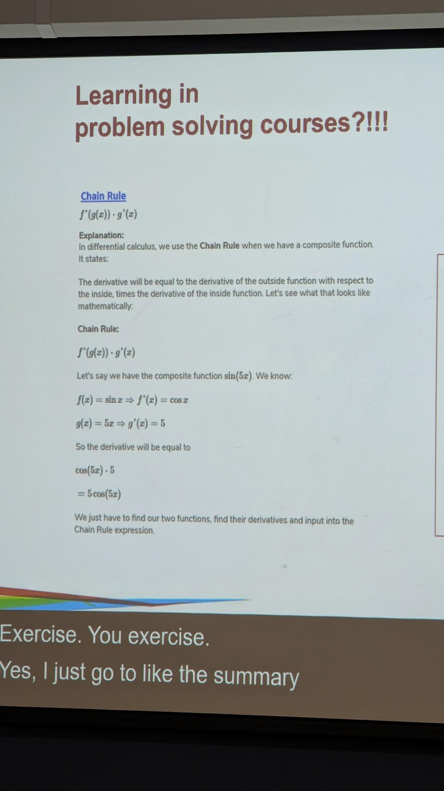
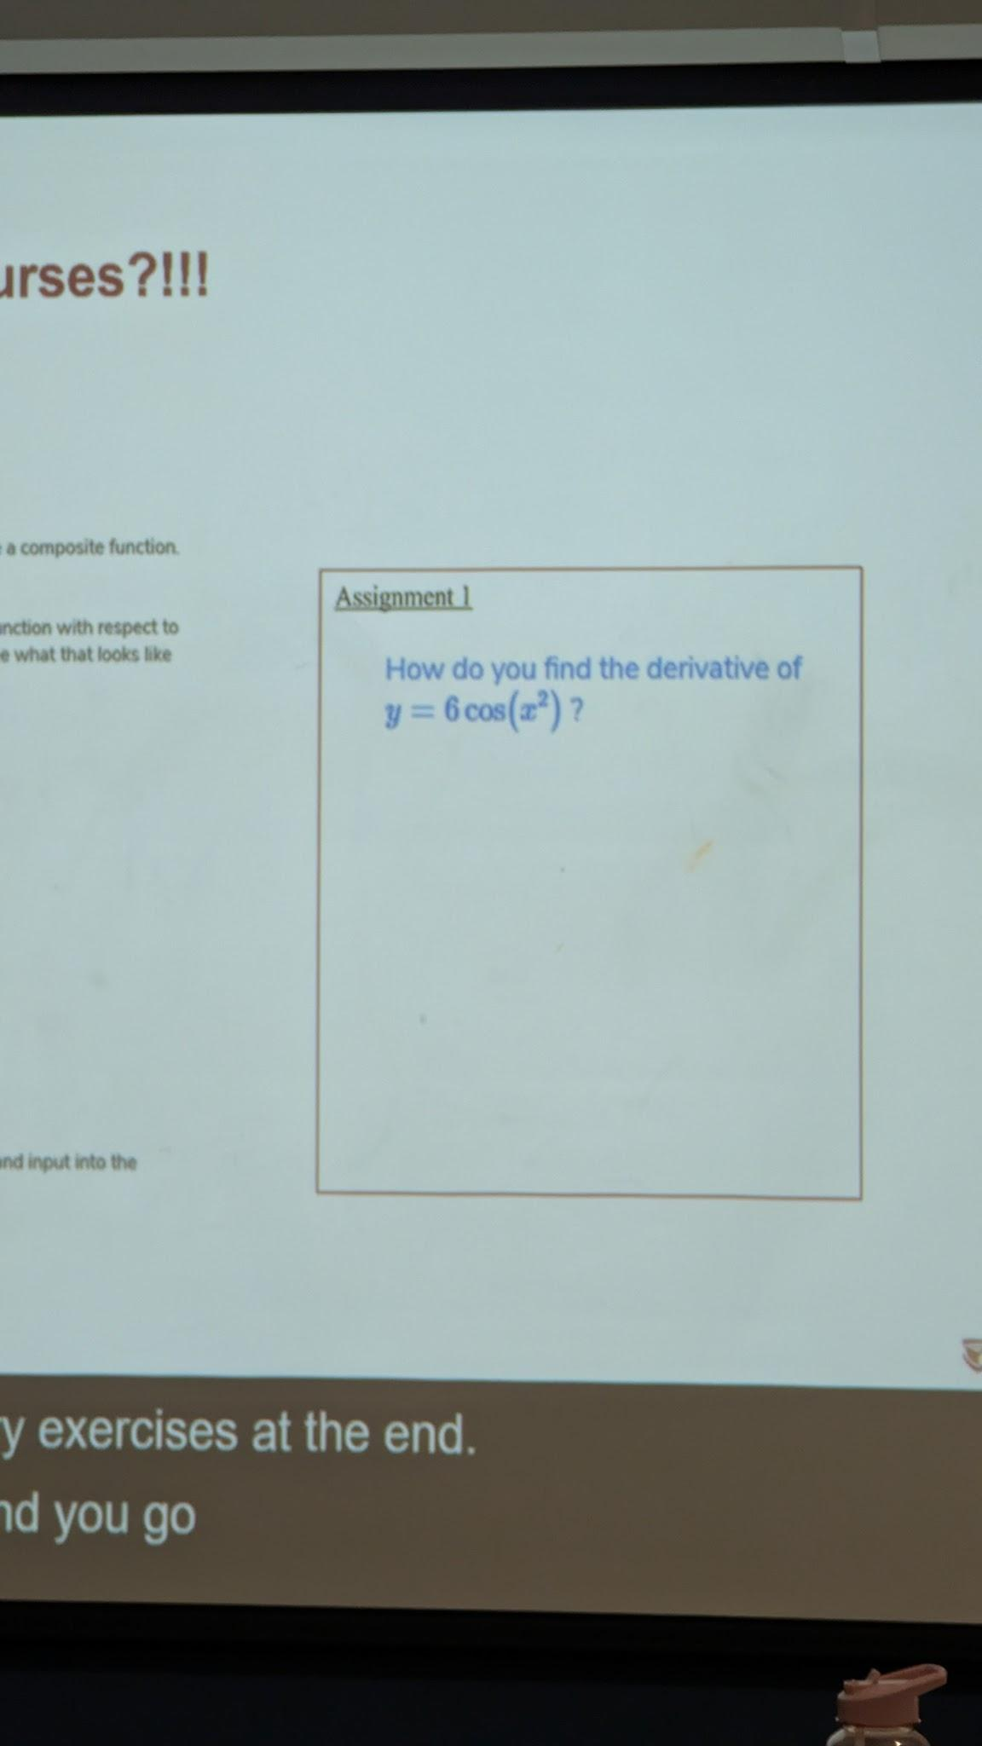
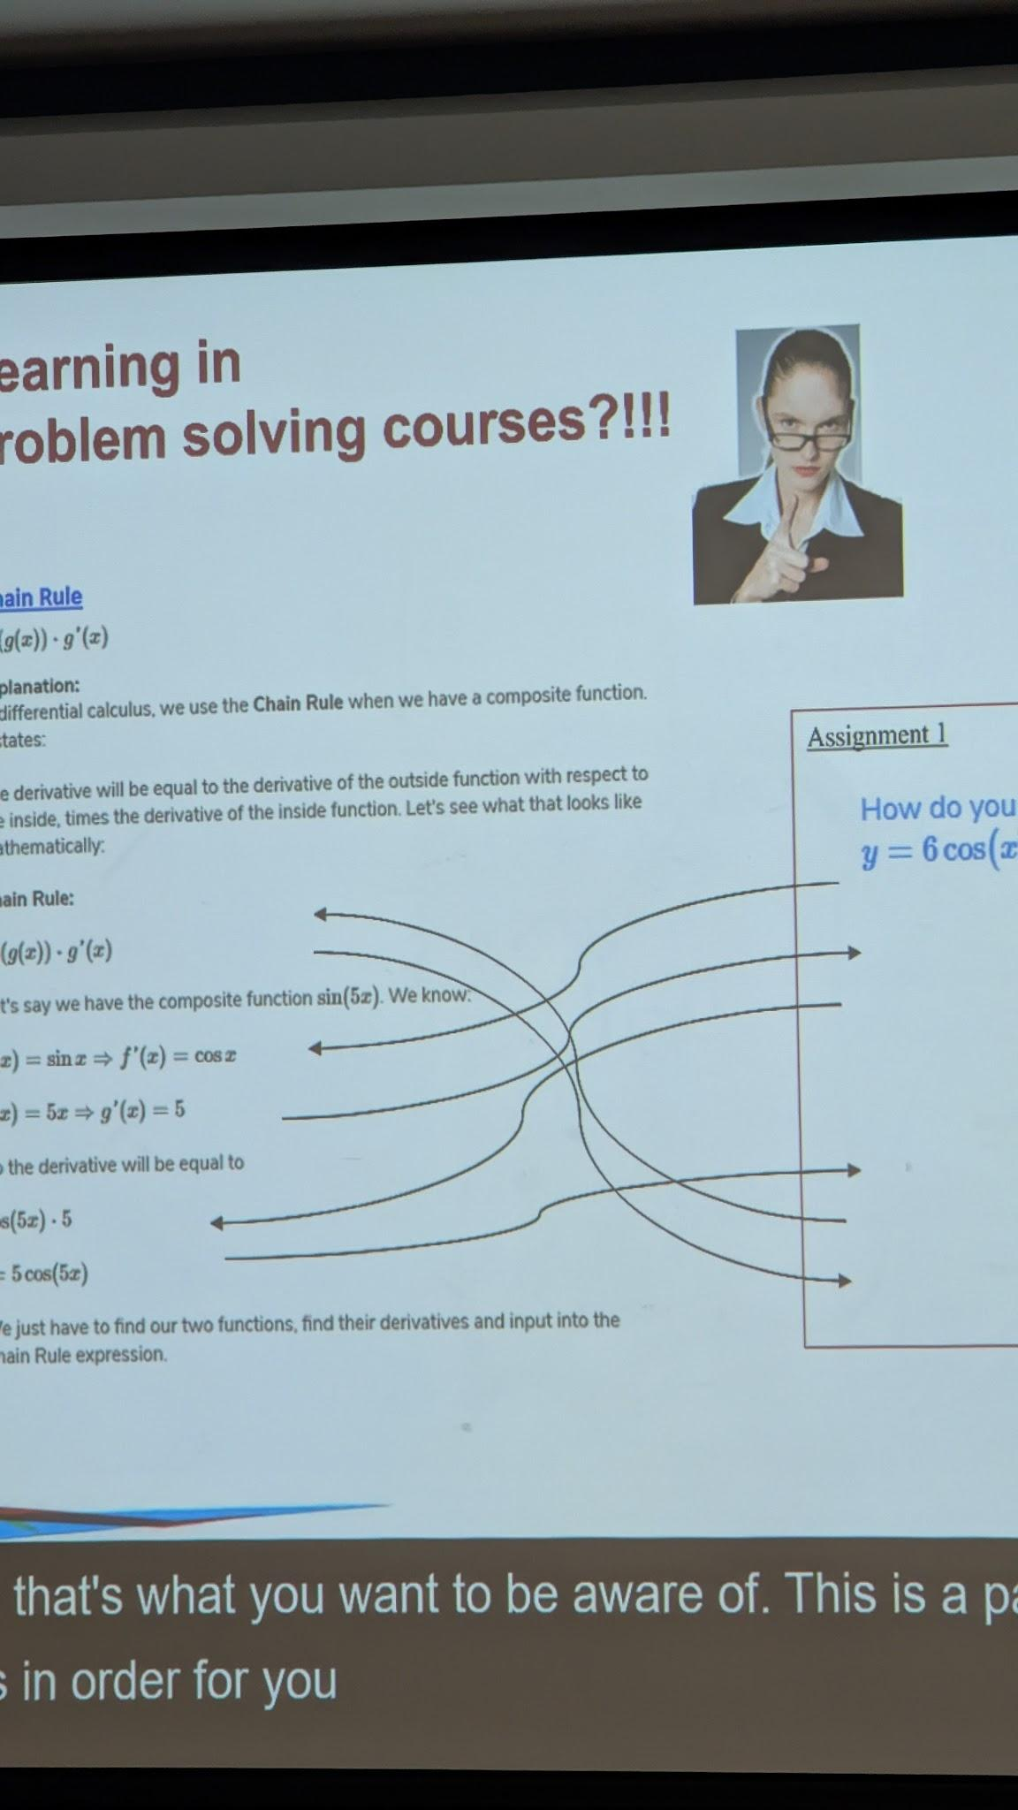
FIELD NOTE 01
From worked example to independent solution
01 · STUDY THE METHOD
Understand why each step works.
02 · HIDE THE MODEL
Attempt the derivative unaided.
03 · DIAGNOSE THE PATH
Find the missing link—then retry.
Session evidence · Learning in problem-solving courses · 02 Sep 2026

Slide 20
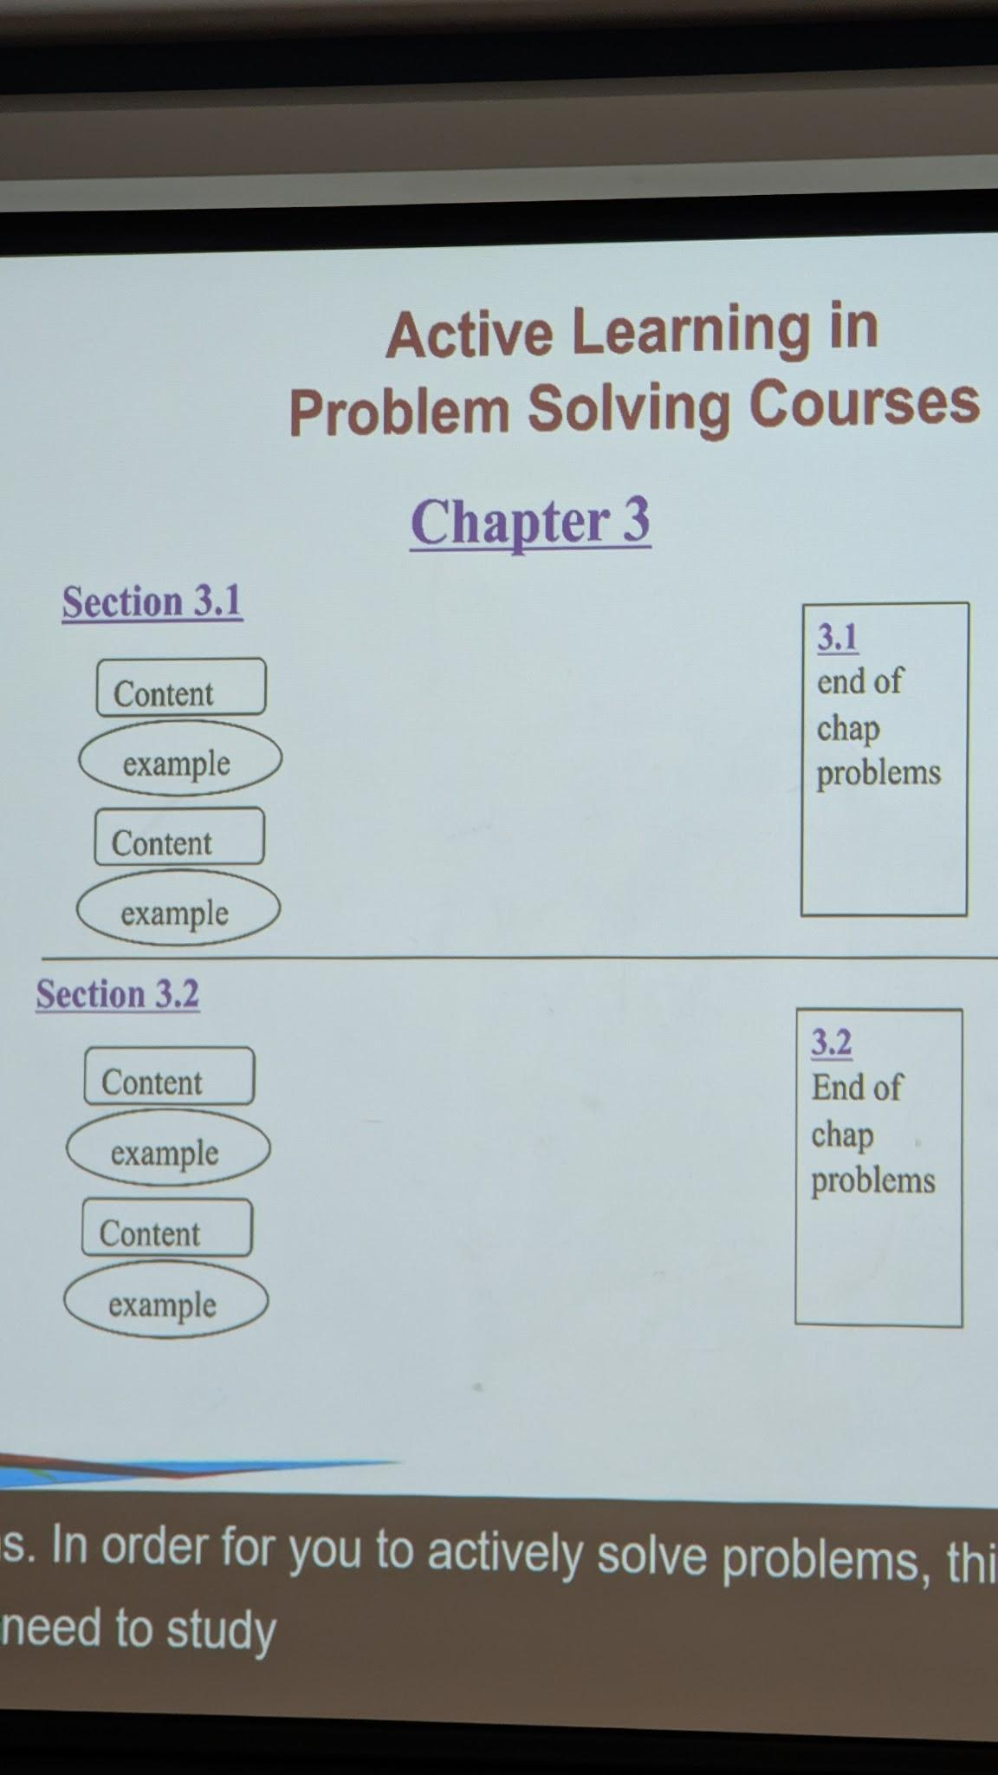
FIELD NOTE 02
Active learning repeats section by section
THE REPEATABLE UNIT
01
Read one content block
Build the concept.
02
Study one worked example
Explain each move.
03
Solve section problems
Create without looking.
↻
Repeat for the next section
Layer knowledge as you go.
The photo preserves the presenter’s chapter diagram; the right side turns it into a reusable routine.

Slide 21
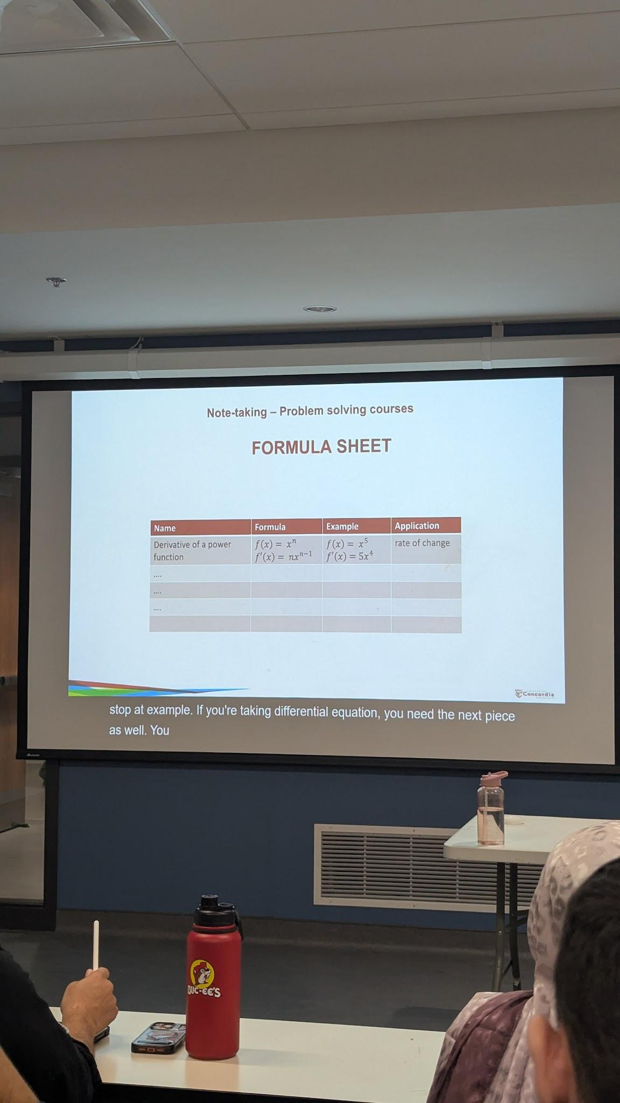
FIELD NOTE 03
A formula sheet should encode decisions—not just equations
FOUR RETRIEVAL CUES
NAME
Retrieve the concept
What is this called?
FORMULA / RULE
Retrieve the structure
Can I write it accurately?
WORKED EXAMPLE
Rehearse execution
Can I use it once without copying?
APPLICATION / TRIGGER
Recognize the moment
When should I reach for it?
As courses become more advanced, the application column becomes the most valuable.
Session photo · Formula-sheet example · 02 Sep 2026

Slide 22
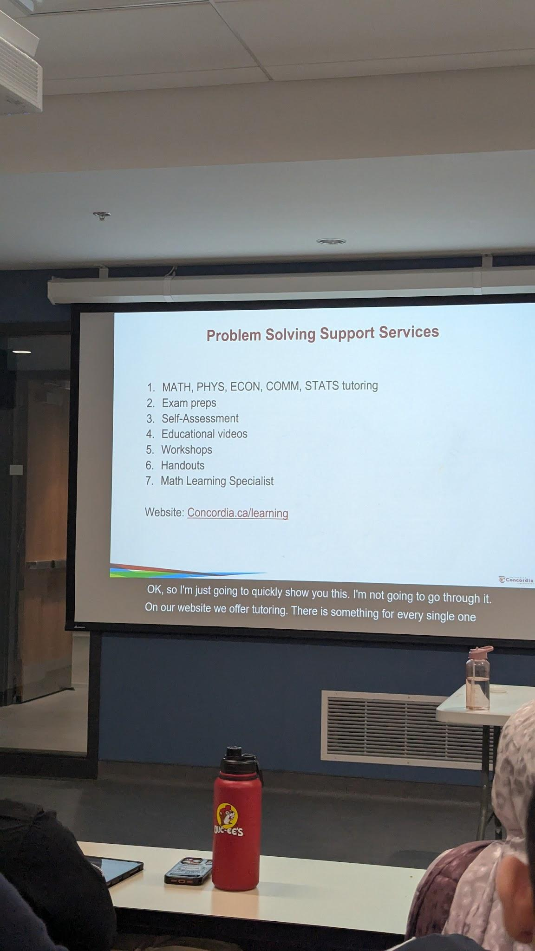
FIELD NOTE 04
Support is part of the learning system
Use these services before a small gap becomes a course-wide problem.
01
Tutoring — MATH, PHYS, ECON, COMM, STATS
05
Workshops
02
Exam preparation
06
Handouts
03
Self-assessment
07
Math Learning Specialist
04
Educational videos
START HERE
concordia.ca/learning
Session photo · Problem Solving Support Services · 02 Sep 2026

