Slide 1



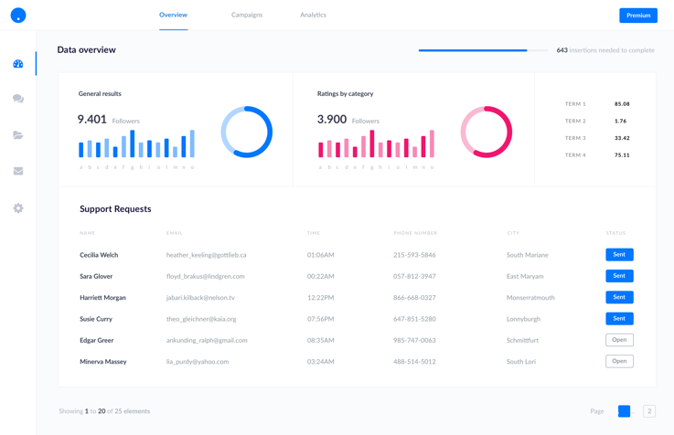



Angular Unit Testing – Testing ecosystem
Unit Testing
Integration Testing (E2E)
Test Runner
Syntax

Slide 2

Angular Unit Testing – What?
Component

Slide 3

Angular Unit Testing – What?
Component

Slide 4
Angular Unit Testing – On what?
Component
Unit Testing !!

Slide 5
Angular Unit Testing – How ?
Mocked Environment
Angular Lifecycle
User Actions

Slide 6
Angular Unit Testing – How ?
Angular Lifecycle

Slide 7
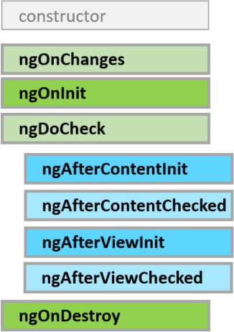
Angular Unit Testing – Ng Lifecycle

Slide 8
Angular Unit Testing – Demo !
Write
Run
Debug
Coverage
Data Generator

Slide 9

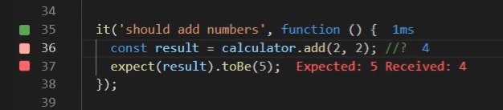
Angular Unit Testing – More tools?

Slide 10
Angular Unit Testing – More tools?
$!

