Slide 1


All-NBA Team Predictions
Capstone Presentation
James Martinez
April 30, 2019

Slide 2
Introduction
The National Basketball Association (NBA) is considered to be the premier basketball league in the world.
Popularity is increasing - total revenue increased by 8.5% over the previous season, hitting the $8 billion mark¹.
Clients:
General basketball fans
Sports betters
Team Front-Offices

Slide 3

Problem
Changes to contracts and salary cap rules related to “star” players (e.g., players who make the All-NBA team)
High-value players can be gained or lost by teams based on whether or not the player makes an All-NBA team.
The Utah Jazz could have offered Gordon Hayward more money than any other team - had he made the All-NBA roster
The Boston Celtics were able to sign him in 2017 for $40M less than Utah was willing to pay²

Slide 4

Solution
Leverage historical NBA data from Kaggle to train a predictive model

Slide 5
Data
Data set: Men's Professional Basketball
Stats on players, teams, and coaches in men's pro basketball leagues, 1937-2012
Only the following used:
master: biographical information for players and coaches
players: stats for each player, per year
awards_players: player awards, per year
player_allstar: individual player stats for the All-Star Game, per year

Slide 6
Data
Features
Final data set contains 64 variables
Mostly numerical, engineered from initial raw statistics
Limitations
Data only up to 2011-2012 season
Cannot capture true nature of selection process (point-based vote)
Cannot accurately leverage post-season data for model

Slide 7
Data Wrangling
Tidy data
1 observation per column
Merging datasets
Inconsistency between Kaggle data sets
Encoding issues
master
players
players_clean
awards_players
player_allstar

Slide 8
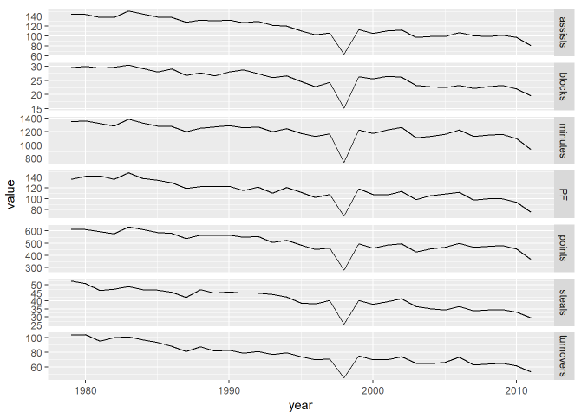
Exploratory Data Analysis
Data summarized to view mean stats per year
There's a noticeable dive in every statistic in 1998 and 2012.

Slide 9
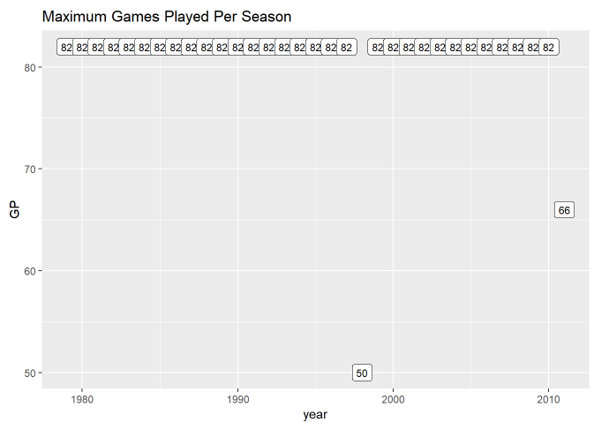
Exploratory Data Analysis – Lockout Seasons
Two NBA lockouts resulted in shorter regular seasons (less games played before Playoffs)
To get a more accurate picture: normalize each stat on a per-game basis

Slide 10
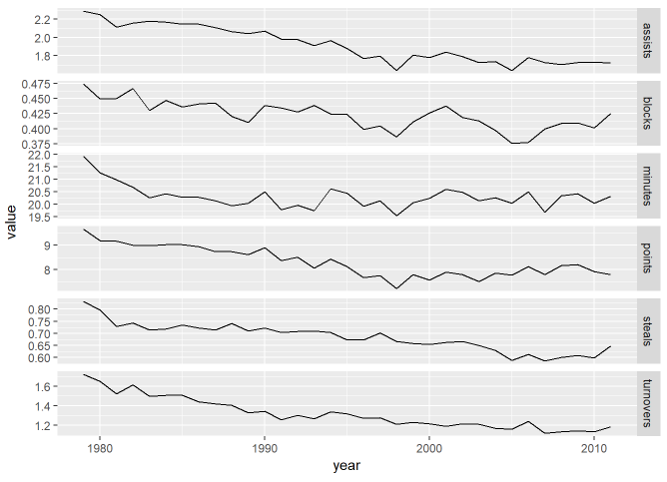
Exploratory Data Analysis – Per Game Stats
3-point shooting became an increasingly important part of the game
Despite the 3-point shooting, the points scored per game decreased overall

Slide 11
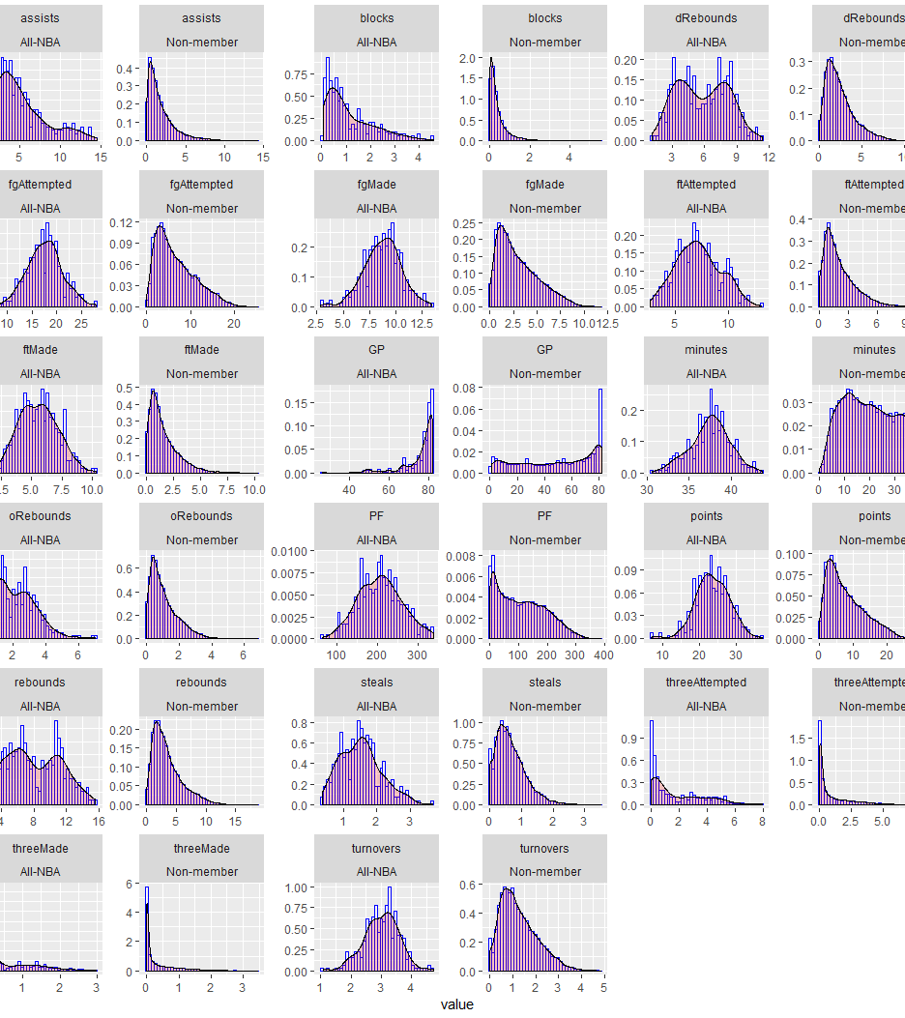

Exploratory Data Analysis – Stat Distributions
Interesting relationships
Bi-modal:
Rebounds
Free throws made
Demonstrates potential positional differences

Slide 12
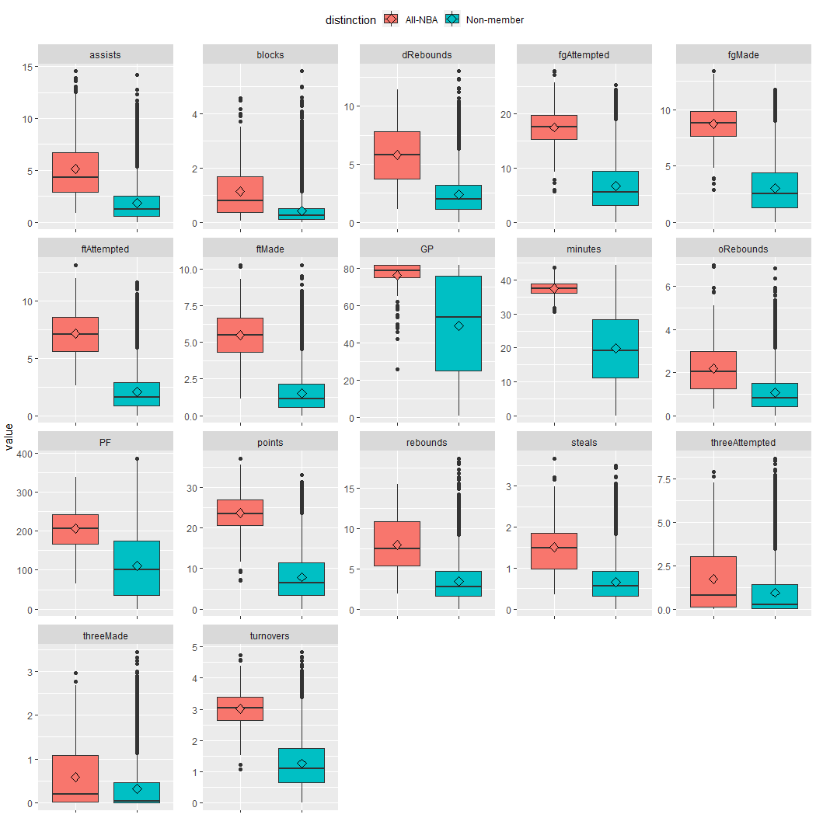
Exploratory Data Analysis – Stat Distributions
Interesting relationships
All-NBA members averaged more of everything, including:
Turnovers
Personal Fouls

Slide 13
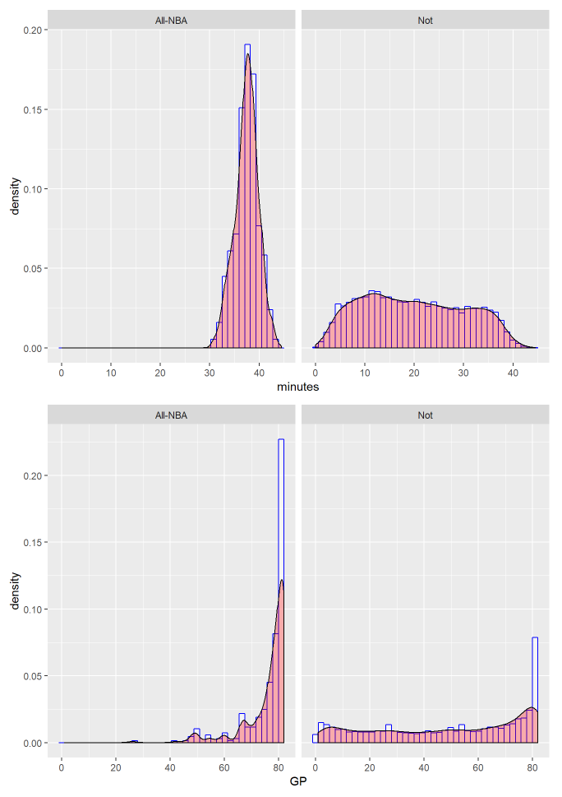
Exploratory Data Analysis – Games Played
All-NBA Team members play a lot more:
New features “GPRatio” and “healthy”

Slide 14
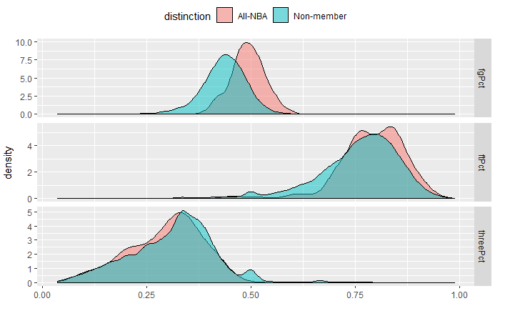
Exploratory Data Analysis – Shot %
All-NBA members were generally more effective shooters
Except for three-pointers
Both mean and median are higher for non-members
Maybe non-members receive assists

Slide 15
Machine Learning
Regularized Logistic Regression
LASSO – feature selection
Ridge – feature shrinkage
Elastic-Net – combination of above
Binary Classifier (All-NBA or not)

Slide 16
Train/Test Split
Initial 80-20 split
Good performance based on AUROC
Variable performance with actual predictions
10 of 15 correct predictions for 2011-2012 All-NBA Team
Maximized training data
All but last season used for training
Last available season (2011-2012) used for testing
Better performance than initial split based on AUPRC and Cross-Entropy

Slide 17
Threshold Value
Threshold value is typically a business decision
Based on willingness for false positives, false negatives, etc.
We’re only interested in a player’s relative probability to make the team
Rank players by position and probability
Top 2 Guards/Forwards and #1 Center – First Team
#3 and #4 Guards/Forwards and #2 Center– Second Team
#5 and #6 Guards/Forwards and #3 Center – Third Team

Slide 18

Predictions – First Team
Position | Lasso | Ridge | Elastic-Net | Actual
Guard | Chris Paul | Chris Paul | Chris Paul | Chris Paul
Guard | Kobe Bryant | Kobe Bryant | Kobe Bryant | Kobe Bryant
Forward | LeBron James | LeBron James | LeBron James | LeBron James
Forward | Kevin Durant | Kevin Durant | Kevin Durant | Kevin Durant
Center | Dwight Howard | Dwight Howard | Dwight Howard | Dwight Howard

Slide 19
Predictions – Second Team
Position | Lasso | Ridge | Elastic-Net | Actual
Guard | Deron Williams | Deron Williams | Deron Williams | Tony Parker
Guard | Russell Westbrook | Russell Westbrook | Russell Westbrook | Russell Westbrook
Forward | Kevin Love | Kevin Love | Kevin Love | Kevin Love
Forward | Blake Griffin | Blake Griffin | Blake Griffin | Blake Griffin
Center | Andrew Bynum | Andrew Bynum | Andrew Bynum | Andrew Bynum

Slide 20
Predictions – Third Team
Position | Lasso | Ridge | Elastic-Net | Actual
Guard | Brandon Jennings | Dwyane Wade | Dwyane Wade | Dwyane Wade
Guard | Tony Parker | John Wall | Tony Parker | Rajon Rondo
Forward | Pau Gasol | Pau Gasol | Pau Gasol | Dirk Nowitzki
Forward | Josh Smith | Josh Smith | Josh Smith | Carmelo Anthony
Center | Marcin Gortat | Marc Gasol | Marcin Gortat | Tyson Chandler

Slide 21
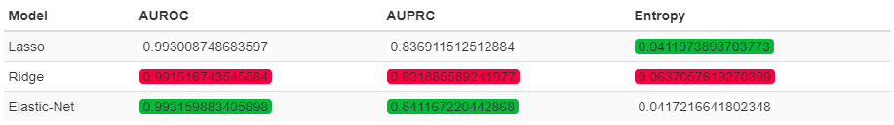
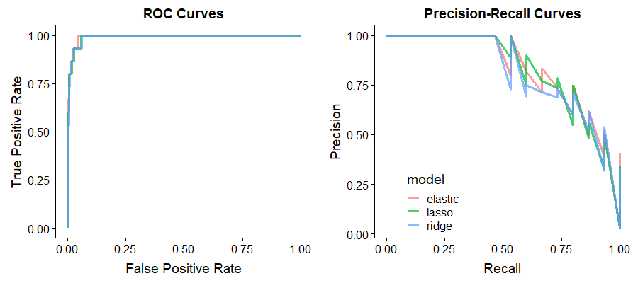
Model Comparison – Metrics
Area Under ROC Curve (AUROC)
Area Under PR Curve (AUPRC)
(Mean) Cross-Entropy loss
Elastic-Net provides the best model
Based on metrics + results

Slide 22
Conclusion
All models did a good job predicting First and Second Teams (9 of 10 players)
Results should be used as a guideline, particularly Third Team
Compare relative probabilities for each position

Slide 23
Improving the Model – Future Work
Scrape missing data (seasons after 2011-2012).
Train on algorithms that can better describe non-linear relationships (e.g. CART, random forests, gradient boosted trees).
Resampling or weighting to address class imbalance.
Add Playoff qualification as an indicator variable.
Applying clustering before creating models.
Potentially more ideas...

Slide 24
References
https://www.forbes.com/sites/kurtbadenhausen/2019/02/06/nba-team-values-2019-knicks-on-top-at-4-billion/
https://www.sportskeeda.com/basketball/all-nba-teams-the-who-what-when-why-and-how

