Slide 1
Some JavaScript Fundamentals
Getting to know the language
in approximately 120 minutes
Martijn Burgers
Twitter: @martijnburgers
Web: www.martijnburgers.net

Slide 2
Before we start…
Take a deep breath and say to yourself
“JavaScript is a totally different language then
C# or Java.”

Slide 3
Why learn JavaScript?
You can’t turn your back on it.
Make your websites better.
Websites become/are web-applications.
It’s more than just the web.
JavaScript is fun!
Notes:
Programming has moved to the web, as browsers and JavaScript engines getting better every day this is continuing to grow.
JavaScript is no longer a sub-language relegated to simple scripts. It’s now a standalone language with full potential.
JavaScript is the only client-side scripting language.
Together with HTML5 and CSS3 it’s posible to create websites and webapplication that behave as they where desktop apps.

Slide 4
Language Fundamentals
JavaScript is a loosely-weakly typed language.
JavaScript is dynamically typed.
De primitive types are:
numbers (floating-point values), strings, booleans, null and undefined
Primitive types are immutable.
Everything else is an object and mutable:
functions, arrays, dates, regular expressions, primitive wrappers
Notes:
En dat betekent dat je de data types van een variable niet explicitiet declared. Wat niet wil zeggen dat er geen datatypes bestaan.
Dynamicly typed wil zeggen dat types pas worden controleerd tijdens de executie van een programma. Dit in contrast tot een staticly typed language waar dit vooraf gebeurt.

Slide 5
Language Fundamentals
Objects
The definition of a object is simple:
an object is a unordered mutable collection of properties
Each property has a name and a value.
Each property has the associated attributes: writeable, enumerable and configurable (ECMAScript 5).

Slide 6
Language Fundamentals
Object categories
Native objects | Defined by the ECMAScript specification
Host objects | Defined by the host environment (such as a webbrowser)
User-defined | Defined by the user themself.
Objects
Each object has associated attributes: prototype, class and extensible (last one is added in ECMAScript 5)
Objects are categorized in three types:

Slide 7
Language Fundamentals
Objects
An object can be created in various ways:
Object Literal { }
Constructor function (with the new keyword)
Object.create factory method (ECMAScript 5)

Slide 8
Language Fundamentals
Objects
JavaScript is a class free, prototypal language.
A JavaScript object inherits properties of another object, called it’s prototype
A prototype is JavaScript’s way for inheritance.
Every object has a prototype property (which is a different object).
Every object inherits from Object.prototype.
ECMAScript 5 introduces objects with no prototypes.

Slide 9
Language Fundamentals
.__proto__ is not the same as .prototype.
.__proto__ is a non standard property (but in draft ES6)
Person.prototype is used to establish the prototype of objects created by new Person()
This Person.prototype object becomes the prototype of the object returned by new Person()
Prototype examples
Object.prototype | Array.prototype
Function.prototype | Regex.prototype
Number.prototype | String.prototype
Date.prototype | Boolean.prototype

Slide 10
Language Fundamentals
Example of the default inheritance chain
Object.prototype
…
__proto__ [==null]
Mammal.prototype
says()
getName()
__proto__
new Mammal(name)
name
__proto__

Slide 11
Language Fundamentals
Example 2 of an inheritance chain
Mammal.prototype
says()
getName()
__proto__
new Mammal() becomes a new created object
new Mammal()
name
__proto__
new Cat(name)
name
saying = “meow”
purr()
__proto__
Object.prototype
constructor
__proto__ [==null]

Slide 12
Language Fundamentals
Relational Operators: (In)equality
JavaScript objects are compared by reference, not by value.
Primitives are compared by value.
Avoid using the evil twins == and != for (in)equality checks.
Always use the honest trio === and !== (avoids type coercion).

Slide 13
Language Fundamentals
Relational Operators: (In)equality
Beware of truthy and falsy values
statement | result
( null ? true : false ); | False
( 0 ? true : false ); | False
( "" ? true : false ); | False
( false ? true : false ); | False
( NaN ? true : false ); | False
( undefined ? true : false ); | False
(0 == false); | True
(1 == true); | True
(“” == false); | True
(0 === false); | False
(1 === true); | False
(“” === false); | False
(0 === 0); | True

Slide 14
Language Fundamentals
Relational Operators: The in operator
prop is a string or numeric expression representing a property name or array index.
Returns true if the left-side operand is in the right-side operand (that is an object).
prop in objectName

Slide 15
Language Fundamentals
The instanceof operator tests whether an object has in its prototype chain the prototype property of a constructor.
The instanceof operator tests whether an object has in its prototype chain the prototype property of a constructor.
Relational Operators: The instanceof operator
The instanceof operator tests whether an object has in its prototype chain the prototype property of a constructor.
It expects a left-side operand that is an object and right-side operand that is an constructor function.
If the right-side operand is not a function, it throws a TypeError.

Slide 16
Language Fundamentals
Relational Operators: Comparison
Less than (<), Greater than (>), Less than or equal (<=), Greater than or equal (>=).
Test the relative order (numerical or alphabetics) of their two operands.
The operands may be of any type BUT…
Comparison can be performed only on numbers and strings!
Operands that are not numbers or strings are converted to primitives.

Slide 17
Language Fundamentals
Miscellaneous Operators
The conditional operator (?:) is the only ternary operator.
var x = 1, b = x > 0 ? x : -x;
The delete operator. It attempts to delete the object property or array element specified as its operand.
When a property is deleted, the property ceases to exist.
Not all properties can be deleted.
Deleting a array element leaves a “hole” in the array and does not change the array’s length.

Slide 18
Language Fundamentals
Miscellaneous Operators
The typeof operator. Returns a string value that specifies the type of the operand.
x | typeof x
undefined | “undefined”
null | “object” // this stands since the beginning of JavaScript
true / false | “boolean”
Any number | “number”
NaN | “number” // despite being "Not-A-Number"
Any string | “string”
Any function | “function”
Any nonfunction native object | “object”

Slide 19
Language Fundamentals
Functions
Functions are objects so they can have properties and methods.
Function objects inherit from Function.prototype.
Every function gets the bonus parameters this (invocation context) and arguments.
Functions can be stored in variables, objects or arrays.
Functions can be static.
Functions can be passed as a argument.
Function can be returned as a result of another function.
Function definitions can be nested within other functions.

Slide 20
Language Fundamentals
Functions
JavaScript does not support block scoping (the one exception to this are catch blocks of a try-catch statement).
A (local) variable within a function is therefor visible everywhere in the function. This feature is called hoisting.
JavaScript implicitly “hoists” the declaration part to the top of the enclosing function.
Consider manually hoisting local variable declarations to avoid confusion.

Slide 21
Language Fundamentals
Functions
JavaScript functions has lexical (aka static) scoping.
Functions create scope when they are defined, not when they are executed.
A nested (inner) function has access to every variable of the outer function. This is also called a closure.
Closures store their outer variables by reference, not by value.

Slide 22
Language Fundamentals
JavaScript Object Notation
Data serialization format based on JavaScript literals.
Native in ECMAScript 5 (prior to that use json2.js).
The primitive value undefined is not supported.
The numbers NaN and Infinity are not supported.
Functions are not supported.
Dates, RegExps and Errors are not supported.
JSON.Stringify(o, filter, indent)
JSON.Parse(s, reviver)

Slide 23

Language Fundamentals left…
A lot!
Good parts and bad parts – study them hard and become a JavaScript Ninja!

Slide 24
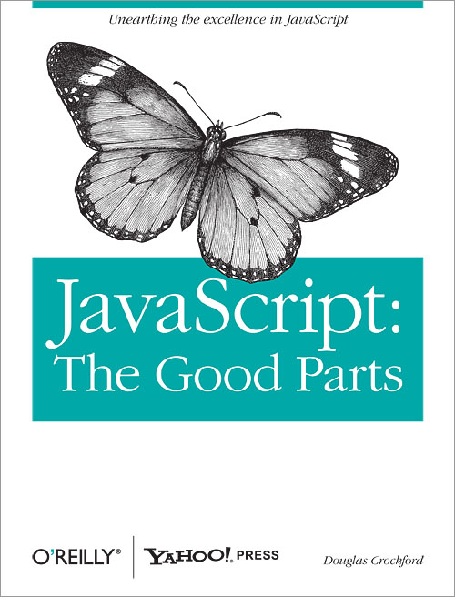
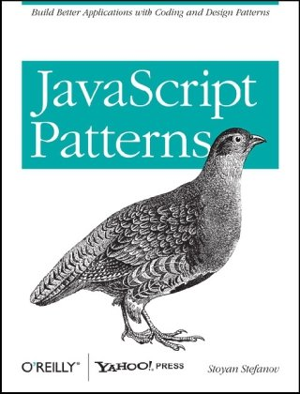
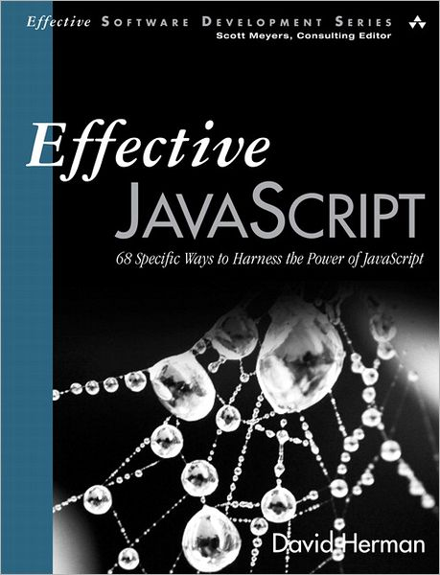

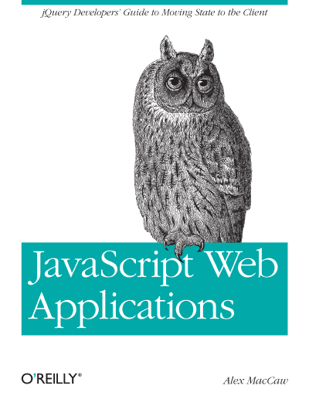
Recommended Books
3
1
2
5
4

Slide 25
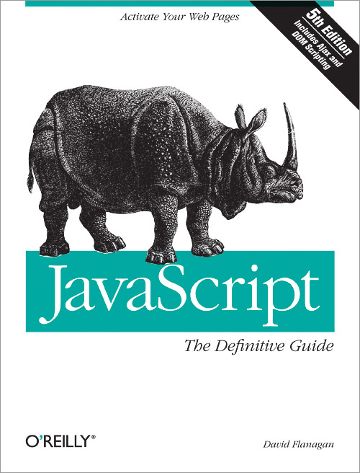

JavaScript References
The Bible (~1100 pages) online @ https://developer.mozilla.org

Slide 26
THANKS FOR WATCHING!
The presentation and demo’s can be found at
https://github.com/martijnburgers/somejsfundamentals
Martijn Burgers
Twitter: @martijnburgers
Web: www.martijnburgers.net

