Slide 1
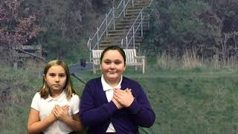
Emotional Feature
Video E1-2
Megan and Alex
Youtube: https://youtu.be/7mn9U6pQ8l4

