Slide 1
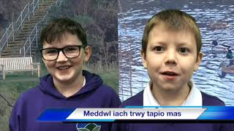
Emotional Feature
Video E1-3
Jayden, Iestyn and Deacon
Youtube: https://youtu.be/YDxchDv6LI8

