Slide 1
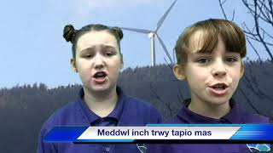
Emotional Feature
Video E1-4
Cianna and Macy
Youtube: https://youtu.be/75Zt4H4S9ks

