Slide 1
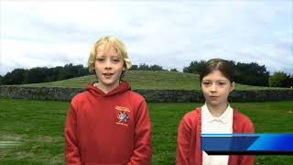
Emotional Feature
Video E2-1
Theo and Evie
Youtube: https://youtu.be/qxb6EMwq8UQ

