Slide 1
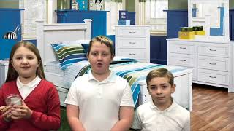
Emotional Feature
Video E2-4
Harry, Calla and Ashton
Youtube: https://youtu.be/xWMDRBVzxYQ

