Slide 1
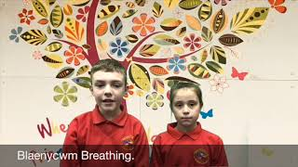
Emotional Feature
Video E4-2
Tyler and Bethany
Youtube: https://youtu.be/04SGYB1lrFE

