Slide 1
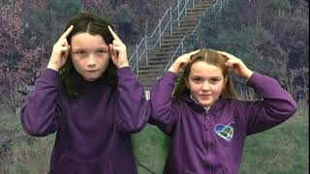
Meditation Animation
Physical Feature
Video E1-1
Dilys and Lauren
Youtube: https://youtu.be/KB6CYtpNNEc

