Slide 1
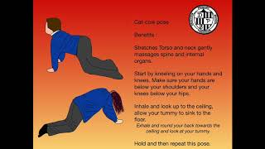
Yoga Tutorial
Physical Feature
Video P3
Youtube: https://youtu.be/OJasZcwsQGU

