Slide 1

МИНИСТЕРСТВО ОБРАЗОВАНИЯ РЕСПУБЛИКИ БЕЛАРУСЬ
Учреждения образования «БЕЛОРУССКИЙ ГОСУДАСТВЕННЫЙ ТЕХНОЛОГИЧЕСКИЙ УНИВЕРСИТЕТ»
Факультет информационных технологий
Кафедра информационных систем и технологий
Тема проекта:
«Мультимастер архитектура на основе технологий PostgesSQL, Citus и Kubernetes»
Выполнил: Марушко Тимофей Фёдорович
Руководитель: Блинова Евгения Александровна
Минск 2026

Slide 2




Kubernetes
PostgreSQL
Helm
Citus
Notes:
Введение

Slide 3
Kubernetes
Notes:
Что такое k8s

Slide 4
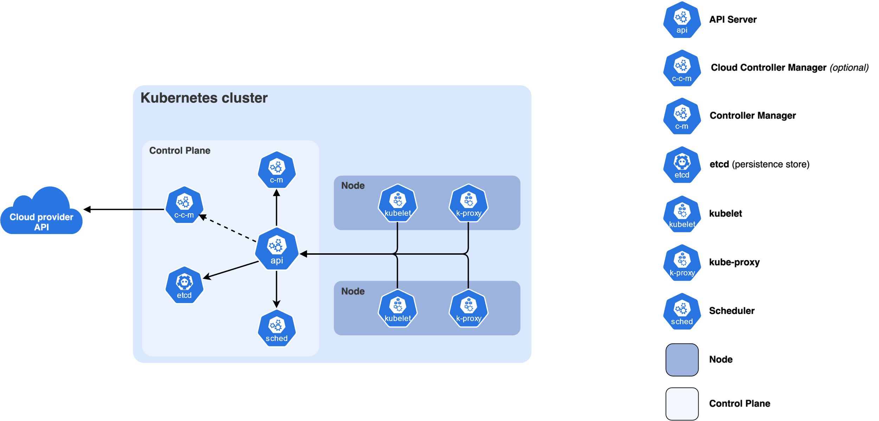
Notes:
Объекты k8s, какую роль играет каждый

Slide 5
PostgreSQL
Notes:
PostgreSQL что это

Slide 6
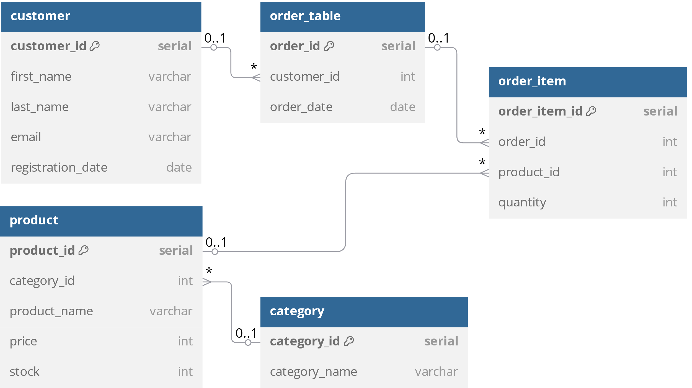

Slide 7
Citus
Notes:
Что такое Citus

Slide 8
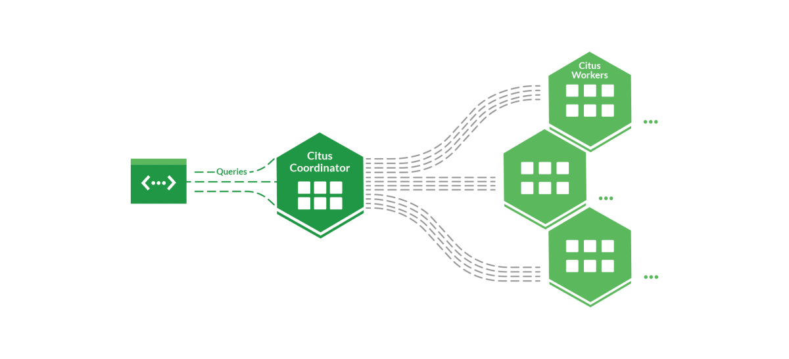

Slide 9
Helm
Notes:
Что такое helm

Slide 10
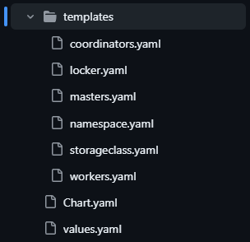
Notes:
Структура шаблонов в моем проекте

Slide 11
Слой блокировки
pg-locker

Slide 12
Слой записи
master-2
replica
replica
master-1
master-3
replica

Slide 13
Связь между слоями блокировки и записи
replica
pg-locker
replica
master-2
master-3
lock
lock
lock
master-1
replica
replica

Slide 14
Слой чтения
coord-1
sharding
worker-1-0
worker-1-1
worker-1-2

Slide 15
Связь между слоями записи и чтения
coord-1
master-1
replica
sharding
worker-1-0
worker-1-1
worker-1-2

Slide 16
Общая архитектура кластера
replica
pg-locker
replica
master-1
master-3
lock
lock
lock
replica
replica
replica
master-2
replica
worker-1-2
worker-3-0
coord-1
coord-3
coord-2
replica
sharding
sharding
sharding
worker-1-0
worker-1-1
worker-2-0
worker-2-1
worker-2-2
worker-3-1
worker-3-2

Slide 17
Слой чтения
replica
pg-locker
replica
master-1
master-3
lock
lock
lock
replica
replica
replica
master-2
replica
worker-1-2
worker-3-0
coord-1
coord-3
coord-2
replica
sharding
sharding
sharding
worker-1-0
worker-1-1
worker-2-0
worker-2-1
worker-2-2
worker-3-1
worker-3-2

Slide 18
Слой чтения
replica
pg-locker
replica
master-1
master-3
lock
lock
lock
replica
replica
replica
master-2
replica
worker-1-2
worker-3-0
coord-1
coord-3
coord-2
replica
sharding
sharding
sharding
worker-1-0
worker-1-1
worker-2-0
worker-2-1
worker-2-2
worker-3-1
worker-3-2

Slide 19
Слой чтения
replica
pg-locker
replica
master-1
master-3
lock
lock
lock
replica
replica
replica
master-2
replica
worker-1-2
worker-3-0
coord-1
coord-3
coord-2
replica
sharding
sharding
sharding
worker-1-0
worker-1-1
worker-2-0
worker-2-1
worker-2-2
worker-3-1
worker-3-2

Slide 20
Слой чтения
replica
pg-locker
replica
master-1
master-3
lock
lock
lock
replica
replica
replica
master-2
replica
worker-1-2
worker-3-0
coord-1
coord-3
coord-2
replica
sharding
sharding
sharding
worker-1-0
worker-1-1
worker-2-0
worker-2-1
worker-2-2
worker-3-1
worker-3-2

Slide 21
Слои записи и чтения
replica
pg-locker
replica
master-1
master-3
lock
lock
lock
replica
replica
replica
master-2
replica
worker-1-2
worker-3-0
coord-1
coord-3
coord-2
replica
sharding
sharding
sharding
worker-1-0
worker-1-1
worker-2-0
worker-2-1
worker-2-2
worker-3-1
worker-3-2

Slide 22
Общая архитектура кластера
replica
pg-locker
replica
master-1
master-3
lock
lock
lock
replica
replica
replica
master-2
replica
worker-1-2
worker-3-0
coord-1
coord-3
coord-2
replica
sharding
sharding
sharding
worker-1-0
worker-1-1
worker-2-0
worker-2-1
worker-2-2
worker-3-1
worker-3-2

Slide 23
Общая архитектура кластера
replica
pg-locker
replica
master-1
master-3
lock
lock
lock
replica
replica
replica
master-2
replica
worker-1-2
worker-3-0
coord-1
coord-3
coord-2
replica
sharding
sharding
sharding
worker-1-0
worker-1-1
worker-2-0
worker-2-1
worker-2-2
worker-3-1
worker-3-2

Slide 24
Общая архитектура кластера
replica
pg-locker
replica
master-1
master-3
lock
lock
lock
replica
replica
replica
master-2
replica
worker-1-2
worker-3-0
coord-1
coord-3
coord-2
replica
sharding
sharding
sharding
worker-1-0
worker-1-1
worker-2-0
worker-2-1
worker-2-2
worker-3-1
worker-3-2

Slide 25
Общая архитектура кластера
replica
pg-locker
replica
master-1
master-3
lock
lock
lock
replica
replica
replica
master-2
replica
worker-1-2
worker-3-0
coord-1
coord-3
coord-2
replica
sharding
sharding
sharding
worker-1-0
worker-1-1
worker-2-0
worker-2-1
worker-2-2
worker-3-1
worker-3-2

Slide 26
Общая архитектура кластера
replica
pg-locker
replica
master-1
master-3
lock
lock
lock
replica
replica
replica
master-2
replica
worker-1-2
worker-3-0
coord-1
coord-3
coord-2
replica
sharding
sharding
sharding
worker-1-0
worker-1-1
worker-2-0
worker-2-1
worker-2-2
worker-3-1
worker-3-2

Slide 27
Общая архитектура кластера
replica
pg-locker
replica
master-1
master-3
lock
lock
lock
replica
replica
replica
master-2
replica
worker-1-2
worker-3-0
coord-1
coord-3
coord-2
replica
sharding
sharding
sharding
worker-1-0
worker-1-1
worker-2-0
worker-2-1
worker-2-2
worker-3-1
worker-3-2

Slide 28
Общая архитектура кластера
replica
pg-locker
replica
master-1
master-3
lock
lock
lock
replica
replica
replica
master-2
replica
worker-1-2
worker-3-0
coord-1
coord-3
coord-2
replica
sharding
sharding
sharding
worker-1-0
worker-1-1
worker-2-0
worker-2-1
worker-2-2
worker-3-1
worker-3-2

Slide 29
Общая архитектура кластера
replica
pg-locker
replica
master-1
master-3
lock
lock
lock
replica
replica
replica
master-2
replica
worker-1-2
worker-3-0
coord-1
coord-3
coord-2
replica
sharding
sharding
sharding
worker-1-0
worker-1-1
worker-2-0
worker-2-1
worker-2-2
worker-3-1
worker-3-2

Slide 30
Общая архитектура кластера
replica
pg-locker
replica
master-1
master-3
lock
lock
lock
replica
replica
replica
master-2
replica
worker-1-2
worker-3-0
coord-1
coord-3
coord-2
replica
sharding
sharding
sharding
worker-1-0
worker-1-1
worker-2-0
worker-2-1
worker-2-2
worker-3-1
Worker-3-2

Slide 31
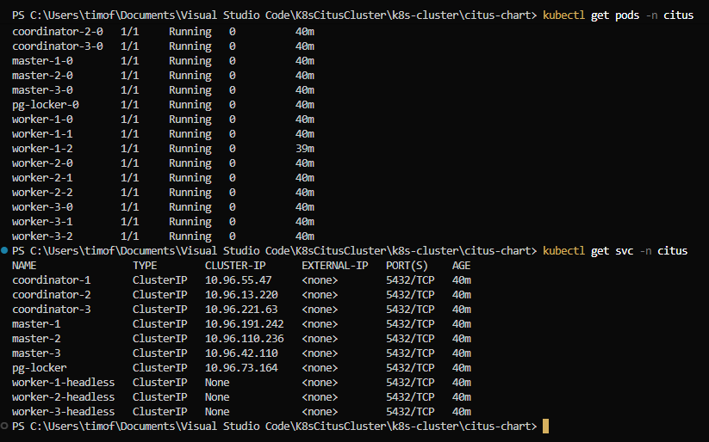

Slide 32
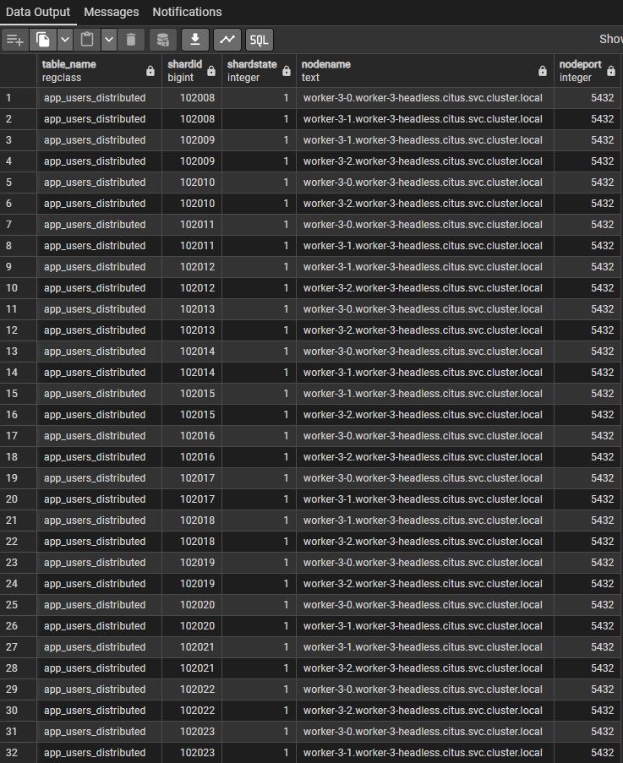
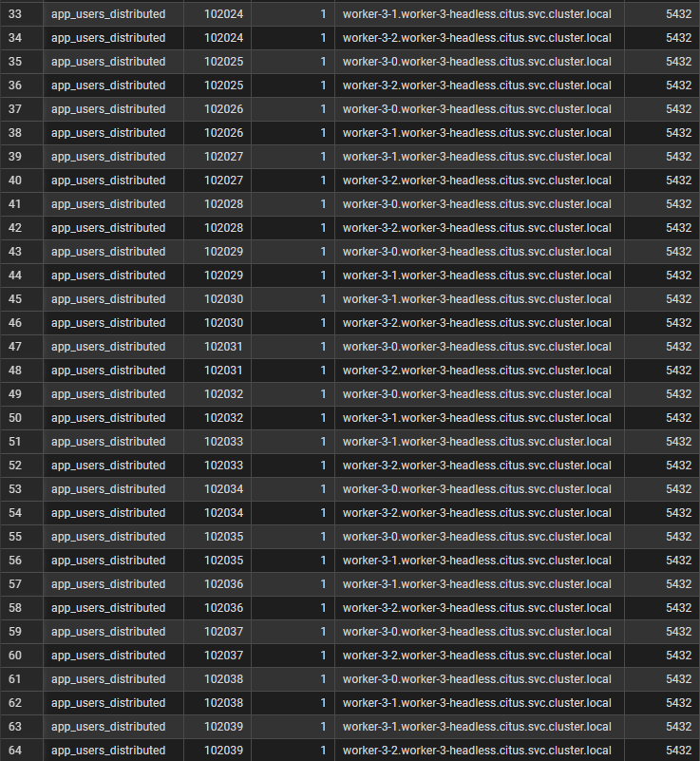

Slide 33
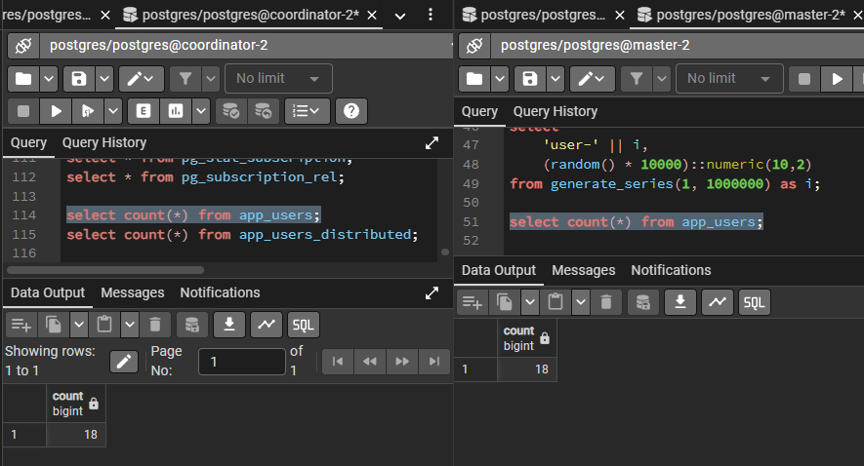
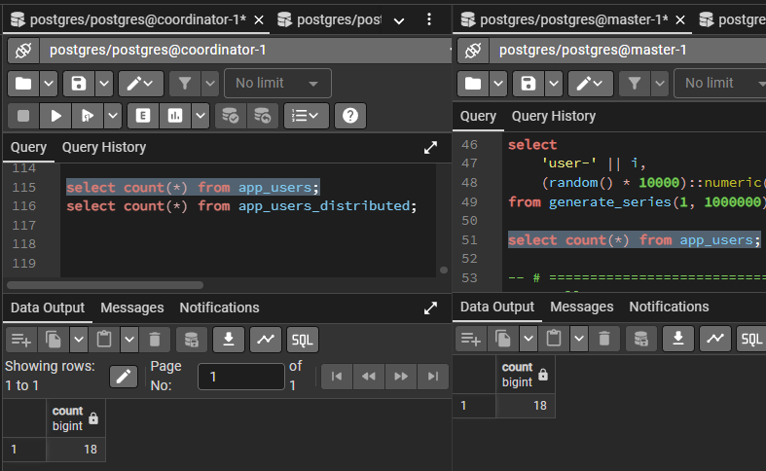
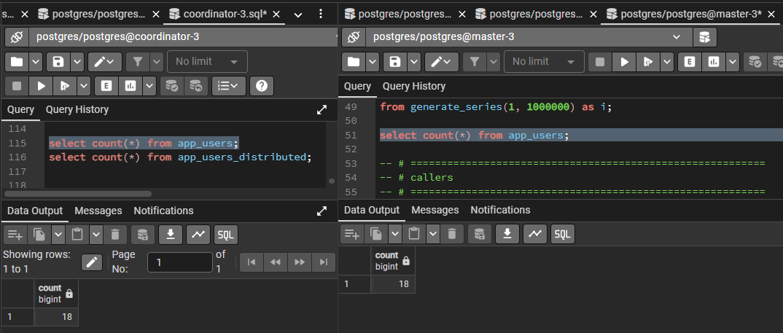

Slide 34
Спасибо за внимание
cт. 2 к. 2 гр. ФИТ
Марушко Т. Ф.

