Slide 1
BODY SHAMING DETECTION ON TWITTER Data Mining and Machine Learning
Martina Marino
Roberta Matrella
Notes:
Good morning, I am …
… and I are going to talk about Body shaming detection on Twitter

Slide 2
ROADMAP
01
02
03
INTRODUCTION
MODEL BUILDING
04
05
06
DATASET
ONLINE MONITORING
APPLICATION
CONCLUSIONS
Notes:
In this presentation we are going to explain the entire process that has been carried out in our project, starting from… and finally the conclusions

Slide 3
INTRODUCTION
01
Body shaming
on social networks

Slide 4
— International Journal of Bullying Prevention
“body shaming is a practice in which people are put to shame because of their bodies”

Slide 5

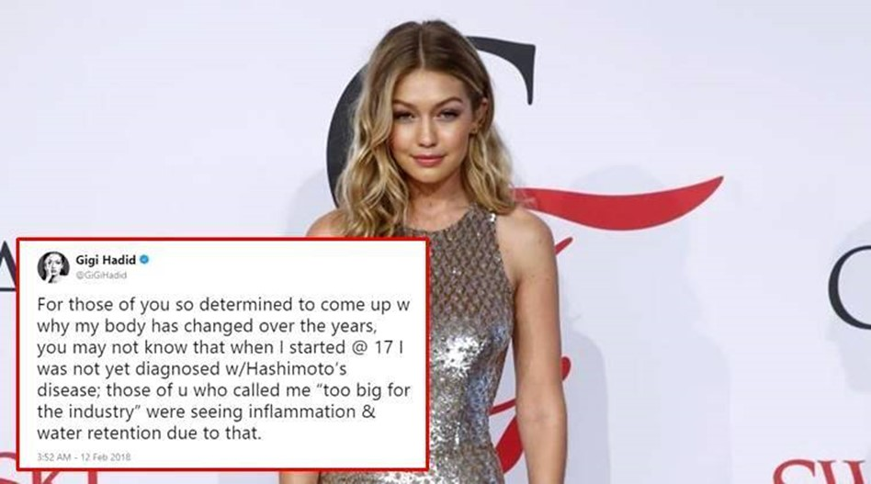
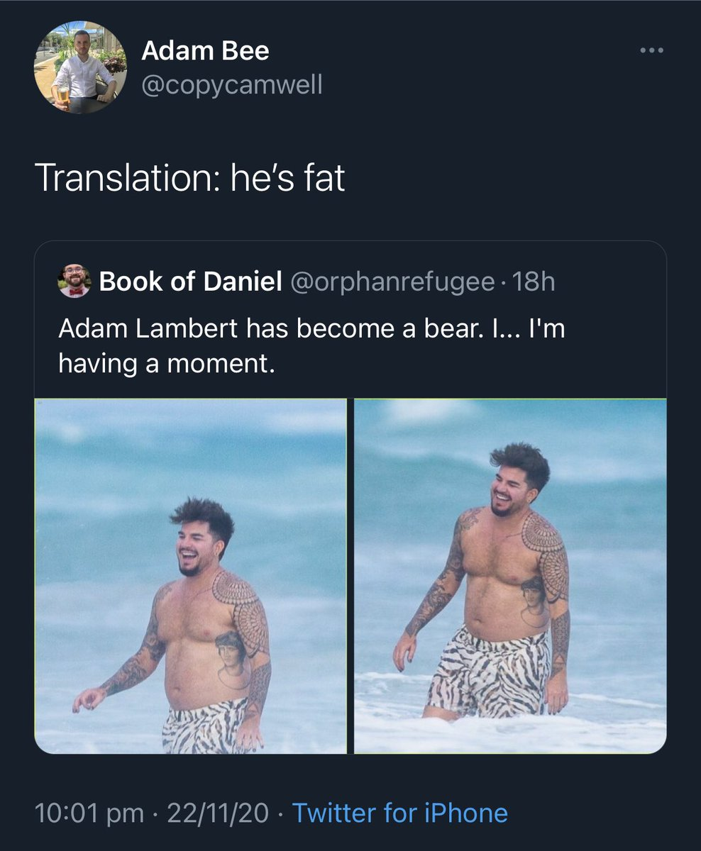
BODY SHAMING ON TWITTER
The body shaming is particularly diffused on social networks because the people feel freer to write negative comments
Notes:
Body shaming viene fatto soprattutto sui social perché si è più fieri dietro uno schermo
Visto che Twitter è un social con messaggi brevi è adatto ad essere analizzato in un processo di dm.

Slide 6

GOALS
Collect data on Twitter
Build a model
See what happens in long-term period
Build an application

Slide 7
DATASET
02
Initial dataset building

Slide 8
DATASET – DATA SCRAPING
No reply
No retweet
No quoted
Italian language
Scraping
Keywords related to bodyshaming
From 1st December 2021
to 20th July 2022
Notes:
144638 total tweets

Slide 9
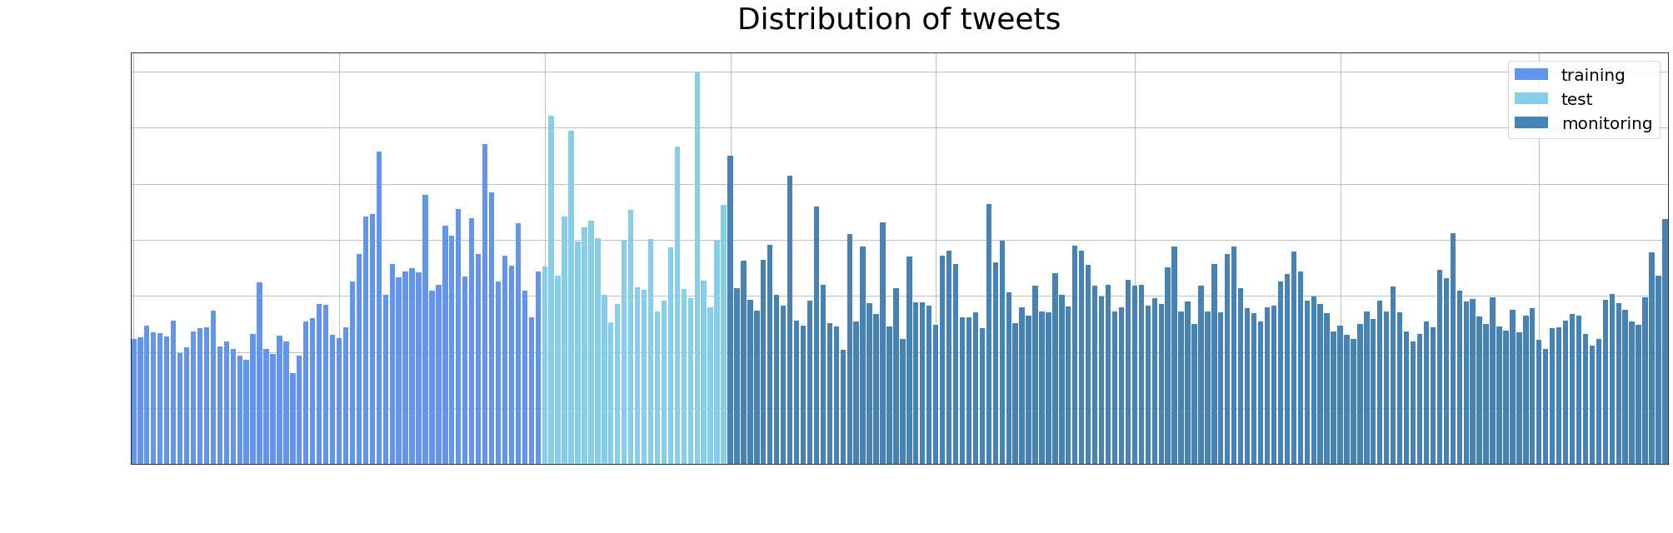
DATASET - DATA BUILDING
144,638 tweets collected from 1st December 2021 to 20th July 2022

Slide 10

DATASET - DATA CLEANING
Maaaamma mia,
quanto sei grassa 1! 😂😂
@ing0rdigia Maaaamma mia,
quanto sei grassa 1! 😂😂 http://t.co.dTh0f
Maaaamma mia, quanto sei grassa 1! 😂😂
Raw scraped data
Remove URLs
Remove new lines
Remove multiple spaces
Remove mentions
75,357
tweets
59,583
tweets
@ing0rdigia Maaaamma mia,
quanto sei grassa 1! 😂😂
Maaaamma mia, quanto sei grassa 1!😂😂
Notes:
At the end all tweets without keywords are removed

Slide 11
DATASET - MANUAL LABELING
59,583 tweets
1° December 2021 to 31° January 2022
788 body shaming tweets
788 non body shaming tweets

Slide 12
DATASET – DATA PREPROCESSING
Maaaamma mia, quanto sei grassa 1! 😂😂
mamma mia quanto sei grassa 1 😂😂
Cleaned data
Text reformat
Emojis removal
Punctuation removal
Maaaamma mia quanto sei grassa 1 😂😂
mamma mia quanto sei grassa 1

Slide 13
DATASET – DATA ELABORATION
Preprocessed data
Stop-word filtering
Stemming
Tokenization
Stem filtering
mamma mia quanto sei grassa 1
<mamma>, <grassa>, <1>
<mamm>, <grass>
<mamma>, <mia>, <quanto>, <sei>, <grassa>, <1>
<mamm>, <grass>, <1>

Slide 14
MODEL BUILDING
03
Comparing different ML algorithms

Slide 15
MODEL BUILDING - TRAINING
Report results after the 10 iterations of the 10-fold cross validation
Notes:
Vocabolario 4669 features
Da dire: std tanto basso da essere trascurabile
Execution time di random forest, gradient e bagging alta

Slide 16
MODEL BUILDING - PAIRED T-TEST
​ | SVM Acc. 71.77% | MultinomialNB Acc. 72.15% | ComplementNB Acc. 72.27%
Logistic Regression Acc. 72.03% | 1.5923 | -0.6517 | -1.4485
SVM Acc. 71.77% |  | -2.1598​ | -3.0530
MultinomiaNB Acc. 72.15% |  | ​ | -2.1083​
Paired t-test performed between the 4 best classifiers
After paired t-test, SVM has been discarded.

Slide 17
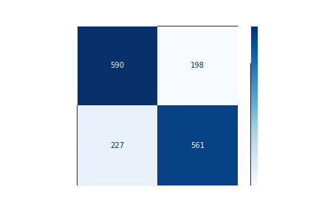
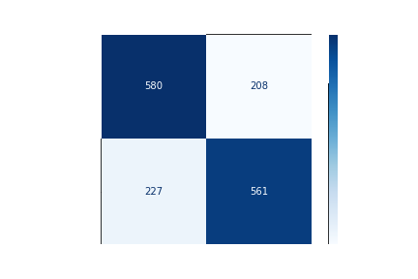
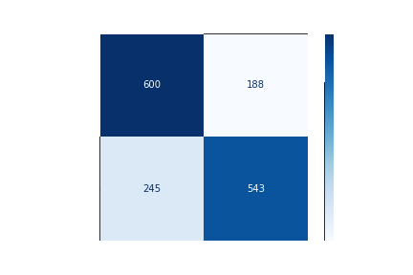
MODEL BUILDING – TEST RESULTS
ComplementNB
MultinomialNB
Logistic Regression
73,29%
73,29%
71,59%
Notes:
Vocabolario 4669 features

Slide 18
04
ONLINE MONITORING
Testing model on long period

Slide 19
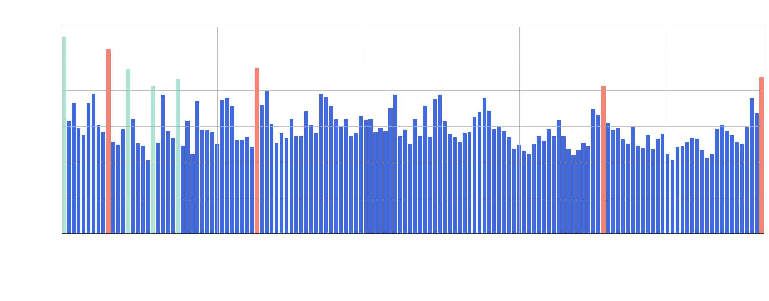
MONITORING ANALYSIS - TIMELINE
Identified 8 events, corresponding to peaks of tweets, on the time period considered
Focused on the 4 events in red

Slide 20
MONITORING ANALYSIS - EVENTS
2022-04-09
2022-07-20
2022-03-10
2022-06-18
Tv program GF semifinal
Vanessa Incontrada host of Gigi D’alessio’s tv show
Amici episode with Sangiovanni host
Government crisis

Slide 21
MONITORING ANALYSIS- APPROACHES
 | DESCRIPTION
STATIC | Always exploits the initial training set of 1576 tweets
SLIDING | Retrained each time with the 1576 most recent tweets, removing the 80 (60 for July) oldest and inserting the 80 newest (60 for July)
INCREMENTAL | Retrained each time using the initial training set and all the labeled tweets of the previous events

Slide 22
MONITORING ANALYSIS - RESULTS
Comparison in terms of accuracy of the three approaches
sliding approch

Slide 23
MONITORING ANALYSIS - RESULTS
Comparison in terms of number of features of the three different approaches

Slide 24
APPLICATION
05
BSblocker

Slide 25
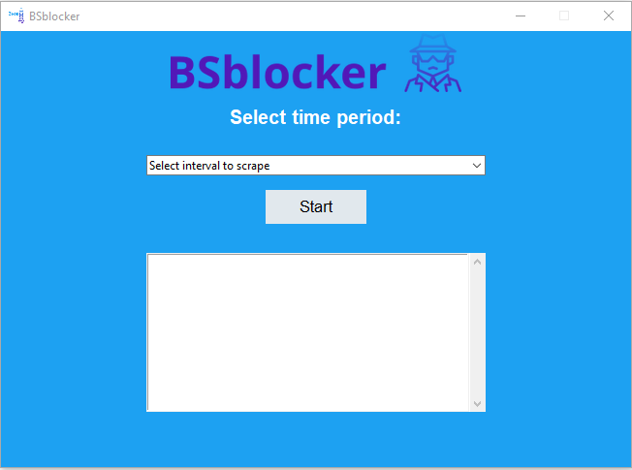
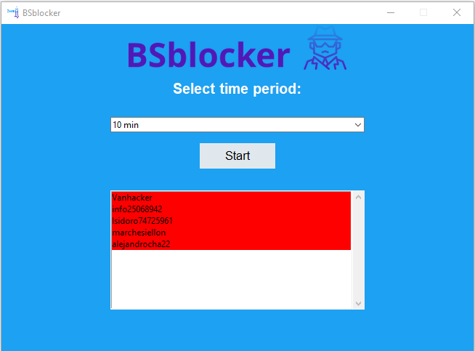
APPLICATION - BSblocker
Application just opened
Find users to put in blacklist

Slide 26
CONCLUSIONS
02

Slide 27

CONCLUSIONS
144,638 tweets have been analyzed
ComplementNB turns out to be the best model for our topic
Sliding approach is the best to handle with concept drift
BSblocker provides a service of real-time body shaming detection on Twitter

Slide 28
THANK YOU
For Your Attention
Do you have any questions?
https://github.com/martimarino/Body-shaming-detection.git

