Slide 1




CorSano
Alan Marques – 125046
Daniel Duque – 124880
Tiago Oliveira – 125155
Martim Gil – 124833
Apresentação 2
Modelação e Análise de Sistemas

Slide 2
TABLE OF CONTENTS
01
02
03
04
TRANSFORMAÇÃO DIGITAL
CONCEITO DO PRODUTO
INCREMENTO IMPLEMENTADO
LIÇÕES APRENDIDAS

Slide 3
01
TRANSFORMAÇÃO DIGITAL

Slide 4
Transformação Digital
Objetivo Principal:
Criar uma plataforma que promove estilo de vida saudável e maximiza o uso de recursos no campus.
Pilares Fundamentais:
Eficiência
Personalização
Acessibilidade
Uso estratégico da informação
Dar a conhecer sobre os recursos disponíveis no campus
Facilitar o acesso aos recursos
Optimizar a sua utilização

Slide 5
02
CONCEITO DO PRODUTO

Slide 6
WEEKLY SCHEDULE
TIME | MON | TUE | WED | THU | FRI
09-10h |  | Physical education |  | Physical education
10-11h
11-12h
12-13h | LUNCH BREAK
13-14h | Physical education |  | Physical education |  | Physical education
14-15h

Slide 7
PSYCHOLOGICAL NEEDS
PSYCHOLOGICAL NEED | DEFINITION OF THAT NEED | EXAMPLE OF A STRATEGY
AUTONOMY | Mercury is the closest planet to the Sun | Venus is the second planet from the Sun
FLOW | Despite being red, Mars is actually a very cold place | Jupiter is the biggest planet in the Solar System
PURPOSE | Saturn is composed of hydrogen and helium | Neptune is the farthest planet from the Sun
RELATEDNESS | Earth is also known as the blue planet | The Moon is Earth’s only natural satellite

Slide 8
GLOBAL CURRENTS OF PE
PHYSICAL SPORTS
Mercury is the closest planet to the Sun
PSYCHOMOTOR
Venus is the second planet from the Sun
BODY EXPRESSION
Despite being red, Mars is actually cold

Slide 9
DEVELOPMENT OF A CLASS
INTRODUCTION
DEVELOPMENT
Venus is the second planet from the Sun
Jupiter is the biggest planet in the Solar System
EXPLANATION
REFLECTION
Despite being red, Mars is actually a cold place
Saturn is a gas giant and has several rings
1ST
2ND
3RD
4TH

Slide 10

CLASS PLANNING
30%
20%
TEACHER TALK
DEMONSTRATIONS
Venus and the second planet from the Sun
Jupiter is the biggest planet in the Solar System
10%
40%
Q&A
STUDENT ACTIVITY
Despite being red, Mars is actually a cold place
Saturn is composed mostly of hydrogen and helium
Follow the link in the graph to modify its data and then paste the new one here. For more info, click here

Slide 11
TEAMWORK DEVELOPMENT BY SPORT
SPORT A
SPORT B
Venus and the second planet from the Sun
Jupiter is the biggest planet in the Solar System
50%
60%
SPORT C
SPORT C
Despite being red, Mars is actually a cold place
Saturn is a gas giant and has several rings
20%
10%

Slide 12
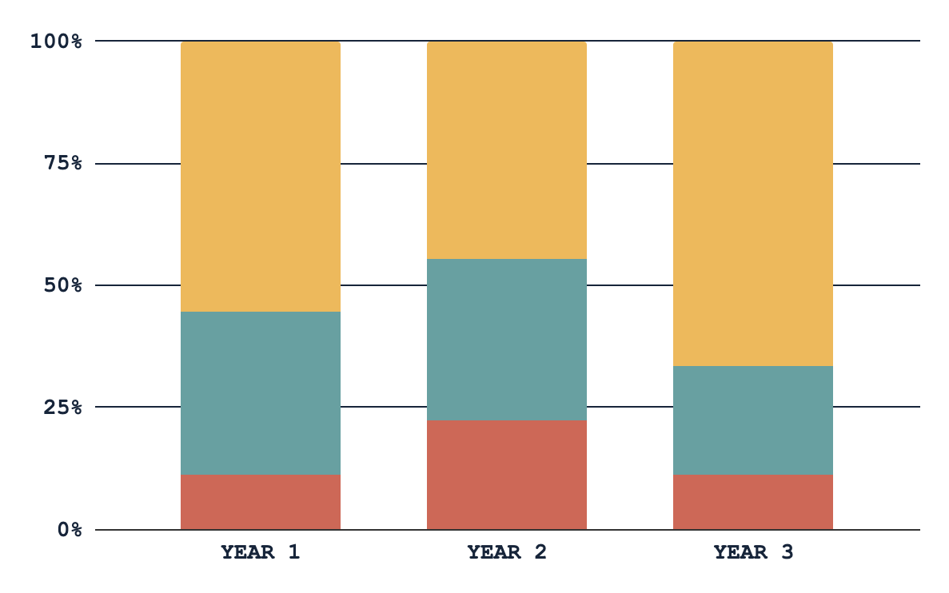
EXPECTED STUDENTS’ DEVELOPMENT
AREA A
Jupiter is the biggest planet in the Solar System
AREA B
Venus and the second planet from the Sun
AREA C
Despite being red, Mars is actually a cold place
Follow the link in the graph to modify its data and then paste the new one here. For more info, click here

Slide 13
REQUESTED UNIFORM FOR CLASS
MERCURY
JUPITER
Mercury is the closest planet to the Sun
Jupiter is the biggest planet in the Solar System
EARTH
VENUS
Earth is the third planet from the Sun and has life
Venus and the second planet from the Sun

Slide 14
HOW TO PREPARE A CLASS
STEP 01
STEP 3
STEP 05
Venus and the second planet from the Sun
Jupiter is the biggest planet in the Solar System
Mercury is the closest planet to the Sun
STEP 02
STEP 04
Despite being red, Mars is actually a cold place
Saturn is a gas giant and has several rings

Slide 15
SUGGESTED PHASED INTRODUCTION
GAME CATEGORY | YEAR 1 | YEAR 2 | YEAR 3 | YEAR 4 | YEAR 5 | YEAR 6
GAMES MAKING
TARGET GAMES
STRIKING GAMES
NET/WALL GAMES
INVASION GAMES
MERCURY IS THE CLOSEST PLANET TO THE SUN

Slide 16
THANKS!
DO YOU HAVE ANY QUESTIONS?
youremail@freepik.com
+34 654 321 321
yourwebsite.com
Please keep this slide for attribution

Slide 17
ICON PACK

Slide 18
ALTERNATIVE RESOURCES
Here’s an assortment of alternative resources whose style fits that of this template:
VECTORS
Cartoon illustration of children in physical education class

Slide 19
03
INCREMENTO IMPLEMENTADO

Slide 20
RESOURCES
Did you like the resources on this template? Get them for free at our other websites:
PHOTOS
Happy children enjoying their gym class I
Happy children enjoying their gym class II
VECTORS
Hand drawn illustration of children in physical education class I
Hand drawn illustration of children in physical education class II
Hand drawn illustration of children in physical education class III
Hand drawn physical education day illustration
ICONS
Urban Sports Icon Pack | Flat

Slide 21
04
LIÇÕES APRENDIDAS

Slide 22
LIÇÕES APRENDIDAS
1. Uso de Ferramentas de Gestão de Projetos (Jira):
Planejamento e Organização: Aprendemos a importância de dividir tarefas e acompanhar o progresso.
Colaboração: A utilização do Jira facilitou a comunicação e alinhamento entre os membros da equipa.

Slide 23
LIÇÕES APRENDIDAS
2. Aplicação da UML na Modelação do Sistema:
Clareza e Padrão: A UML ajudou-nos a criar modelos compreensíveis e padronizados, tornando mais fácil comunicar a estrutura do sistema.

Slide 24
LIÇÕES APRENDIDAS
3. Trabalho em Equipa:
Distribuição de Tarefas: Reconhecemos a necessidade de equilibrar a carga de trabalho para garantir eficiência.
Resolução de Conflitos: Adquirimos experiência em lidar com diferentes opiniões de forma construtiva.

Slide 25
CorSano
Alan Marques – 125046
Daniel Duque – 124880
Tiago Oliveira – 125155
Martim Gil – 124833
Apresentação 2
Modelação e Análise de Sistemas

