Slide 1
You are given a string letters made of N English letters. Count the number of different letters that appear in both uppercase and lowercase where all lowercase occurrences of the given letter appear before any uppercase occurrence. For example, for letters = “aaAbcCABBc” the answer is 2. The condition is met for letters ‘a’ and ‘b’, but not for ‘c’ Write a function: class Solution { public int solution(String letters)}; that, given a string letters, returns the number of different letters fulfilling the conditions above. Examples: 1. Given letters = “aaAbcCABBc”, the function should return 2, as explained above. 2. Given letters = “xyzXYZabcABC”, the function should return 6. 3. Given letters - “ABCabcAefG, the function should return 0. Write an efficient algorithm for the following assumptions: - N is an integer within the range (1..100,000), => string长度 - string letters is made only of letters (a-z and/or A-Z). => 只有英文字母
问题1

Slide 2
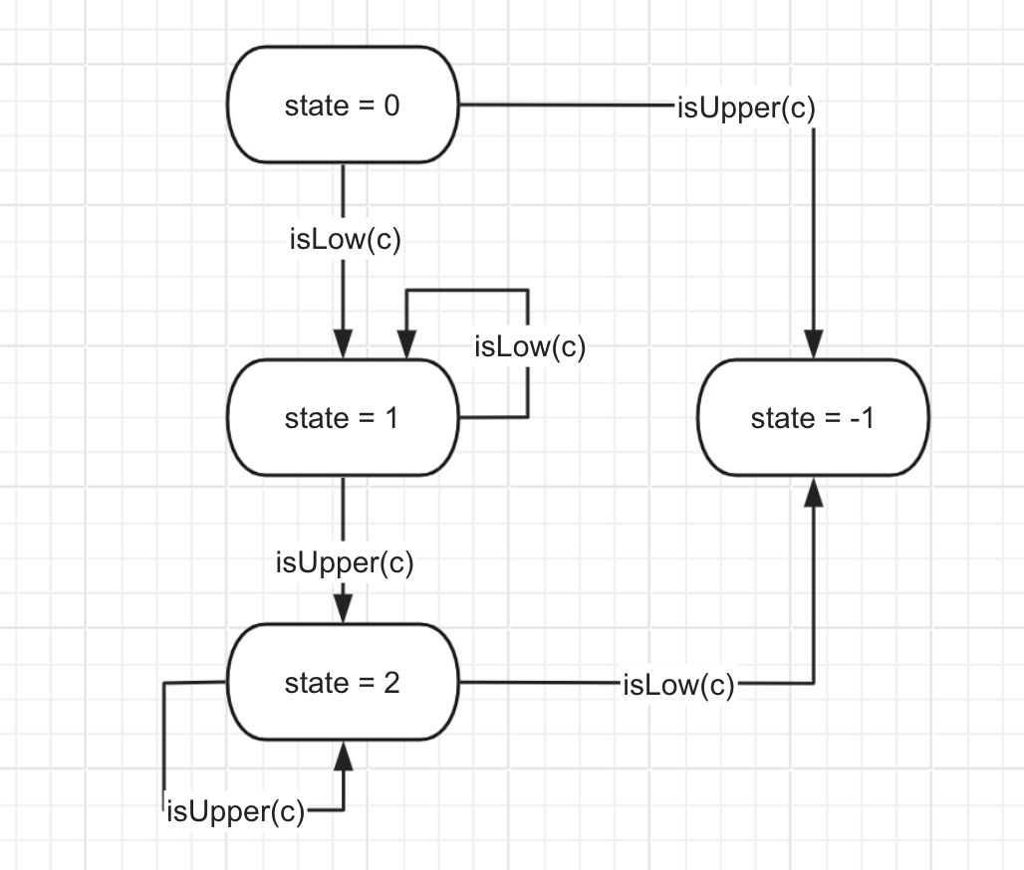
State 0 表示未添加任何元素 State 1表示只有小写
State 2 表示形成大小写队
State-1 表示不匹配
可以使用一个hashmap来表示数据,key是出现字母的小写形式,value是STATE

Slide 3
Java代码

Slide 4
You are given an array A of N integers, representing the maximum heights of N skyscrapers(摩天大厦) to be built. Your task is to specify the actual heights of the skyscrapers, given that: • the height of the K-th skyscraper should be positive and not bigger than A[K]; • no two skyscrapers should be of the same height; • the total sum of the skyscrapers‘ heights should be the maximum possible. Write a function: class Solution { public At[] solution (int[] A); } that, given an array A of N integers, returns an array B of N integers where B[K] is the assigned height of the Kth skyscraper satisfying the above conditions. If there are several possible answers, the function may return any of them. You may assume that it is always possible to build all skyscrapers while fulfilling all the requirements.
问题2

Slide 5
Examples: - 1. Given A = [1, 2, 3], your function should return [1, 2, 3], as all of the skyscrapers may be built to their maximum height. - 2. Given A = [9, 4, 3, 7, 7], your function may return [9, 4, 3, 7, 6]. Note that [9, 4, 3, 6, 7] is also a valid answer. It is not possible for the last two skyscrapers to have the same height. The height of one of them should be 7 and the other should be 6. - 3. Given A = [2, 5, 4, 5, 5], your function should return [1, 2, 3, 4, 5] Write an efficient algorithm for the following assumptions: • N is an integer within the range [1..50,000] (高楼数量很多); • each element of array A is an integer within the range [1..1,000,000,000](每个高楼楼层很高); • there is always a solution for the given input.

Slide 6
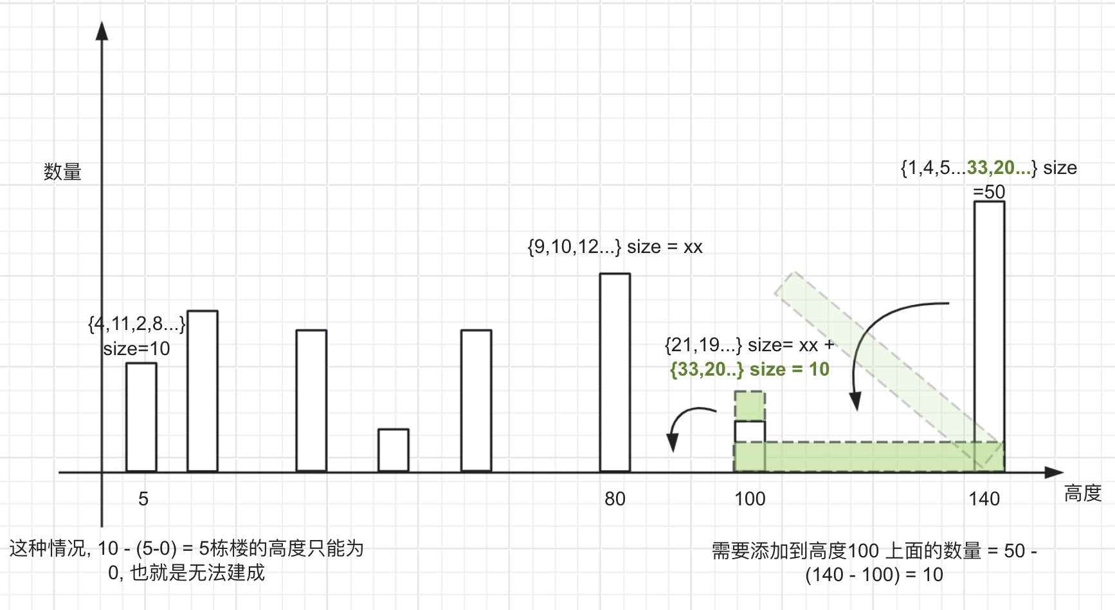

Slide 7
Java代码

Slide 8
There are N patients (numbered from 0 to N-1) who want to visit the doctor. The doctor has S possible appointment slots, numbered from 1 to S. Each of the patients has two preferences. Patient K would like to visit the doctor during either slot A[K] or slot B[K]. The doctor can treat only one patient during each slot. Is it possible to assign every patient to one of their preferred slots so that there will be at most one patient assigned to each slot? Write a function: class Solution { public boolean solution(int[] A, int[] B, int S); } that, given two arrays A and B, both of N integers, and an integer S, returns true if it is possible to assign every patient to one of their preferred slots, one patient to one slot, and false otherwise.
问题3

Slide 9
Examples: 1. Given A = [1, 1, 3]. B = [2, 2, 1] and S = 3, the function should return true. We could assign patients in the following way: [1, 2, 3], where the K-th element of the array represents the number of the slot to which patient K was assigned. Another correct assignment would be [2, 1, 3]. On the other hand, [2, 2, 1] would be an incorrect assignment as two patients would be 2. Given A = [3, 2, 3, 1], B = [1, 3, 1, 2] and S = 3, the function should return false. There are only three slots available, but there are four patients who want to visit the doctor. It is therefore not possible to assign the patients to the slots so that only one patient at a time would visit the doctor. 3. Given A = [2, 5, 6, 5], B = [5, 4, 2, 2] and S = 8, the function should return true. For example, we could assign patients in the following way: [5, 4, 6, 2]. 4. Given A = [1, 2, 1, 6, 8, 7, 8], B = [2, 3, 4, 7, 7, 8, 7] and S = 10, the function should return false. It is not possible to assign all of the patients to one of their preferred slots so that only one patient will visit the doctor during one slot. Write an efficient algorithm for the following assumptions: • Nis an integer within the range [1.100,000]; • S is an integer within the range [2...100,000]: • each element of arrays A and B is an integer within the range

Slide 10


Slide 11
Java代码

