Slide 2
springboot 3.x new features
冲突的由来
2017年，Oracle将JavaEE提交给了Eclipse基金会，并命名为Eclipse Enterprise for Java。
然而，由于“Java”这个名字的商标归Oracle所有，Eclipse基金会无法继续使用 javax.* 和java.*，因此，项目名称改为Jakarta EE。值得一提的是，Jakarta（雅加达）是Java岛（爪洼岛）上最大的城市，也是印度尼西亚的首都。Apache软件基金会+孵化的项目也有名称为Jakarta的，不要混淆了这两个项目，两者没有任何关系。（domain 割裂）

Slide 3
The origin of the conflict
In 2017, Oracle submitted JavaEE to the Eclipse Foundation as Eclipse Enterprise for Java.
However, since the name "Java" is trademarked by Oracle, the Eclipse Foundation is no longer able to use javax.* and java.*, so the project name was changed to Jakarta EE. It is worth mentioning that Jakarta is the largest city on the island of Java (Java) and the capital of Indonesia. The project incubated by the Apache Software Foundation+ also has the name Jakarta, so don't confuse the two projects, the two are not related in any way. (domain splitting)

Slide 4
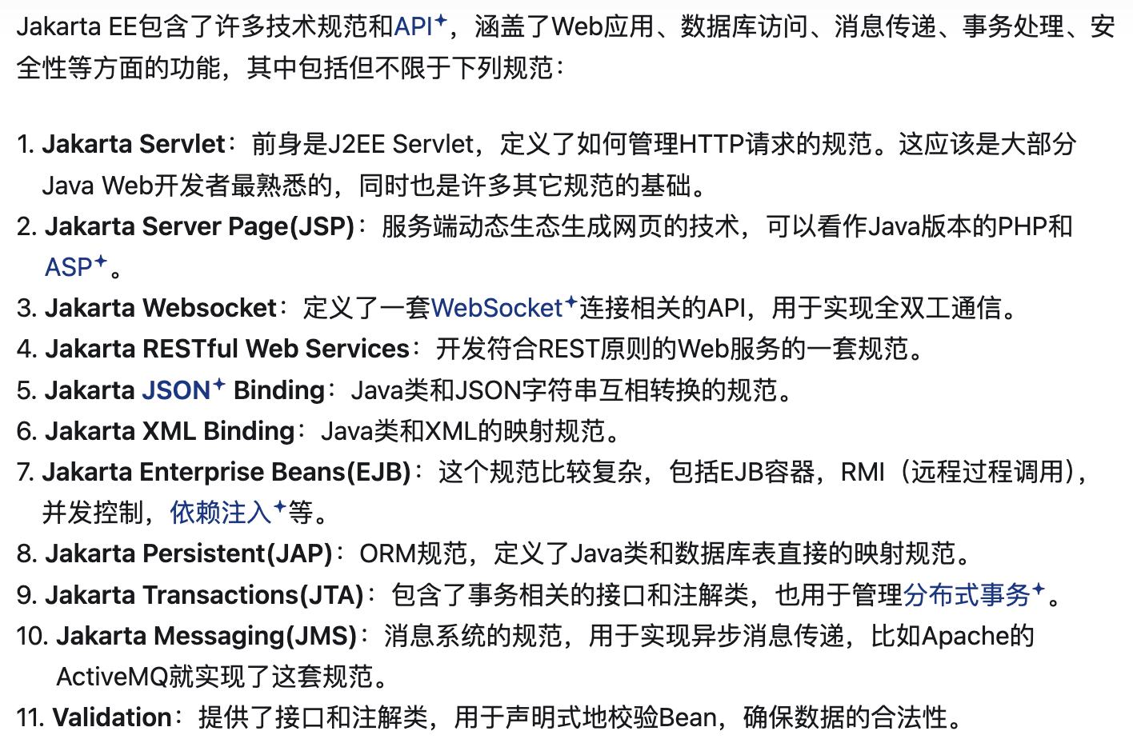

Slide 5
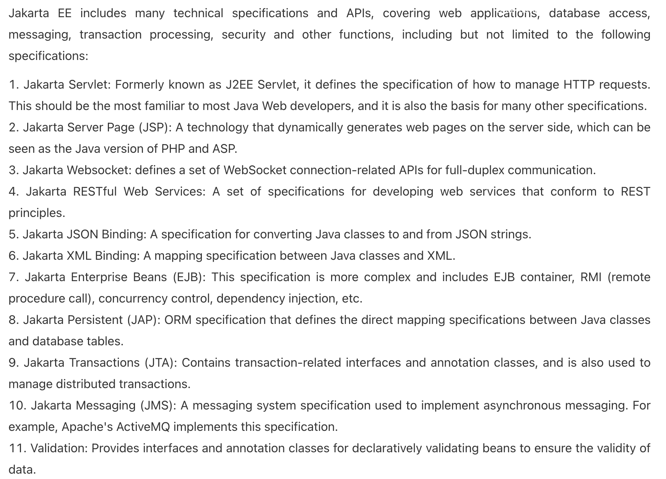

Slide 6
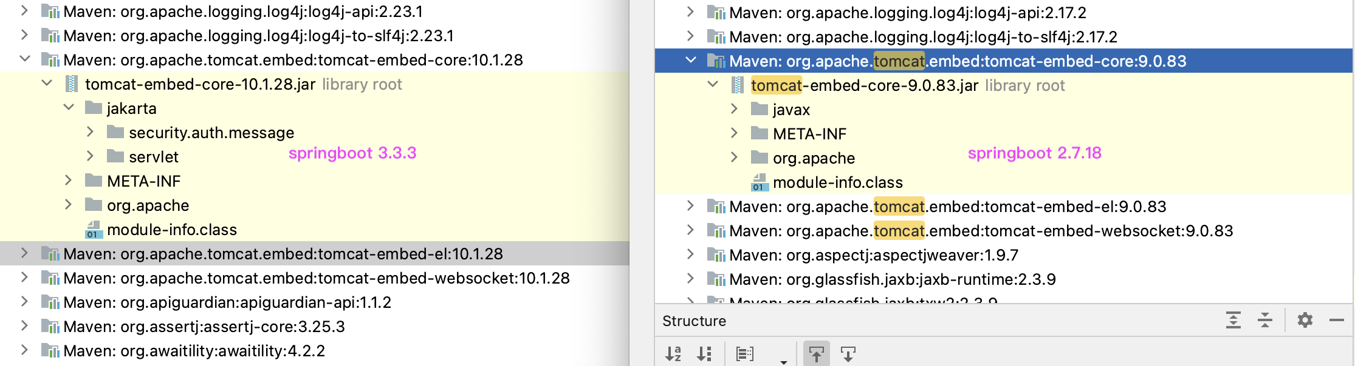
Tomcat9 使用的是javax，而10及以上版本使用jakarta

Slide 7
1. Flyway数据库版本控制工具
Flyway 是一个数据库版本控制工具，可以与 Spring Boot 集成，帮助管理数据库的迁移和版本控制，确保环境（如开发、测试和生产）一致性。
之前是填写rlm 单子并且将某个部署过的rlm request 作为rollback ，而使用了flyway 可以减少流程话的操作，直接部署pod就可以完成脚本的部署
（贴图）
工作原理
Flyway在第一次执行时，会创建一个默认名为flyway_schema_history（可配置）的历史记录表，这张表会用来跟踪或记录数据库的状态，然后每次启动时都会自动扫描在resources/db/migration下（可配置）的文件并且通过查询flyway_schema_history来判断是否为新增文件，从而判断是否进行迁移。

Slide 8
Flyway is a database version control tool that can be integrated with Spring Boot to help manage database migration and version control and ensure the consistency of environments (such as development, testing, and production).
Previously, it was necessary to fill in the rlm form and use a deployed rlm request as a rollback. Using flyway can reduce the process operations and directly deploy the pod to complete the script deployment
(Picture)
How it works
When Flyway is executed for the first time, it will create a history table with a default name of flyway_schema_history (configurable). This table will be used to track or record the status of the database. Then, each time it is started, it will automatically scan the files under resources/db/migration (configurable) and query flyway_schema_history to determine whether it is a new file, so as to determine whether to migrate.

Slide 9
（贴图 ）

Slide 10
注意事项
数据库空表，需配置baseline-on-migrate: true
clean 命令要取消掉，clean-disabled: true
组件版本兼容，springboot与flyway，flyway与数据库版本要一致
多人开发，如V2先入库执行了，那么V1后入库就不会执行
不支持回滚，但可以创建新的迁移脚本来撤消更改

Slide 11
The database table is empty, and baseline-on-migrate: true needs to be configured
The clean command needs to be canceled, clean-disabled: true
Component versions are compatible, springboot and flyway, flyway and database versions must be consistent
Multiple people develop, if V2 is stored first, then V1 will not be executed
Rollback is not supported, but a new migration script can be created to undo the changes

Slide 12
2. Virtual Thread
虚拟线程（Virtual Threads）是 Java 19 引入的一个新特性，是 JDK 而不是 OS 实现的轻量级线程(Lightweight Process，LWP），由 JVM 调度。许多虚拟线程共享同一个操作系统线程，虚拟线程的数量可以远大于操作系统线程的数量。（调度开销小）
虚拟线程主要解决的问题是减少I/O密集型任务的I/O阻塞。某个线程在处理I/O阻塞时等待I/O完成，导致CPU的利用率低。
不适用于计算密集型任务，因为密集型计算始终需要CPU资源作为支持。

Slide 13
Virtual Threads is a new feature introduced in Java 19. It is a lightweight thread (LWP) implemented by JDK instead of OS and scheduled by JVM. Many virtual threads share the same OS thread, and the number of virtual threads can be much larger than the number of OS threads. (Small scheduling overhead)
The main problem solved by virtual threads is to reduce I/O blocking of I/O intensive tasks. A thread waits for I/O to complete while processing I/O blocking, resulting in low CPU utilization.
It is not suitable for computationally intensive tasks, because intensive computing always requires CPU resources as support.

Slide 14
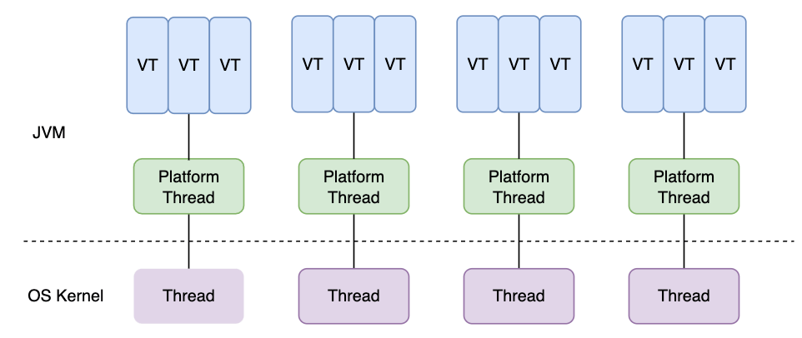

Slide 15
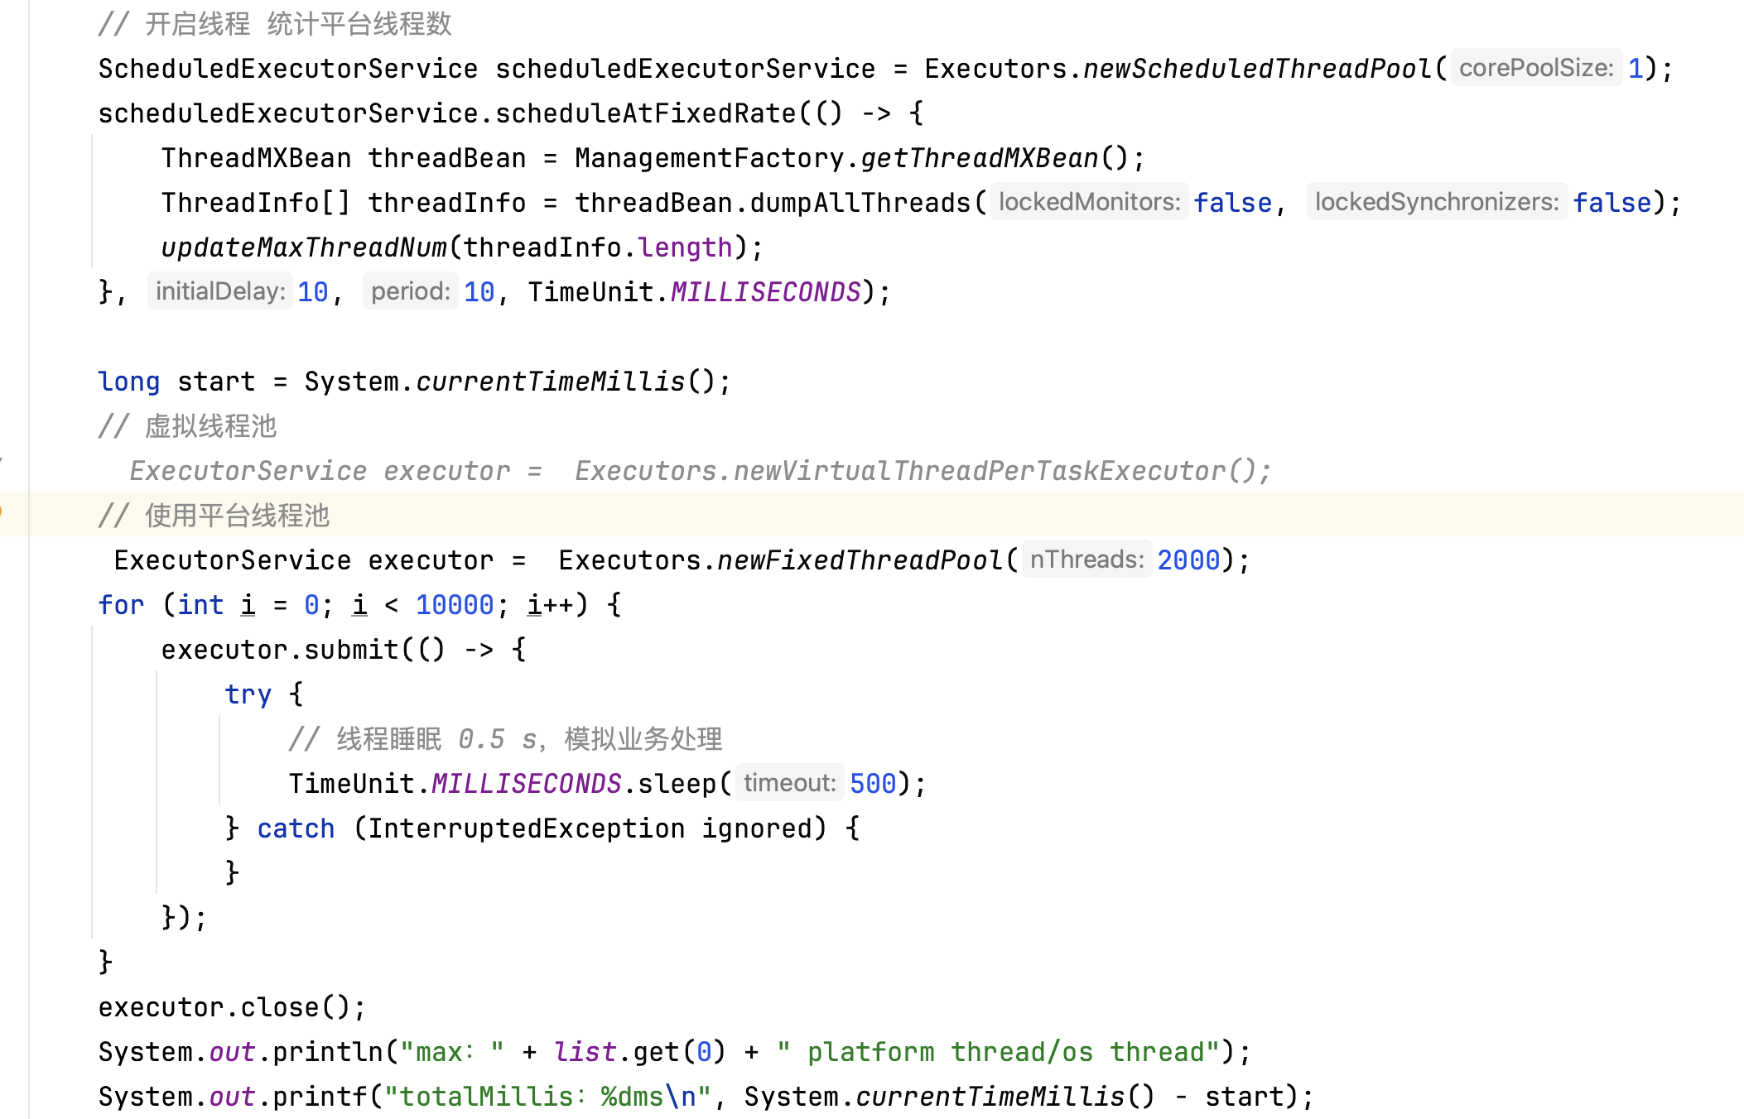
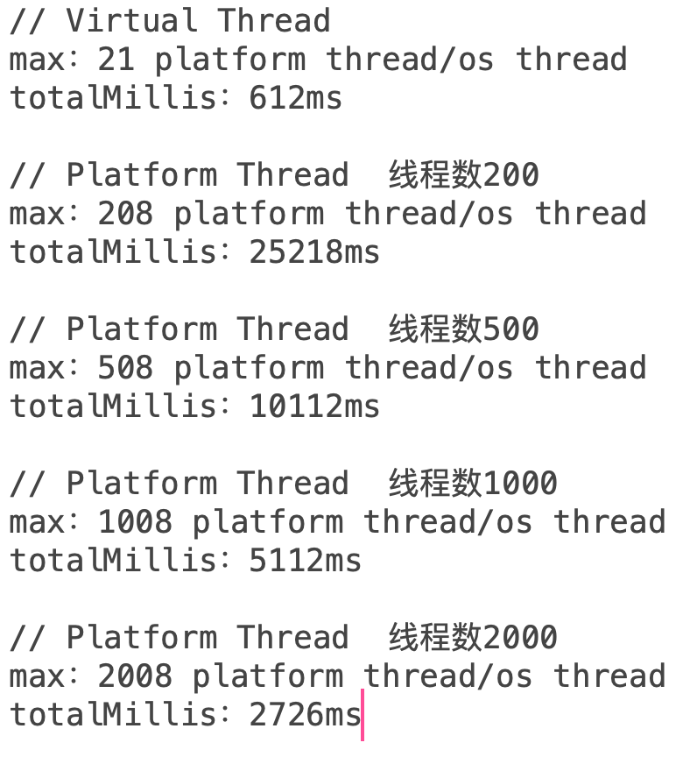

Slide 16
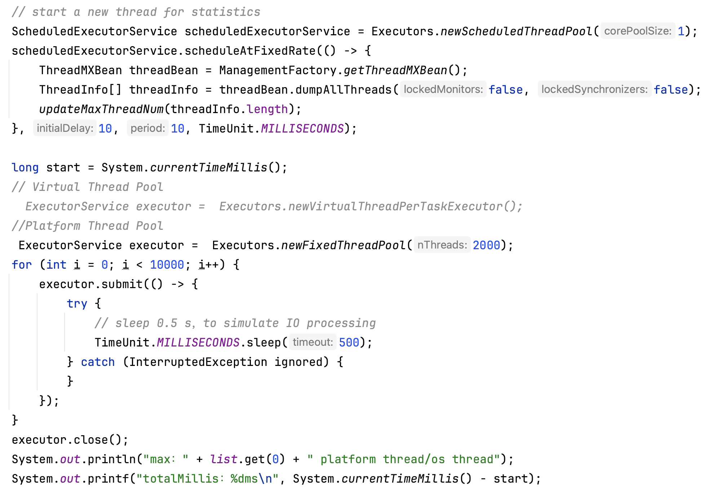
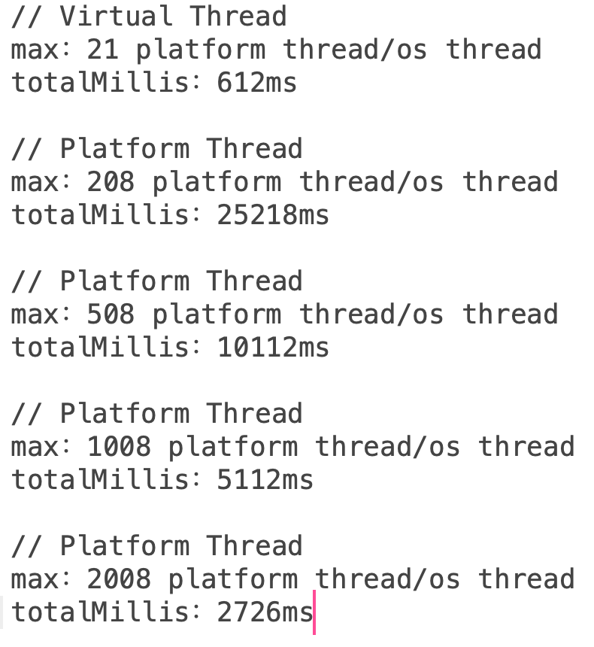

Slide 17
《虚拟线程 – VirtualThread源码透视》
《虚拟线程常见问题总结》
《java线程，java虚拟线程，go语言的goroutine和C++的线程对比》
Goroutine 使用的channel实现线程通信，JVM使用共享变量+同步机制

Slide 18
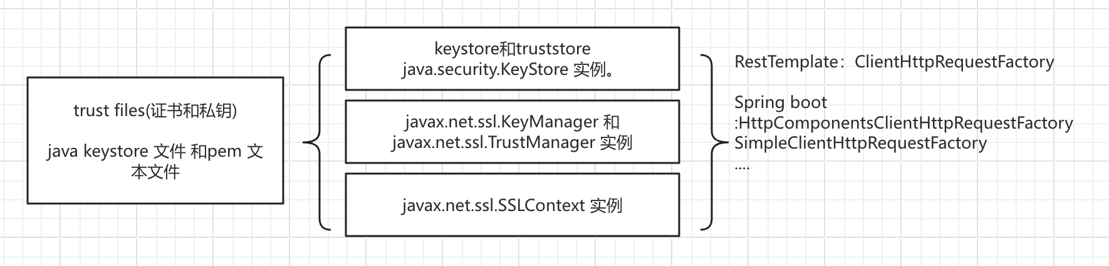
3.Ssl bundle
Spring Boot 3.1中引入的 SSL bundle
引入的目的是为了简化配置且方便地应用到 REST 客户端， 数据服务连接和嵌入式服务器中
springboot 2.7 如果配置ssl 需要大量的深度配置

Slide 19
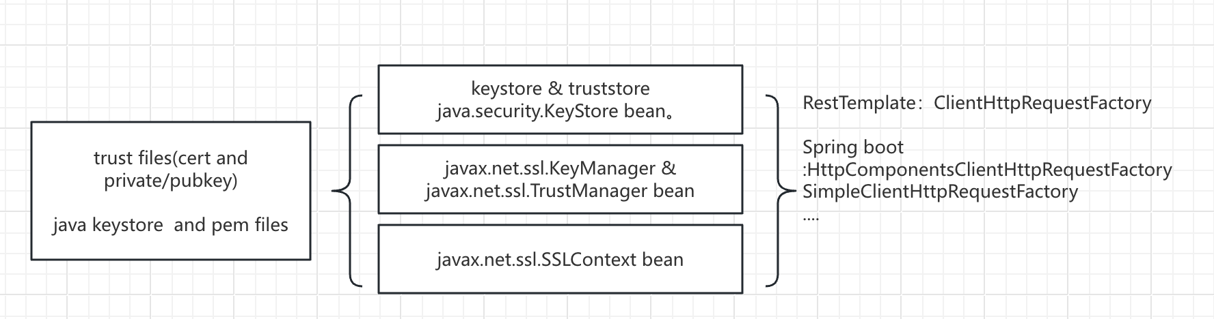

Slide 20
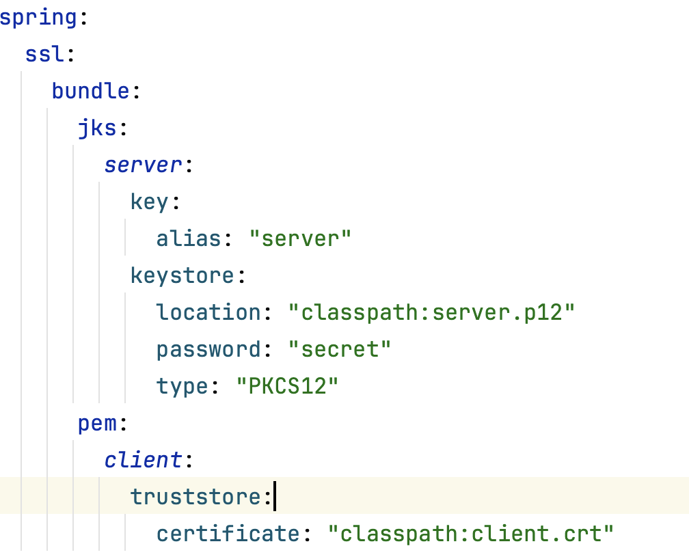
spring.ssl.bundle.jks
可以用来配置使用 Java
keystore 文件的 bundle。
spring.sll.bundle.pem
可以用来配置使用PEM
编码的文本文件的 bundle。

Slide 21
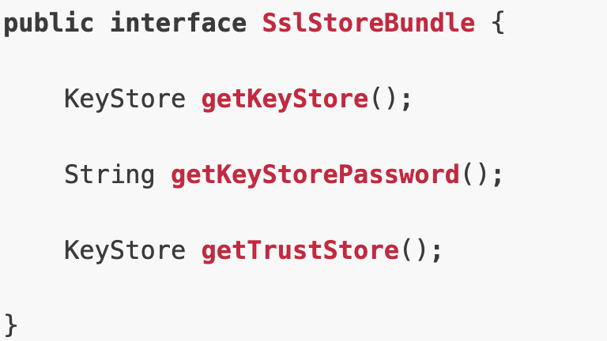
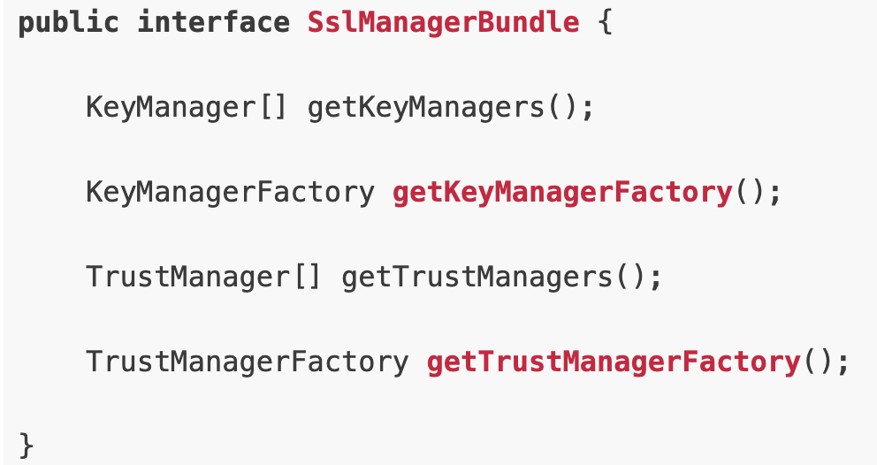
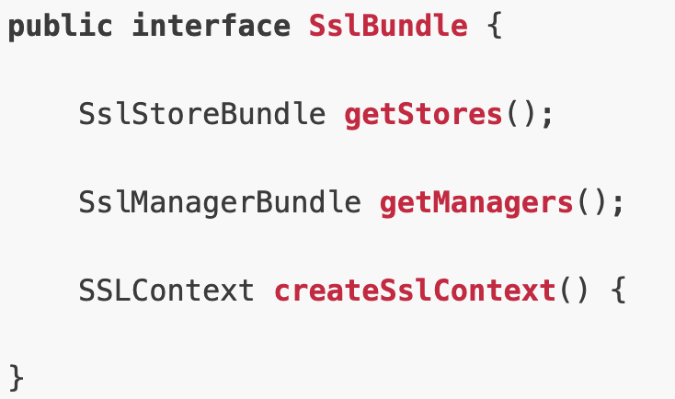
SslBundle 对这些接口做了整合，使用起来更加统一
java.security.KeyStore 作为 keystores 和 truststore
javax.net.ssl.KeyManager 和javax.net.ssl.TrustManager
javax.net.ssl.SSLContext

Slide 22
//获取配置的bundle
SslBundle sslBundle = sslBundles.getBundle("client"); SSLContext sslContext = sslBundle.createSslContext();
//Restful template
this.restTemplate = restTemplateBuilder.setSslBundle(sslBundles.getBundle(”server")).build();
//webClient
this.webClient = webClientBuilder.baseUrl("https://example.org").apply(ssl.fromBundle(”client")).build();

Slide 23
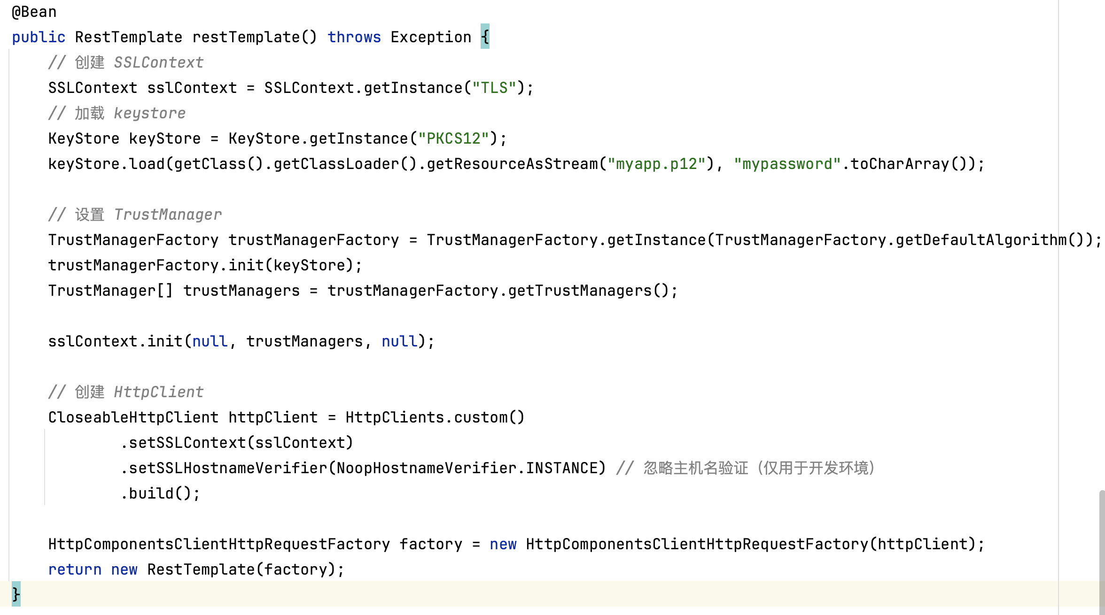

Slide 24
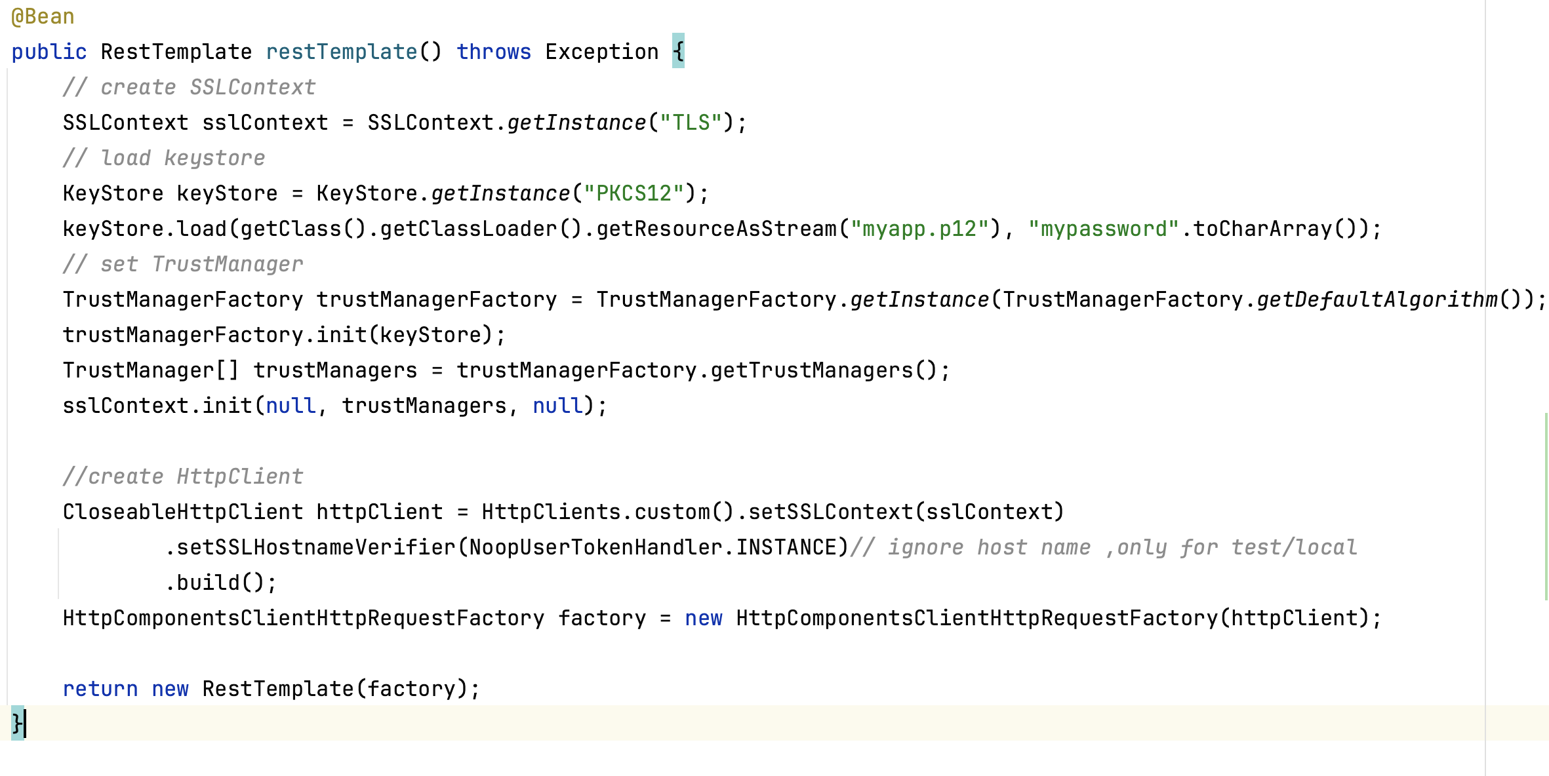

Slide 25
4. correlation id 与log 日志
correlation id 是架构中附加到每个请求的唯一标识符。相关 ID 不是错误号或代码。简单来说，它是为每个请求自动生成的 GUID（全局唯一标识符）。相关标识符没有标准格式。它可以是 UUID 或应用程序域的任何有意义的唯一标识符。我们更喜欢使用 UUID 作为关联标识符。
应用场景有消息队列，分布式微服务等，

Slide 26
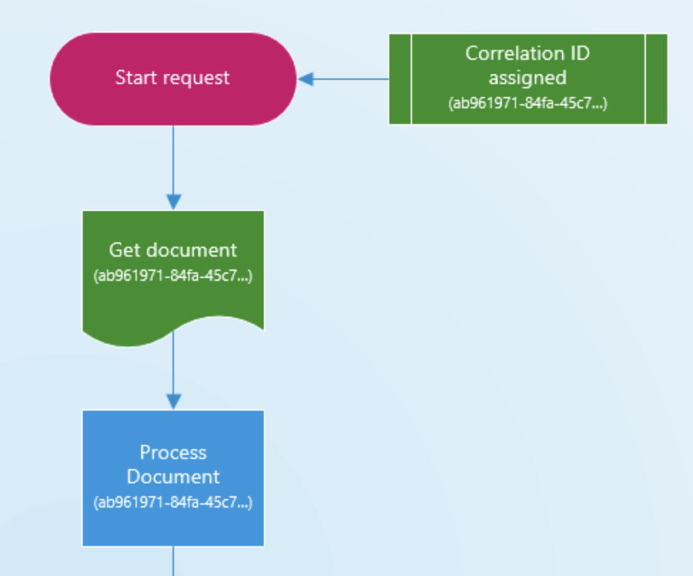

Slide 27
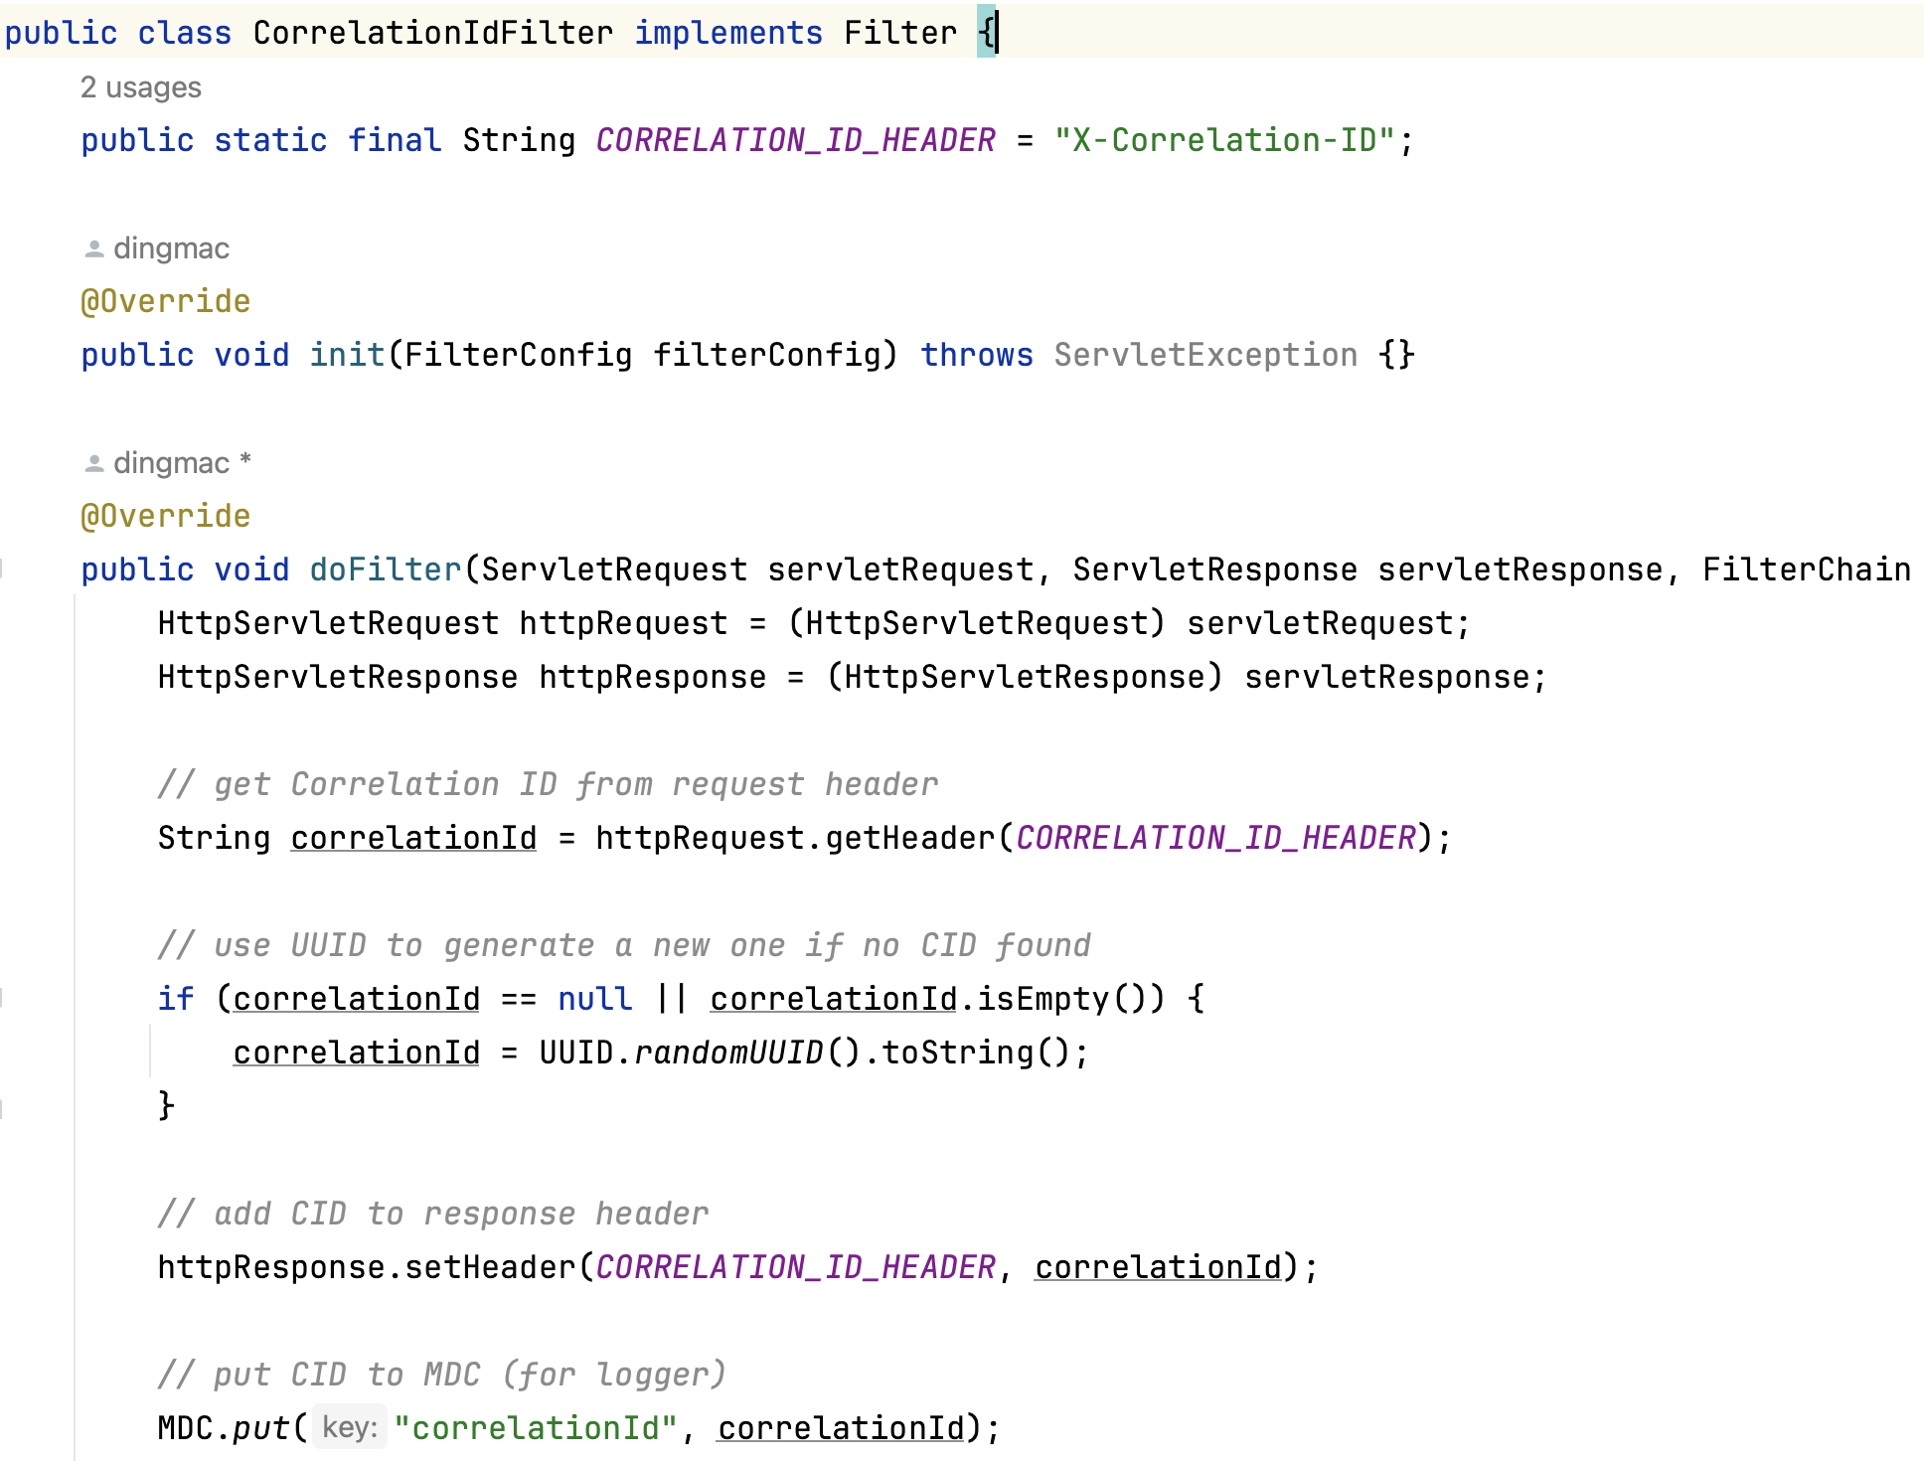

Slide 28
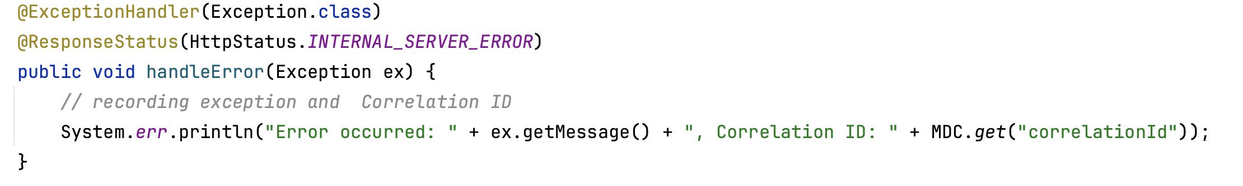
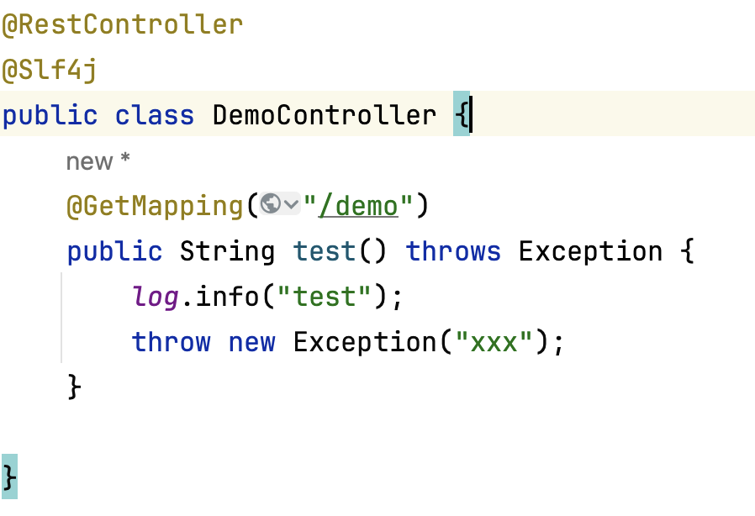
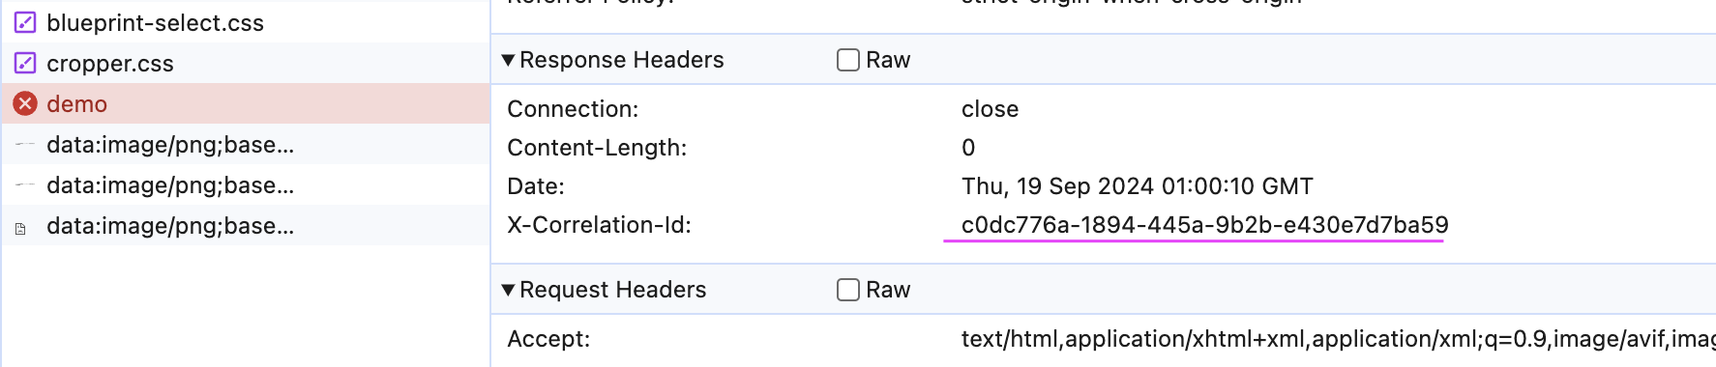
logging.pattern.console=%d{yyyy-MM-dd HH:mm:ss} [%thread] %-5level %logger{36} - %msg, Correlation ID: %X{correlationId}%n

Slide 29
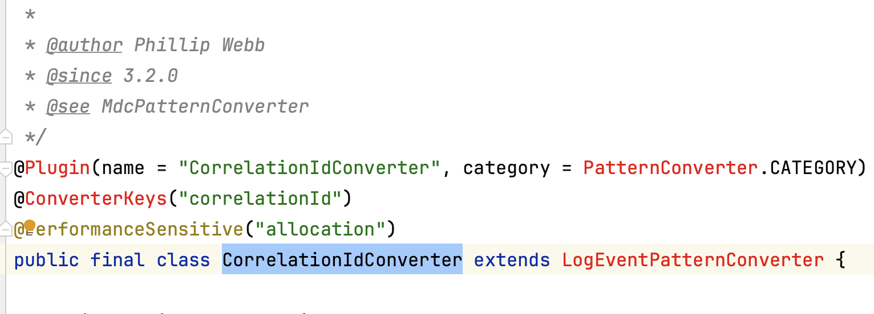
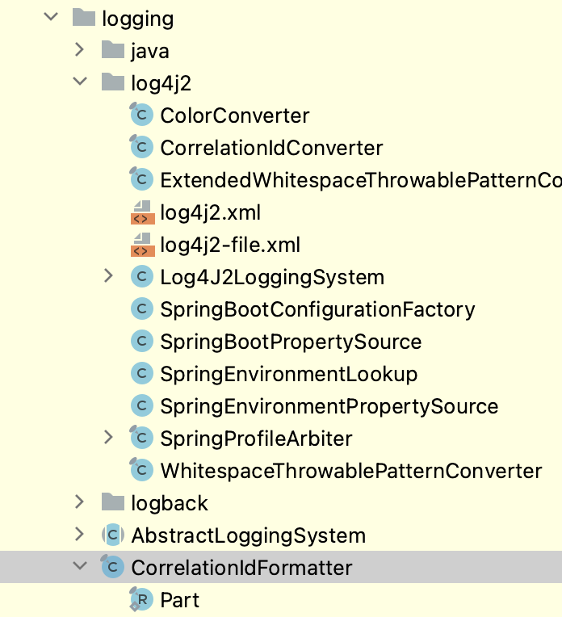
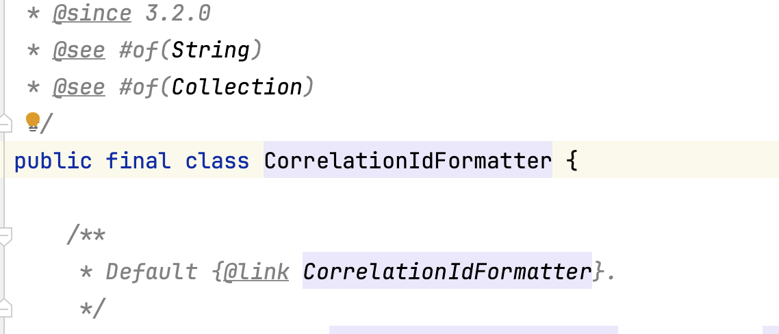
Springboot 3.2 提供了更多的关于correlationId的方法，大家如果感兴趣的话可以再研究

Slide 30
更多新特性
参考 Spring boot Release Notes

