Slide 1
Smart Mug
Presentation 1: Concept
Dennis Tritschler, Guerkan Karacocuk, Martin Dold
Winter Term 2016

Slide 2
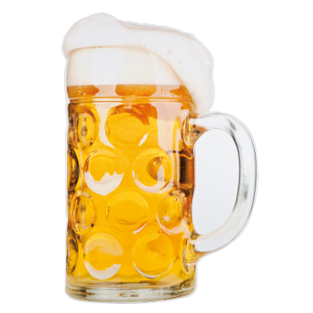
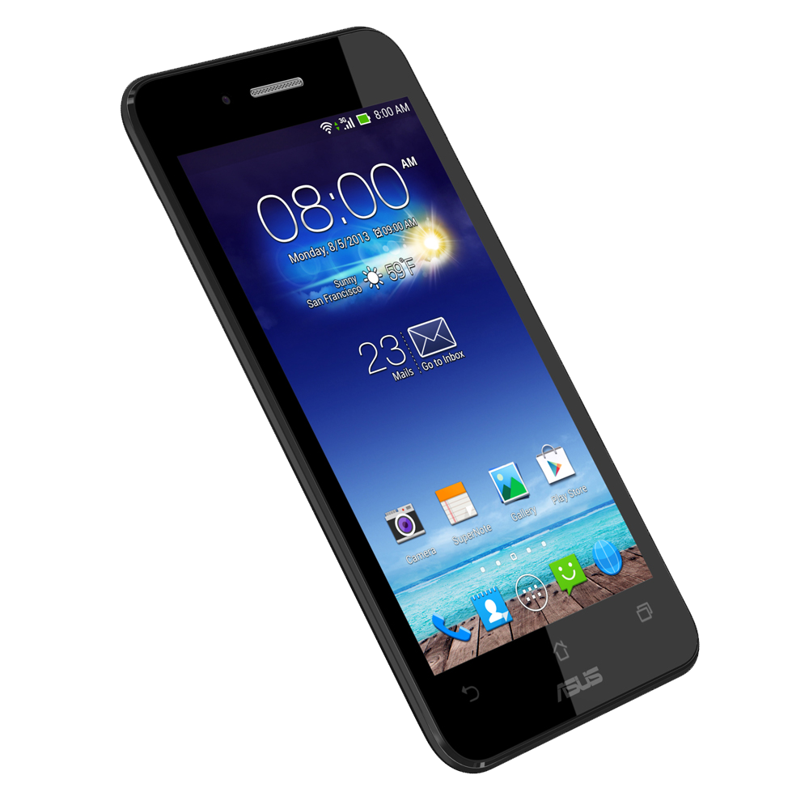
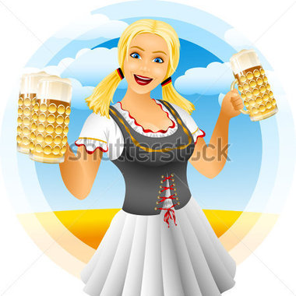
Motivation
I don't want to wait for the waiter/waitress to order new beer!

Slide 3
Plan A
Beer level sensing
  By weight, by capacitive sensing, …
Connect mug with smartphone
  Bluetooth LE
  Barcode, RFID
Order by app and color of mug
Live data for bar keeper
Interactive drinking games

Slide 4
Plan B
Measure beer level
  By weight, by capacitive sensing, …
Connect mug with smartphone
  Bluetooth LE
  Entering mug ID into app
Order by color of mug

Slide 5
Plan C
Connect mug with smartphone
  Bluetooth LE
  Entering mug ID into app
Order by color of mug

Slide 6
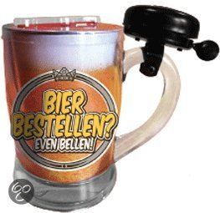
Plan D – Worst case
If neither wireless communication nor measurement works …

Slide 7
Next steps / work plan
15.11. | Present (initial) selection of HW: - Sensor(s) - Bluetooth module
22.11. | Start SW implementation sensor reading, BLE connection Start HW schematic, layout
29.11. | Continue …
6.12. | Prepare for mid-term presentation: SW: sensor reading, BLE connection HW: schematic, layout ready

Slide 8
Next steps / work plan
20.12. | First HW prototype ready
10.01. | Extend SW parts: order by app
17.01. | Extend SW parts: Connect to bar tender, display filling level
24.01. | Debugging / bug fixing
31.01. | Finalize debugging / bug fixing Report / Poster
07.02. | Project finalization

Slide 9
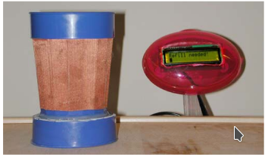
Related work
Wireless Liquid Level Sensing for Restaurant Applications (iGlassware)

Slide 10
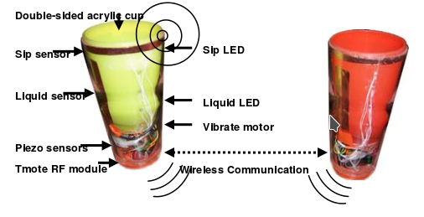
Related work
Lover’s Cups: Drinking Interfaces as New Communication Channels

Slide 11
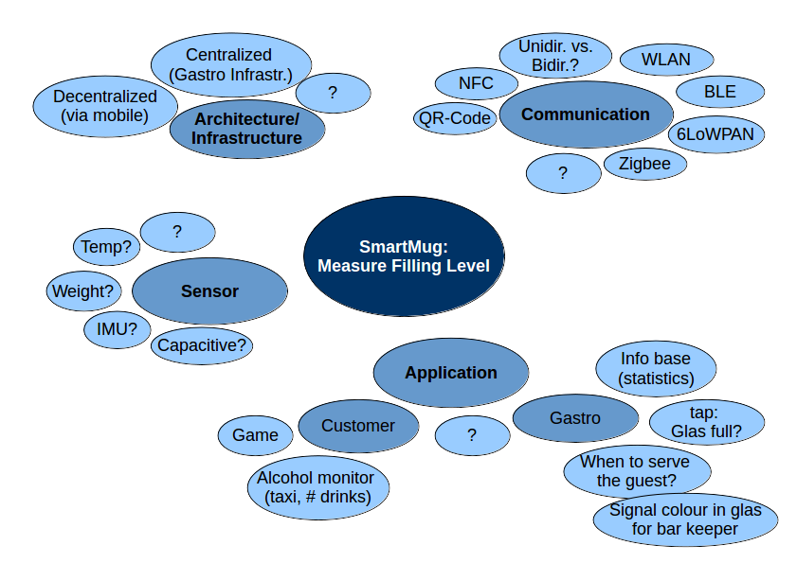
Appendix

Slide 12

Dieses Folienlayout bitte nur verwenden, um großformatige Abbildungen wie in diesem Beispiel zu zeigen.
Es ist nicht für Texte etc. vorgesehen.

